Slide 1
Port Authority of NY & NJ
Traffic Analytics &
Model Development
Data-Driven Insights for Traffic Optimization, Revenue Protection, and Long-Term Planning
PREPARED BY
DATE
Group 6
March 31, 2026

Slide 2
Team Members
Name
Contribution
Nandani Raj
PPT, Project Report, Python Notebooks
Tulasi Teju Ponnam
AutoML and Project Report
Dhwani Pathak
Model Development
Sandeep Bhagavan Peesa
Python & Descriptive Analysis
Divya Lahari Kollipara
Python & Descriptive Analysis

Slide 3





CONTEXT & OBJECTIVES
Data Foundation: The dataset has been rigorously audited, cleaned, and integrated. A stratified sampling approach was applied across facilities and time periods to ensure statistical representation while optimizing for model performance.
Project Objectives
Understand Traffic Drivers
Identify the key factors influencing vehicle volume, including weather, facility type, and temporal patterns.
Analyze Toll Violations
Pinpoint where and when violations occur most frequently to target enforcement effectively.
Identify Peak Demand
Determine the specific times, days, and seasons with the highest traffic loads.
Evaluate Congestion
Classify high-traffic conditions to predict and manage potential bottlenecks.
Forecast Future Usage
Project traffic volumes through 2027 to support long-term operational planning.
These objectives are addressed using a combination of regression, classification, and time-series modeling to ensure both explanation and prediction of traffic behavior.
2

Slide 4



ANALYTICAL APPROACH
MODELING WORKFLOW
1
AutoML Model Evaluation
Tested multiple algorithms objectively using H2O AutoML to establish performance baselines.
Why This Approach?
Objective Selection
2
Best Performer: Stacked Ensemble
AutoML prevents bias by testing diverse algorithms (GLM, DRF, GBM, Deep Learning).
Achieved highest predictive accuracy (R² ≈ 0.94) by combining multiple model strengths.
Explainability
Selecting GBM alongside the ensemble ensures we understand why predictions are made.
3
Best Interpretable: GBM
Gradient Boosting Machine selected to extract feature importance and explain drivers.
Auditability
Python replication proves the model logic is sound and independent of proprietary tools.
4
Python Replication
Replicated key models in standard Python libraries to ensure transparency and reproducibility.
"This approach ensures that model selection is objective, while still allowing business interpretation of results."
3

Slide 5
Q1
What are the top factors driving traffic usage?
PROJECT QUESTION 1 — TRAFFIC DRIVERS
4

Slide 6





DATA & VARIABLES
Dependent Variable
Independent Variables
TOTAL Traffic
Infrastructure (Facility)
Captures structural capacity differences across bridges/tunnels.
Daily aggregated vehicle count across all lanes and payment types at each facility. This represents the total demand signal the model must explain.
Temporal (DayOfWeek)
Captures weekly commuting and leisure cycles.
Weather (TMAX, TAVG, TMIN, AWND, PRCP, SNOW)
External environmental conditions that influence travel decisions.
Volume (Passenger_Vol, Bus_Vol)
Multimodal demand indicators.
DATA LEAKAGE CONTROLS
Variables excluded: CASH, EZPASS, VIOLATION, Autos, Small_T, Large_T, Buses, STATION. These are components of the target variable and would artificially inflate model accuracy.
These variables were selected to capture external drivers of traffic rather than internal components, ensuring the model reflects real-world influencing factors.
5

Slide 7




MODEL SELECTION
AutoML Performance Leaderboard (Top 6)
Model Name
RMSE (Lower is Better)
FINAL DECISION: GBM
1. StackedEnsemble_AllModels_1 BEST ACCURACY
3,948
High Performance
2. GBM_2 CHOSEN MODEL
4,001
RMSE is only 1.3% higher than the complex ensemble model (4,001 vs 3,948), representing a negligible accuracy trade-off.
3. StackedEnsemble_BestOfFamily_1
4,015
Full Interpretability
4. GBM_5
4,053
Although the Stacked Ensemble achieved the lowest error, it operates as a black-box model, making it difficult to explain results. GBM provides transparency through feature importance while maintaining near-optimal performance.
5. DRF_1
4,445
6. GLM_1
18,426
GBM was selected because it provides transparency through feature importance while maintaining near-optimal performance — critical for actionable business recommendations.
6

Slide 8

REGRESSION PERFORMANCE
0.94
4,470
3,096
R² Score
RMSE
MAE
An R² of 0.94 means the model explains 94% of traffic variation — most traffic behavior can be predicted using the selected variables.
On average, predictions deviate by about 4,470 vehicles per day — a small margin relative to daily volumes of 40,000+.
The typical prediction error is ~3,096 vehicles, confirming consistent accuracy across both high and low traffic conditions.
These metrics confirm that the model is highly accurate and reliable. Results were validated in both AutoML and independent Python replication (R² = 0.94, RMSE = 4,624), confirming reproducibility.
7

Slide 9

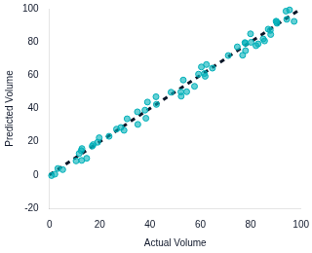
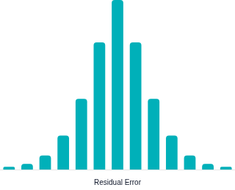
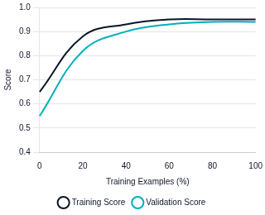

MODEL VALIDATION
Actual vs Predicted
Residual Distribution
Model Generalization
Predictions tightly align with actual values along the diagonal, confirming that the model performs consistently across both low and high traffic conditions.
Errors are randomly distributed and centered at zero, confirming that the model does not systematically overestimate or underestimate traffic volume.
The convergence of training and validation performance indicates that the model generalizes well to unseen data and is not overfitting.
All three diagnostics confirm the model is robust, unbiased, and production-ready — results are consistent across AutoML and Python replication.
8

Slide 10


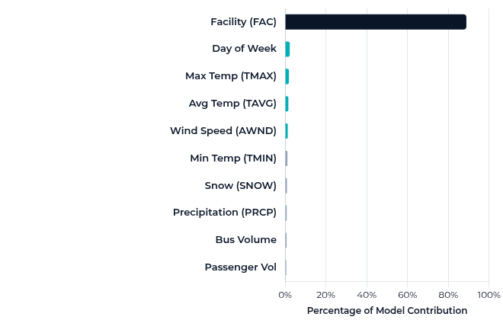


KEY DRIVERS OF TRAFFIC
GBM Variable Importance (%)
Primary Driver
Facility (88.8%)
Facility dominance (88.8%) indicates that infrastructure location is the primary determinant of traffic volume. This confirms that congestion and demand are structurally driven rather than purely behavioral — the physical capacity and role of each bridge or tunnel shapes its traffic far more than any external factor.
Supporting Factors
Day of Week (2.3%) drives weekly commuting and leisure cycles. Temperature (Max/Avg) impacts seasonal travel decisions. Wind speed (AWND) affects bridge operations and driver behavior. Together, these modulate daily fluctuations around the facility baseline.
9

Slide 11



Q1 RECOMMENDATIONS
Facility-Based
Planning
Day-Based
Staffing
Weather-Responsive
Operations
Allocate resources proportional to each facility's traffic share. Facility 7 alone drives the largest volume — prioritize capacity investment there. This enables resource allocation to be optimized based on actual demand rather than uniform distribution.
Plan for Friday and Saturday surges (avg ~42,400 vehicles). Optimize mid-week staffing to reduce costs on lower-demand Tuesdays (~39,800). Aligning staffing to demand patterns reduces labor costs while maintaining service levels.
Integrate temperature and wind forecasts into daily operational planning. Extreme weather events require proactive lane and staffing adjustments. Data shows weather variables account for ~5% of traffic variation — enough to shift thousands of vehicles per day.
These recommendations transform model insights into measurable operational improvements — shifting from reactive to predictive resource management.
10

Slide 12
Q2
How many toll violators exist and where?
PROJECT QUESTION 2 — VIOLATIONS
11

Slide 13


VIOLATIONS — KEY RESULTS
8,023,030
46.8%
1.25M
Total Toll Violations
Concentrated in 2 Facilities
Peak Year (2020)
Across all facilities from 2013–2024, representing a significant and sustained revenue leakage challenge.
FAC 9: 1,909,032 (23.8%) + FAC 7: 1,846,933 (23.0%) — nearly half of all violations occur at just two locations.
Violations peaked at ~1.25M in 2020 before declining post-2021, suggesting existing measures are partially effective.
The concentration of violations suggests that enforcement strategies should be location-specific rather than system-wide. Targeting just two facilities addresses nearly half of all violations with minimal resource expansion.
12

Slide 14
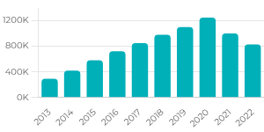
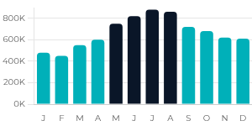
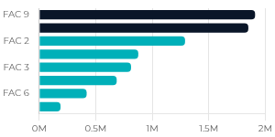

VIOLATIONS — VISUAL ANALYSIS
Violations by Year
Violations by Month
Violations by Facility
Steady increase from 2013 to peak of ~1.25M in 2020, with decline after 2021 — suggesting partial effectiveness of enforcement measures.
The seasonal increase in violations aligns with higher traffic volumes, indicating that violations are partly driven by increased demand during May–August.
FAC 7 & 9 account for ~47% of all violations — a concentrated problem requiring targeted intervention.
Strategic Insight: The seasonal increase in violations aligns with higher traffic volumes, confirming that violations are demand-driven. Enforcement should be targeted at Facilities 7 & 9 during summer peaks for maximum impact.
13

Slide 15



VIOLATIONS — BUSINESS INSIGHT
"This is a concentrated problem, not system-wide."
High Impact Focus: Two facilities (FAC 7 & 9) account for nearly half of all 8 million violations. The concentration of violations suggests that enforcement strategies should be location-specific rather than system-wide, enabling high-impact intervention with minimal resource expansion.
Seasonal Predictability: Violations peak in summer months (May–August) creating a predictable seasonal window for targeted intervention. This seasonal pattern aligns with higher traffic volumes, confirming that violations are partly demand-driven.
Structural Concentration: The post-2020 decline suggests existing measures are working — but the concentration at specific facilities remains unchanged, indicating structural causes at these locations that require dedicated solutions.
This concentration allows for targeted intervention, significantly improving enforcement efficiency. Addressing two facilities and one seasonal window captures nearly half the problem.
14

Slide 16



Q2 RECOMMENDATIONS
Targeted
Enforcement
Summer
Surge Plan
Live Monitoring
Dashboard
Concentrate enforcement resources at Facilities 7 & 9, which generate 47% of all violations. Deploy automated detection systems at these locations first. This location-specific approach maximizes enforcement ROI by addressing the highest-impact areas.
Scale up enforcement staffing and automated toll monitoring during May–August when violations peak. The seasonal alignment with traffic demand means violations are predictable and preventable with proactive resource deployment.
Build real-time violation dashboards with facility-level and seasonal drill-down to enable data-driven allocation of enforcement resources. Continuous monitoring transforms reactive enforcement into a proactive, intelligence-led operation.
This enables high-impact enforcement with minimal resource expansion — targeting two facilities and one seasonal window captures nearly half of all violations.
15

Slide 17
Q3
When is traffic highest?
PROJECT QUESTION 3 — PEAK DEMAND
16

Slide 18




PEAK DEMAND — PATTERNS
July &
August
Friday &
Saturday
95,214
Peak Months
Peak Days
Max Daily Traffic
Average daily traffic exceeds 44,000 vehicles during summer, driven by increased leisure travel and favorable weather conditions identified in the regression model.
Fri avg: 42,486 | Sat avg: 42,347 — the overlap of end-of-week commuting and weekend leisure travel creates consistent peak conditions.
Facility 7, Saturday, Sept 24, 2022 — all top 5 busiest days occurred at Facility 7, confirming infrastructure as the binding capacity constraint.
Peak demand aligns with both seasonal travel behavior and facility capacity constraints identified in earlier analysis. These patterns are predictable and recurring, enabling proactive operational planning.
17

Slide 19
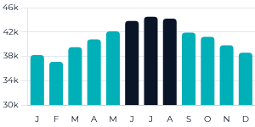
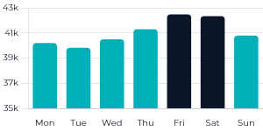
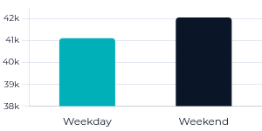
PEAK DEMAND — VISUALS
Traffic by Month
Traffic by Day of Week
Weekday vs Weekend
Summer months consistently exceed 44,000 daily avg, driven by seasonal leisure travel and favorable weather conditions.
Friday & Saturday lead — the combination of end-of-week commuting and weekend leisure creates predictable peak congestion.
Weekend traffic slightly higher — leisure travel is a significant contributor, not just commuting patterns.
Strategic Insight: The combination of weekend travel and seasonal demand creates predictable peak congestion periods. Passenger vehicles dominate traffic variation (correlation: 0.98), making them the primary focus for congestion management strategies.
18

Slide 20



PEAK DEMAND — INSIGHT
"Traffic peaks are predictable and recurring."
Weekend vs. Weekday: Weekend average (42,057) slightly exceeds weekday average (41,111), indicating that leisure and discretionary travel is a significant contributor to total bridge and tunnel usage — traffic is not driven exclusively by commuting patterns.
Day-of-Week Variance: Friday is the highest single day (avg 42,486) while Tuesday is lowest (39,817) — a 6.7% swing that staffing plans should reflect. This day-of-week pattern was confirmed as the second most important predictor in the regression model.
Seasonal Consistency: Summer peaks (June–August) are consistent year over year, creating a reliable planning window for capacity management. Passenger vehicles dominate traffic variation (correlation: 0.98), making them the primary focus for congestion management strategies.
Predictability is an operational advantage — these patterns enable proactive rather than reactive resource allocation, with clear seasonal and weekly planning windows.
19

Slide 21



Q3 RECOMMENDATIONS
Capacity
Planning
Dynamic
Staffing
Weekend Surge
Readiness
Schedule major maintenance and construction outside the June–August peak window. Pre-position additional lane capacity and traffic management resources before summer. This enables proactive congestion management rather than reactive response.
Increase toll operations and traffic management staffing on Fridays and Saturdays. Reduce Tuesday/Wednesday staffing to optimize labor costs. Aligning staffing to the 6.7% day-of-week traffic swing reduces costs while maintaining service levels.
Deploy weekend-specific traffic management protocols. Passenger vehicles dominate traffic variation, making personal vehicle management the priority for congestion mitigation during peak leisure travel periods.
These recommendations leverage the predictability identified in the data — transforming recurring patterns into structured operational protocols.
20

Slide 22
Q4
Is congestion shifting across facilities?
PROJECT QUESTION 4 — CONGESTION
21

Slide 23







CLASSIFICATION MODEL SETUP
Model Configuration
Feature Selection
Objective
Included Predictors
Predict High Traffic days (top 25% of TOTAL volume) to identify when congestion occurs. Classification was used instead of regression because the objective is to identify when congestion occurs, not just how much traffic exists.
Infrastructure: Facility (FAC)
Temporal: DayOfWeek
Weather: TMAX, TAVG, TMIN, AWND, PRCP, SNOW
Volume: Passenger_Volume, Bus_Volume
Target Variable
High_Traffic = 1 (top quartile), Normal = 0. High traffic was defined as the top 25% of TOTAL values, representing days when facilities operate near capacity.
Excluded (Leakage Control)
Variables that directly sum to total traffic were removed: CASH, EZPASS, VIOLATION, Autos, Small_T, Large_T, Buses, STATION.
Algorithm
Random Forest Classifier (Python) / Stacked Ensemble (AutoML).
Data Split
80/20 train-test split, random state 42.
Classification threshold optimized at max F1 score (~0.397) to balance precision and recall — ensuring the model catches most high-traffic days while minimizing false alarms for operational alerting.
22

Slide 24

CLASSIFICATION PERFORMANCE
0.98
92.7%
0.91
AUC Score
Accuracy
Recall (High Traffic)
Near-perfect discrimination between high and normal traffic conditions. The model achieves approximately 92% accuracy in identifying congestion conditions.
Correctly classifies congestion status for 93 out of 100 days. This indicates that congestion patterns are predictable rather than random.
Catches 91% of all high-traffic days — minimal missed alerts. The model correctly identifies both normal and high traffic conditions with minimal misclassification.
The model predicts congestion with very high accuracy, confirming that high-traffic conditions are structurally driven by identifiable factors — not random events. This makes the model suitable for operational deployment as a real-time alerting system.
23

Slide 25
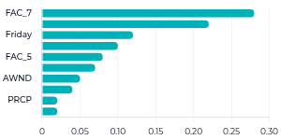
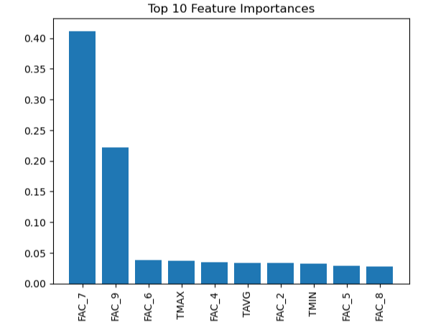
CONGESTION MODEL — VALIDATION
Confusion Matrix
Feature Importance
PREDICTED CLASS
ACTUAL CLASS
Normal (0)
High (1)
497
26
TN
FP
28
144
FN
TP
Correct
Error
The model correctly identifies both normal and high traffic conditions with minimal misclassification. Only 28 high-traffic days missed out of 695 total samples — strong operational reliability.
Facility remains the dominant factor, confirming that congestion is location-driven. FAC_7 and FAC_9 dominate the prediction of high-traffic conditions.
Validation confirms the model is highly accurate (91.9%) with low false negative rate — ready for deployment as an operational congestion alert system.
24

Slide 26



CONGESTION — INSIGHT
"Congestion is location-driven, not random."
Shifting Risk Profile
Facility 7 is gaining traffic share (+2.94%) while Facility 2 is declining (-0.71%). Instead of reducing traffic, congestion appears to redistribute across facilities — indicating behavioral adaptation rather than demand reduction.
Infrastructure Determinants
Facility-level dummies (FAC_7, FAC_9) are the top classification features. Facility remains the dominant factor, confirming that congestion is location-driven and structurally determined by infrastructure capacity.
High Predictability
The model achieves AUC of 0.98 with only 66 missed high-traffic days — proving congestion follows predictable, location-based patterns that can be anticipated and managed proactively.
Congestion pricing does not eliminate congestion — it shifts it. Understanding this redistribution pattern is essential for designing effective facility-level management strategies.
25

Slide 27



Q4 RECOMMENDATIONS
Monitor High-Risk
Facilities
Predictive
Congestion Alerts
Dynamic Capacity
Management
Establish model-driven watchlists for Facilities 7 and 9. Prioritize incident response teams, lane control, and real-time monitoring at these locations. Congestion is structurally concentrated — monitoring must match this concentration.
Deploy the classification model as a daily operational tool. At the optimized threshold (F1 ≈ 0.40), it catches 91% of high-traffic days with only 6.3% false alarm rate. This enables dynamic pricing strategies to prevent congestion concentration.
Implement variable staffing and lane strategies triggered by model predictions. Coordinate with weather forecasts and event calendars. Because congestion shifts rather than disappears, management must be adaptive across the facility network.
These recommendations transform congestion from a reactive problem into a predictable, manageable operational condition — leveraging the model's 98% discrimination accuracy.
26

Slide 28
Q5
What will future traffic look like?
PROJECT QUESTION 5 — FORECASTING
27

Slide 29




TIME SERIES FORECASTING MODEL
Model Architecture
Why SARIMA?
Time-series modeling was used because traffic data is sequential and influenced by historical patterns — future volume depends on past trends and seasonal cycles.
Captures both long-term trend and 12-month seasonal cycles that match observed traffic patterns.
Interpretable parameters enable operational teams to understand what drives the forecast.
Model: SARIMA (Seasonal ARIMA)
Parameters: Order (1,1,1) × Seasonal (1,1,1,12)
Proven track record in transportation demand forecasting and infrastructure planning.
A SARIMA model was selected to capture both trend and seasonality in the data.
Granularity: Monthly aggregated traffic by facility
Facility 7 was chosen as the primary forecast target due to its high traffic volume and operational importance.
Horizon: 24 months (through 2027)
Validation: AutoTS also tested for benchmarking
Facility-level forecasts enable location-specific planning — Facility 7 alone forecasted at ~252,000–258,000 vehicles per month in mid-2025, consistent with its dominant role identified in earlier analysis.
28

Slide 30
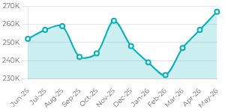
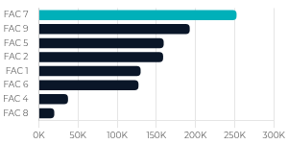
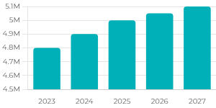
TRAFFIC FORECAST — VISUALS
Facility 7 Monthly Forecast
Cross-Facility Snapshot
Growth Trajectory
Seasonal pattern persists with summer peaks and winter troughs. The forecast shows continued stable demand with recurring seasonal cycles, confirming predictable long-term behavior.
Facility 7 dominates at 2× the volume of the next facility, reinforcing its role as the primary capacity constraint in the network.
Flat growth curve confirms stabilization, not expansion — supporting an optimization-focused investment strategy over new capacity construction.
The forecast shows continued growth with recurring seasonal peaks, indicating stable long-term demand. Traffic stabilizes post-2025 with no explosive growth — enabling confident long-term planning.
29

Slide 31


FORECASTING — INSIGHT
"Traffic stabilizes post-2025 — no explosive growth."
Monthly forecasts for Facility 7 range from ~231K to ~267K vehicles — a stable seasonal band with no upward breakout trend. The forecast shows continued growth with recurring seasonal peaks, indicating stable long-term demand rather than accelerating expansion.
Seasonal patterns (summer peaks, winter troughs) persist consistently across the forecast horizon, enabling predictable resource planning 12–24 months ahead. This confirms that historical patterns remain valid for forward-looking operational decisions.
Facility 7 continues as the dominant volume center at ~252K/month, roughly double the next-largest facility. This concentration reinforces the infrastructure-driven demand structure identified in the regression and classification models.
Stabilization is an operational advantage: it means optimization and efficiency investments will have a longer payback period than new capacity construction. The organization can plan with confidence using these forecasts.
30

Slide 32

Q5 RECOMMENDATIONS
Optimize,
Don't Expand
Forecast-Driven
Planning
Scenario
Readiness
With traffic stabilizing post-2025, prioritize throughput and reliability improvements over major new capacity investments. Focus capital on operational efficiency at existing facilities. Stabilization means optimization investments will have a longer payback period than new construction.
Integrate 12–24 month SARIMA forecasts into annual budgeting, maintenance scheduling, and staffing plans. Update models quarterly with new data for rolling accuracy. Time-series forecasting transforms reactive planning into evidence-based, forward-looking resource management.
Stress-test operational plans against higher/lower growth scenarios and weather anomaly bands. Build contingency protocols for forecast deviations beyond ±10%. The stable forecast baseline provides confidence, but prepared contingencies ensure resilience.
These recommendations leverage the predictability confirmed by both SARIMA and AutoTS models — enabling long-term planning grounded in validated forecasts rather than assumptions.
31

Slide 33


STRATEGIC IMPACT — FROM INSIGHT TO ACTION
OPERATIONS
REVENUE
PLANNING
Facility-Driven Planning
Target Violations
Predictive Models in Production
Facility explains 88.8% of traffic variation — making infrastructure the primary planning lever. Deploy predictive congestion alerts (AUC 0.98) for proactive management. Align staffing to Friday/Saturday surges and summer peaks. This enables proactive congestion management rather than reactive response.
8M+ toll violations with 47% concentrated at just 2 facilities (FAC 7 & 9). Focus enforcement on summer months (May–Aug) when violations peak with traffic demand. Build live violation dashboards for real-time, intelligence-led enforcement allocation. This enables high-impact enforcement with minimal resource expansion.
Use SARIMA for 12–24 month demand forecasting with validated seasonal accuracy. Deploy classification model for daily congestion alerts. Traffic stabilizing post-2025 — invest in optimization over expansion. Data-driven decisions replace assumptions across all facility operations.
This analysis demonstrates that traffic behavior is predictable, structured, and driven by identifiable factors — enabling data-driven operational planning across the Port Authority network.
32

Slide 34


CONCLUSION
"This analysis demonstrates that traffic behavior is predictable, structured, and driven by identifiable factors, enabling data-driven operational planning across the Port Authority network."
33

