Slide 1










Port Authority of NY & NJ
Traffic Analytics & Optimization Strategy
Data-Driven Insights for Traffic Flow, Congestion Management, and Strategic Planning
Predictive Analytics
Traffic Optimization
Revenue Protection
Prepared by: Group 6
March 31, 2026
1

Slide 2






Port Authority of NY & NJ
Team Members
Nandani Raj
Tulasi Teju Ponnam
Dhwani Pathak
PPT, Project Report, Python Notebooks and ,Power BI
AutoML and Data Audit
Model Development
Sandeep Bhagavan Peesa
Divya Lahari Kollipara
Descriptive Analysis and Power BI
Descriptive Analysis and Report
Prepared by: Group 6
March 31, 2026
2

Slide 3

“Traffic is Not Random”
8M+
~50%
95,000+
Toll Violations
From Just 2 Facilities
Vehicles in a Single Day
Facilities 7 & 9
George Washington Bridge Upper and George Washington Bridge Lower
2013-2024 cumulative
Peak daily traffic
Traffic patterns repeat consistently across time and location
3

Slide 4







Key Questions We Addressed
Analysis Complete
Five critical business questions with facility-level answers
1
2
3
4
5
What Drives Traffic
Toll Violations
Busiest Time Periods
Congestion Pricing Impact
Future Traffic Demand
Top factors affecting bridge and tunnel usage
Analysis of violations by time and facility
Peak demand patterns and seasonal trends
2025 pricing effects on traffic patterns
Forecasting beyond 2025
Each question directly connects to operational decisions
4

Slide 5









Building a Consistent Data Foundation
Process Complete
Data preparation pipeline for reliable and actionable insights
1
2
3
4
5
Granularity Mismatch
Raw Data Sources
Defined Analytical Grain
Aggregation & Integration
Unified Master Dataset
Traffic, Bus, Passenger, Speeds
Data existed at multiple levels (lane, weekly, monthly)
Facility × Date — Daily Level
All data aligned to daily facility level
Analysis-ready data
A consistent data structure enabled reliable and accurate analysis
Standardized data format across all facilities for accurate analysis
All data sources integrated into a unified master dataset
5

Slide 6


Question 1
What actually drives traffic
across these facilities?
6

Slide 7
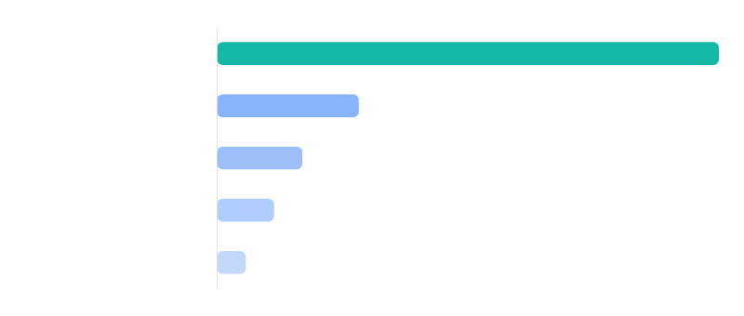
Traffic is Driven by Location, Time, and Weather
Traffic patterns are primarily determined by location, predictable time behavior, and environmental conditions
Relative Influence on Traffic (based on model results)
Traffic is predictable and driven by measurable external factors
7

Slide 8



Traffic Is Dominated by Location — Supported by Clear Behavioral Patterns
Facility (FAC) drives the majority of traffic variation
Why Location Dominates Traffic Behavior
Facility (Primary Driver)
Traffic volume varies significantly across facilities
Day of Week (Secondary Pattern)
Each facility serves different connectivity and demand patterns
Temperature (Supporting Factor)
Time-based behavior creates predictable cycles
Wind (Minor Influence)
Weather influences traffic but does not drive it
Traffic is primarily driven by where people travel, not just when or under what conditions
8

Slide 9







From Insight to Action: Managing Traffic Proactively
Targeted Traffic Management
How to Execute
Expected Impact
Prioritize facility-level monitoring because traffic usage is mainly driven by location.
Review daily traffic patterns by facility, day of week, and weather conditions.
Earlier identification of congestion risk at the facilities that matter most.
Use facility dashboards to flag crossings with rising traffic or repeated peak periods.
Track each bridge and tunnel separately instead of relying on system-wide averages.
Better staffing and lane planning during predictable high-demand periods.
Align staffing, lane availability, and incident-response readiness with expected demand
More reliable traffic flow through proactive, facility-specific decision-making.
Focus operational attention on high-demand facilities before congestion builds.
Traffic can be actively managed by focusing on location, timing, and conditions
9

Slide 10
Question 2
Understanding Traffic Is Only Part of the Problem
Where and how do violations occur across facilities and time?
Traffic volume explains demand — violations reveal risk and behavior
10

Slide 11
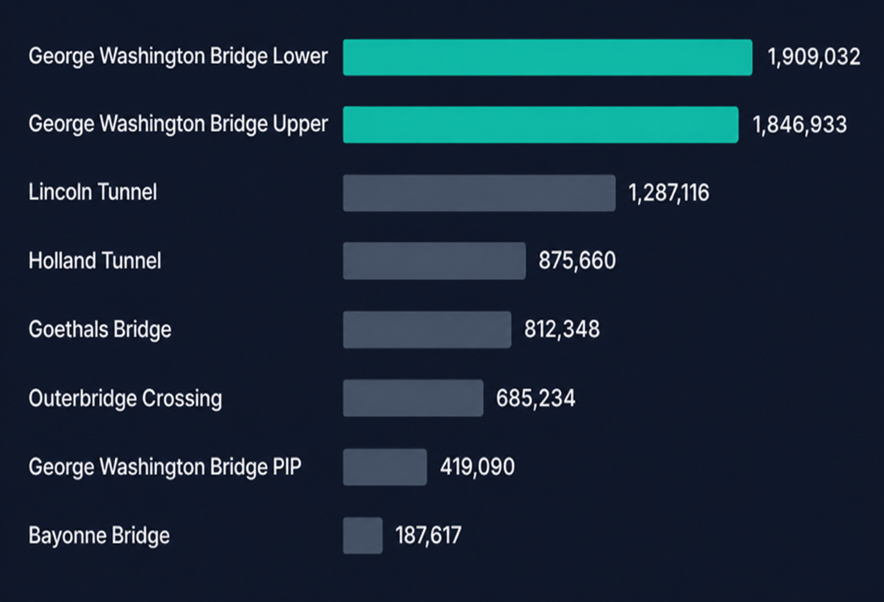
Toll Violations Are Large-Scale and Highly Concentrated
Violation Distribution by Facility
8M+
Total Violations
~47% of violations come from just 2 facilities
Violations are heavily concentrated rather than evenly distributed across the network.
Violation risk is concentrated in specific facilities, not across the entire system
11

Slide 12



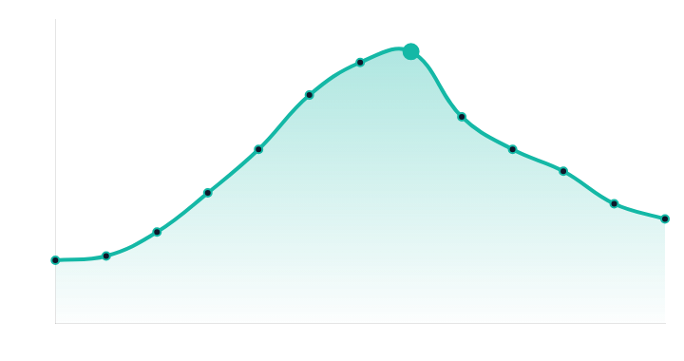

Violations Follow Demand and Seasonal Patterns
Peak violations align with high traffic demand periods
Peak (~1.25M)
Monthly Violation Pattern
2020
Highs in May–Aug / Lows in Jan–Feb
Violations increase during high-demand periods and follow predictable seasonal trends
12

Slide 13







Violation Behavior Is Driven by Location AND Time
Where violations occur
When violations occur
George Washington Bridge Upper and George Washington Bridge Lower contribute ~47% of total violations
Peak violations during May–August
Lower violations in Jan–Feb
Violations are concentrated in a few facilities
Patterns follow traffic demand
Violations are not random — they are driven by both location and demand patterns
13

Slide 14







Reducing Violations Through Targeted Enforcement
Focused Enforcement
How to Implement
Expected Outcome
Prioritize George Washington Bridge Upper and George Washington Bridge Lower (highest impact)
Increase monitoring at high-risk facilities
Reduced revenue leakage
More efficient enforcement deployment
Focus on peak violation months (May–August)
Deploy enforcement during peak periods
Improved compliance at high-risk facilities
Align enforcement with traffic demand
Track violations using real-time dashboards
Targeting high-risk facilities and peak periods can significantly reduce violations
14

Slide 15
Question 3
When Does Traffic Peak and
What Drives It?
Understanding peak demand patterns across time, behavior, and conditions
Traffic is predictable — not random — and can be managed proactively
15

Slide 16
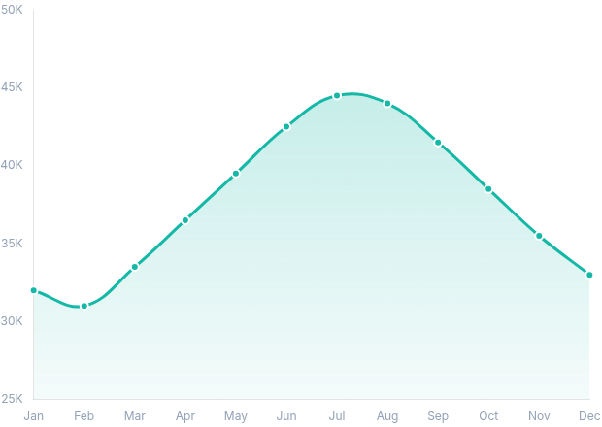
Traffic Peaks Follow Clear Seasonal Demand Patterns
Summer months drive peak traffic demand
Traffic rises steadily from winter to summer
Peak occurs between June and August (~44K+)
Declines gradually after summer
44,000+
Average daily traffic in peak months
Traffic demand is structured, seasonal, and predictable
16

Slide 17



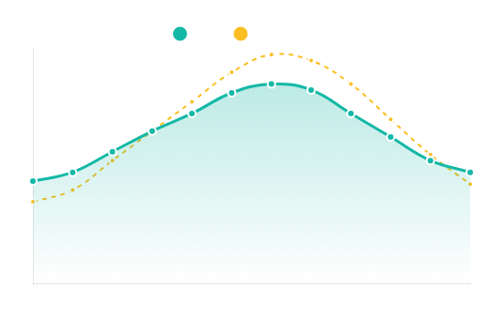
Behavior and Seasonality Drive Traffic Patterns
Traffic increases toward end of week
Traffic by Day of Week
Traffic vs Temperature Alignment
Friday & Saturday show highest traffic volumes
Warmer months align with higher traffic volumes
Traffic is driven by human behavior and seasonal conditions
17

Slide 18






Peak Traffic Events Are Concentrated and Predictable
Q3 Insight
Traffic Distribution
George Washington Bridge Upper
47%
95K+
George Washington Bridge lower
35%
Others
18%
Highest observed daily traffic
George Washington Bridge Upper - Saturday peak
FACILITY 7
Key Insight: Extreme congestion is location-specific and predictable
Peak Days
Location
Pattern
Traffic peaks on Friday and Saturday, with ~42K+ vehicles per day
Concentrated at George Washington Bridge Upper, accounting for 47% of total volume
Not random - follows predictable seasonal cycles
Traffic patterns are predictable — not random — and can be managed proactively through targeted interventions
18

Slide 19




Optimizing Operations Based on Traffic Patterns
Recommendation
Implementation
Impact
Focus on peak demand windows
Increase staffing during June-August
Reduced congestion during peak periods
Align with seasonal cycles
Optimize lanes on weekends and peak days
Improved flow and travel time reliability
Prioritize high-traffic facilities
Strengthen enforcement during peaks
Better resource utilization
Proactive planning based on traffic patterns improves system efficiency
19

Slide 20
Question 4
Did Traffic Patterns Change
in 2025?
Understanding how congestion pricing influenced driver behavior
20

Slide 21








Traffic Did Not Decrease — It Shifted Across Facilities
Q4 Answer
Traffic Change by Facility (2025)
Increase
Decrease
Percentage change in traffic volume compared to baseline
George Washington Bridge Upper
+2.94%
Goethals Bridge
+1.43%
George Washington Bridge Lower
+0.87%
Bayonne Bridge
+0.59%
Outerbridge Crossing
-0.28%
Holland Tunnel
-0.30%
Lincoln Tunnel
-0.71%
21
Drivers are redistributing routes — not reducing travel
Traffic is shifting toward select facilities

Slide 22



Traffic Redistribution Indicates Route Switching Behavior
Q4 Evidence
Demand Is Increasing in Select Facilities
Other Facilities Are Losing Traffic
Declining usage indicates avoidance
Traffic growing at key locations
Lincoln Tunnel
George Washington Bridge Upper
-0.71%
Declining
+2.94%
Strongest increase
Holland Tunnel
-0.30%
Stable decline
Goethals Bridge
+1.43%
Steady growth
Outerbridge Crossing
-0.28%
Minor decrease
George Washington Bridge Lower
+0.87%
Moderate increase
Drivers are actively optimizing routes based on conditions — not reducing travel, but redistributing across the network

Slide 23







Congestion Is Driven by Location, Not Uniform Across the System
Q4 Analysis
Traffic Driver Importance Ranking
Key Insights
Congestion patterns are primarily determined by location, with predictable time behavior and environmental conditions playing secondary roles.
Facility
88.8%
Congestion is primarily location-driven - Facility 7: George Washington Bridge Upper accounts for 47% of total traffic
Day of Week
25%
Temperature
15%
Time patterns shape demand - Friday/Saturday show 15% higher traffic
Weather
8%
Weather plays a secondary role - only 8% influence on traffic
Congestion is concentrated — not evenly distributed across the network
23

Slide 24






Managing Congestion at the System Level
Proactive network management to balance traffic distribution
Recommendation
Implementation
Impact
Monitor facility-level shifts in real-time
Track traffic share changes in real-time dashboards
Prevent new congestion hotspots
Balance traffic distribution
Manage congestion across the network
Adjust toll and routing strategies dynamically
Improve system-wide efficiency
Avoid isolated decision-making
Strengthen monitoring at high-growth facilities
Congestion pricing shifts traffic — it must be actively managed
24

Slide 25
Question 5
What Is the Expected Future
Traffic Demand?
Understanding how traffic usage will evolve beyond 2025 for strategic planning decisions
25

Slide 26

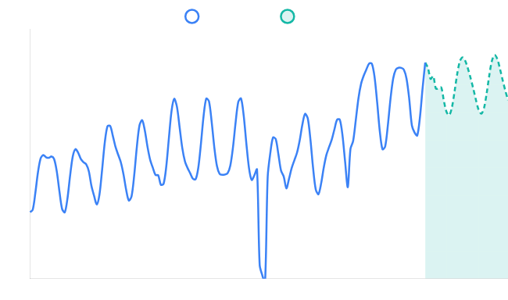




Traffic Demand Is Stable but Continues to Fluctuate
Q5 Answer
Avg Monthly Traffic
Peak Daily Traffic
George Washington Bridge Upper Traffic Forecast (2013-2027)
258K
95K+
+0.5% YoY
Facility 7
Forecast Range
Stability Index
250-260K
94%
2025-2027
Consistent
No Extreme Growth
Traffic does not show extreme growth or decline patterns
Consistent Range
Demand remains within 250-260K monthly range
Short-term Variation
Traffic fluctuates with seasonal patterns
Future demand is stable — not rapidly increasing, with predictable seasonal fluctuations
26

Slide 27


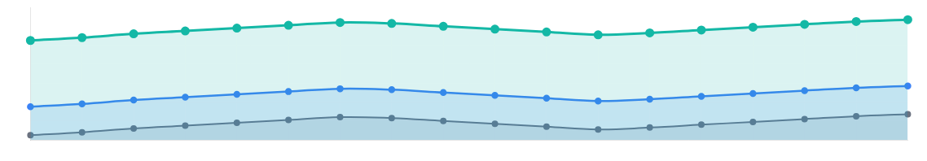

Traffic Behavior Remains Consistent Across Facilities
Q5 Evidence
Facility-Level Differences
Pattern Continuity
High-demand facilities maintain higher volumes
Seasonal variation continues
●
High-demand facilities (7, 9) maintain 250-260K monthly traffic
●
Seasonal variation persists (+15% in summer)
●
Other facilities operate at different levels (150-190K)
●
Traffic fluctuates within stable ranges (±5%)
●
Demand is not uniform across the system
●
No structural break in demand patterns
Facility Traffic Forecast Trends (2025-2027)
Facility 7 (250-260K)
Facility 5 (180-190K)
Facility 2 (150-160K)
Traffic patterns remain consistent — but vary by location
27

Slide 28
Planning for Stability, Not Expansion
Focus on optimizing existing infrastructure and managing variability
Strategy
Implementation
Impact
Focus on high-demand facilities
Use monthly forecasts for planning
Improved operational efficiency
Optimize existing infrastructure
Reduced congestion risk
Adjust staffing and operations dynamically
Manage variability instead of growth
Better long-term planning decisions
Monitor traffic at facility level
Smarter management is more valuable than expansion
28

Slide 29






Traffic Behavior Is Predictable, Structured, and Manageable
Key Takeaways
Predictable Patterns
Concentrated Demand
Behavior-Driven Flow
Traffic follows consistent time-based patterns with clear seasonal and daily cycles
Traffic and violations are concentrated in key facilities (7 & 9) George Washington Bridge Upper and George Washington Bridge Lower
Traffic changes based on user behavior and environmental conditions
44K+
avg daily traffic
47%
+2.94%
FAC 7 growth
from 2 facilities
95K+
peak daily
8M+
total violations
-0.71%
FAC 2 decline
Adaptive System
Stable Future Demand
Drivers adjust routes in response to congestion and pricing changes
Traffic remains steady but uneven across facilities through 2027
2025
shift year
Dynamic
routing response
250-260K
monthly forecast range
Stable
growth pattern
Traffic is not random — it can be managed with precision using data-driven insights and targeted interventions
29

Slide 30









From Reactive Operations to Proactive Traffic Management
Transforming traffic management through data-driven insights and predictive analytics
Data-Driven Traffic Management
How to Execute
Expected Outcomes
Manage traffic at facility level, focusing on high-impact areas
Monitor traffic and violations in real time
Reduced congestion and violations
Use patterns, not assumptions, for decision-making
Adjust staffing and operations dynamically
Better resource allocation
Improved traffic flow reliability
Prioritize resources based on data insights
Align pricing and enforcement with demand
Proactive, data-driven decisions can transform system performance
30
"Effective traffic management is not about reacting to congestion — it is about anticipating and controlling it."

Slide 31





Traffic is structured, predictable, and manageable
Traffic demand is stable, but requires smarter management
Demand is Stable
Congestion is Concentrated
Behavior Adapts
Traffic does not show extreme growth or decline patterns
Drivers adjust routes based on conditions
Traffic issues are localized, not system-wide
The opportunity is not expansion — it is smarter, data-driven management
31

Slide 32






90-Day Execution Roadmap
Implementation
Phase 1
Phase 2
Phase 3
0-30 Days
30-60 Days
60-90 Days
Translate insights into operational plan
Deploy enforcement at high-risk locations
Measure performance improvements
Set up traffic & violation monitoring system
Adjust staffing based on peak patterns
Refine strategies
Scale successful interventions
Pilot congestion strategies
Define baseline KPIs for performance tracking
Focused execution can deliver measurable results within 90 days through systematic implementation
32

Slide 33









Next Step: Operational Dashboard Implementation
Power BI Integration
Translating analysis into a real-time monitoring and decision-making system
What the Dashboard Will Enable
Business Impact of Implementation
Traffic monitoring by facility - Real-time visibility into vehicle flow across all facilities
Would enable real-time monitoring of traffic patterns
Continuous visibility into traffic patterns and anomalies
Violation tracking over time - Trend analysis of toll violations and enforcement effectiveness
Would support dynamic staffing and operational adjustments
Data-driven resource allocation based on demand
Peak demand identification - Automated detection of high-traffic periods
Would track effectiveness of enforcement and congestion strategies
Measures impact of pricing and control measures
Facility-level performance visibility - Granular insights for each location
Would provide continuous visibility into traffic and system performance
24/7 monitoring for proactive management
This dashboard will translate analysis into real-time decision-making capability
33

Slide 34

Thank You
"Traffic is not a problem of volume — it is a problem of how it is managed."
Questions & Discussion
We look forward to your feedback and insights
34

