Slide 1
Quantifying Climate Vegetation Lags
Team TBD2 Project 25
Vivek R, Nandan Rajesh Kamat, Shaurya Gupta

Slide 2
Research gap
Studies show forest communities lag climate change, but our question is quantitative:
  How many centuries does each tree genus lag temperature?
  Do unusual communities line up with fast climate change?
  Were past migration rates fast enough to match moving climate zones?

Slide 3
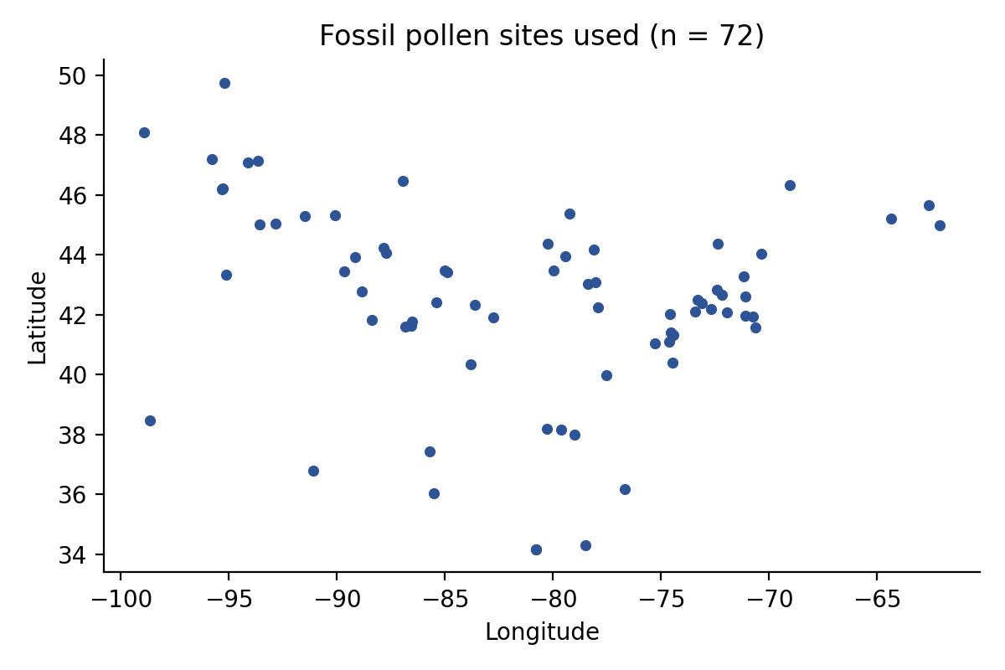
Data and pipeline
Study sites

Slide 4
  Neotoma fossil pollen: 423 cached datasets
  Filtered fossil analysis: 72 sites and 1782 binned samples
  TraCE-21ka TREFHT temperatures matched to each site
  500-year bins from 14.75 ka BP to 0.25 ka BP

Slide 5
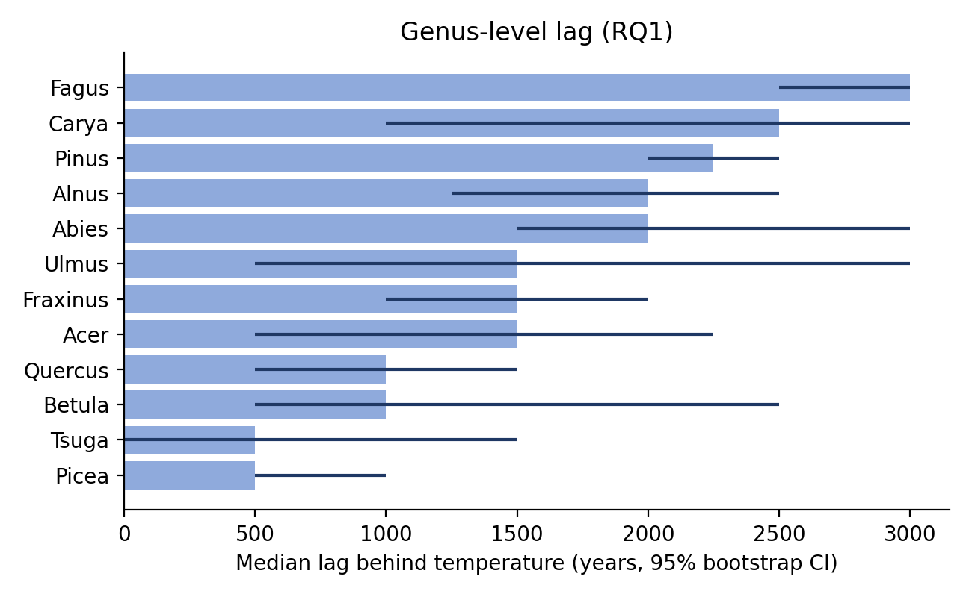
Genus lags differ
Lag chart

Slide 6
Kruskal-Wallis p = 1.66e-08

Slide 7
Main lag result
Shortest median lags:
  Picea, Tsuga: 500 years
Longer median lags:
  Pinus, Carya, Fagus: 2250 to 3000 years
Interpretation: tree genera did not track temperature as a single moving forest unit.

Slide 8
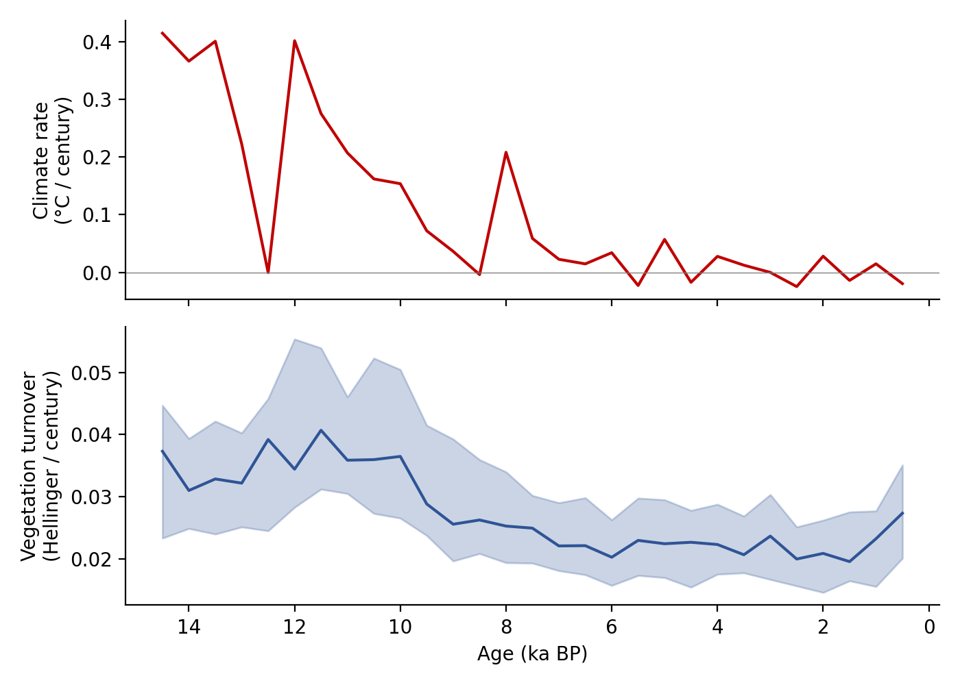
Rates through time
Rates

Slide 9
Median absolute climate rate: 0.034 deg C per century
Median vegetation turnover: 0.025 Hellinger units per century

Slide 10
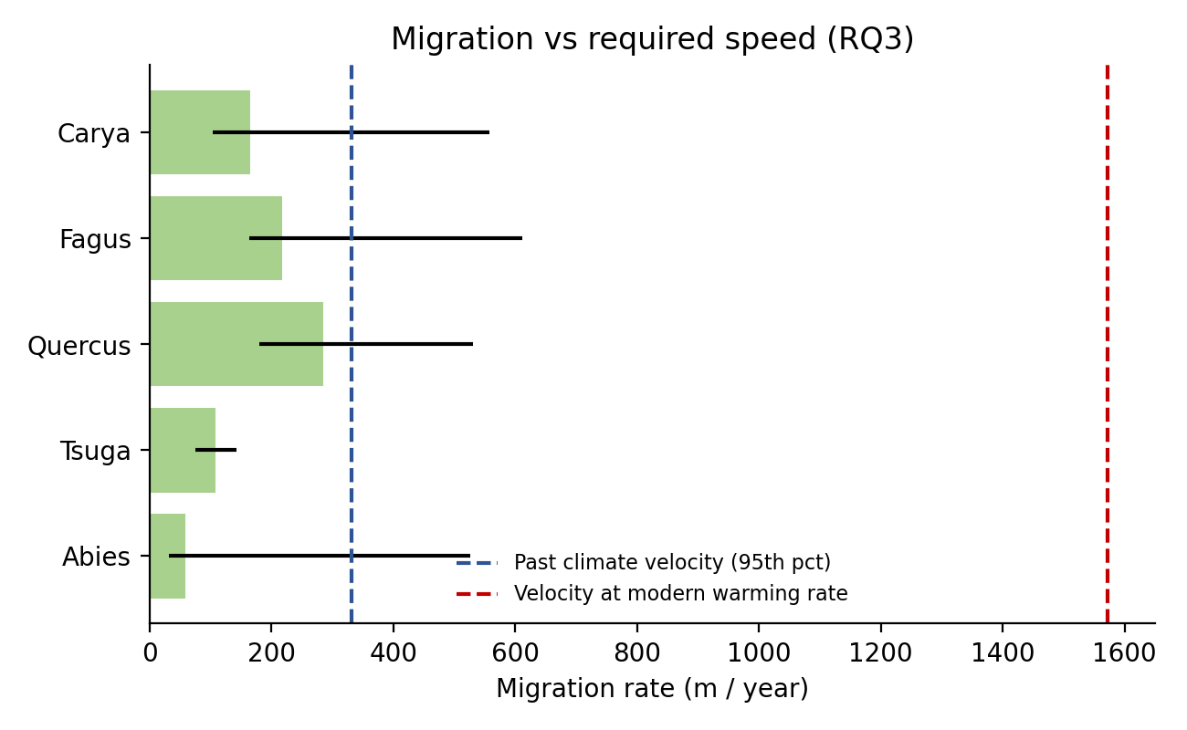
Migration versus climate velocity
Migration

Slide 11
  Median inferred migration: 164.7 m/yr
  Past 95th percentile climate velocity: 331.8 m/yr
  Modern climate velocity at 1.9 deg C per century: 1572 m/yr

Slide 12
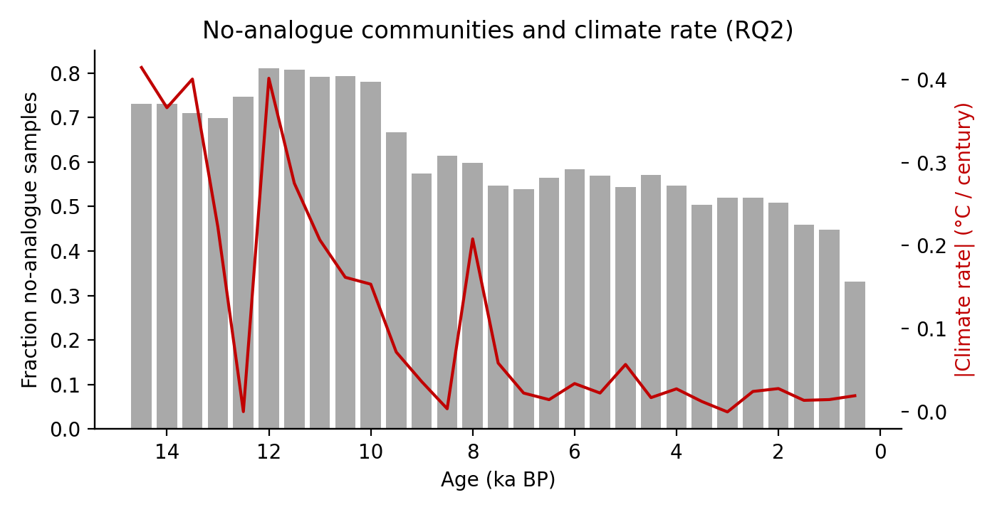
No-analogue communities
No analogue

Slide 13
  Threshold: 0.066 squared chord distance
  Modern reference samples: 644
  Flagged fossil samples: 59.9 percent
  Spearman rho with climate rate: 0.66

Slide 14
Conclusion
The real-data pipeline supports two core claims.
  Tree genera had different lag times, from about 500 to 3000 years.
  No-analogue frequency rose during faster climate and vegetation change.
  Modern climate velocity is about 9.5 times the median inferred migration rate.
The modern reference set now contains 644 filtered surface samples, but the API should still be rerun if Neotoma becomes stable.

