Slide 1
FACING THE FIRE: LIVING NEAR SOUTH ICELAND’S VOLCANOES
Presented by Mary Kendig, Namrata Rao, and Neeraj Shirame

Slide 2
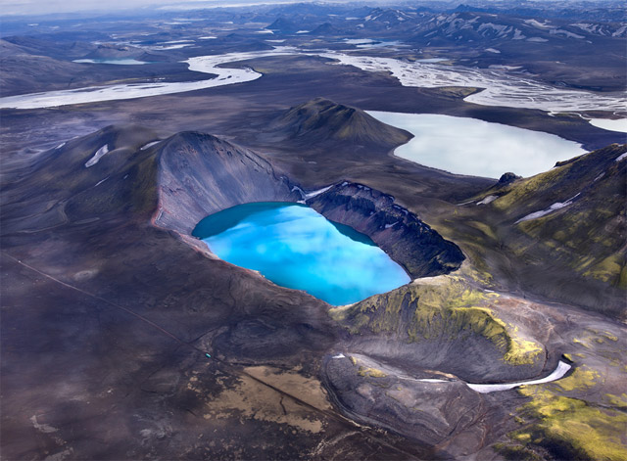
Welcome
Thank you for attending!
Summary:
Research Questions
Data
Our Interpretations
Imminent Threats
Next Steps
Notes:
Image: http://www.thisiscolossal.com/wp-content/uploads/2012/09/andre-3.jpg

Slide 3
Research Questions
What is the statistical relationship between earthquake magnitude, depth, and distance to known volcanoes?
Which locations are experiencing increased seismic activity?
Is there a spatial pattern in which the increased earthquake activity occurs?

Slide 4
Why are the Questions Important?
To help find a relationship between the magnitude of an earthquake and its distance from the nearest volcano. This could help in realizing the vulnerability of a region that is close to a Volcano since it clearly draws a picture about the possibility of experiencing higher magnitude earthquakes as you move closer to the Volcano.
Finding a pattern in which these earthquakes occur with a view to identify which regions in Iceland are more prone to earthquakes. This is another very important question since it helps us in pointing out the potential 'high risk' areas across Iceland and thereby mitigating risks by making people aware about such regions.

Slide 5
Who Should Care?
Southern Icelanders residing in the vicinity of Volcanoes displaying higher activity
Public and private sector corporations planning to expand businesses in these areas
Geothermal energy
Chemical / manufacturing
Tourists who are not aware of our emergency and evacuation plans

Slide 6
ORIGIN OF DATA
Icelandic Meteorological Office (IMO) website
Derived from SIL seismic network
Online Dataset
Earthquakes in the last 48 hrs
Updated every 5 minutes
Web crawler to monitor data over a period of 4 weeks

Slide 7
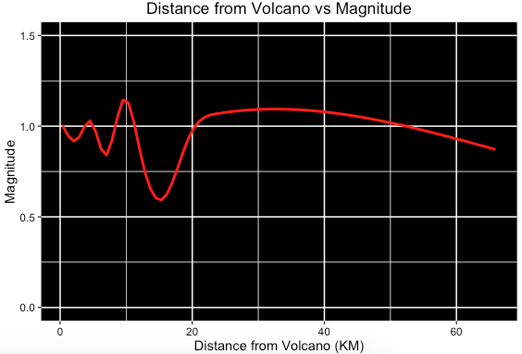
METHODOLOGY
Elements of the data set
Location, Magnitude, Depth of the Earthquake
Distance from Volcano
Frequent Volcanic Activity
Decipher relation between Magnitude and Distance from Volcano

Slide 8
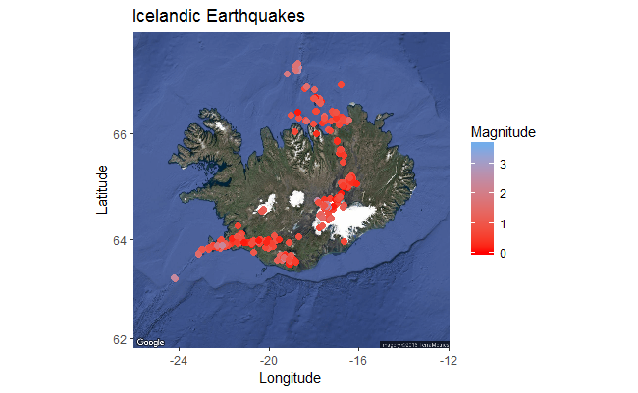
DATA INTERPRETATION
Locations of increased earthquake activity:
Hábunga (Mountain)
Grímsey (Island)
Bárðarbunga (Volcano)
Known volcanoes near locations:
Katla (Hábunga Mountain)
Bárðarbunga (Volcano)

Slide 10
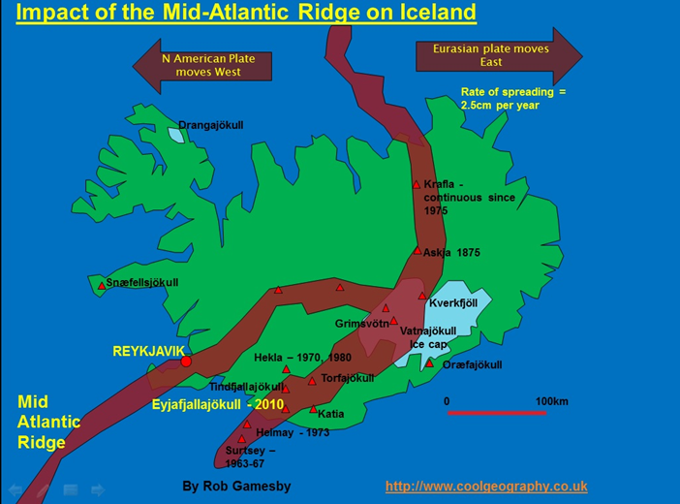
Notes:
http://www.coolgeography.co.uk/A-level/AQA/Year%2013/Plate%20Tectonics/Volcanoes/Iceland%20Tectonic%20Map.jpg

Slide 11
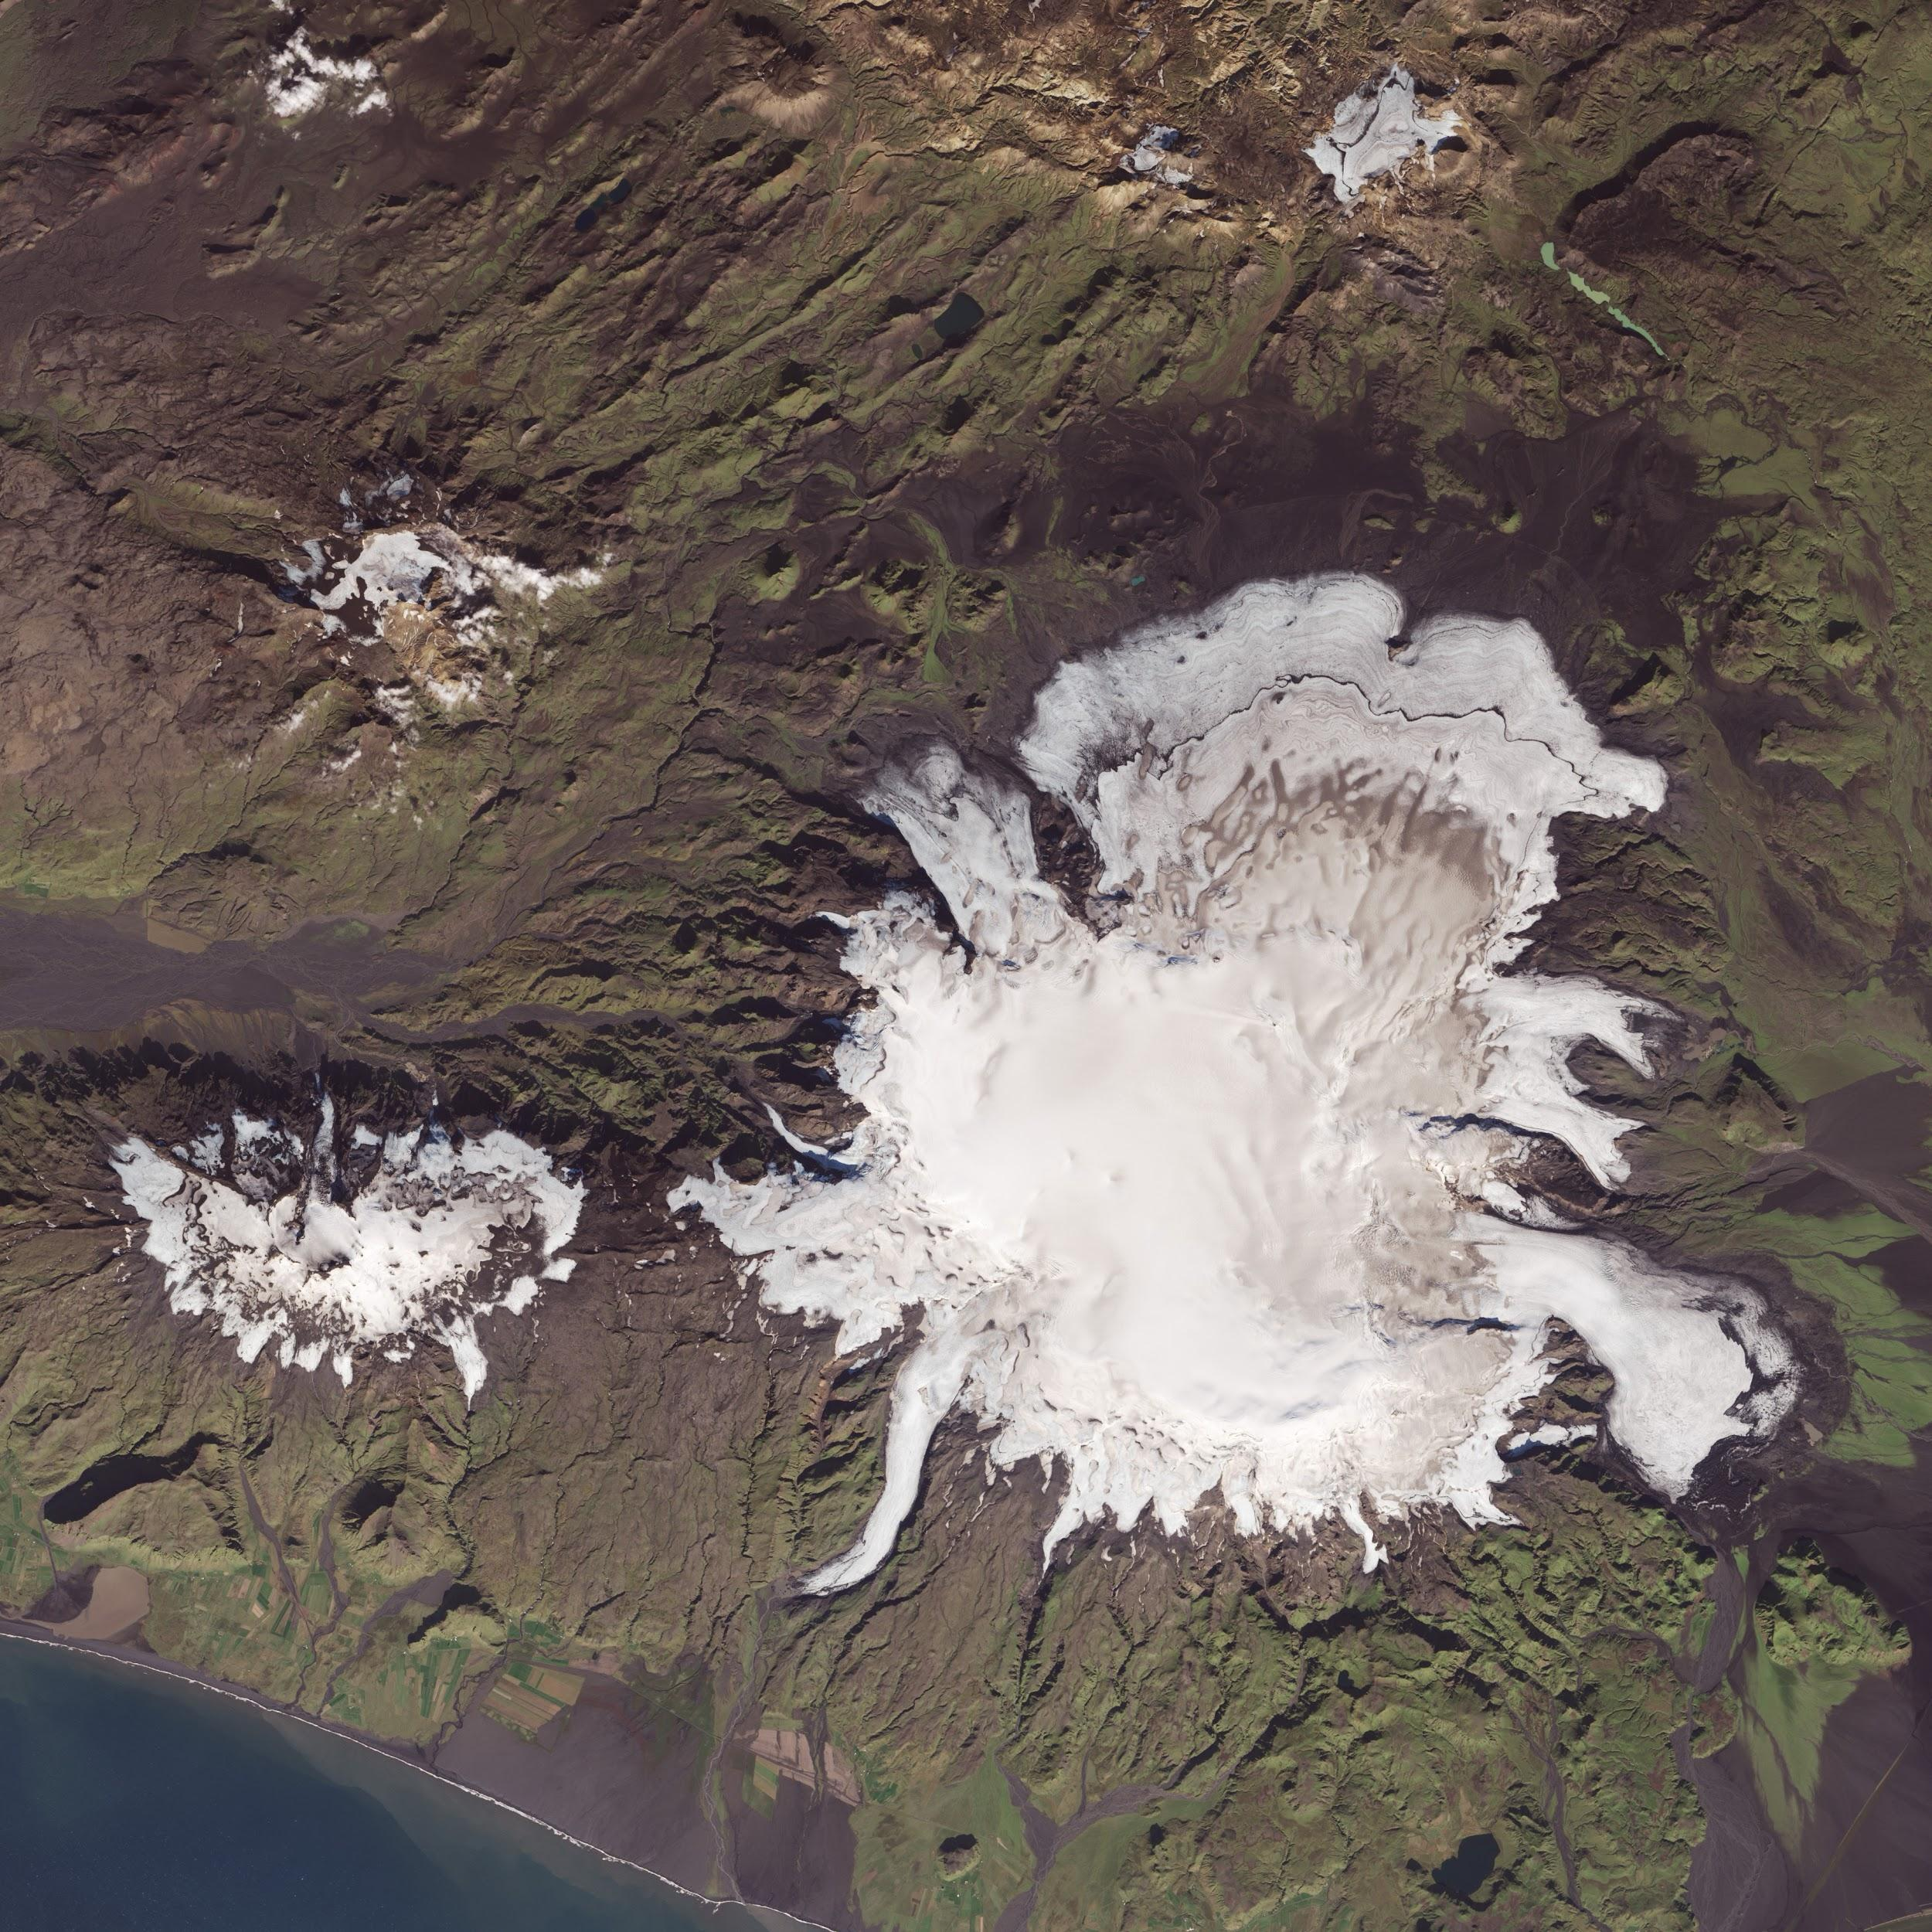
IMMINENT THREAT: KATLA
Subglacial volcano under Mýrdalsjökull glacier
Erupts every 60 years
Major eruption every 100 years
Last major eruption: 1918
MAJOR EARTHQUAKE SWARM:
September 29 & 30, 2016
Notes:
Image: http://icelandmag.visir.is/sites/default/files/styles/lightbox/public/thumbnails/image/myrdalsjokull_2014.jpg?itok=2PH5jDTr

Slide 12
September 29th and 30th
Sep 29th: 3 X 3.6 magnitude 4.6 KM from Hábunga mountain (Katla)
351 earthquakes followed with average .935 magnitude
May indicate magma movement within volcano

Slide 14
OUR NEXT STEPS
Dig deeper into correlation between depth and magnitude
Statistical significance detected!
Continue to monitor earthquake activity around Katla
Utilize satellite images to determine glacial depression

Slide 15
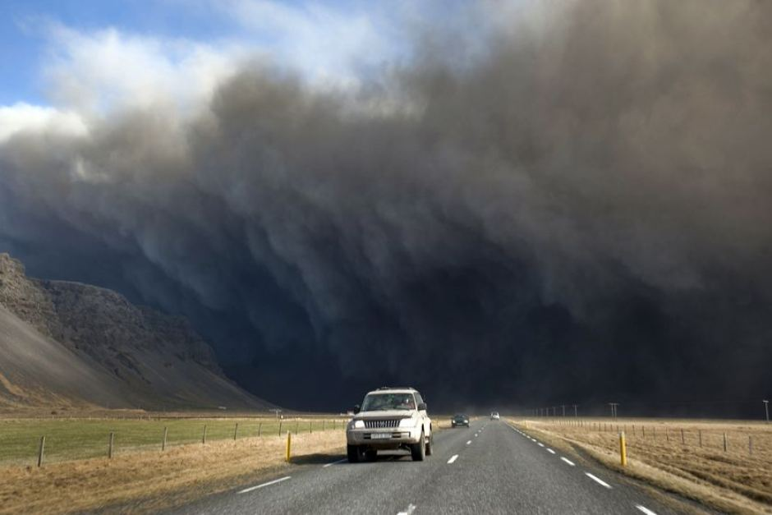
YOUR NEXT STEPS
Continue funding our research
Stay connected with Icelandic Met Office
Consider relocating west or east of Mid-Atlantic Ridge
Memorize all evacuation plans!
Notes:
Image: http://www.abc.net.au/news/image/399132-3x2-940x627.jpg

Slide 16
Any Questions?
Thank you!

