Slide 1
Neha Rathi Senior Technical Writer, Evolent Health
Automating End-User Guide Generation from Confluence Pages
Read confluence pages for shared information
Translate into an end-user document
Upload it to Confluence

Slide 2
Problem Statement
Data extraction from multiple pages.
Filter jargons, developer notes and sensitive information
Structuring multiple times with changes coming
Styling issue
Technical Specs
Claude
Technical writer skill
Cursor
Github
MCP Connectors
Confluence
Jira
Github
Microsoft

Slide 3
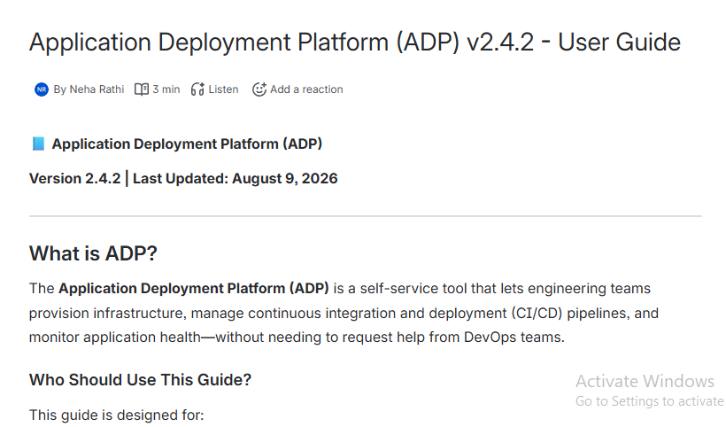

DEMO
https://github.com/nrathi42/nrathi_twtai

Slide 4
Thank You!

