Slide 1
Predictive Modeling of Traffic Flow
Nandini Raveendran Nair Subhadra

Slide 2
Introduction
Investigating the relationship between weather condition and traffic flow.
Models used
Recurrent neural network (RNN)
Long short-term memory network (LSTM)

Slide 3
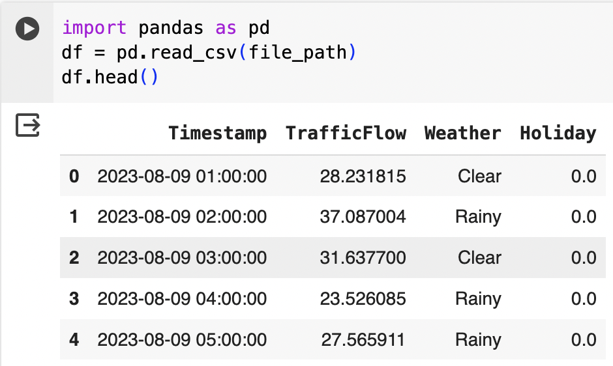
Objective
Aim to predict traffic patterns during the next months.
Be able to understand the relationship between weather and traffic flow captured by RN end and LSTM models will facilitate accurate forecasting.
Key Variables
Timestamp
Traffic Flow
Weather
Holiday
Months chosen that have a wide range of weather conditions
August, September, and October

Slide 4
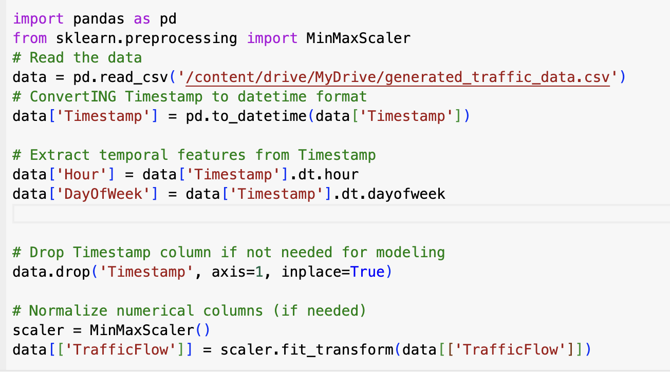
Methodology
Used a timeseries data analysis utilizing Pandas and Keras
Conversion of timestamps to extract temporal features
Data normalization, and one hot encoding for continuous and categorical variables

Slide 5
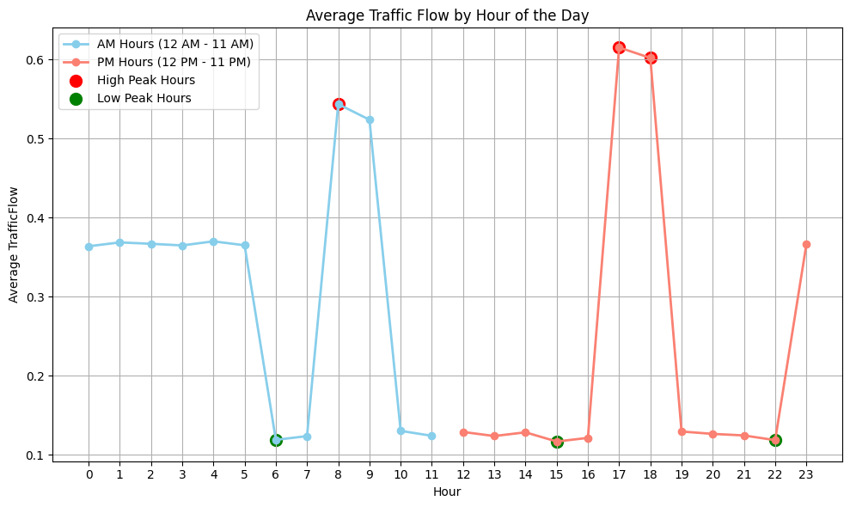
Analysis
Average traffic flow by hour
The weather and temperature impact the traffic flow the most during peak travel hours.

Slide 6
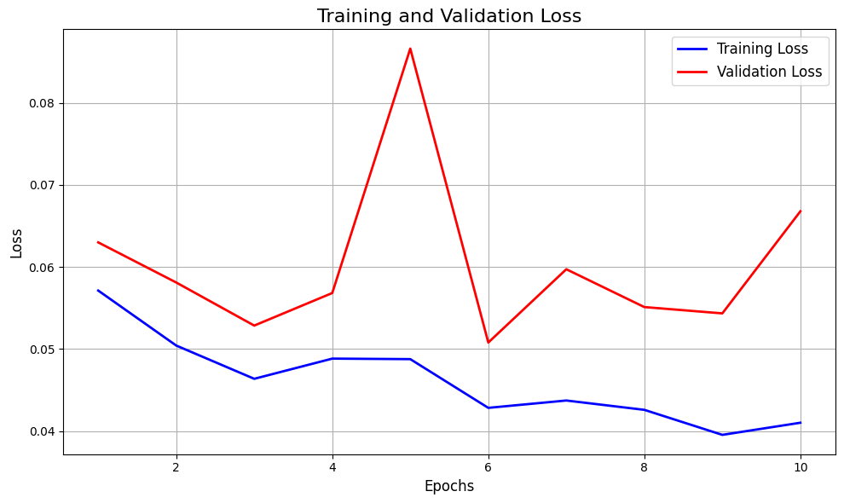
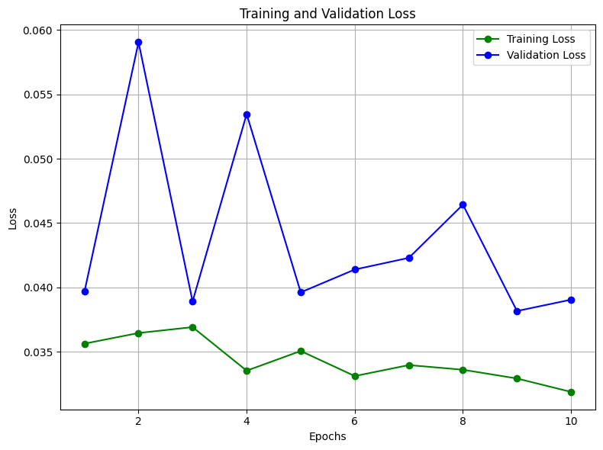
Model Training and Validation
Models used specify for analyzing time series data
RNN (left) and LSTM (right)
Excel at handling Sequential Data Processing and temporal dynamics
MSE was a critical metric during training
Notes:
RNN: Validation loss initially decreases but starts to plateau around epoch 6.
LSTM: Validation loss steadily decreases with minimal fluctuations throughout the training process.
RNN: The plateauing of the validation loss may indicate that the model reaches a limit in improving performance on the validation set.
LSTM: The steady decline in validation loss suggests continuous learning without signs of overfitting or stagnation.
Both models exhibit effective training processes with reasonably low validation losses.
RNN and LSTM showcase distinct patterns in how they learn from the training data, emphasizing the importance of selecting the right model architecture.

Slide 7
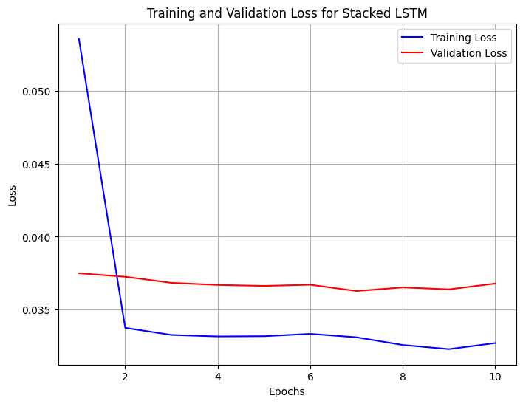
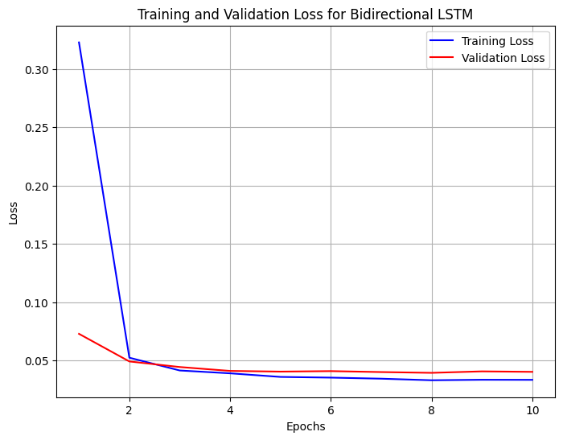
Model Architecture Variation
We explored Stacked and Bidirectional LSTMs to capture intricate temporal dependencies and both past and future time stamps
Explored different batch sizes and learning rate to find the optimal model performance
Notes:
Smaller Batch Sizes:
Effect: Faster convergence with more frequent updates.
Observation: Potential for noisy updates, impacting stability.
Larger Batch Sizes:
Effect: Stable updates but slower convergence.
Observation: Computational efficiency with potential memory requirements.
Higher Learning Rates:
Effect: Faster convergence but risk of overshooting.
Observation: Potential for oscillations or divergence.
Lower Learning Rates:
Effect: More stable convergence but slower.
Observation: Reduced risk of overshooting, potential for getting stuck.

Slide 8

Model Evaluation
Validation loss after final Epoch
Model 1: 0.0621
Model 2: 0.0734
Model 3: 0.0521 (Best Performing Model)
Best LSTM
Epoch 10 Validation Loss: 0.0548
Test Loss: 0.0480
Learning Rate: 0.01, Units 64
Notes:
Stated that lower validation loss generally indicates better performance.
Noted the competitive performance of the best LSTM model with a test loss close to the validation loss.

Slide 9
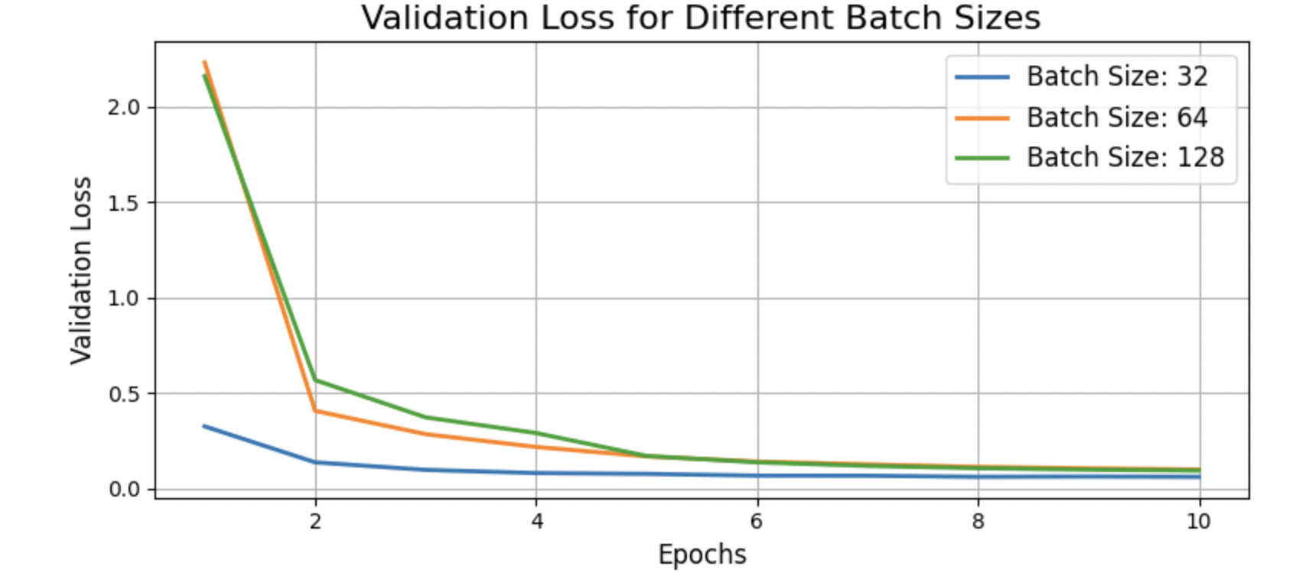
Results
Best of RNN
Learning rate of 0.01, 32 units, test loss 0.0391
Best LSTM
Learning rate of 0.01, 64 units, test loss 0.1234
RNN outperforms LSTM in test loss
Test Loss (Best Model): 0.028342263773083687

Slide 10
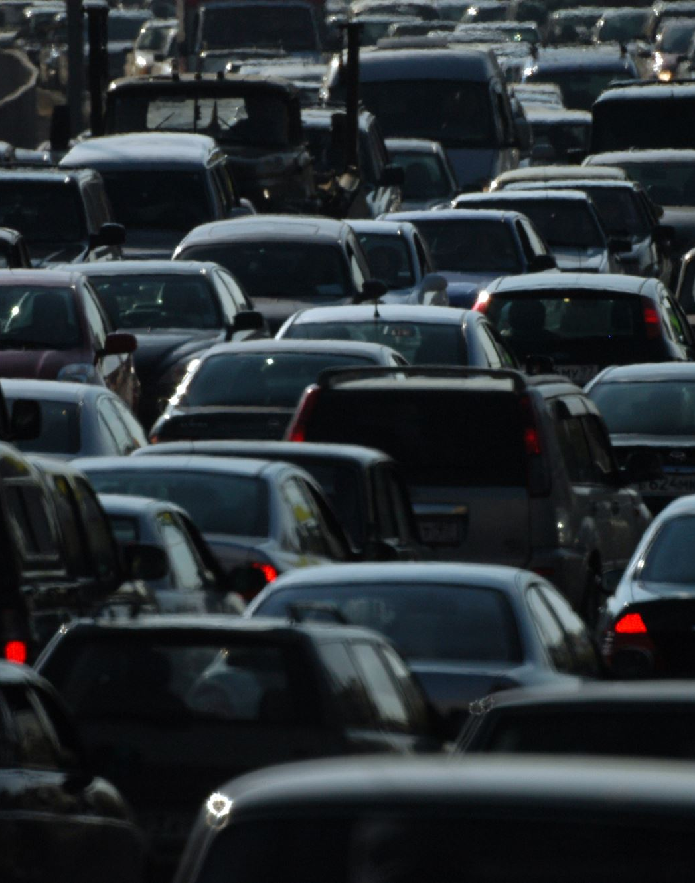
Conclusion
Model selection is important in traffic forecasting
RNN had the ability to handle the complexities of weather-impacted traffic
Future Research
Explore additional variables
Assess broader applicability in diverse scenarios

Slide 11
Questions?
Thank you!

