Slide 1
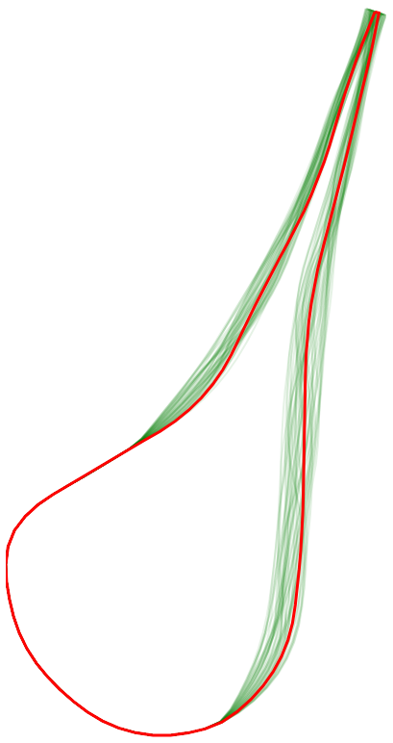
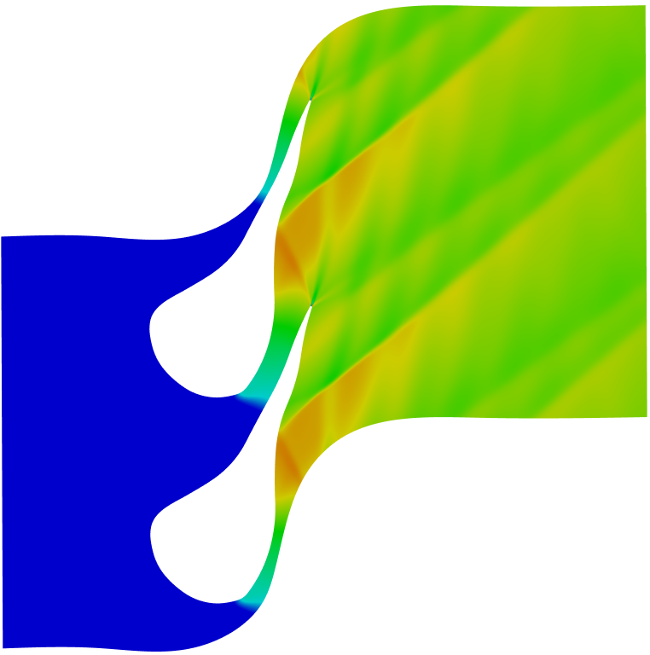
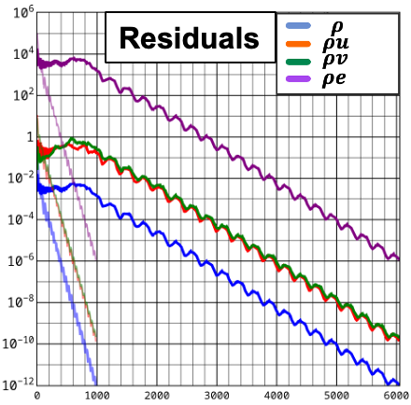



Warm Start: Accelerating ORC Turbine CFD
with Machine Learning
Design Project (Bureau d’Études)
ML
SU2
η(d, θ)
d, θ
Nassim RAZAALY
ISAE-ENSMA – Institut Pprime
Notes:
Welcome. This design project is about using machine learning to speed up CFD simulations of an ORC turbine. The idea in one line: from a geometry d and operating conditions θ, a neural network predicts the flow field, which is then used as the starting point of the SU2 solver, so it converges in fewer iterations.

Slide 2
Table of content
I. Context: ORCs, dense gases, ORC turbines
II. The project: warm-starting SU2 with ML
III. What you will build: pipeline and design space
IV. The machine-learning part, step by step
V. Training path and going further
VI. Resources
2/20
Notes:
Plan: context on ORCs and dense gases, the project and its objectives, the pipeline you will build, the machine-learning part explained step by step, how the project is organized as a training path, an optional advanced part, and resources.

Slide 3
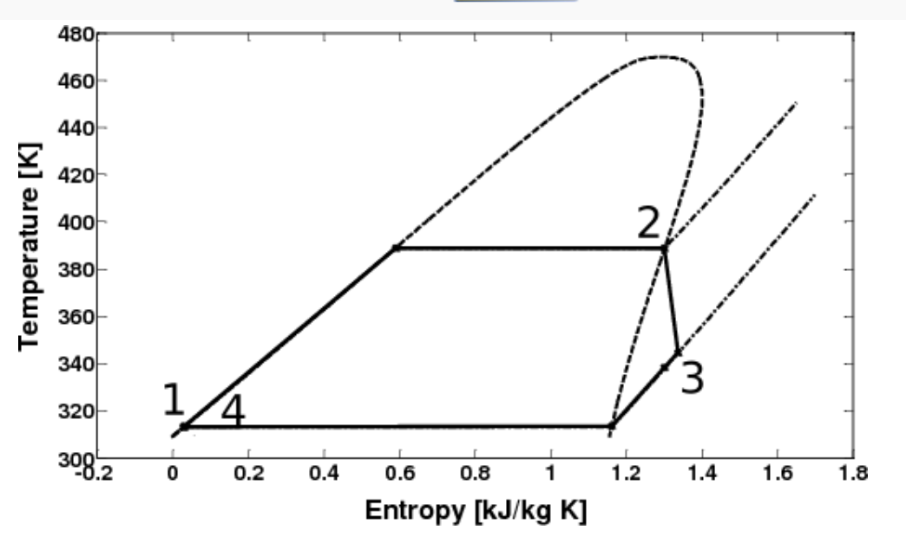
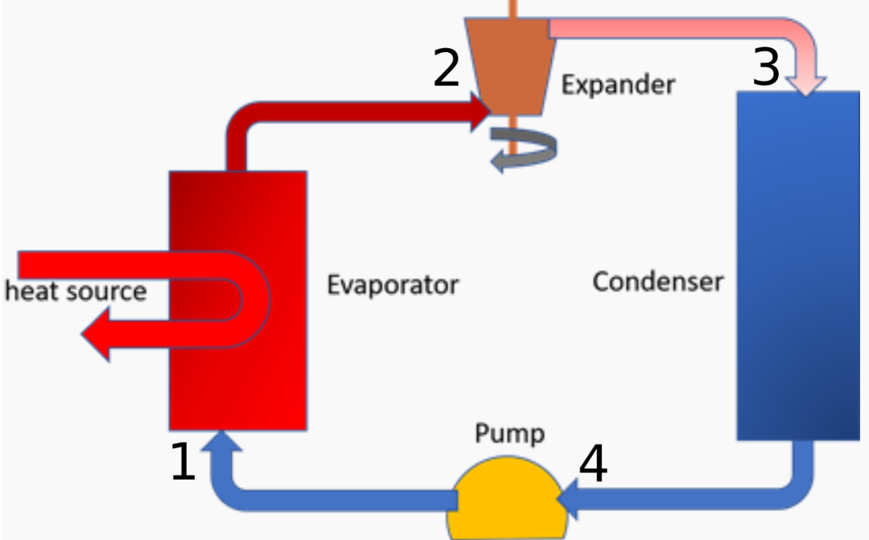
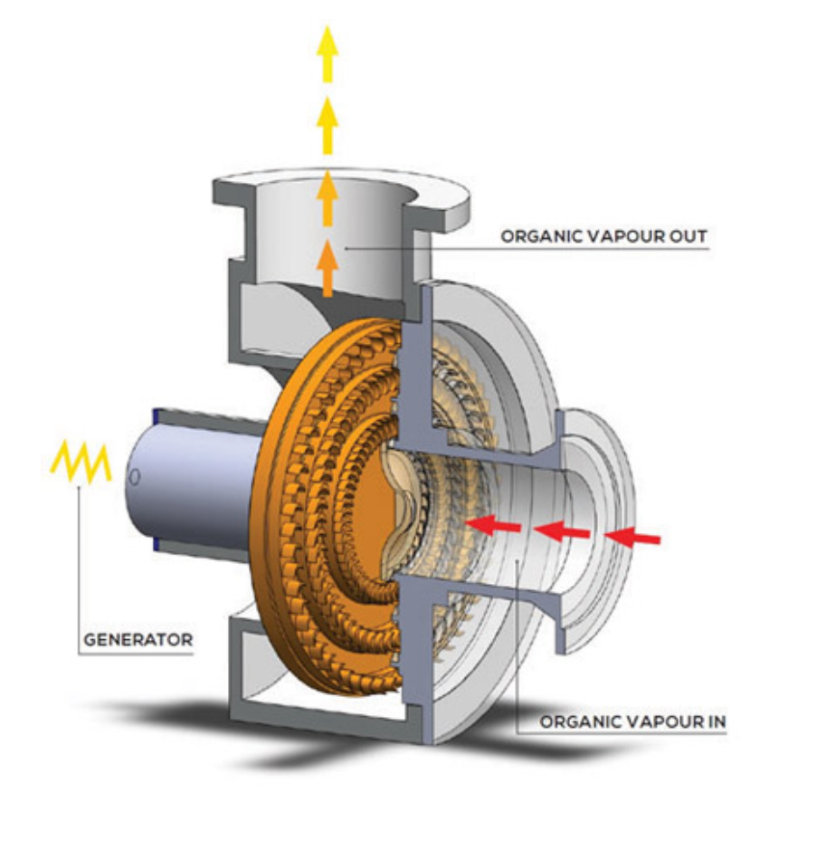
I. CONTEXT: Organic Rankine Cycles (ORC)
Rankine cycle with an organic fluid instead of water
Low/medium-temperature heat: geothermal, biomass, waste heat, solar
Small to medium scale (kW to MW)
Key component: the turbine
Complex fluid
Variable operating conditions
→ shape optimization under operational uncertainties
T–s diagram
Pump → evaporator → turbine → condenser
ORC turbo-generator
3/20
Notes:
An ORC is a Rankine cycle, like in a steam power plant, but with an organic fluid. These fluids evaporate at lower temperature, so they can exploit low-grade heat: geothermal, biomass, waste heat, solar. The machines are small to medium scale. The key component is the turbine: complex fluid, variable operating conditions, so its shape must be designed carefully.

Slide 4
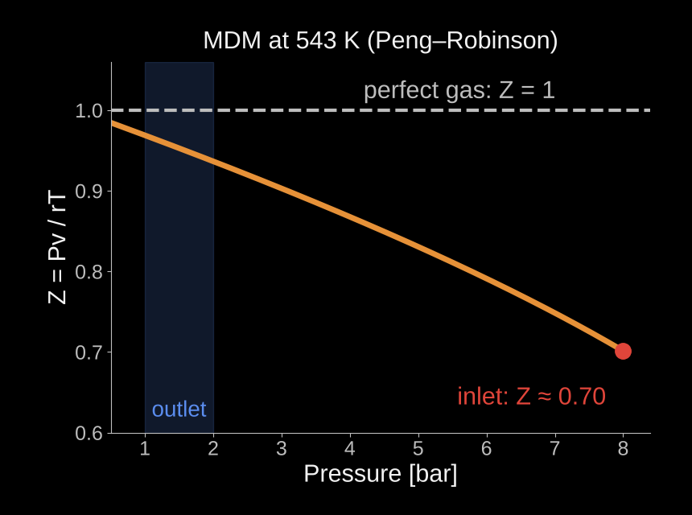
I. CONTEXT: Dense-Gas Specificity (*NICFD)
Z ≠ 1: the perfect-gas law (GP) is off by up to 30% here
Low speed of sound → supersonic flow and shocks
Γ can be < 1: non-ideal evolution of the Mach number
For you: MDM real-gas, with iPRSV model in SU2 instead of GP
*NICFD: Non-Ideal Compressible Fluid Dynamics
4/20
Notes:
The curve is the compressibility factor Z of MDM at 543 K, computed with the Peng–Robinson equation of state. A perfect gas would give Z = 1. At the turbine inlet, 8 bar, Z is about 0.70: the perfect-gas law is wrong by 30 percent. The speed of sound is low, so the flow becomes supersonic with shocks, and the fundamental derivative Gamma can be below one, which changes how the Mach number evolves. For you, in practice: you will switch SU2 from the perfect gas to a real-gas model and use it.

Slide 5
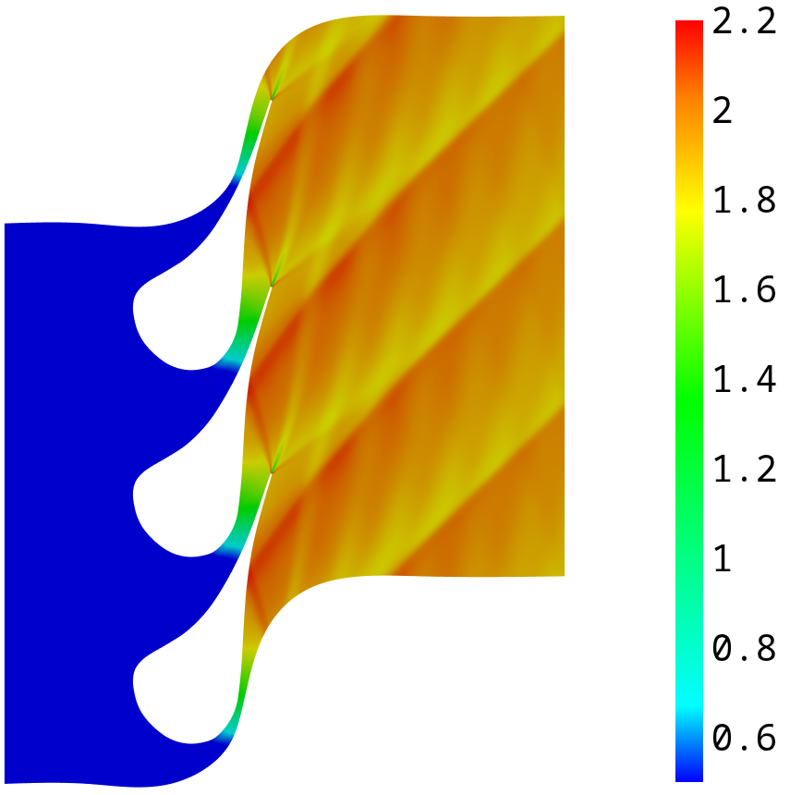
I. CONTEXT: ORC Turbine Stator Test Case [1]
MDM
8 bar · 543 K
siloxane, real gas
inlet (total)
1 – 2 bar
Mach ≈ 2
outlet (static)
supersonic, shocks
We want the efficiency η(d, θ)
d = blade geometry · θ = operating conditions
Mach number, baseline geometry (2D, SU2)
[1] Pini et al., Journal of Engineering for Gas Turbines and Power, 2015.
5/20
Notes:
The test case is a well-known ORC stator. Siloxane MDM, 8 bar and 543 K at the inlet, 1 to 2 bar at the outlet: a very high pressure ratio, supersonic flow up to Mach 2 with shocks at the trailing edge. 2D steady simulations with SU2. What we care about is the efficiency, which depends on the geometry d and the operating conditions theta.

Slide 6
II. PROJECT: Motivation
100
of CFD runs for one shape optimization
6000
of iterations per run, from a uniform field
1 scalar
kept per run (η): the flow fields are thrown away
SU2 residuals, uniform initialization
[3] Economon et al., AIAA Journal, 2016 (SU2).
6/20
Notes:
Optimizing the blade shape means hundreds of CFD simulations. Each one starts from a uniform field and iterates thousands of times until the residuals are small, as on this plot. And at the end, we keep only one number, the efficiency, and throw the whole flow field away. That is the waste we want to recycle.

Slide 7

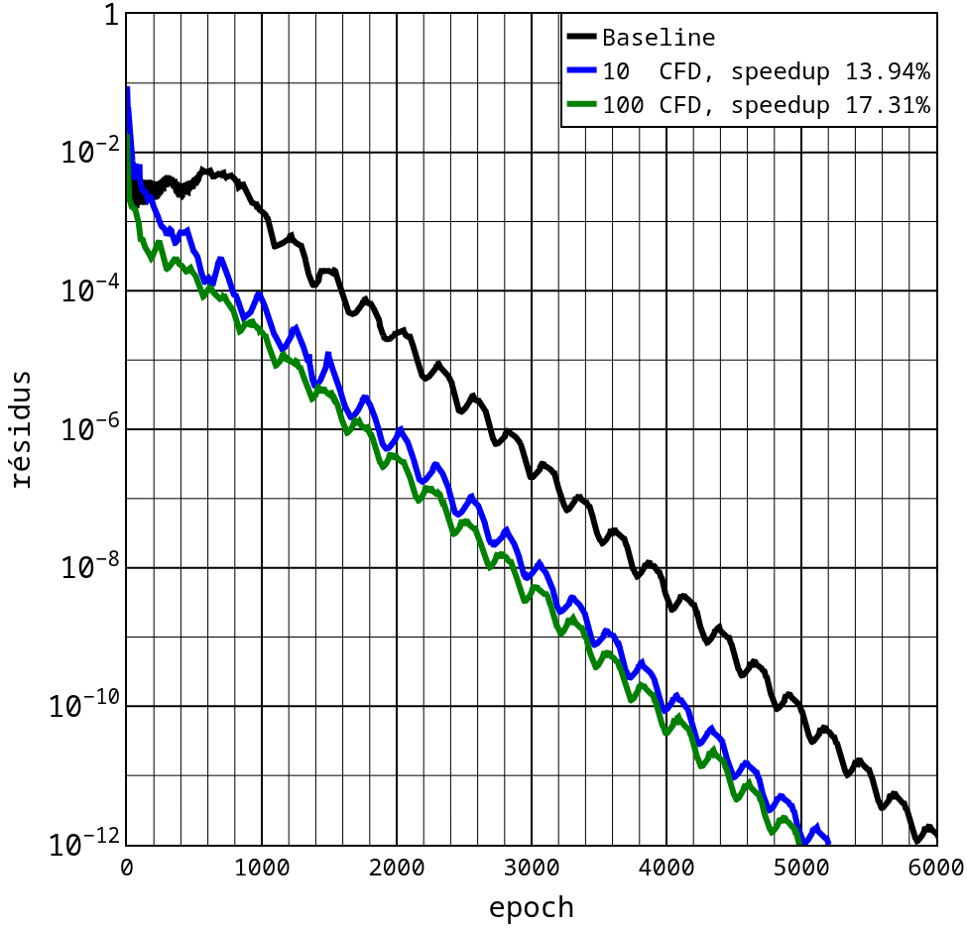

II. PROJECT: The Idea in One Picture
uniform
field
Today
SU2
thousands of iterations
Warm start
d, θ
MLP
SU2
fewer iterations
7/20
Notes:
Top: what is done today. SU2 starts from a uniform field and needs thousands of iterations. Bottom: the warm start. From the geometry d and the operating conditions theta, a neural network, an MLP, predicts the flow field. SU2 starts from this prediction, which is already close to the solution, and converges in fewer iterations. Same final result, lower cost.

Slide 8
II. PROJECT: Objectives
1
2
3
Better field prediction
Fewer SU2 iterations
Few geometries
Architecture, loss function, physics-informed terms (PINNs [5])
Euler first, then RANS
Small training database: ≈ 10 CFD
Previous internship (Euler): up to ≈ 84% fewer iterations with only 10 training CFDs
[5] Raissi et al., Journal of Computational Physics, 2019.
8/20
Notes:
Three objectives. One: improve the flow-field prediction, by changing the architecture, the loss, or adding physics, as in PINNs. Two: reduce the number of SU2 iterations, first with the Euler equations, then with RANS. Three: do it with very few geometries, around ten CFDs, because CFD is expensive. A previous internship already reached up to 84 percent fewer iterations in Euler with ten CFDs.

Slide 9



III. PIPELINE: What You Will Build
1 Sample designs
2 Geometry
3 Mesh
4 SU2 database
random d and θ
B-spline from d
RBF deformation
≈ 10 CFD runs
you code
provided
provided
you code
5 Dataset
6 Train MLP
7 Predict
8 Warm start
one row per node
PyTorch
new d* → initial field
count SU2 iterations
you code
you code
you code
you code
Steps 5 to 8 = the machine-learning core, explained on the next slides
9/20
Notes:
This is what you will build, step by step. Steps 2 and 3, geometry generation and mesh deformation, are provided in Python. You will sample designs, run SU2 to build a small database of about ten CFDs, turn the results into a table, train the MLP, use it to predict the field of a new geometry, and give that prediction to SU2 to count how many iterations you save. The next slides detail steps 5 to 8.

Slide 10
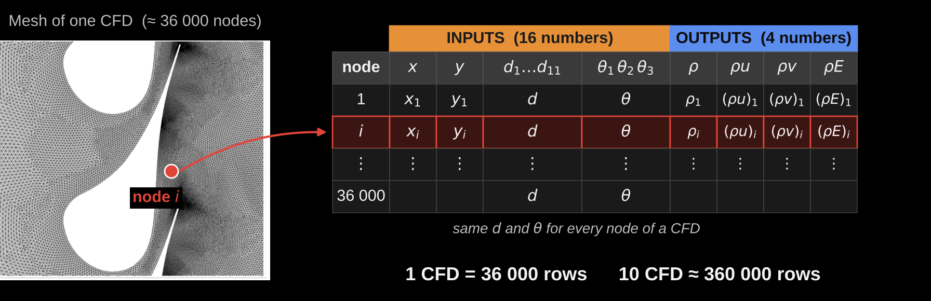
IV. MACHINE LEARNING: From CFD to a Training Table (step 5)
Each mesh node = one example
Normalize each column before training
11/20
Notes:
First question: what does the network learn from? Each CFD gives a solution at every node of the mesh. For each node i we build one row: the inputs are the node coordinates x and y, the geometry d, which is the same for all nodes of this CFD, and the operating conditions theta. The outputs are the four conservative variables computed by SU2 at that node. So one CFD gives 36 000 examples, and ten CFDs about 360 000. Practical tip: normalize every column, for example to mean 0 and standard deviation 1, before training.

Slide 11
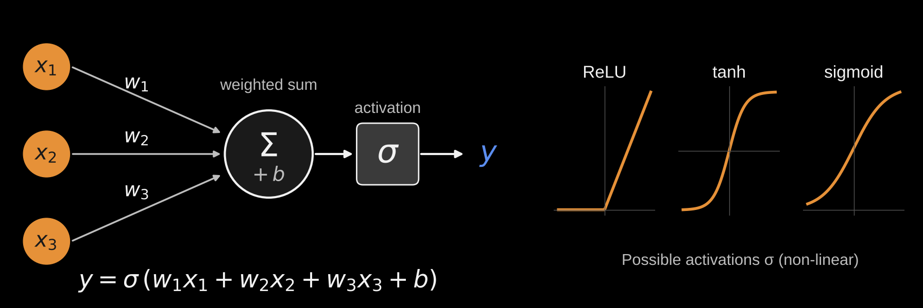
IV. MACHINE LEARNING: One Neuron
Weighted sum + non-linear function. Training = finding the weights w and biases b.
12/20
Notes:
The building block is the neuron. It takes inputs, multiplies each one by a weight, adds them with a bias, and passes the result through a non-linear activation function, such as ReLU, tanh or sigmoid. Without the activation, stacking neurons would only give a linear function. The weights and biases are the unknowns: training means finding their values.

Slide 12
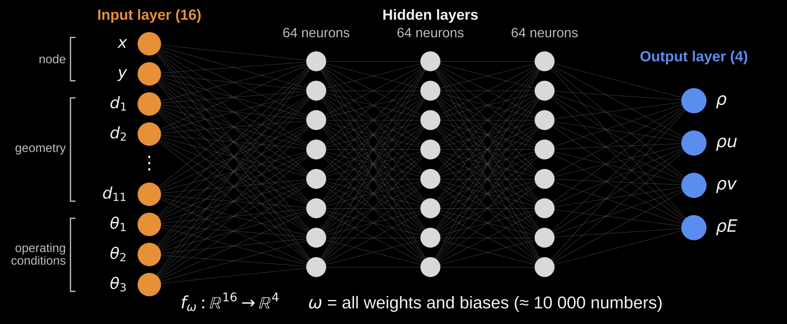
IV. MACHINE LEARNING: The Network (MLP)
One node in → 4 values out. Apply it to all 36 000 nodes → the full field.
13/20
Notes:
An MLP is just layers of neurons, each layer fully connected to the next. The input layer receives the 16 numbers of one row: node coordinates, geometry and operating conditions. Here three hidden layers of 64 neurons, these sizes are hyperparameters you can change. The output layer gives the four conservative variables. In total about 10 000 weights and biases, called omega. To get the full field, you evaluate the same network at every node of the mesh, which is very fast.

Slide 13
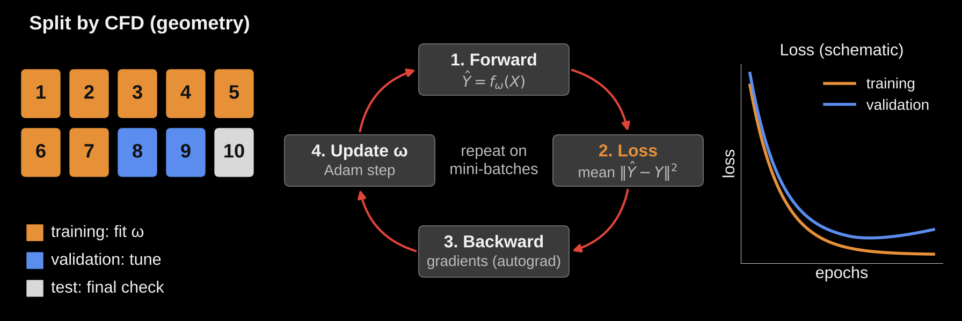
IV. MACHINE LEARNING: Training the Network (step 6)
min over ω : L(ω) = Σ over training nodes ‖ y − f(x; ω) ‖² with Adam [4]
[4] Kingma and Ba, ICLR, 2015.
14/20
Notes:
How do we find omega? First, split the CFDs, not the nodes: some geometries for training, some for validation to tune the hyperparameters, one for the final test. Splitting by node would cheat, because neighbouring nodes of the same CFD are almost identical. Then the loop: forward pass to predict, compute the loss, the mean squared error, backward pass to get the gradients with autograd, and an Adam update of the weights. Repeat on mini-batches for many epochs. Watch both curves: if the validation loss goes up while the training loss goes down, the network is overfitting.

Slide 14
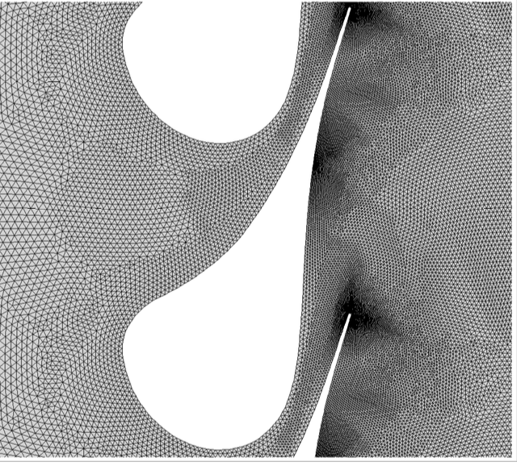

IV. MACHINE LEARNING: Using the Prediction in SU2 (steps 7–8)
MLP
all nodes
new d*
mesh
initial field
residuals
Write the field as an SU2 restart file
RESTART_SOL= YES
Measure the iterations to reach the residual target → speed-up
RANS: also initialize the turbulence variable
16/20
Notes:
Once trained, the network is used on a new geometry d star that was not in the database. Deform the mesh, evaluate the MLP at all nodes, write the predicted field in the format of an SU2 restart file, and run SU2 with RESTART_SOL set to YES. Then compare the residual history with the uniform initialization and count how many iterations you save. For RANS, the turbulence variable must also be initialized.

Slide 15
V. TRAINING
1
2
3
Linux terminal
PyTorch and MLP
SU2
for those who need it
coursePINNs notebooks
install, config, Euler / RANS
all steps
4
5
6
Geometry and mesh
Automatic script
Reduce number of CFD iterations
Python, provided
You!
Several tests
17/20
Notes:
The project is built as a training path: each step comes with a short training. Linux terminal basics for those who have never used it. PyTorch and MLP basics with the coursePINNs notebooks. SU2: installation, configuration file, Euler and RANS runs. Geometry generation and mesh deformation in Python, provided. Using a dense-gas model in SU2 instead of the perfect gas. And finally chaining everything into one automated script. The grey tags tell you which pipeline steps each training serves.

Slide 16



V. GOING FURTHER: Multi-Point Shape Optimization
For motivated students
Use the complete chain to maximize the turbine efficiency over several operating points
maximize over d ∈ [−1, 1]¹¹ : Σₖ wₖ η(d, θₖ), k = 1…K
Optimizer
Geometry + mesh
MLP prediction
SU2 × K
η(d, θₖ)
Python
warm start
operating points θₖ
weighted mean
new design d
Warm start ⇒ cheaper evaluations ⇒ more designs explored for the same CFD budget
18/20
Notes:
For those who want to go further: once the chain works, plug it into an optimizer. Multi-point means we evaluate each design at several operating conditions, for example several outlet pressures, and maximize a weighted mean of the efficiency. Each design costs K CFD runs, so the warm start directly reduces the cost of the optimization.

Slide 17
VI. RESOURCES
Project repository: codes, data, tutorials
github.com/nrazaaly/BE_2026-27
[1] Pini, Persico, Pasquale, Rebay, Journal of Engineering for Gas Turbines and Power, 2015.
[2] Razaaly et al., International Journal for Numerical Methods in Engineering, 2019.
[3] Economon, Palacios, Copeland, Lukaczyk, Alonso, AIAA Journal, 2016.
[4] Kingma, Ba, Adam: A method for stochastic optimization, ICLR, 2015.
[5] Raissi, Perdikaris, Karniadakis, Journal of Computational Physics, 2019.
19/20
Notes:
All the material will be on GitHub. The coursePINNs repository covers the PyTorch and MLP basics. The project repository, with the codes, data and tutorials, will be shared at the kick-off.

