Slide 1
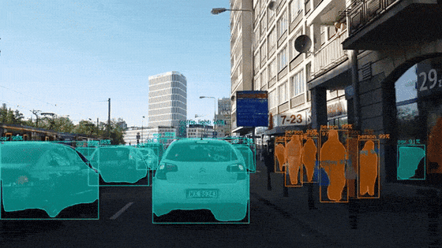
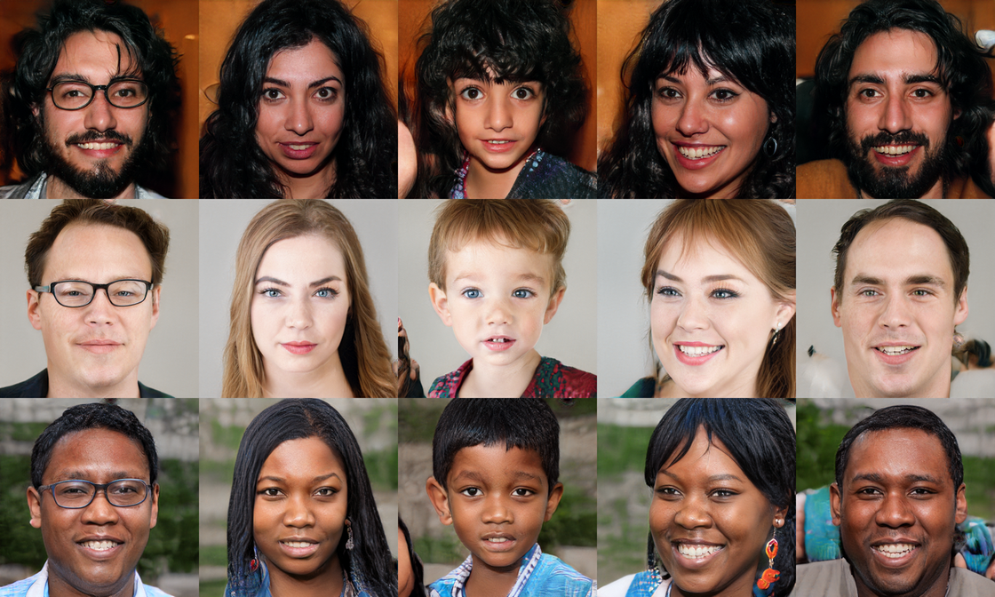
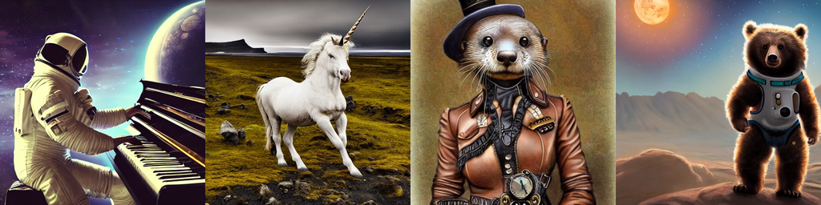
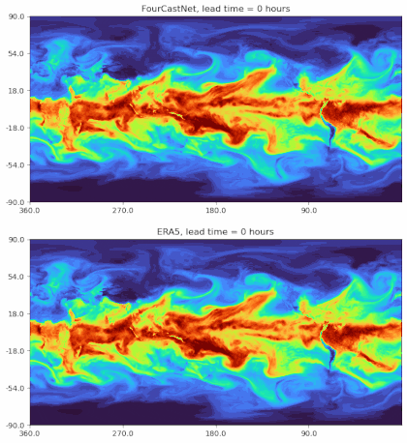
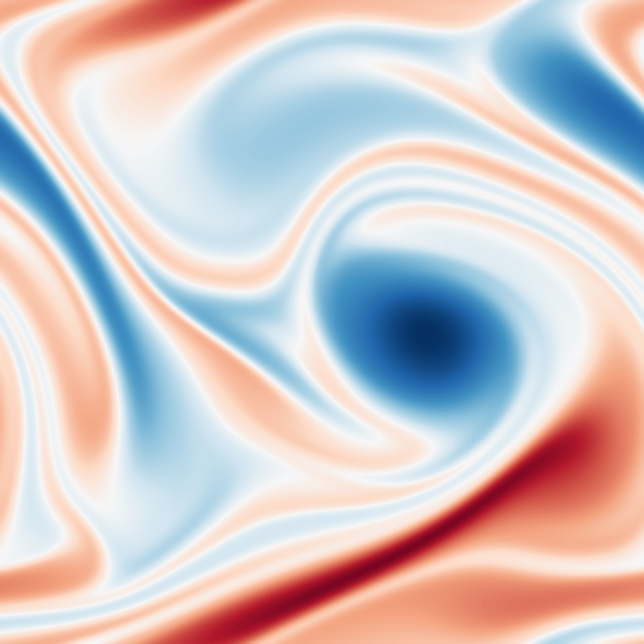
AN INTRODUCTION TO ARTIFICIAL INTELLIGENCE
From modern AI to neural networks
A visual tour of the breakthroughs — CNNs, GPT, diffusion, reinforcement learning — down to the MLP, the building block behind PINNs.
Nassim RAZAALY · ISAE-ENSMA -- with the assistance of Claude Code
Notes:
Announce the thread: we start from AI's spectacular applications (film strip: vision, generated faces and images, weather, turbulence) and work down to the common building block - the MLP - which then powers PINNs.

Slide 2
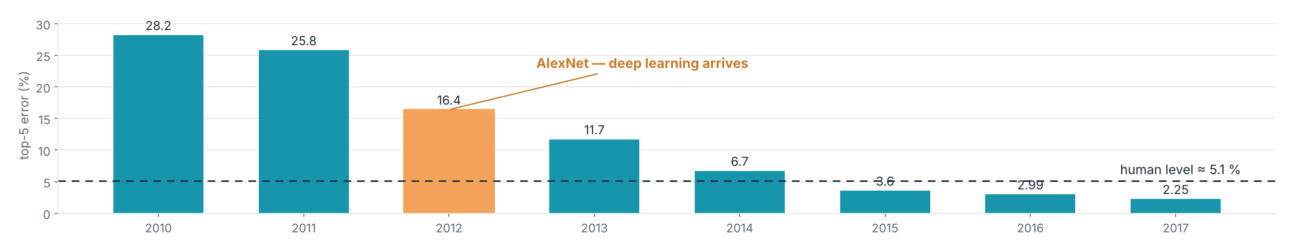
RECENT BREAKTHROUGHS
A decade of stunning progress
2012
2016
2017
2020–22
2022–24
AlexNet
AlphaGo
Transformers
GPT-3 → ChatGPT
Stable Diffusion
CNNs crush the ImageNet challenge.
RL beats the world Go champion.
The architecture behind every LLM.
Large language models go mainstream.
Image & video generation for everyone.
ImageNet top-5 error of the annual ILSVRC winners — the 2012 break is AlexNet; by 2015 machines surpass humans. Data: Russakovsky et al., IJCV 2015.
Intro to AI · 2 — Refs: Krizhevsky et al. 2012 · Silver et al. 2016 · Vaswani et al. 2017 · Brown et al. 2020 · Rombach et al. 2022
Notes:
One common thread behind all five milestones: ever-deeper neural networks trained on ever more data and compute. The chart makes the 2012 discontinuity visible.

Slide 3
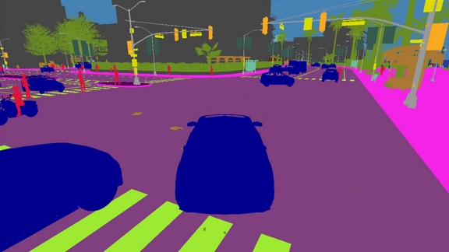
WHAT AI « SEES »
Detection & segmentation: the eyes of robots and cars
Semantic view from the CARLA simulator (Dosovitskiy et al., CoRL 2017), where self-driving stacks are trained.
Live instance segmentation — Mask R-CNN (He et al., ICCV 2017), official Matterport repository.
A self-driving car = cameras + lidar + radar → neural networks → objects, lanes, pedestrians → decisions.
Intro to AI · 3
Notes:
Every frame is processed tens of times per second. The same perception stack powers Waymo, Tesla, warehouse robots, surgical robotics. Transition: how does a machine learn to do this? -> supervised ML.

Slide 4
AI ⊃ machine learning ⊃ deep learning
Artificial intelligence
Machines that mimic human abilities: perceiving, reasoning, deciding.
« Classic » AI
Expert systems, planning, graph search — rules written by humans.
Machine learning
Learning behaviour from data, instead of hand-coded rules.
Machine learning
Regression, classification, clustering — random forests, SVMs, k-means…
Deep learning
Deep neural networks: CNNs, transformers, diffusion…
Deep learning
Powers every breakthrough on the previous slides — and the PINNs we are heading toward.
Intro to AI · 4
Notes:
Nesting: AI contains ML, which contains deep learning. This course lives in the innermost layer - but the vocabulary matters: not every AI is learned, not every ML model is deep.

Slide 5
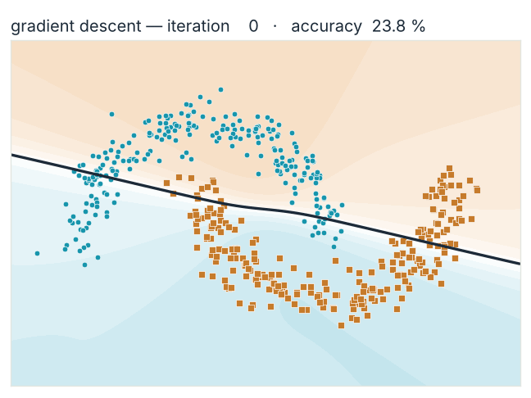
Supervised learning: watch a model learn
1 · Labelled data (x, y)
Hundreds of examples: a point x, its class y (class A or class B).
2 · A model f(x) with tunable knobs
Measure the error between ŷ = f(x) and the truth y, nudge the knobs downhill, repeat.
3 · Generalisation
The model is judged on examples it has never seen.
Gradient descent, live: an MLP (2×16) trained for this course on the two-moons dataset — from random to 100 % accuracy in 4,000 iterations.
Classification predicts a category · regression predicts a number.
Intro to AI · 5
Notes:
Let the animation run while talking: every frame is one snapshot of real training - the boundary is literally gradient descent at work. This loop (data, loss, optimiser) is the template for everything that follows, PINNs included.

Slide 6

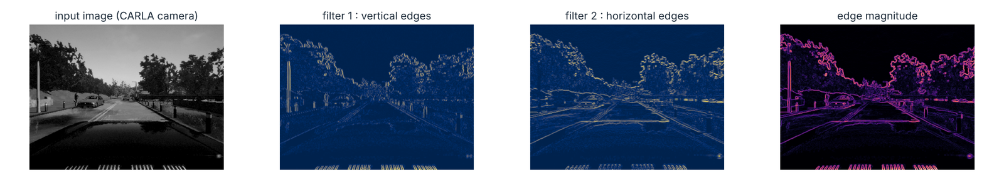
COMPUTER VISION
CNNs: networks that « see »
Real feature maps, computed for this course: convolving a street image (CARLA camera) with two 3×3 filters already pulls out the structure a car needs to see.
The convolution: a small filter slides across the image — Dumoulin & Visin, 2016
In a CNN the filters' weights are learned, and stacked layers build a hierarchy: edges → textures → parts → objects. Two ideas make it cheap: locality and weight sharing.
This is the architecture behind the 2012 ImageNet break on slide 2. Refs: LeCun et al., Proc. IEEE 1998 · Krizhevsky et al., NeurIPS 2012 · He et al., CVPR 2016.
Intro to AI · 6
Notes:
Left: the mechanism (watch the kernel slide). Right: the result of actually doing it - Sobel filters applied to a real frame. In a CNN those kernels are learned by gradient descent, exactly as on the previous slide.

Slide 7
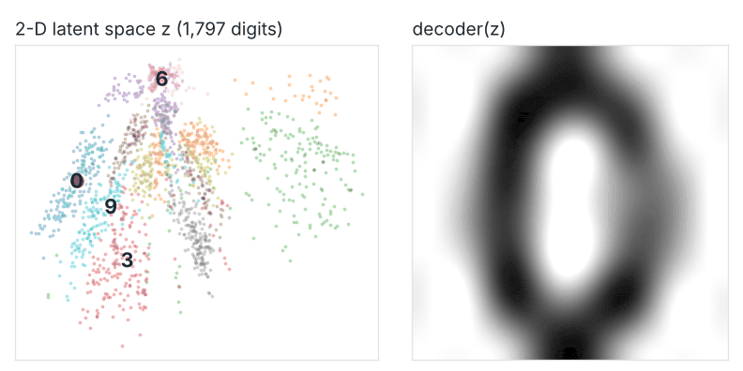
GENERATIVE MODELS
VAE & GAN: learning to create
None of these people exist — faces generated by a GAN: two networks play against each other until fakes are indistinguishable. StyleGAN, Karras et al., CVPR 2019 · Goodfellow et al., NeurIPS 2014.
x
encoder
z
decoder
x̂
The VAE makes this latent space smooth and samplable: sampling z is generating — Kingma & Welling, ICLR 2014. Stable Diffusion runs in exactly such a latent space.
An auto-encoder compresses 1,797 digits into 2 numbers z — walking through z morphs one digit into another.
Intro to AI · 7
Notes:
Pivot from discriminative to generative: we learn the data distribution itself. Left: the GAN result that fooled humans in 2019. Right: a latent space you can actually watch - trained live on scikit-learn's digits. The latent-space idea carries into the next slide (Stable Diffusion's VAE).

Slide 8
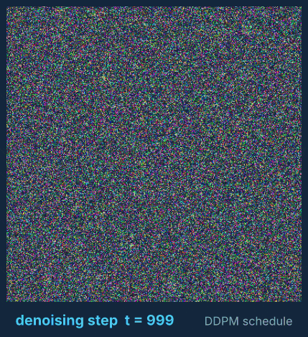
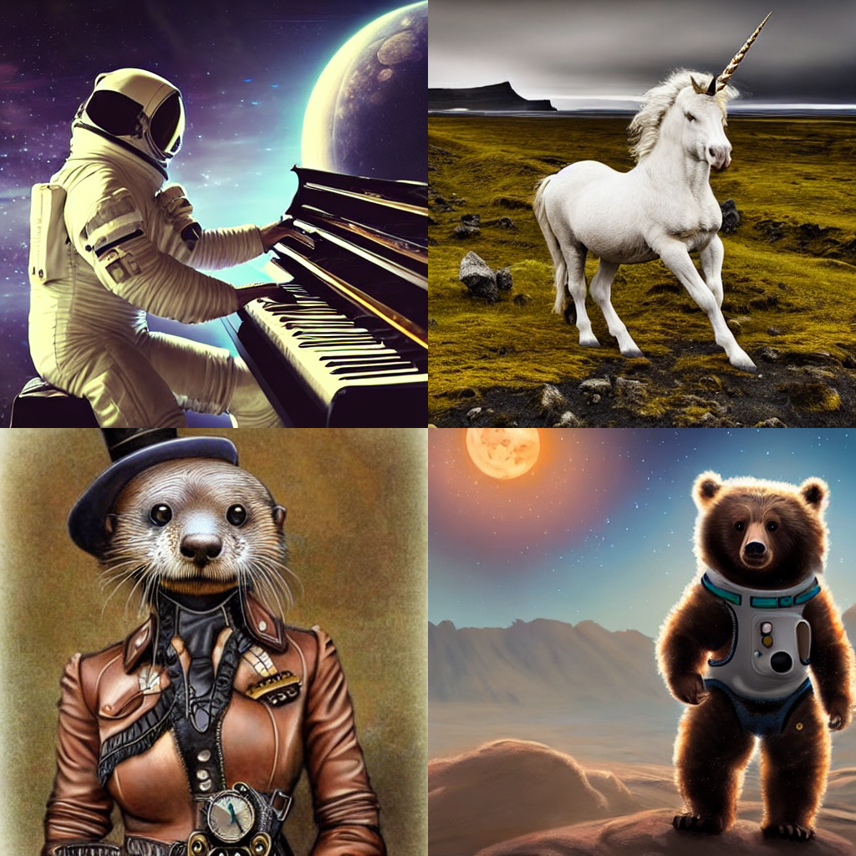
Diffusion: text → noise → image
Stable Diffusion outputs (official CompVis repository) — Rombach et al., CVPR 2022. Video is the same idea extended through time: Sora (OpenAI), Veo (Google DeepMind).
Stable Diffusion sample, re-noised along the exact DDPM (Denoising Diffusion Probabilistic Model) schedule and played backwards.
Intro to AI · 8 — Refs: Ho et al., NeurIPS 2020 · Rombach et al., CVPR 2022
Notes:
Let the animation loop: the network's whole job is to undo one small step of this noising, over and over, conditioned on the text. Adding noise is trivial, so training data is unlimited - the model learns the inverse problem. It runs in the latent space of a VAE (previous slide).

Slide 9
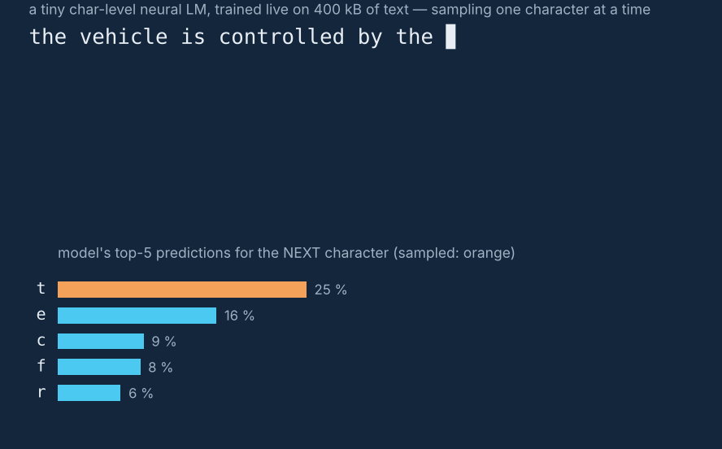
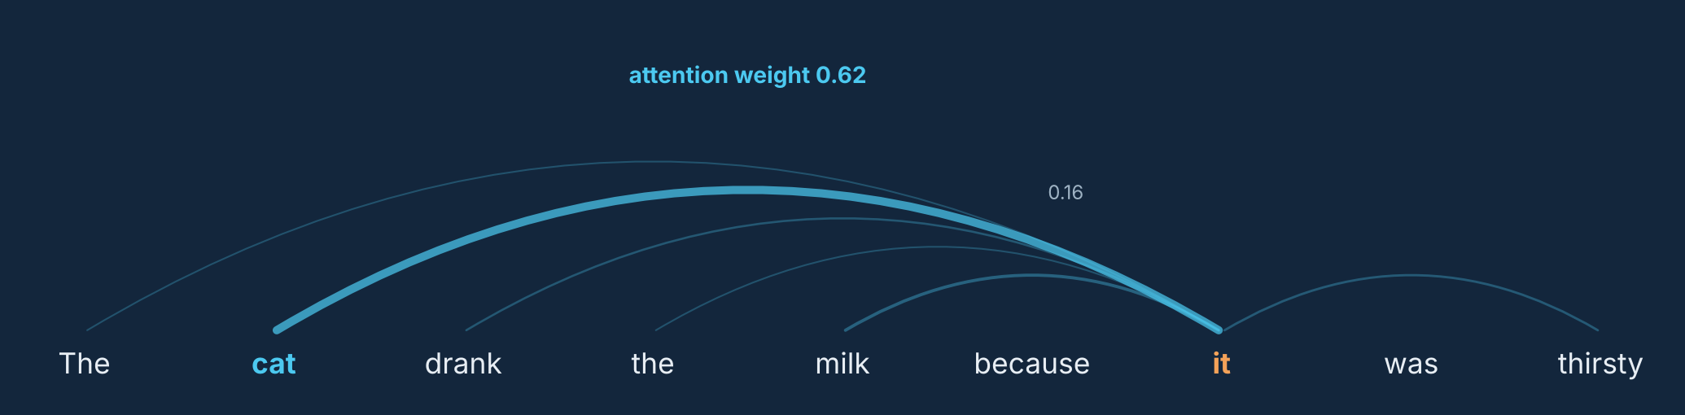
LANGUAGE MODELS
GPT: predict the next word, at planetary scale
« The cat sleeps on the … »
Transformer
couch
62 %
billions of parameters, self-attention
rug
23 %
bed
9 %
roof
2 %
Self-attention: « it » looks at every word — and resolves to « cat » (schematic).
Scale → emergence
Generation, live: a char-level LM trained for this course on 400 kB of text. GPT = this idea × a trillion words.
Pre-trained on trillions of words — as models grow, translation, coding and reasoning appear.
Intro to AI · 9 — Refs: Vaswani et al., NeurIPS 2017 · Brown et al. (GPT-3), NeurIPS 2020 · Ouyang et al. (RLHF), 2022
Notes:
A disarmingly simple objective - predict the next token - that, at scale, forces the model to learn grammar, facts and reasoning. The animation is a real model trained live; the arc diagram is the heart of the Transformer. ChatGPT then adds RLHF - teaser for the RL slide.

Slide 10
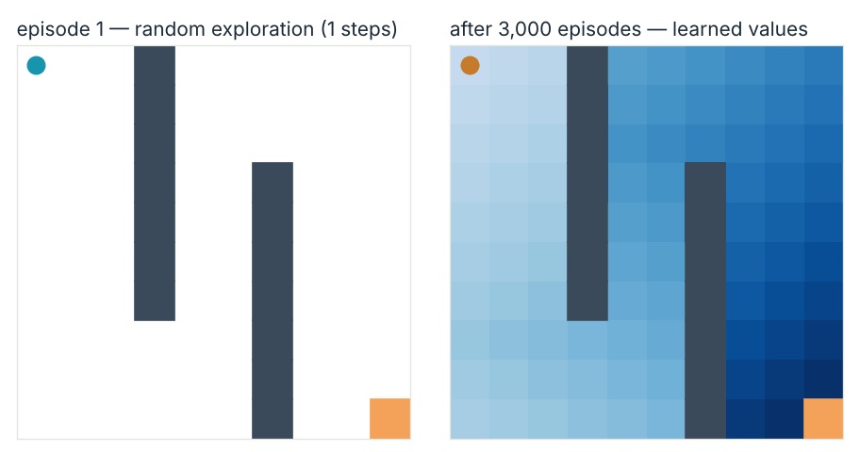
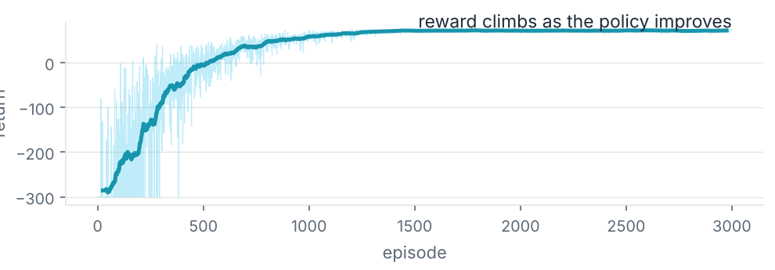



REINFORCEMENT LEARNING
Learning by trial and error
The only training signal: reward. No labels anywhere.
AlphaGo — millions of games of self-play.
Robotics — walking, grasping, flying.
Q-learning, trained live for this course: the agent acts, receives a reward, improves its policy π. Episode 1 wanders; after 3,000 episodes it reads the learned value map and reaches the goal in 29 steps.
ChatGPT — RLHF aligns LLMs with our preferences.
Intro to AI · 10 — Refs: Mnih et al., Nature 2015 · Silver et al. (AlphaGo), Nature 2016
Notes:
Same loop at every scale: agent -> action -> environment -> state + reward -> better policy. This maze is tabular Q-learning; swap the table for a deep network and you get DQN (Atari, 2015) and AlphaGo. The learning curve is the real returns from this very training run.

Slide 11
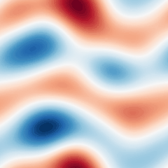
SCIENTIFIC MACHINE LEARNING
AI accelerates fluid dynamics
Neural operators (FNO)
Learn the solution operator of a whole PDE family, any initial condition — Li et al., ICLR 2021.
ML-accelerated CFD solvers
Accuracy of an 8–10× finer mesh at 40–80× the speed — Kochkov et al., PNAS 2021.
Learned turbulence closures
Data-augmented RANS / LES models — Duraisamy et al., Annu. Rev. Fluid Mech. 2019.
Turbulence — nonlinear, multiscale, expensive to simulate — is the perfect target. (2D vorticity, evolving: pseudo-spectral Navier–Stokes simulation computed for this course.)
FourCastNet: global weather forecast by a neural network, ~45,000× faster than the numerical model — Pathak et al., 2022 (NVIDIA / NERSC).
Intro to AI · 11
Notes:
Three strategies: replace the solver (FNO, FourCastNet), speed it up (Kochkov: the network corrects a coarse solver), or fix its models (closures). There is a fourth way, which needs no data at all: constrain the network with the PDE itself -> PINNs, after the MLP.

Slide 12
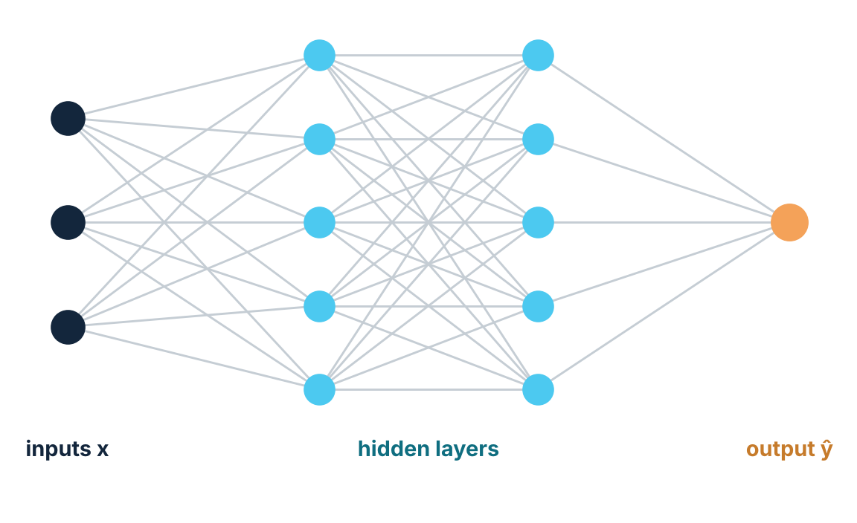
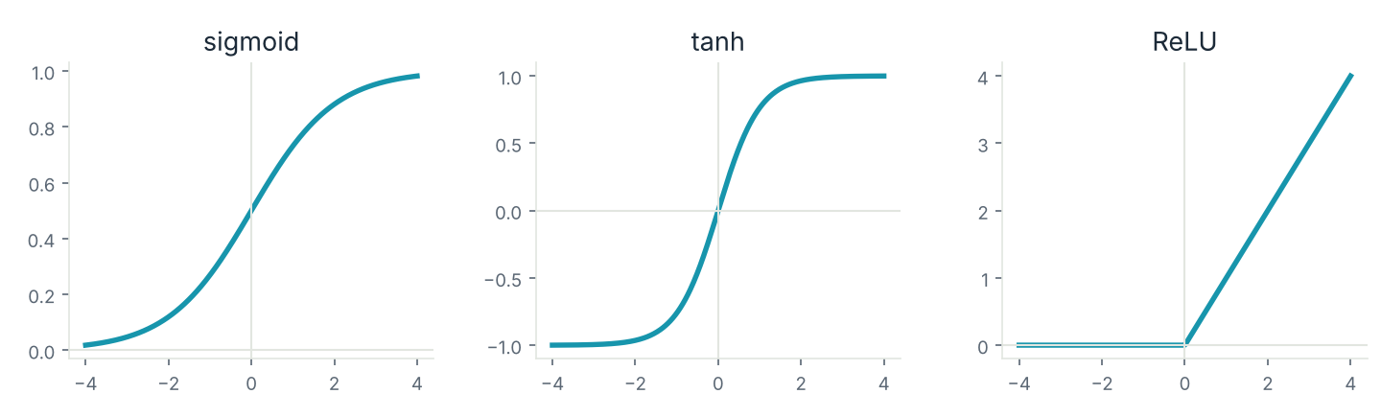
THE ELEMENTARY BUILDING BLOCK
The MLP — multilayer perceptron
One neuron
z = w·x + b, then a nonlinearity: a = σ(z)
Universal approximation
An MLP can approximate any continuous function — Cybenko 1989, Hornik 1991.
Training
Backpropagation + gradient descent — Rumelhart et al., Nature 1986.
CNNs, GPT, diffusion, RL — all are built from this same brick. So are PINNs.
The nonlinearity σ is what makes depth powerful — without it, layers collapse into one.
Intro to AI · 12
Notes:
Turning point of the course: from the panorama to the mechanics. Detail the dot product, the bias, and the role of the nonlinearity - without it, the whole stack collapses into a single linear layer. This 3-5-5-1 diagram is the exact shape of network we will code for PINNs.

Slide 13
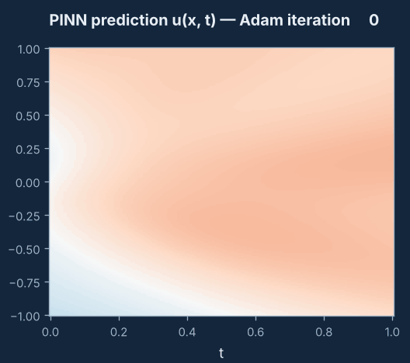
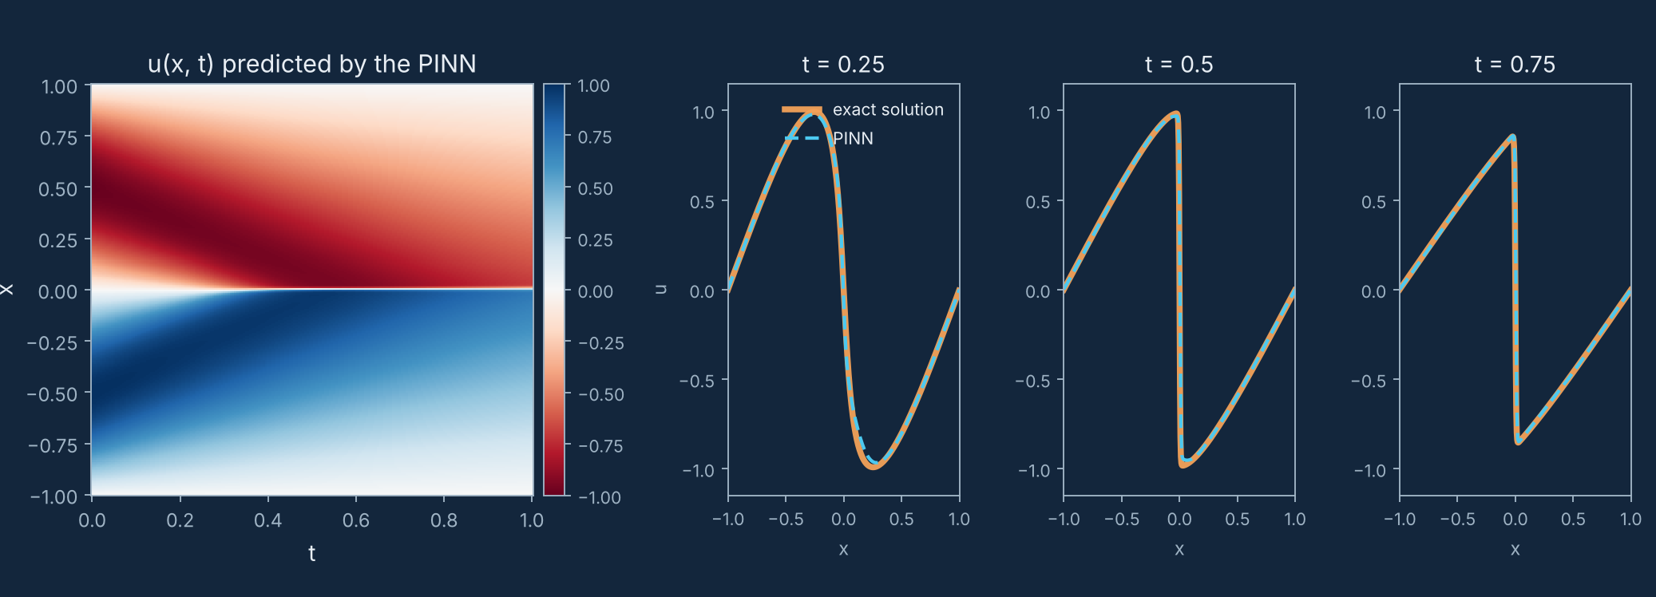
WHAT COMES NEXT
PINNs: an MLP constrained by physics
After training: the PINN (MLP 3×32, tanh) overlaps the exact solution of Burgers' equation uₜ + u·uₓ = ν·uₓₓ, shock included — trained for this course. Method: Raissi, Perdikaris & Karniadakis, J. Comput. Phys. 2019.
The solution emerging during training — no mesh, no solver: just a loss being minimised.
Loss: L = L_data + λ·L_physics — the PDE residual enters training, with ∂u/∂x from automatic differentiation. Little or no data: the physics guides.
Intro to AI · 13 · N. Razaaly
Notes:
The pivot of the whole deck: the MLP from the previous slide, the training loop from slide 5 - with one new ingredient, the PDE residual in the loss. Left animation: watch the shock form as Adam runs. Next: automatic differentiation, building the loss, Burgers step by step.

