Slide 1
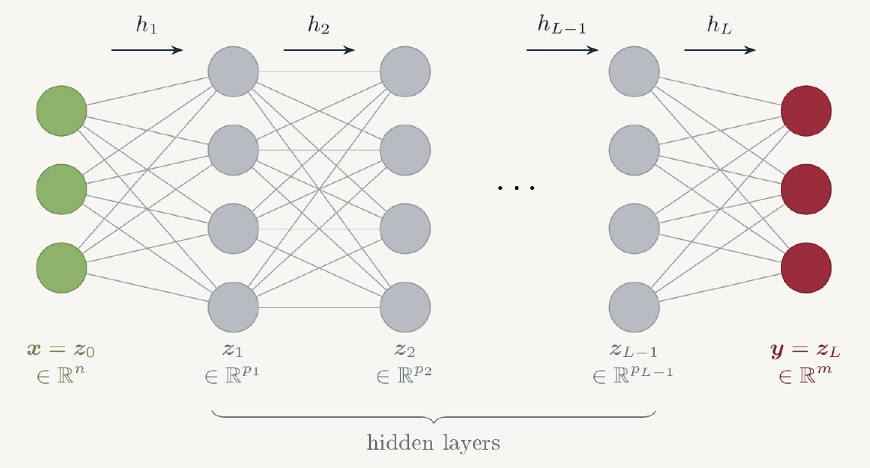
PINNS COURSE · PART 1
Introduction to Machine Learning: Supervised Learning
Neural networks, losses and optimizers
Nassim RAZAALY
v1 · 14/10/26

Slide 2
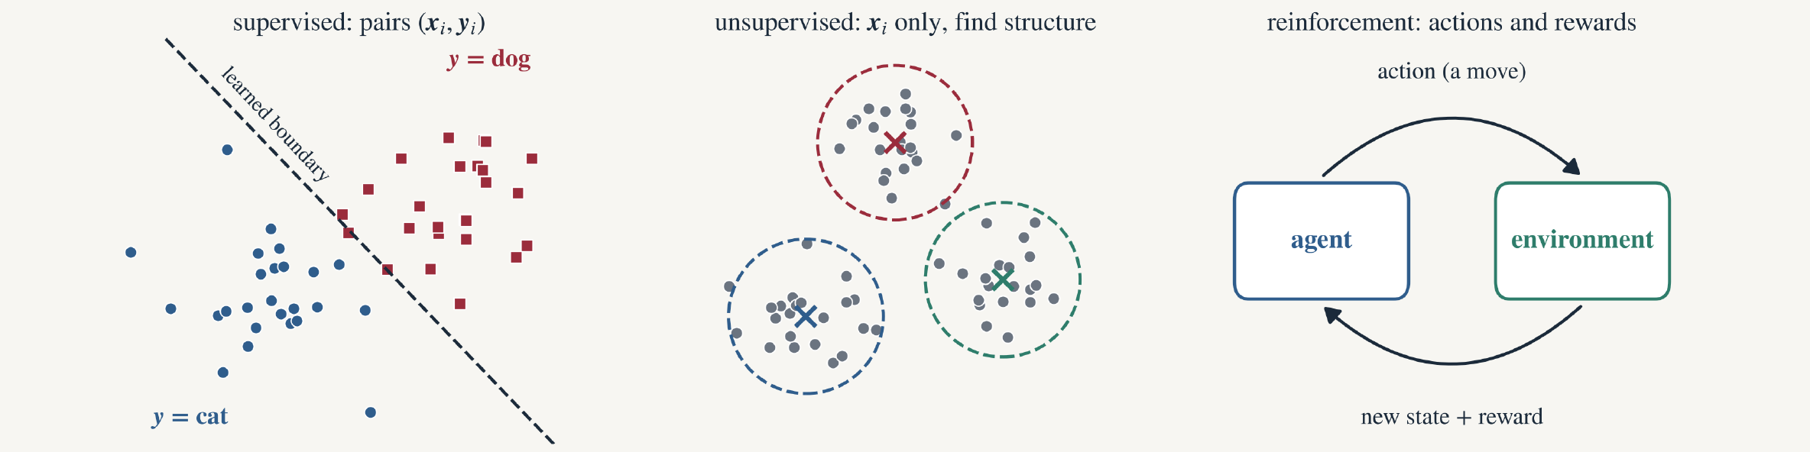
Machine learning
Problem
Model
Training
Optimization
In practice
Kinds of learning
Three ways to learn
Learning | Data | Goal | Examples
Supervised | pairs (x_{i}, y_{i}) | predict y for a new x | image labels, translation, weather, PINNs
Unsupervised | x_{i} only | find structure, groups | similar songs or listeners, anomaly detection
Reinforcement | actions, rewards | a strategy with high reward | AlphaGo, robotics, ChatGPT

Slide 3
Machine learning
Problem
Model
Training
Optimization
In practice
This course
This course: neural networks for supervised learning
I · PROBLEM
data (x_{i}, y_{i})
II · MODEL
MLP f̃ with parameters θ
III · TRAINING
loss ℒ(θ), data split
IV · OPTIMIZATION
gradients, Adam, L-BFGS
V · IN PRACTICE
PyTorch, a recipe
Why neural networks?
they can approximate any continuous function (part II);
their parameters are found by gradient methods, at any scale (part IV);
they are differentiable with respect to their inputs: derivatives ∂ũ/∂x, ∂ũ/∂t are computed exactly by automatic differentiation, which is what PINNs need.
Why the MLP?
The simplest network: layers of neurons, fully connected. It is the standard model of PINNs, and the building block of larger architectures.
Notation: vectors in bold (x, y, θ), N samples, d parameters, L layers.

Slide 4
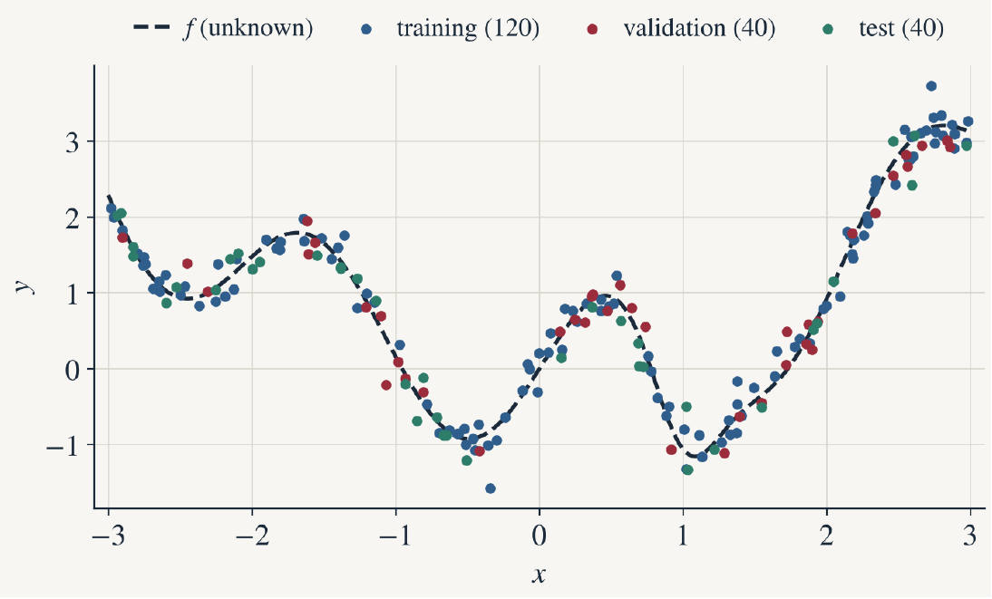
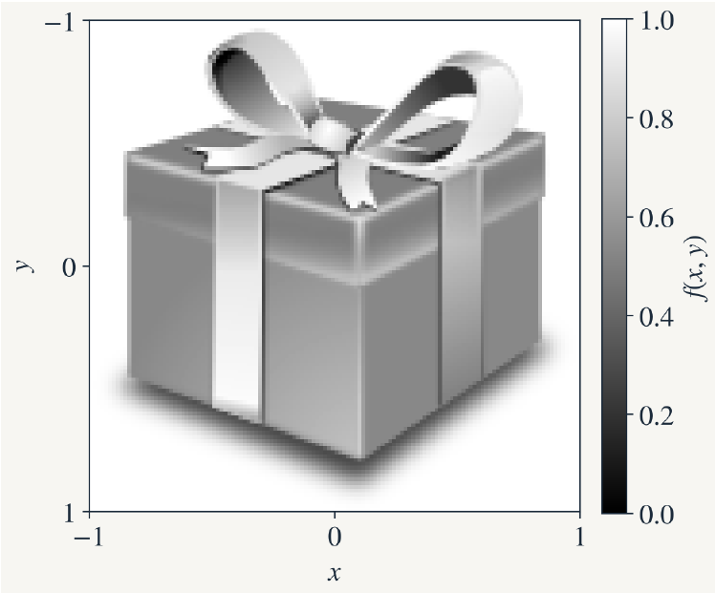

Machine learning
Problem
Model
Training
Optimization
In practice
Supervised learning
I. Learning a function from input/output pairs
$$f:ℝ^{n}→ℝ^{m}, x↦y=f\left(x\right) \text{unknown}$$
$$\text{find} θ∈ℝ^{d} \text{such} \text{that} {\tilde{f}}_{θ}\left(x\right)≈f\left(x\right)$$
$$𝒟=\{\left(x_{i},y_{i}\right)\}_{i=1}^{N}, y_{i}=f\left(x_{i}\right)+ε_{i} \text{(}\text{noise}\text{)}$$
Example 1 · n = m = 1, N = 200 noisy samples
Example 2 · an image is a function
f : [−1, 1]² → [0, 1], n = 2, m = 1, N = 128² = 16 384 pixels
Parametric model: f̃ is chosen in a family indexed by θ ∈ ℝ^{d}.

Slide 5
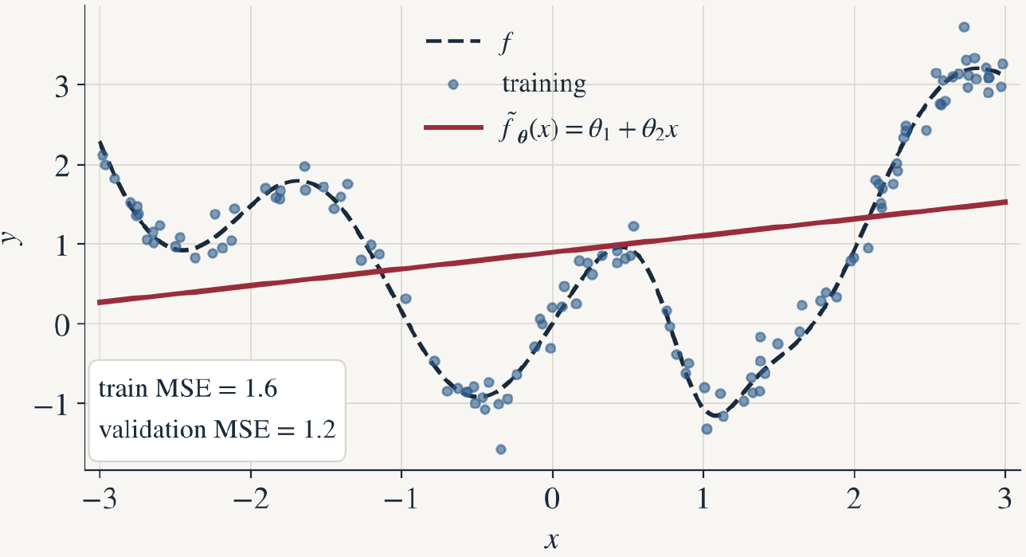
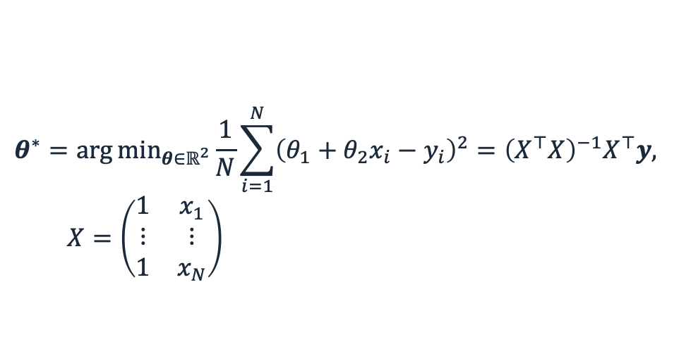

Machine learning
Problem
Model
Training
Optimization
In practice
Linear model
I. A first model: linear least squares
$${\tilde{f}}_{θ}\left(x\right)=θ_{1}+θ_{2} x, θ=\left(θ_{1},θ_{2}\right)∈ℝ^{2}$$
$$θ^{∗}={arg min}_{θ∈ℝ^{2}}\frac{1}{N}\sum_{i=1}^{N}{{\left(θ_{1}+θ_{2}x_{i}−y_{i}\right)}^{2}}={\left(X^{⊤}X\right)}^{−1}X^{⊤}y,$$
$$X=\left(\begin{matrix}1 & x_{1} \\ ⋮ & ⋮ \\ 1 & x_{N}\end{matrix}\right)$$
1 · Model f̃ with parameters θ → part II (MLP)
Example 1, 120 training points: θ * = (0.90, 0.21)
Underfitting: Model too simple!
2 · Loss measuring the residuals → part III
3 · Optimizer to find optimal θ → part IV

Slide 6
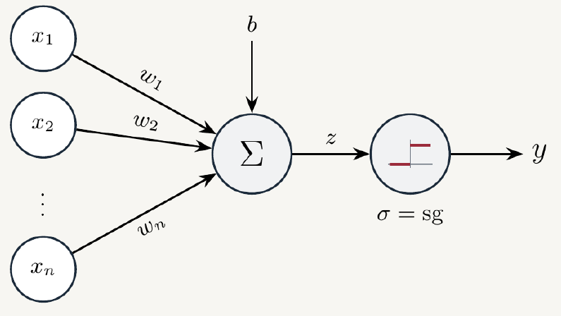

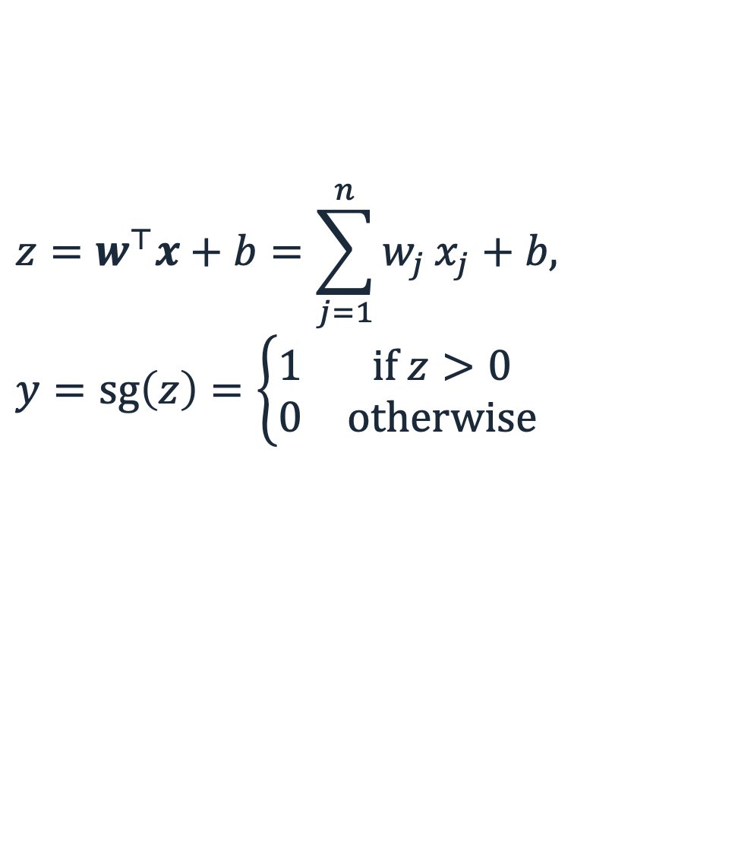
Machine learning
Problem
Model
Training
Optimization
In practice
Perceptron
II. From the perceptron [2] to the neural unit
$$z=w^{⊤}x+b=\sum_{j=1}^{n}{w_{j}}x_{j}+b,$$
$$y=sg\left(z\right)=\left\{\begin{matrix}1 & \text{if} z>0 \\ 0 & \text{otherwise}\end{matrix}\right.$$
$$y=σ\left(w^{⊤}x+b\right)$$
Neural unit: sg → σ nonlinear, differentiable
[2] F. Rosenblatt, The perceptron: a probabilistic model for information storage and organization in the brain, Psychological Review, 1958.

Slide 7
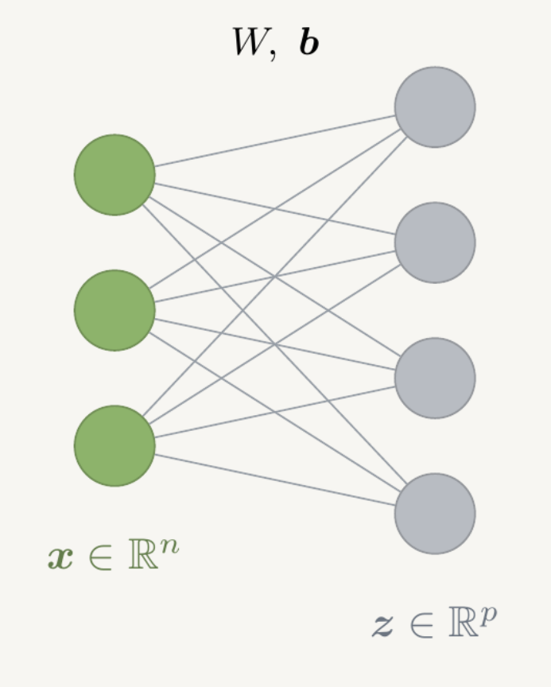
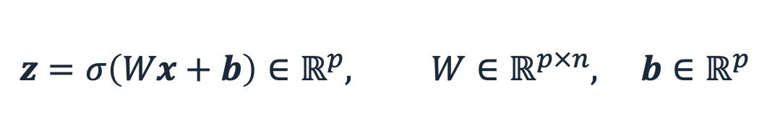

Machine learning
Problem
Model
Training
Optimization
In practice
One layer
II. One layer
Linear(n,p) -> Activation $σ$
$$z=σ\left(Wx+b\right)∈ℝ^{p}, W∈ℝ^{p×n}, b∈ℝ^{p}$$
1 layer: p(n + 1) parameters

Slide 8
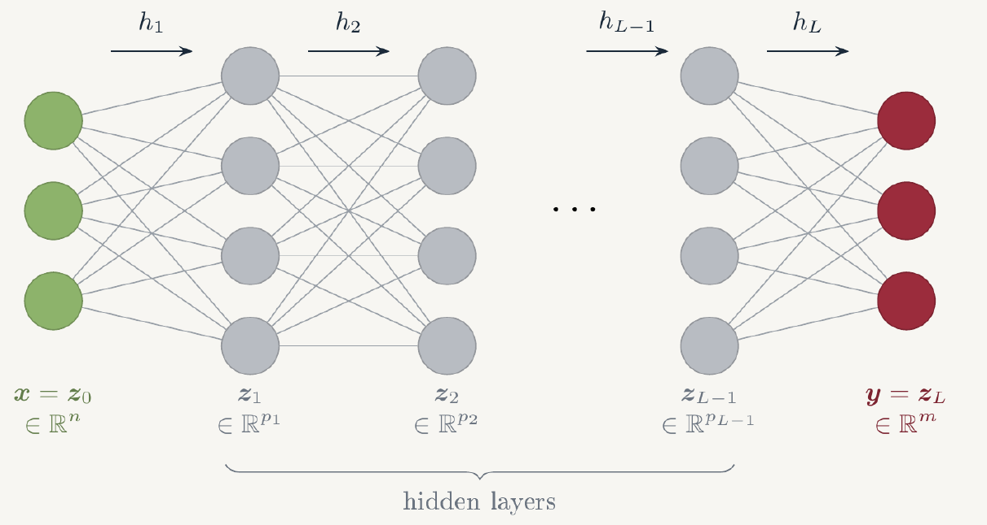
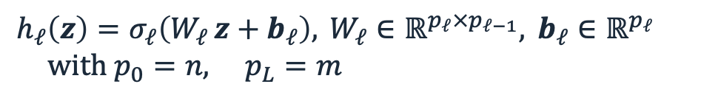
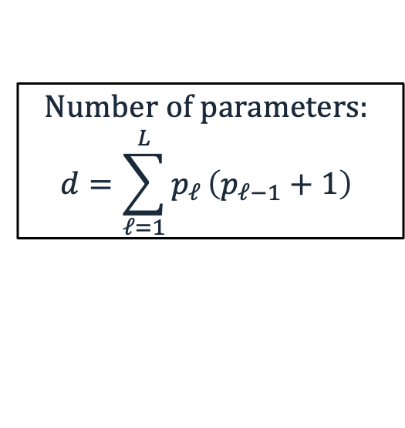
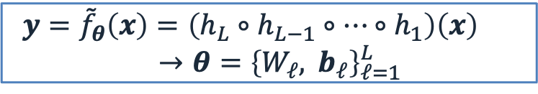
Machine learning
Problem
Model
Training
Optimization
In practice
Multilayer perceptron
II. The multilayer perceptron (MLP): a composition of layers
Names: MLP, FCN (Fully Connected Network)
$$h_{ℓ}\left(z\right)=σ_{ℓ}\left(W_{ℓ} z+b_{ℓ}\right), W_{ℓ}∈ℝ^{p_{ℓ}×p_{ℓ−1}}, b_{ℓ}∈ℝ^{p_{ℓ}}$$
$$with p_{0}=n, p_{L}=m$$
$$y={\tilde{f}}_{θ}\left(x\right)=\left(h_{L}∘h_{L−1}∘⋯∘h_{1}\right)\left(x\right)$$
$$→θ={\left\{W_{ℓ}, b_{ℓ}\right\}}_{ℓ=1}^{L}$$
$$Number of parameters:$$
$$d=\sum_{ℓ=1}^{L}{p_{ℓ}}\left(p_{ℓ−1}+1\right)$$
L layers: Depth L -> layers 1 to L − 1 are hidden
widths p₁, …, p_{L−1}: number of neurons
Last layer for regression: σ_{L} = id.
Hyperparameters (chosen, not learned): L, the widths, the activations.

Slide 9
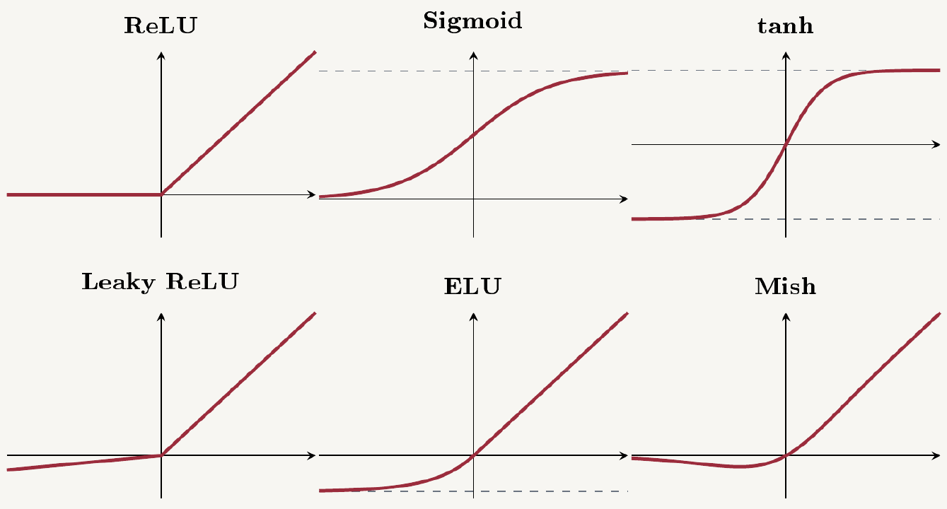
Machine learning
Problem
Model
Training
Optimization
In practice
Activation functions
II. Activation functions σ
σ | σ(z) | range
ReLU | max(0, z) | [0, +∞[
sigmoid | 1 / (1 + e⁻ᶻ) | ]0, 1[
tanh | (eᶻ − e⁻ᶻ) / (eᶻ + e⁻ᶻ) | ]−1, 1[
Leaky ReLU | max(αz, z), α ≈ 10⁻² | ℝ
ELU | z, or eᶻ − 1 if z < 0 | ]−1, +∞[
Mish | z tanh(ln(1 + eᶻ)) | [≈ −0.31, +∞[
Leaky ReLU [3], ELU [4], Mish [5]
[3] Maas et al., ICML Workshop 2013. [4] Clevert et al., ICLR 2016. [5] Misra, BMVC 2020.

Slide 10
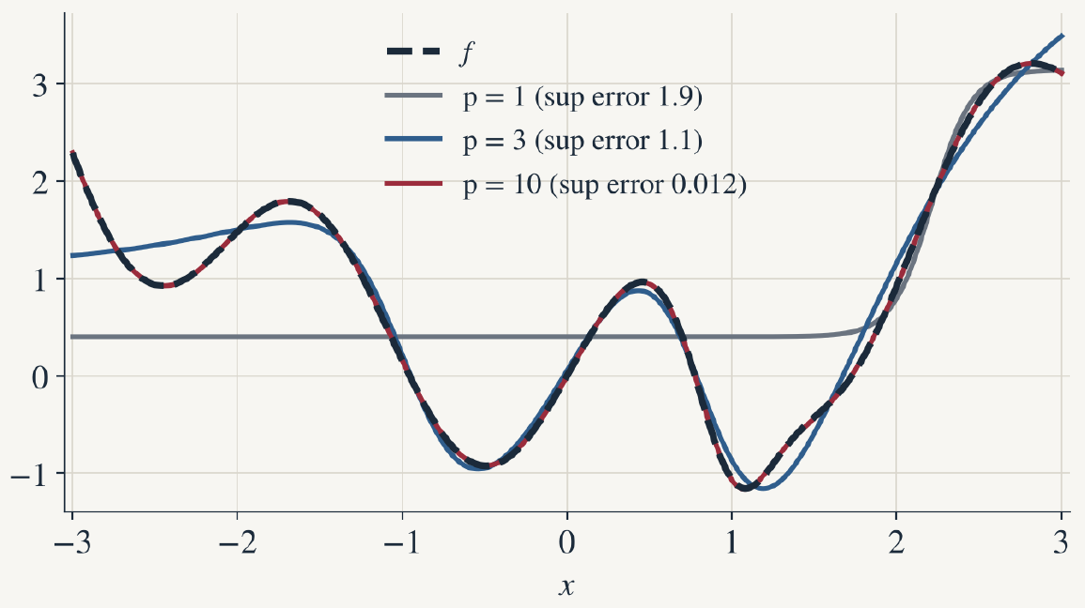
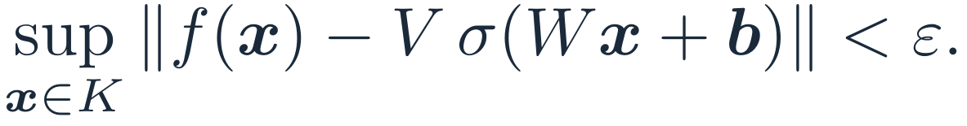
Machine learning
Problem
Model
Training
Optimization
In practice
Universal approximation
II. Why MLPs? The universal approximation theorem [6–8]
Theorem (universal approximation). Let σ : ℝ → ℝ be continuous and not a polynomial, and K ⊂ ℝⁿ compact. For every continuous f : K → ℝᵐ and every ε > 0, there exist a width p and W ∈ ℝ^{p×n}, b ∈ ℝ^{p}, V ∈ ℝ^{m×p} such that
$$\sup_{x∈K}∥f\left(x\right)−V σ\left(Wx+b\right)∥<ε.$$
Illustration: one hidden layer of p tanh neurons fitted to f. With p = 10 the network matches f.
Nonlinearity is essential: σ = id is a polynomial, excluded.
Existence only: says nothing about the width p needed, how to find θ, or generalization.
Depth: some functions need exponentially many neurons with one hidden layer, few with more layers (Telgarsky; Eldan & Shamir, COLT 2016).
[6] Cybenko, Math. Control Signals Syst., 1989. [7] Hornik, Neural Networks, 1991. [8] Leshno, Lin, Pinkus, Schocken, Neural Networks, 1993.

Slide 11
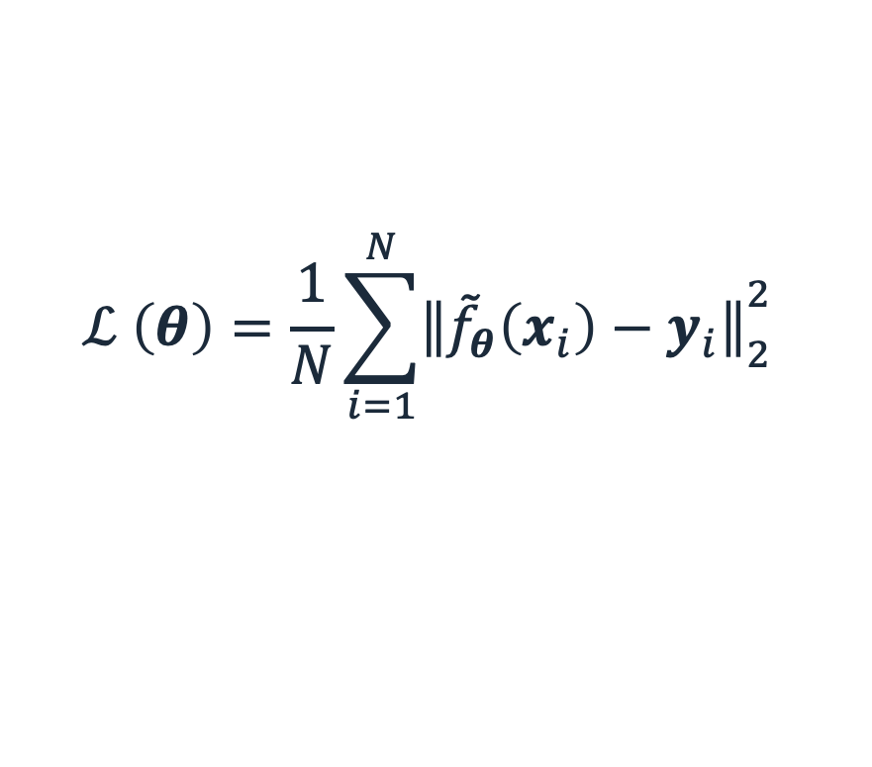
Machine learning
Problem
Model
Training
Optimization
In practice
Loss function
III. The loss function
$$f:ℝ^{n}→ℝ^{m}, x↦y=f\left(x\right) \text{unknown}$$
$$\text{find} θ∈ℝ^{d} \text{such} \text{that} {\tilde{f}}_{θ}\left(x\right)≈f\left(x\right)$$
$$𝒟=\{\left(x_{i},y_{i}\right)\}_{i=1}^{N}, y_{i}=f\left(x_{i}\right)+ε_{i} \text{(}\text{noise}\text{)}$$
Regression loss: Mean Square Error (MSE)
$$ℒ \left(θ\right)=\frac{1}{N}\sum_{i=1}^{N}{{∥{\tilde{f}}_{θ}\left(x_{i}\right)−y_{i}∥}_{2}^{2}}$$
Loss = cost function = empirical risk

Slide 12
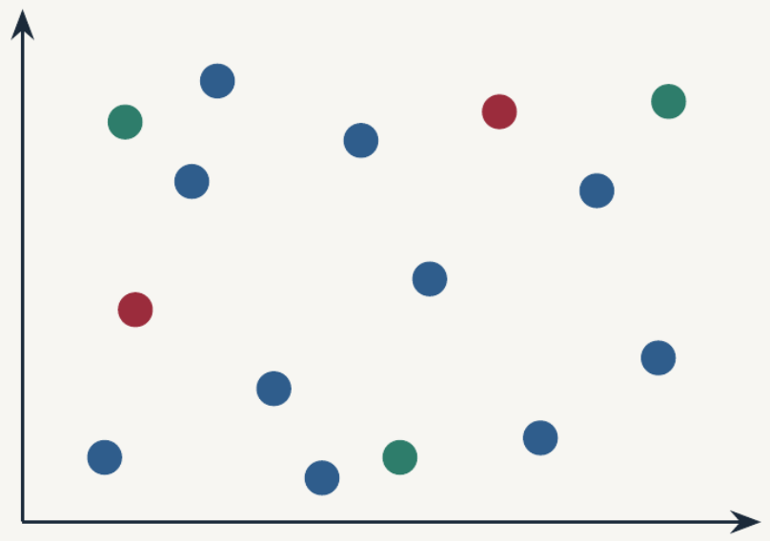
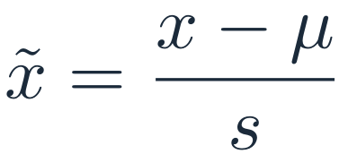
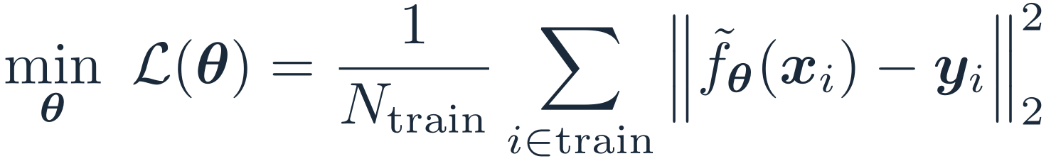
Machine learning
Problem
Model
Training
Optimization
In practice
Data
III. Data: normalize, then split
$$\tilde{x}=\frac{x−μ}{s}$$
1 · Normalize inputs and outputs to order 1:
2 · Split at random into three disjoint sets:
Training (≈ 60 %)
used to fit θ: we minimize the loss on it
$$\min_{θ} ℒ\left(θ\right)=\frac{1}{N_{train}}\sum_{i∈train}^{​}{{∥{\tilde{f}}_{θ}\left(x_{i}\right)−y_{i}∥}_{2}^{2}}$$
Validation (≈ 20 %)
never updates θ: detects overfitting, chooses hyperparameters
Test (≈ 20 %)
used once, at the very end: final error
Notes:
The loss is computed on the training set only. Validation and test data are never used to compute gradients. Normalization: x̃ = (x − μ)/s, or min-max to [−1, 1]; the statistics come from the training set.

Slide 13
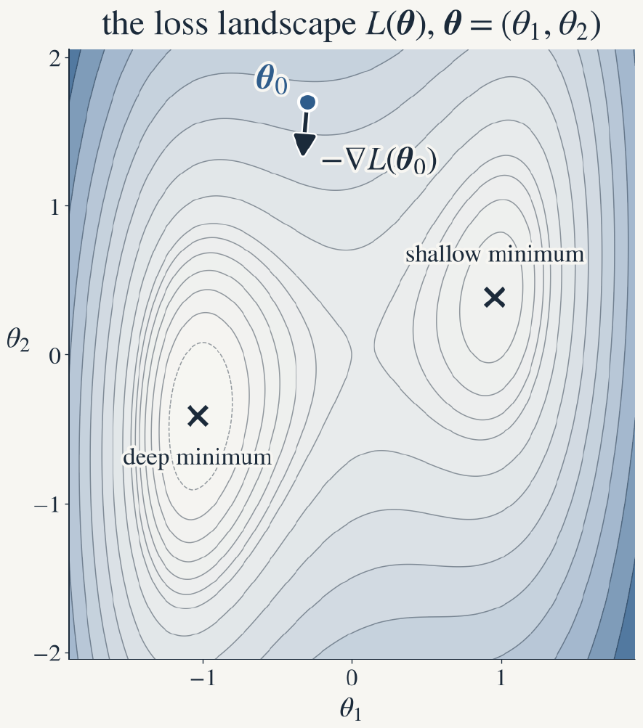
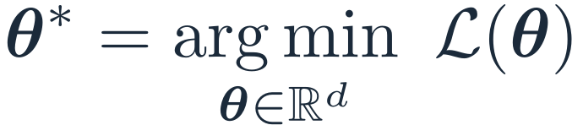
Machine learning
Problem
Model
Training
Optimization
In practice
Optimization problem
III. Training is an optimization problem
$$θ^{∗}={arg min}_{θ∈ℝ^{d}} ℒ\left(θ\right)$$
d unknowns: 10³ (a PINN) … 10¹¹ (GPT-3)
ℒ is nonlinear in θ: no formula for θ*
so we iterate: θ₀ → θ₁ → θ₂ → … → θ*
ℒ has several valleys: the result depends on θ₀

Slide 14
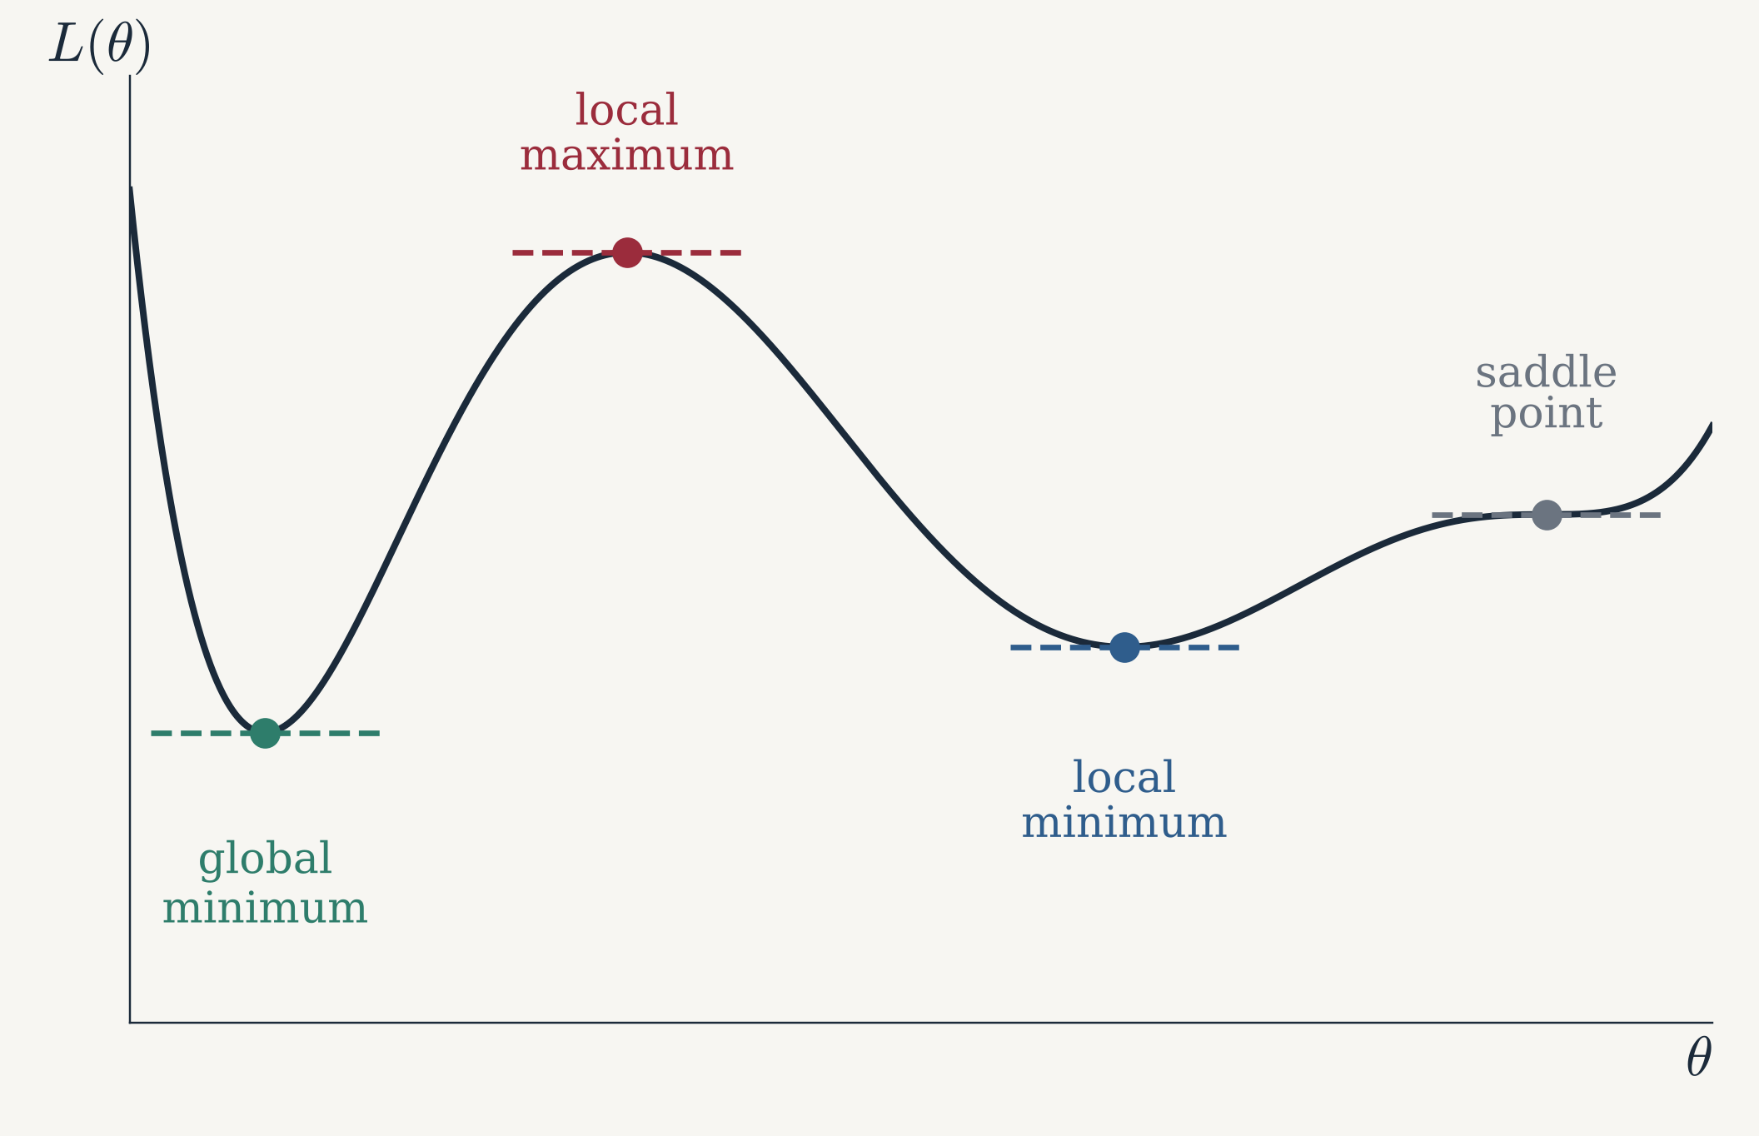
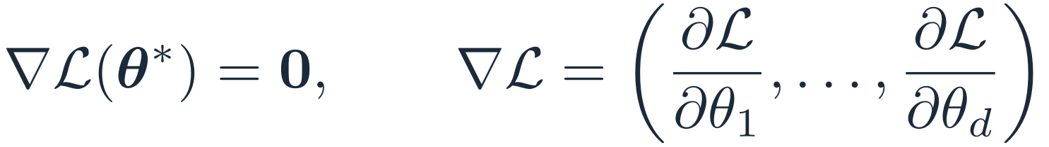
Machine learning
Problem
Model
Training
Optimization
In practice
Reminder
IV. Reminder: a minimum is a critical point
$$θ^{∗} \text{minimum} ⇒ ℒ^{′}\left(θ^{∗}\right)=0$$
Necessary, not sufficient: a critical point can be a minimum, a maximum or a saddle point.
In d dimensions:
$$∇ℒ\left(θ^{∗}\right)=0, ∇ℒ=\left(\frac{∂ℒ}{∂θ_{1}},…,\frac{∂ℒ}{∂θ_{d}}\right)$$
A local minimum is not always the global one.
Notes:
Second-order condition: L″(θ*) > 0 gives a strict local minimum (Hessian positive definite in d dimensions). In high dimension most critical points are saddle points.

Slide 15
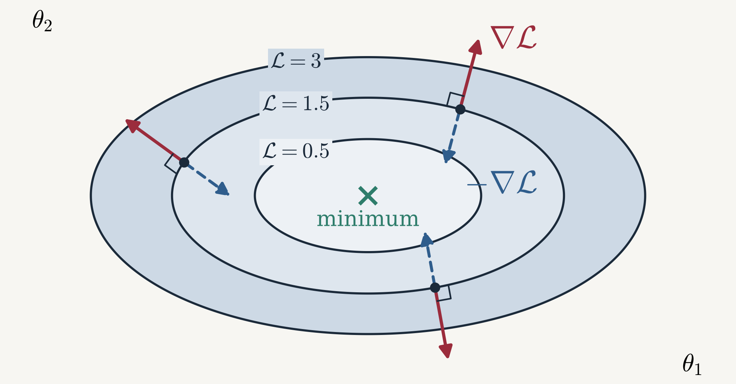
Machine learning
Problem
Model
Training
Optimization
In practice
Gradient
IV. The gradient is perpendicular to the level lines
Level line: all θ with the same loss ℒ(θ) = c
∇ℒ is perpendicular to the level lines and points to larger values
−∇ℒ: the direction of steepest descent
Why? Taylor, for a small step h:
$$ℒ\left(θ+h\right)≈ℒ\left(θ\right)+∇ℒ\left(θ\right)⋅h$$
Like electrostatics: equipotentials V = c, and the field E = −∇V perpendicular to them.
Notes:
Along a level line ℒ does not change, so ∇ℒ·h = 0 for h tangent: the gradient is normal to the level line. Among all steps of a given length, ∇ℒ·h is most negative for h = −∇ℒ: steepest descent.

Slide 16
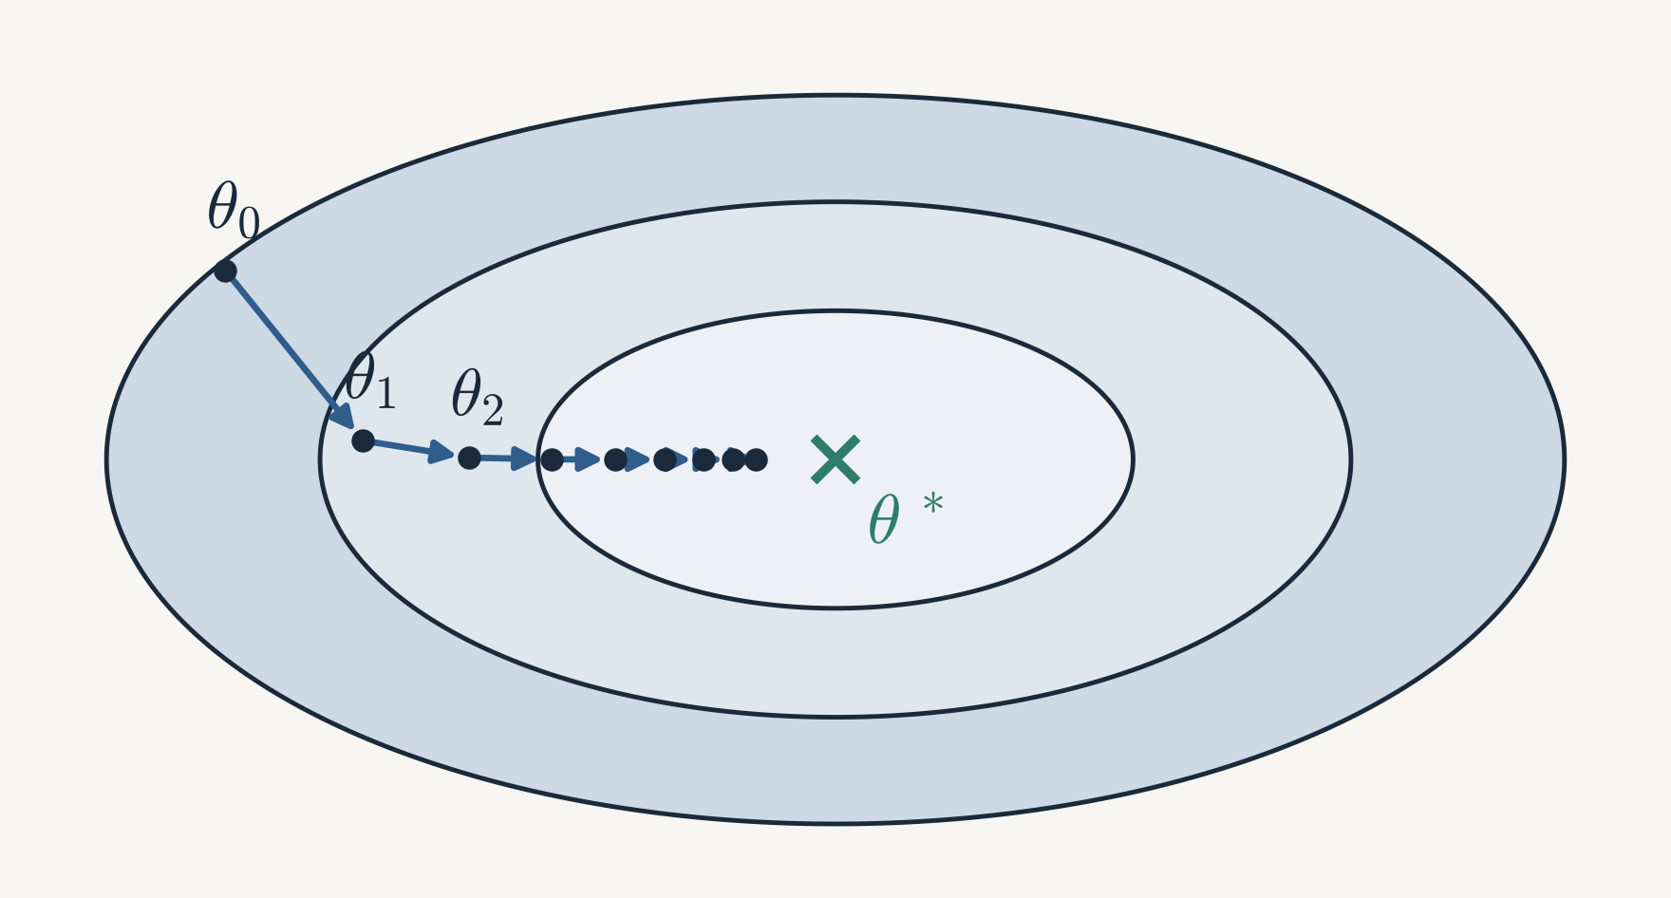

Machine learning
Problem
Model
Training
Optimization
In practice
Gradient descent
IV. Gradient descent
$$θ_{k+1}=θ_{k}−η ∇ℒ\left(θ_{k}\right)$$
η > 0: the learning rate (step size)
θ₀: random (PyTorch does it)
∇ℒ(θ_{k}): computed exactly by automatic differentiation: loss.backward()
repeat until ℒ stops decreasing
Notes:
Each step moves perpendicular to the level line, downhill. The steps shrink near θ* because ∇ℒ → 0 there.

Slide 17
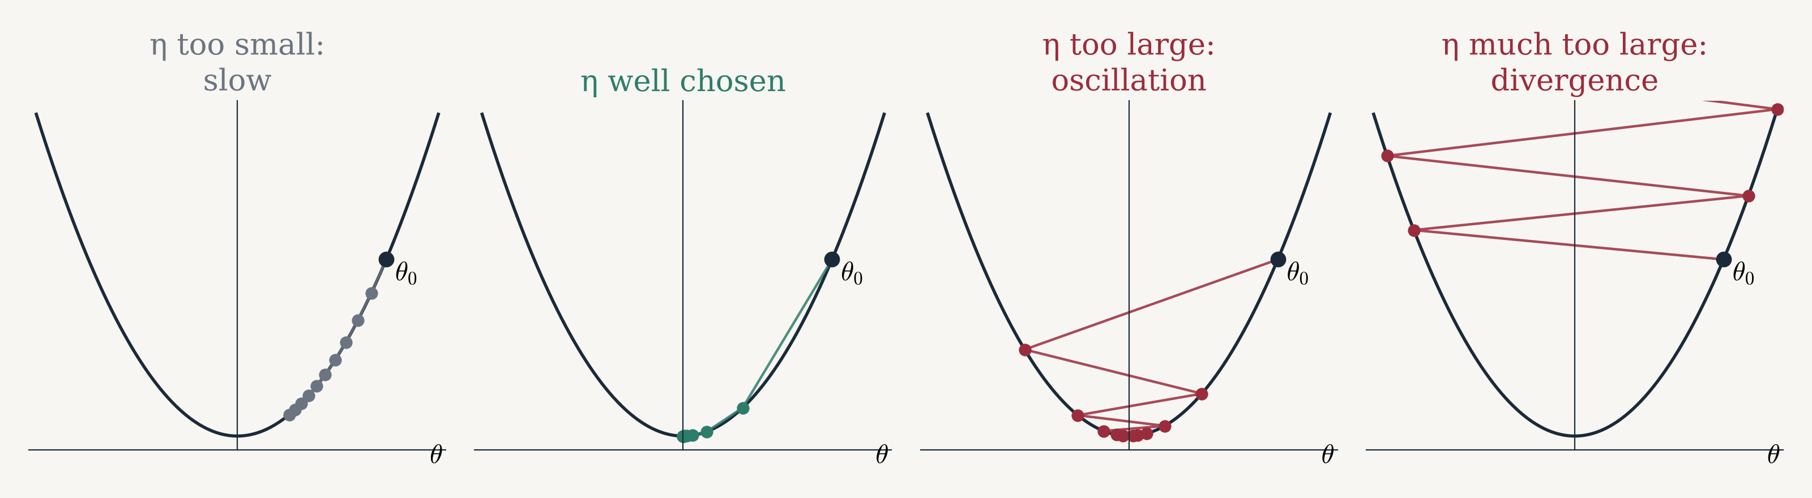
Machine learning
Problem
Model
Training
Optimization
In practice
Learning rate
IV. Choosing η: not too small, not too large
Model problem ℒ(θ) = θ², same start θ₀, 10 steps:
$$θ_{k+1}=θ_{k}−η⋅2θ_{k}=\left(1−2η\right) θ_{k}$$
converges ⟺ 0 < η < 1; alternates sides for η > ½; diverges for η > 1
Too small: slow. Too large: oscillation, then divergence.

Slide 18
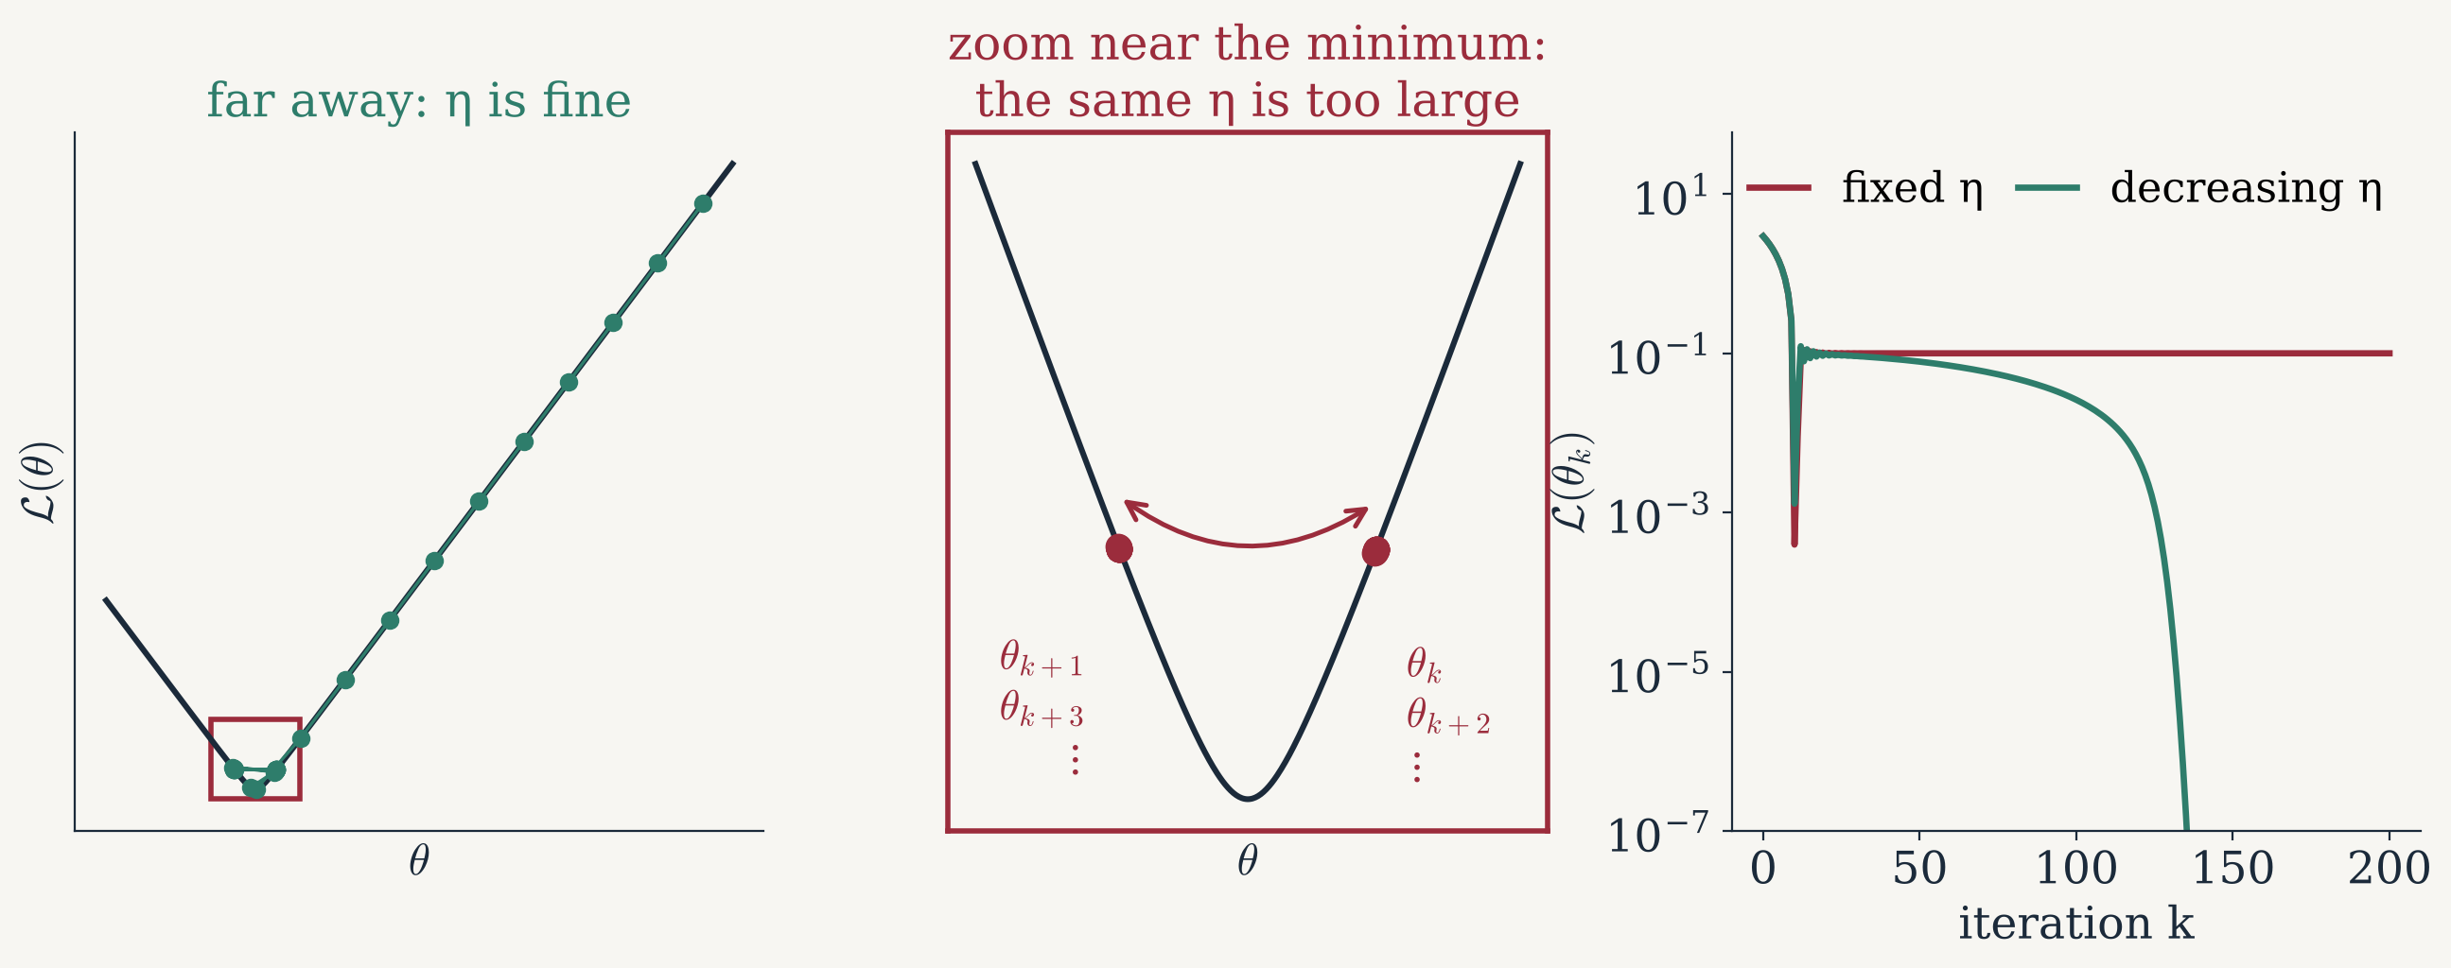
Machine learning
Problem
Model
Training
Optimization
In practice
Learning rate
IV. Even a good η is too large near the minimum
Near θ*, the steps must shrink: decrease η during training (learning-rate scheduler).
Notes:
Here ℒ(θ) is a smoothed |θ|: far away the slope is constant, so a large η is fine; near θ* the curvature is large, so the same η makes θ jump from one side to the other forever. Real losses behave the same way at small scales, and mini-batch noise makes it worse.

Slide 19

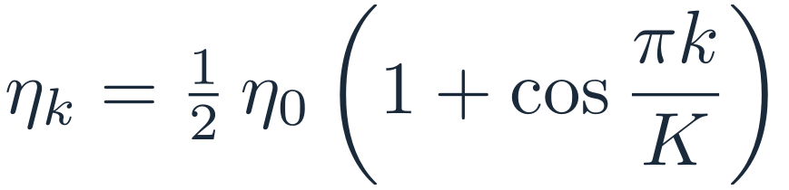
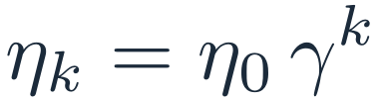
Machine learning
Problem
Model
Training
Optimization
In practice
LR schedulers
IV. Learning-rate schedulers: large steps, then small steps
step decay
$$η_{k}=η_{0} γ^{⌊k/s⌋}$$
StepLR(opt, step_size=s, gamma=γ)
exponential
$$η_{k}=η_{0} γ^{k}$$
ExponentialLR(opt, gamma=γ)
cosine
$$η_{k}=1/2 η_{0}\left(1+cos\frac{πk}{K}\right)$$
CosineAnnealingLR(opt, T_max=K)
In PyTorch: scheduler.step() once per epoch, after the optimizer steps.
Notes:
Other common choices: ReduceLROnPlateau (divide η when the validation loss stops improving), and a short linear warm-up at the start.

Slide 20
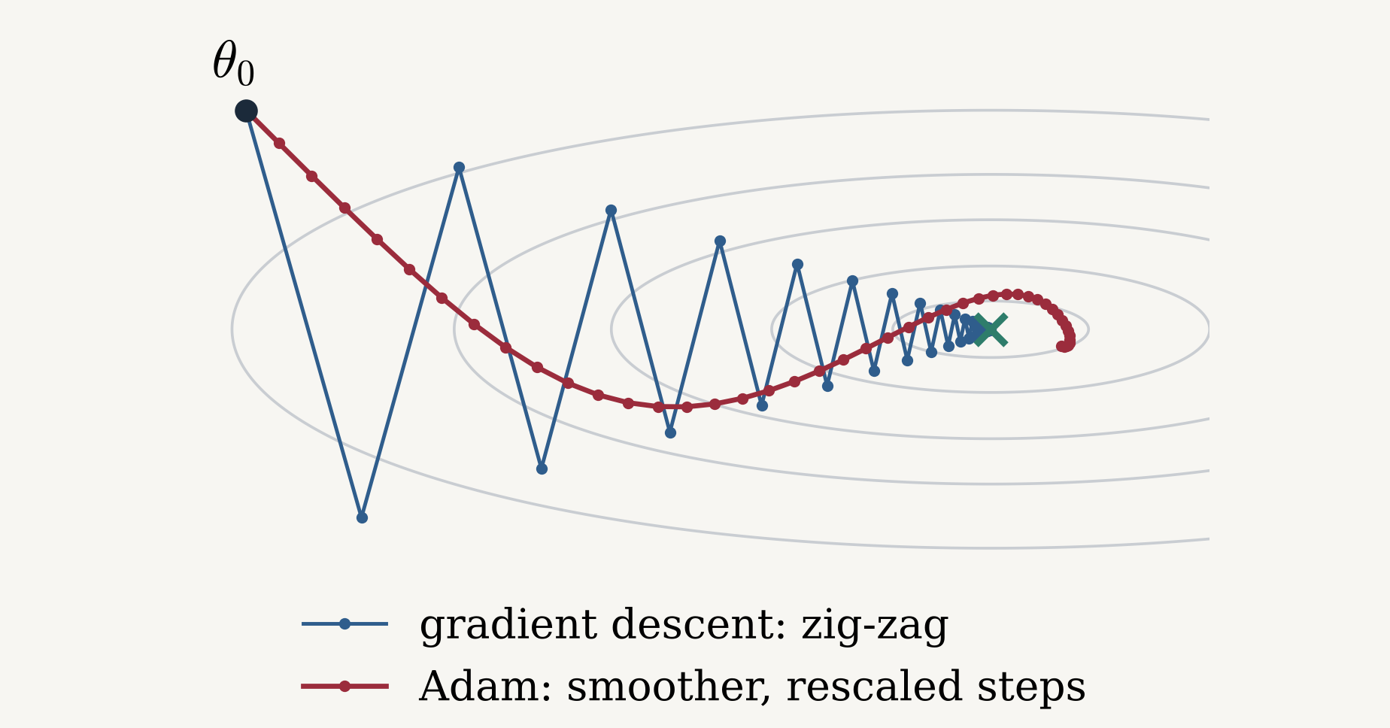

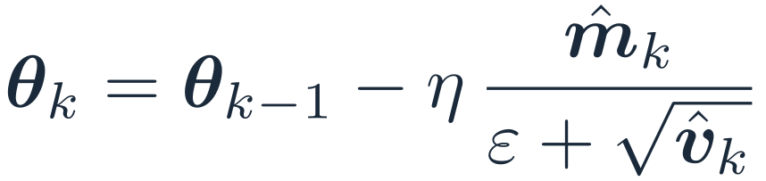

Machine learning
Problem
Model
Training
Optimization
In practice
Adam
IV. Adam: the default optimizer [14]
$$g_{k}=∇ℒ\left(θ_{k−1}\right)$$
gradient
$$m_{k}=β_{1} m_{k−1}+\left(1−β_{1}\right) g_{k}$$
average of the gradients
$$v_{k}=β_{2} v_{k−1}+\left(1−β_{2}\right) g_{k}^{2}$$
average of their squares
$$θ_{k}=θ_{k−1}−η \frac{{\hat{m}}_{k}}{ε+\sqrt{{\hat{v}}_{k}}}$$
step per parameter
m̂, v̂: m, v divided by (1 − β^{k}) (bias correction). β₁ = 0.9, β₂ = 0.999, ε = 10⁻⁸
Same rules for η: not too small, not too large, decrease it near the minimum. Default: η = 10⁻³.
[14] D. P. Kingma, J. Ba, Adam: a method for stochastic optimization, ICLR, 2015. PyTorch: torch.optim.Adam(model.parameters(), lr=η)
Notes:
m: momentum (damps the zig-zag of gradient descent). v: per-parameter scaling (each parameter gets its own step, about η in size). PyTorch calls η "lr".

Slide 21
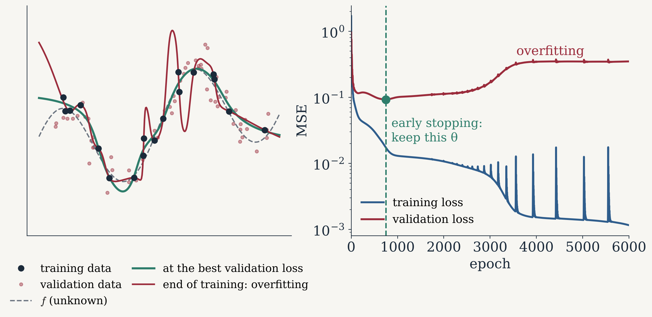
Machine learning
Problem
Model
Training
Optimization
In practice
Overfitting
V. Overfitting: watch the validation loss
Training loss always goes down
Validation loss goes up: overfitting
Early stopping: keep θ at the lowest validation loss
Notes:
MLP 1 → 64 → 64 → 1 (tanh), 18 noisy training points, Adam η = 3·10⁻³, full batch. The network learns the noise: zero training error, large validation error. Remedies: early stopping, a smaller network, more data, regularization.

Slide 22
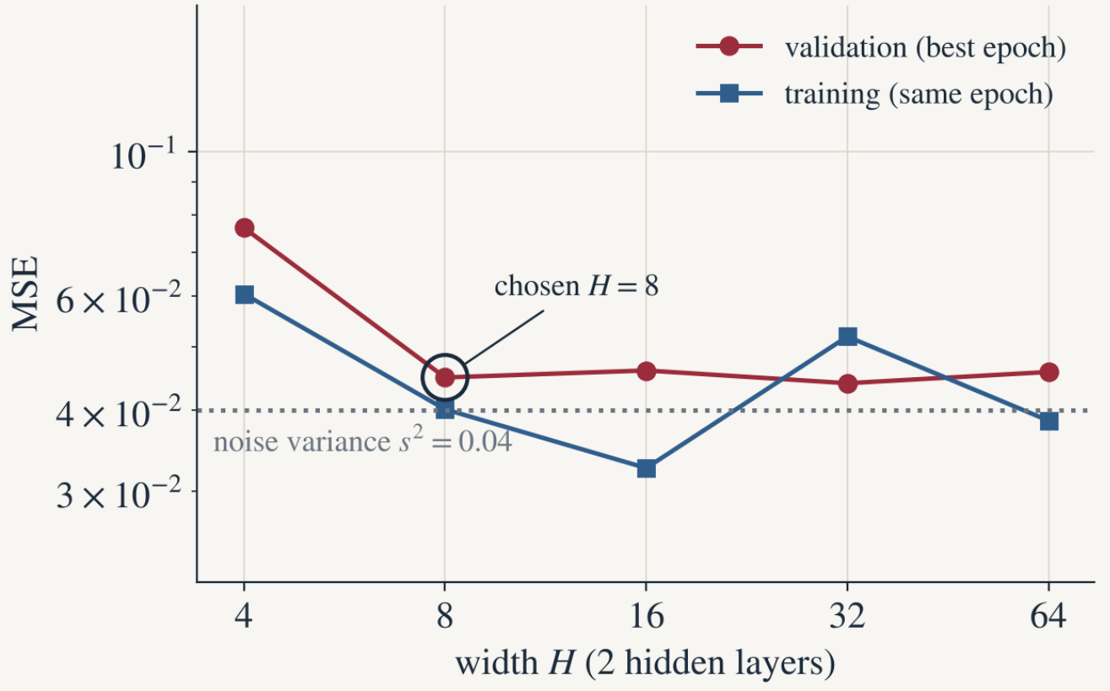
Machine learning
Problem
Model
Training
Optimization
In practice
Hyperparameters
V. Hyperparameters: the validation set decides
Hyperparameter: chosen before training (width, depth, σ, η, batch size…)
Training error always prefers the largest network
Choose the smallest network with a good validation error (here H = 8)
Test error: once, at the end

Slide 23
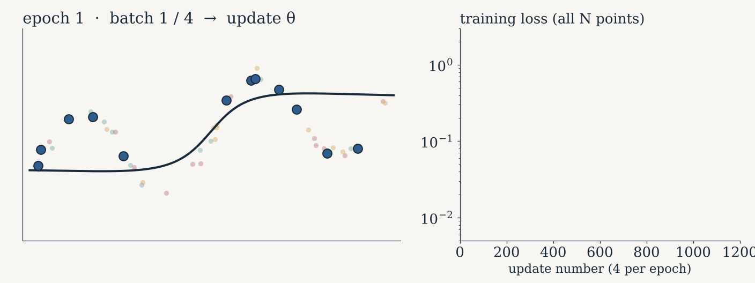

Machine learning
Problem
Model
Training
Optimization
In practice
Mini-batches
V. Mini-batches: update θ after each small packet
$$ℒ_{batch}\left(θ\right)=\frac{1}{B}\sum_{i∈batch}^{​}{{∥{\tilde{f}}_{θ}\left(x_{i}\right)−y_{i}∥}^{2}}, θ←θ−η ∇ℒ_{batch}\left(θ\right)$$
1 epoch = one pass = N / B updates
noisier steps, but many more of them
Notes:
Animation (plays in slideshow): N = 48 points, shuffled every epoch into 4 batches of B = 12 (colors). Each batch moves θ once. The training loss is noisy but goes down much faster per epoch than with the full batch. B = N: full batch; B = 1: “SGD”.

Slide 24
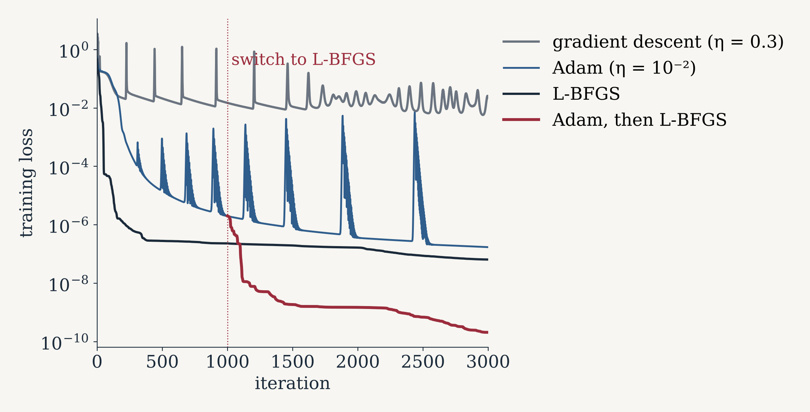
Machine learning
Problem
Model
Training
Optimization
In practice
Adam, then L-BFGS
V. For PINNs: Adam first, then L-BFGS
L-BFGS also uses the curvature, estimated from the last gradients
no η to tune: line search
full batch only
torch.optim.LBFGS
sin(2πx), 256 points, MLP 1 → 20 → 20 → 1 (d = 481), full batch, same θ₀.
Notes:
L-BFGS keeps the last pairs (θ step, gradient change) to approximate the inverse Hessian (Liu & Nocedal, 1989). Adam brings θ into a good valley; L-BFGS then converges much further. Note the Adam spikes: η too large near the minimum again.

Slide 25
Machine learning
Problem
Model
Training
Optimization
In practice
PyTorch
V. Everything in one loop (PyTorch)
model = MLP([1, 64, 64, 1])
optimizer = torch.optim.Adam(model.parameters(), lr=1e-3) # lr = η
scheduler = torch.optim.lr_scheduler.CosineAnnealingLR(optimizer, n_epochs)
for epoch in range(n_epochs):
for xb, yb in train_loader: # mini-batches
optimizer.zero_grad()
loss = loss_fn(model(xb), yb) # loss on the batch
loss.backward() # gradient (autodiff)
optimizer.step() # update θ
scheduler.step() # decrease η
with torch.no_grad():
val_loss = loss_fn(model(X_val), Y_val) # watch overfitting
Then, for PINNs: a few hundred L-BFGS iterations on the full batch.

Slide 26
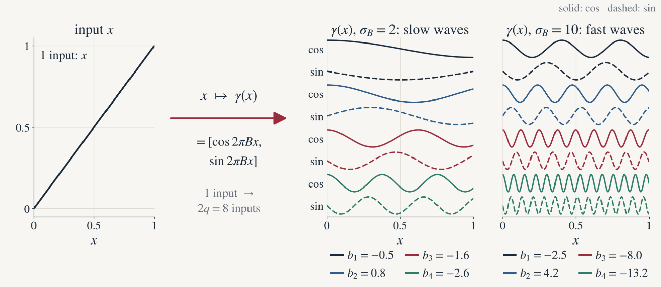
Machine learning
Problem
Model
Training
Optimization
In practice
Fourier features
V. Fourier features: feed the network with waves
B random, fixed. σ_{B}: how fast the waves are (a hyperparameter).
$$γ\left(v\right)=\left[cos\left(2πBv\right), sin\left(2πBv\right)\right], B_{ij}∼𝒩\left(0,σ_{B}^{2}\right)$$
[22] M. Tancik et al., Fourier features let networks learn high frequency functions in low dimensional domains, NeurIPS, 2020.

Slide 27
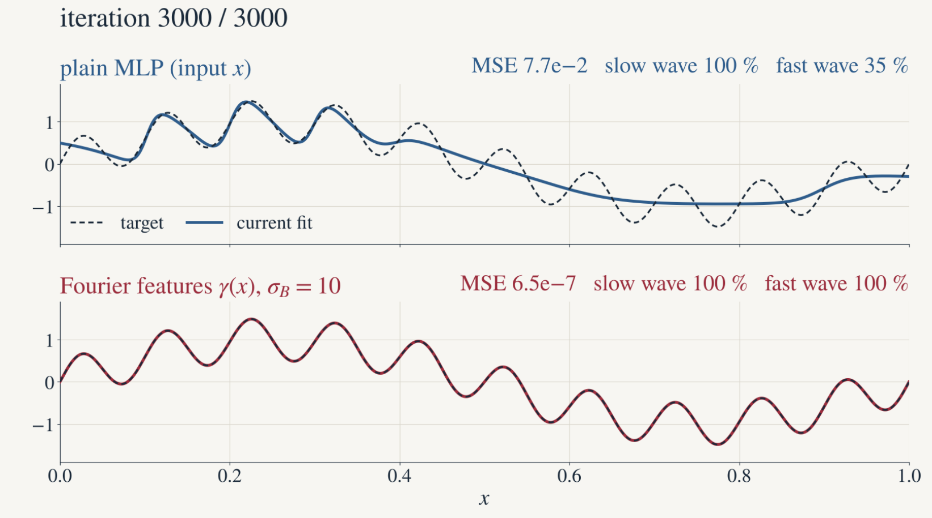
Machine learning
Problem
Model
Training
Optimization
In practice
Fourier features
V. Effect: the fast wave is learned at once
Plain MLP: slow wave first; fast wave still missing after 3000 iterations
Fourier features: both waves within 50 iterations
Networks learn low frequencies first: “spectral bias” [21]
[21] N. Rahaman et al., On the spectral bias of neural networks, ICML, 2019.
Notes:
Target sin 2πx + 0.5 sin(2π·10x), 200 points, Adam η = 10⁻³. Plain MLP MSE 0.077 after 3000 iterations; with Fourier features (σ_B = 10) MSE 6.5·10⁻⁷.

Slide 28
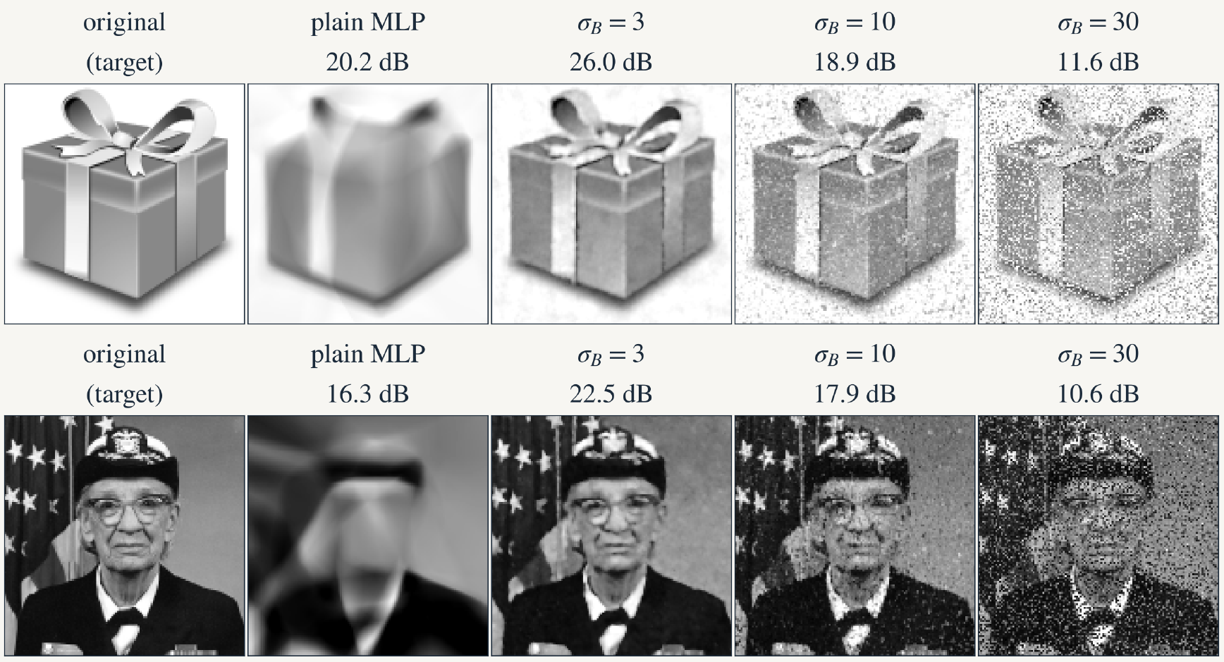
Machine learning
Problem
Model
Training
Optimization
In practice
Fourier features
V. On images: sharper, but σ_B must be chosen
input (x, y) → grey level
σ_{B} = 3: sharp
σ_{B} = 10, 30: noise between pixels: overfitting
σ_{B} chosen on validation
Notes:
Same network [256, 128, 128, 128, 1] ReLU, Adam 10⁻³, batches of 64, 30 epochs. dB: validation PSNR = 10 log₁₀(1/MSE).

Slide 29
Machine learning
Problem
Model
Training
Optimization
In practice
Next
NEXT: HANDS-ON
Now you train your own networks, in a notebook
We practice everything seen today with PyTorch, step by step. The same code will be the starting point of our PINNs.
data
MLP
loss
Adam, L-BFGS
validation
PINNs

