Slide 1
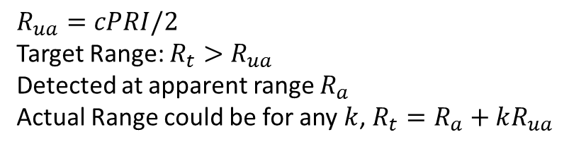
$$R_{ua}=cPRI/2$$
Target Range: $R_{t}>R_{ua}$
Detected at apparent range $R_{a}$
Actual Range could be for any $k$, $R_{t}=R_{a}+kR_{ua}$
X
X
O
Estimated Target Location
Actual Target Location

Slide 2
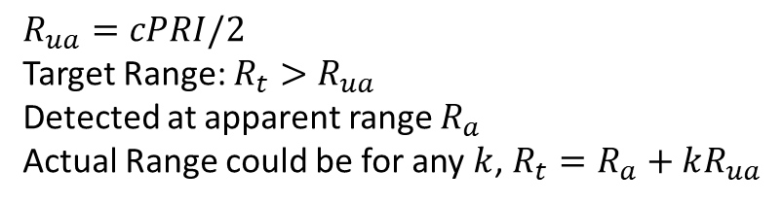
$$R_{ua}=cPRI/2$$
Target Range: $R_{t}>R_{ua}$
Detected at apparent range $R_{a}$
Actual Range could be for any $k$, $R_{t}=R_{a}+kR_{ua}$
Actual Target Location
Estimated Target Location
X
X
O
Operator Adjusts PRI
X
O

Slide 3
Tracker
Scheduler
Modulator
Transmitter
Antenna
Target/ Environment
Receiver
Detector
Integrator
Matched Filter
RF Front End
Simulation
Transmitter
Modulator
Amp
Target/ Environment
Receiver
Detector
Matched Filter
RF Front End

Slide 4
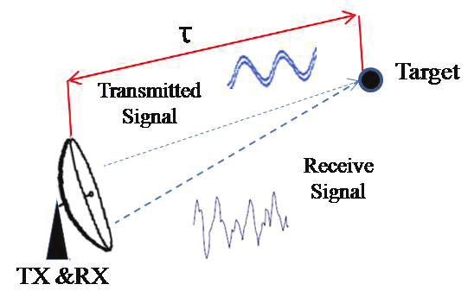


Slide 5
1D
Reference Cells
Guard Cells
Guard Cells
Reference Cells
2D

