Slide 1

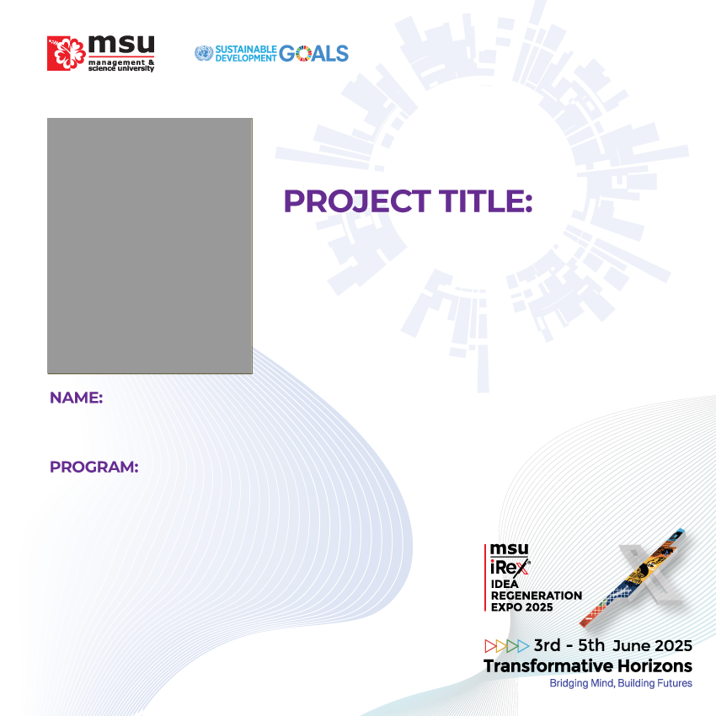
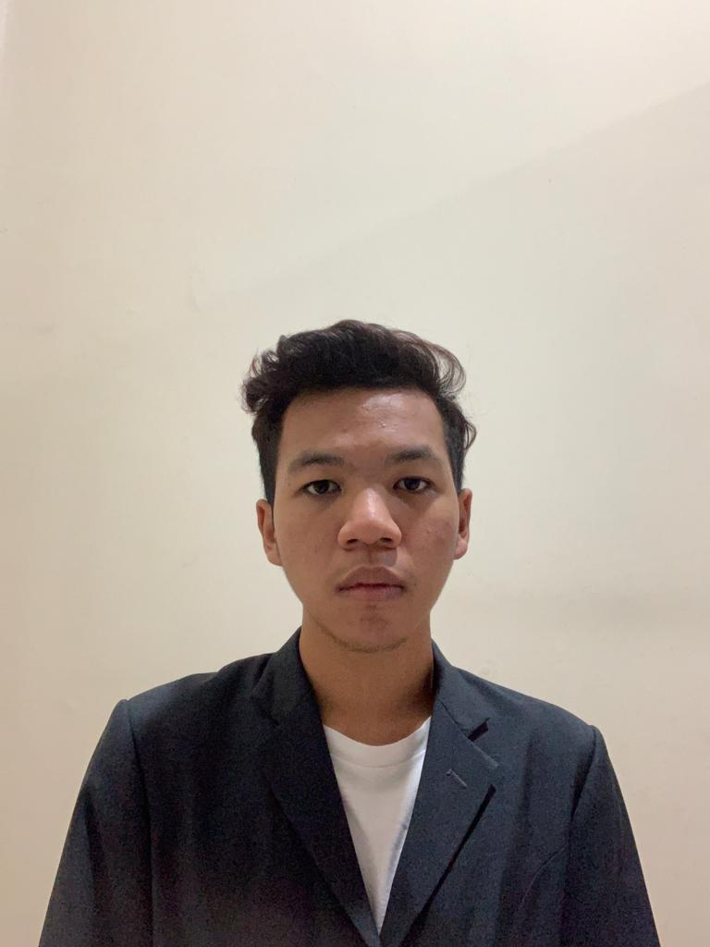

Interactive storybook : Happy Teeth, Happy me
AMIRUL HAKIM BIN AZAHAR
DIPLOMA IN MULTIMEDIA

