Slide 1
Learning Automation Without Barriers
with NRE Labs
Notes:
Hello, my name is < NAME >.
I’m here to talk to you today about NRE Labs - an open source project designed to help infrastructure professionals more easily learn new skills like automation.

Slide 2
Agenda
The Automation Adoption Problem
What is NRE Labs?
How NRE Labs Can Help You
Contributing to NRE Labs
Notes:
Before we get started, a quick agenda - we’ll first cover what I’ll call the “Automation Adoption Problem”, and describe a few of the reasons we launched the NRE Labs project.
We’ll then cover NRE Labs itself, including the general site tour, but also how to use the content available on the site to start improving your own network operations.
Finally we’ll end with a section explaining how you can start contributing to this project.

Slide 3
With automation, you have be an expert before you are allowed to be a beginner
(this is a problem)
Notes:
It’s a relatively uncontroversial opinion that automation has some benefits, from saving time, to reducing outages due to misconfigurations, and more.
However, when it comes to adopting automation, organizations and the network engineers that power them have a major hurdle, which is that the industry inadvertently forces you to be an expert in automation before you’re allowed to be a beginner.
It seems that even to get started with automation, you need to know Python, Docker, Git, Machine Learning, and Kubernetes - all terms that have historically not been a part of a network operators education.

Slide 4

Notes:
This is a fundamental problem in the industry. Automation or software skills are so different these days from what most modern network engineers know, that it’s not as simple as picking up a tutorial and bing bang boom you’ve learned automation.
Automation is a complex tree of prerequisite knowledge, and for many concepts, you need to be an expert in one topic before you can start learning another.
In 2018, we set out to help solve this problem.

Slide 5
Time Investment Minimum (TIM) - HIGH
“I am competent with this”
“This will be useful to me”
Knowledge of a Subject
Potentially weeks or MONTHS of work
Time and Energy Spent Learning Subject
Notes:
For many new topics, but especially for automation, network engineers are often overwhelmed by not only the number of new tools and concepts they need to learn, but also the amount of time and energy it will take to just learn ONE of them.
This is due to the fact that many of the concepts involved with automation are complex, and very foreign to the average network operator. It takes a large amount of time and effort to just get to the point where you know enough about a tool to know if it’s even useful to you.
This is a large amount of risk, with little to no guarantee of payoff.

Slide 6

”
of data center NetOps are still manual
82%
Notes:
It’s no wonder, then, that Gartner estimated recently that data center network operations - ostensibly the most fertile ground for network automation, is still 82% network device CLI driven.
After all, if you know the Time Investment Minimum is so high for learning a new thing, with little guarantee of payoff, you stick with what you know.

Slide 7
Time Investment Minimum (TIM) - LOW
“I am competent with this”
Knowledge of a Subject
“This will be useful to me”
Time and Energy Spent Learning Subject
Notes:
The solution is to reduce the amount of time and effort needed to get to this first milestone. Instead of forcing you to be an expert before you’re allowed to be a beginner, we need to figure out a way to get a foundational experience with automation concepts without being required to go back to school for four years.
This isn’t meant to replace true competence - there’s still a need for deep understanding and experience before making use of automation broadly in production; rather, this is about breaking down the barriers for those very first few steps. It’s about getting you onto this journey more quickly and easily.

Slide 8
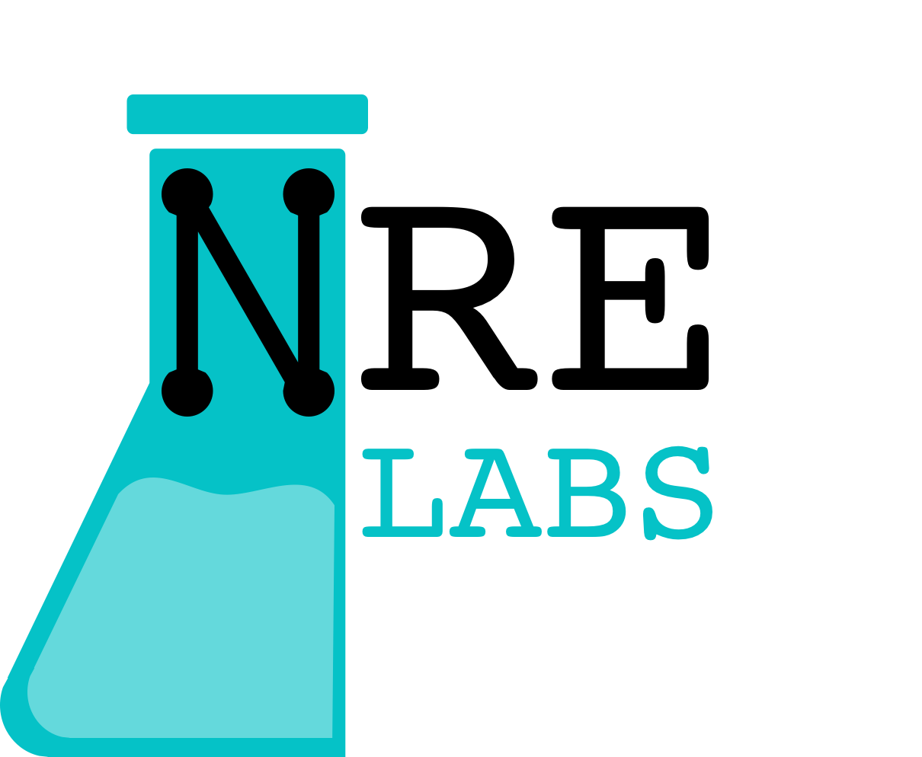
NRE Labs
Community platform for learning and teaching automation and Network Reliability Engineering
Totally browser-based
Internet-accessible
Free - no login, paywall or creepy trackers
Vendor-neutral
Open Source (curriculum too!)
Notes:
To work towards accomplishing this, we created an open source project called NRE Labs.
This is both a community project, as well as a website for hosting interactive lessons on automation and next-generation network engineering skill-sets.
It’s entirely browser-based and free to use for all. No need to sign up, or submit your email address. It’s a public web site that is ready for you to consume, right now.
It’s designed to take the complexity of setting up your own environment, as well as the years of experience that many veteran automators have, and package it into a format that you can use to get your first experience with automation within minutes.

Slide 9
Our Mission
To remove traditional barriers to learning new, advanced skill sets, and meaningfully enhance and edify infrastructure professionals around the world
Notes:
Our mission is to remove traditional barriers to learning new, advanced skill sets, and meaningfully enhance and edify infrastructure professionals around the world
NRE Labs has been an open source project from its inception. We seek to ensure that anyone anywhere can quickly learn key automation concepts using whatever infrastructure or tools they have available. Thus we encourage contributions from a broad swath of the networking and automation communities.
We resolve to provide a platform for education in infrastructure automation tools and techniques for network engineers that can immediately be applied to real-world daily tasks.
We encourage lessons of all types relating to network reliability engineering and infrastructure automation.

Slide 10
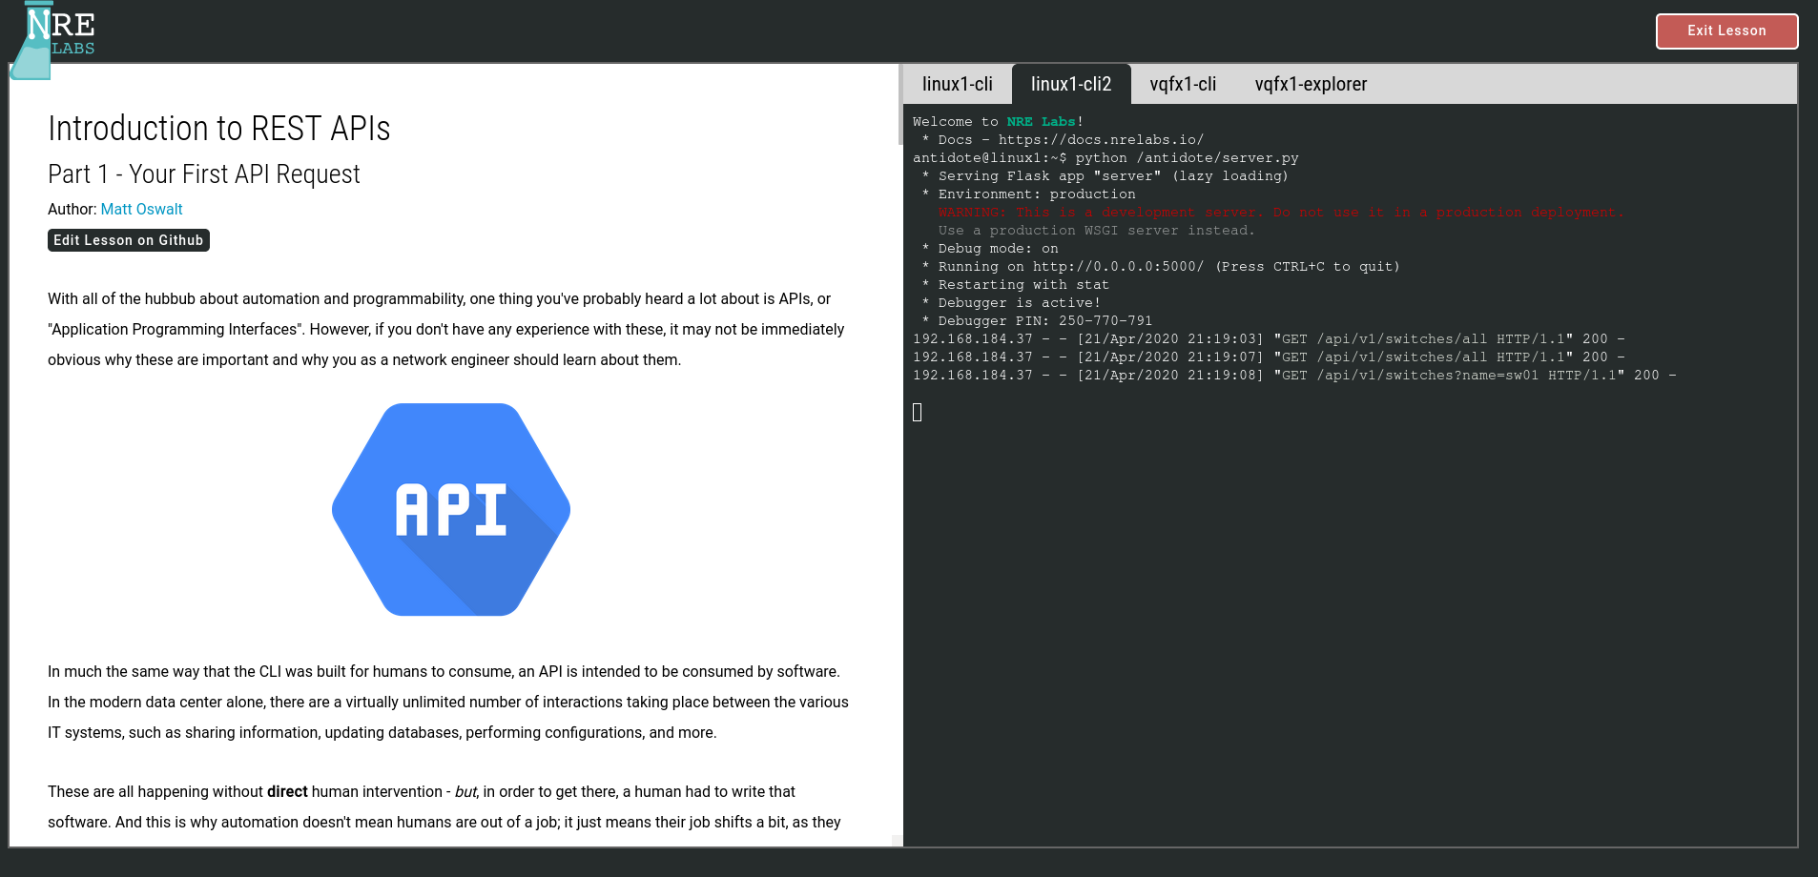
Interactive, Browser-Based, On-Demand.
Notes:
The NRE Labs lesson environment was built to be easy to use, with as few distractions as possible. The left side of the screen contains a helpful lesson guide that walks you through everything you need to know to get started with a topic. This comes complete with code or command snippets you can enter yourself, or you can click a helpful “Run this snippet” button to have the commands pasted into the appropriate terminal.
The right side of the screen contains tabs to work with lesson endpoints. These can be used to gain access to a linux shell to run scripts or commands, a full-blown network device, such as Cumulus Linux, Junos, and many others, as well as web applications that are needed to teach a particular concept.
Lessons are broken up into bite-sized chunks that allow you to make progress in a particular topic without a huge time investment. These “stages” of a lesson generally take anywhere between 5 or 10 minutes to finish.

Slide 11
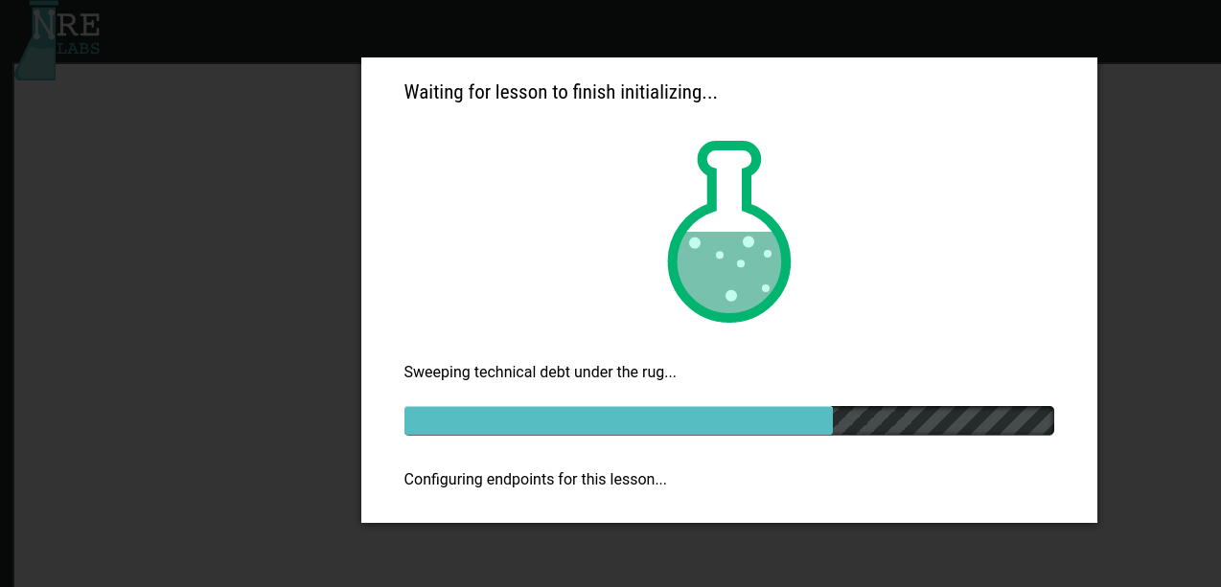
Focus on the Topic
Notes:
Lessons in NRE Labs are meant to keep your focus on the topic you came to learn. Anything outside of that scope is handled for you, without sacrificing the inherent interactivity that comes with a real live environment.
This includes everything from figuring out how to install software dependencies, to connecting endpoints together in some kind of topology - even configuring endpoints so that they’re prepared for the scenario that the lesson uses to teach a concept. If it doesn’t help you focus on the topic at hand, the NRE Labs platform takes care of it behind the scenes.

Slide 12
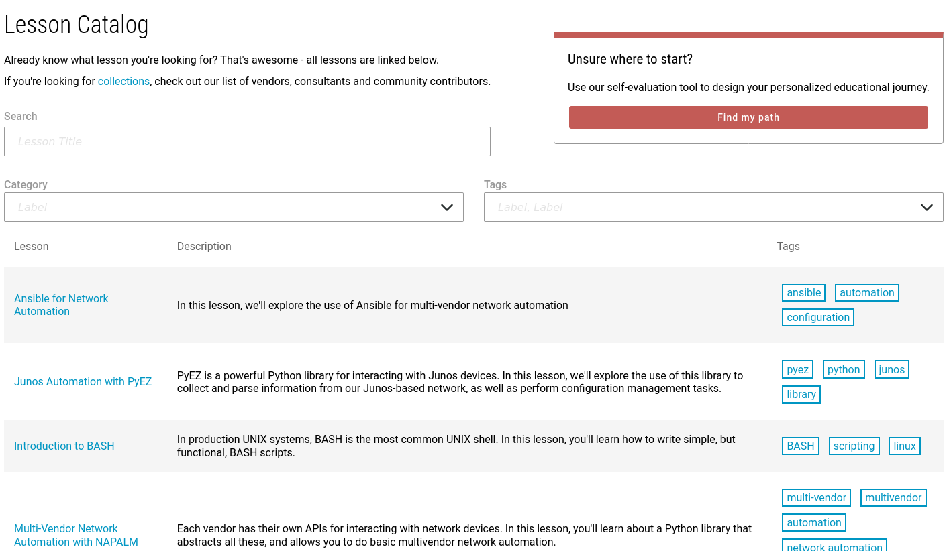
A Diverse and Growing Curriculum
Notes:
The NRE Labs curriculum already contains a diverse and growing number of lessons that cover a range of topics. Some lessons focus on fundamental skills, such as Linux basics, BASH scripting, REST APIs, and version control with Git. Other lessons dive into a specific tool, such as Ansible, Stackstorm, or Salt.
There are also lessons that explore a specific use case or workflow. Once such example is the lesson on Automating STIG compliance, which uses fundamental skills and tools learned about in previous lessons to solve a particular business challenge.

Slide 13
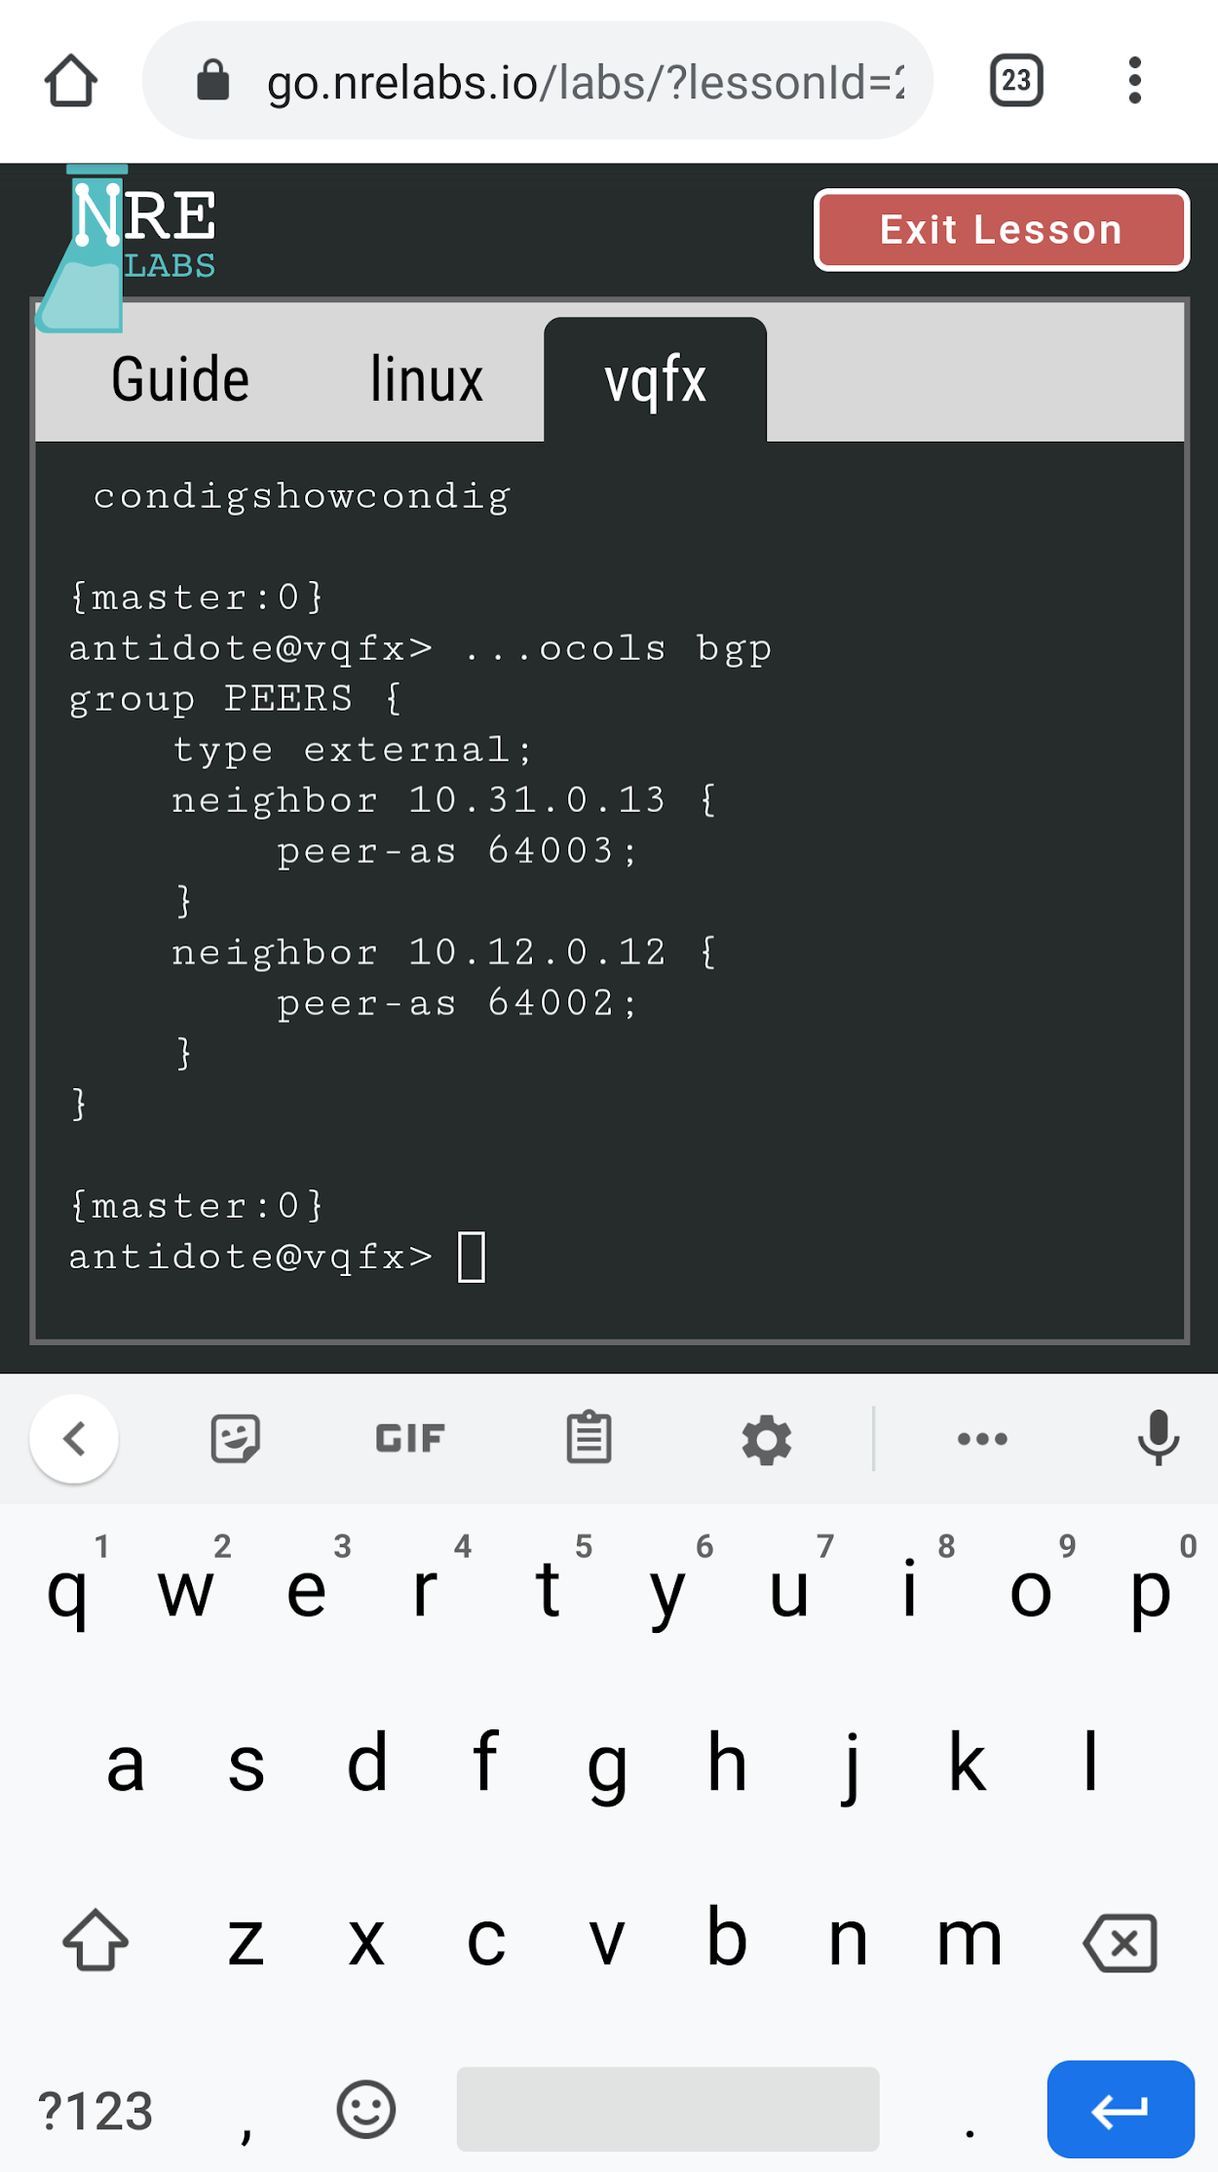
Junos On Your Phone!
Notes:
Most lessons work really well on mobile devices, which makes it really easy to get started with automation wherever you are. You could make your first API call over lunch!

Slide 14
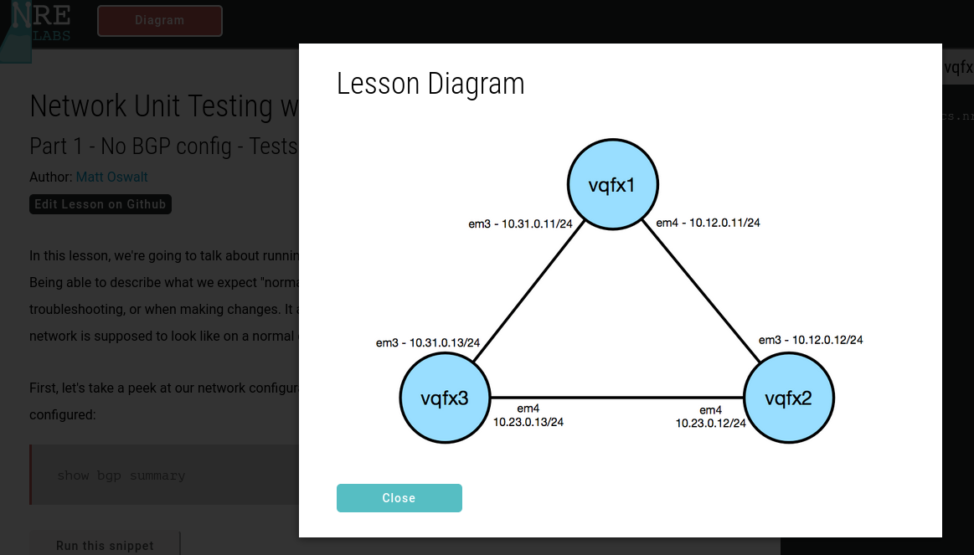
Pre-defined Topologies
Notes:
Some lessons take advantage of the NRE Labs platform’s ability to interconnect multiple endpoints together. This is very useful for lessons like this one, which covers the topic of automated network verification using the JSNAPy project, as multiple network devices are able to peer with each other using protocols like BGP.

Slide 15
Compliance Validation
“Automation”
Notes:
Another problem facing the industry with respect to automation is how to get from where we are today, to being able to use automation to solve a specific business need.
Network operators have a pretty good handle on the aspects of their day-to-day that could use some improvement. One common example is ensuring that infrastructure is compliant with regulations like DoD STIG, PCI, or HIPAA. I probably don’t need to sell you on the idea that automation could help with those things; the idea that automation could help here isn’t particularly controversial.
The problem is….how? And how can I get from there from where I am today? We need to get a lot more “real” than simply waving our hands and saying “automation”.

Slide 16
Fundamentals
Tools
Workflow
YAML
JSNAPy
Bash
Compliance Validation
Jinja
NAPALM
Python
Mapping Out Pre-Requisite Knowledge
Notes:
What most experienced automators don’t tell you is that like almost every other complex skill-set, it’s not a simple matter of flipping a switch and writing a script to accomplish a certain task. Getting to the point where you’re able to do that takes a lot of time and energy learning a series of more fundamental skills and tools, and this tree of prerequisite knowledge isn’t always obvious if you’re just looking at the final task to be accomplished.

Slide 17
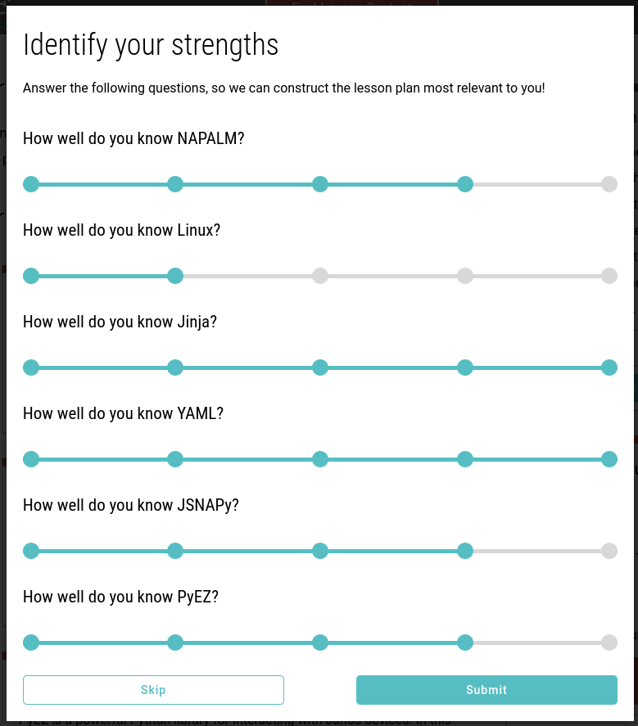
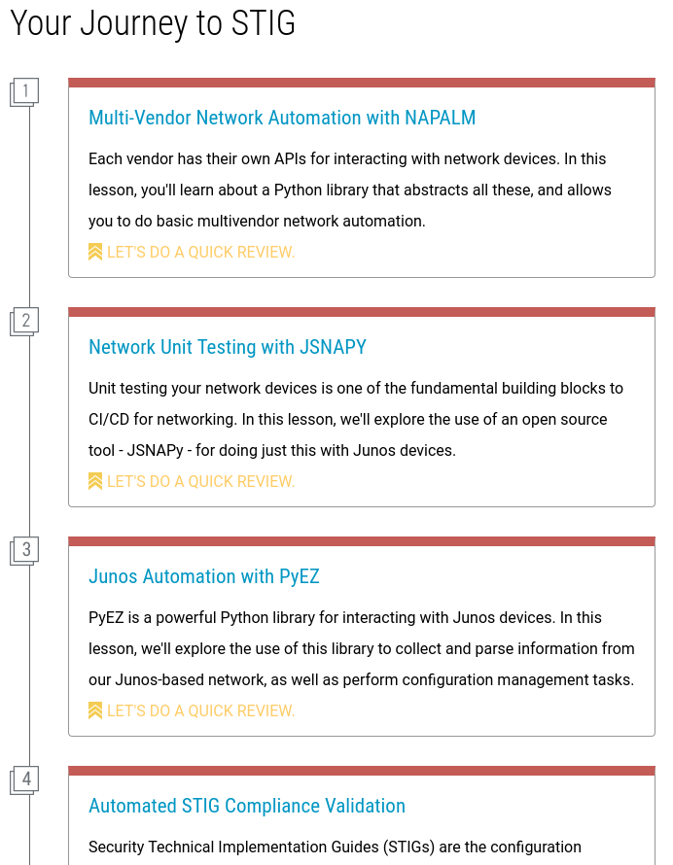
Course Advisor
Notes:
To tackle this, all lessons in NRE Labs contain context about the kind of prerequisite knowledge that may be required for learning a particular topic. Using the built-in “Course Advisor”, users can search for a lesson that covers a specific topic, and see all of the other concepts they didn’t know they needed.
NRE Labs doesn’t just allow experienced automators to convey the details of a specific topic, but also all of the unspoken dependencies of that topic on other fundamental skills that most people have to figure out for themselves.

Slide 18
NRE Labs IS
NRE Labs is NOT
Pre-defined, easy to consume lessons on automation and NRE principles
An Open Source project and curriculum - open to all to contribute
Vendor-Inclusive
Build-your-own topologies
A fully-featured demo or PoC platform
“Owned” by any one of the sponsoring organizations. This is a community project.
Notes:
NRE Labs is not meant to be everything to everyone. Here are a few guidelines for thinking about what NRE Labs is and is not meant to be.
It is a collection of pre-defined lessons that focus on automation and Network reliability engineering principles. It’s not a sandbox where you can build or play with your own custom topologies. The idea here is to trade off a little bit of flexibility, for a much smoother, and simpler way of getting interactive experience with automation skills.
This project was originally started by employees of Juniper Networks, but NRE Labs is not a Juniper project or product, and, just like this slide deck, carries no Juniper branding. Rather, it is a fully open source project and curriculum. The goal for this project is to bring up the automation IQ across the industry, regardless of vertical, vendor, or special discipline, and all are welcome to contribute.

Slide 19
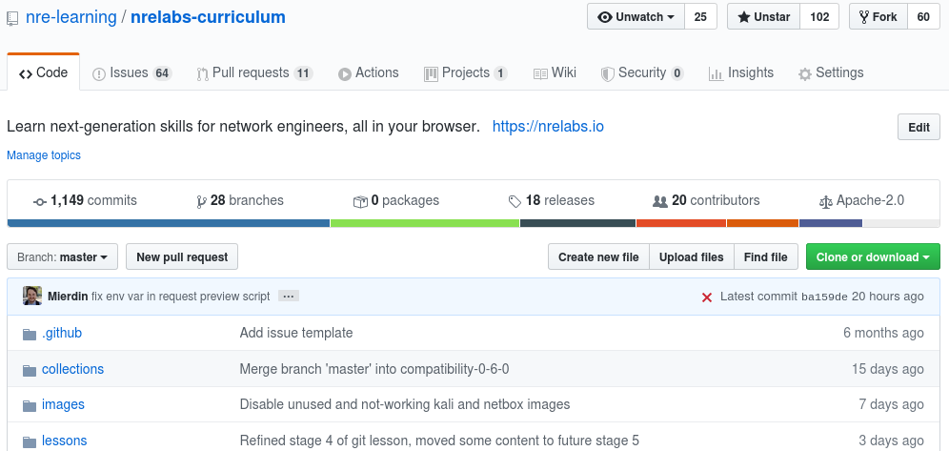
Contributing to NRE Labs
https://github.com/nre-learning/nrelabs-curriculum
Notes:
Let’s switch gears now and talk about how NRE Labs incorporates community contributions
The NRE Labs curriculum is all managed in GitHub. Files that go into each lesson, including lesson guides, scripts, configurations, etc - all are version controlled using Git and contributions take place via Pull Requests to our GitHub repository at the URL shown.

Slide 20
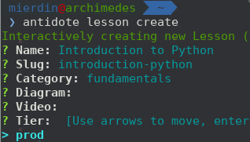
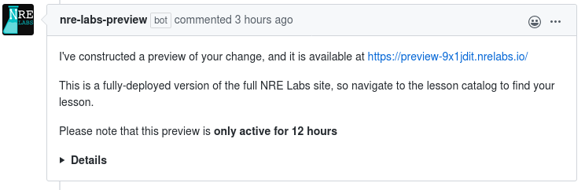
Contributing to NRE Labs
Start here - docs.nrelabs.io/creating-contributing/getting-started
Bootstrap new lesson
Open Pull Request
Iterate until finished
Review and merge
Notes:
Contributing to NRE Labs follows a four-step process, and all relevant details can be found in the NRE Labs documentation.
This process starts with a command-line tool called “antidote” which allows you to quickly bootstrap new content via an interactive wizard.
Once you’ve opened a Pull Request in Github, a bot will generate a preview of your new content that you can view, usually a few minutes after you make a change.
We’re always trying to improve the contributor experience, so let us know if you have feedback!

Slide 21
Resources
Homepage - nrelabs.io
Forums - discuss.nrelabs.io
Docs - docs.nrelabs.io
Open Source - github.com/nre-learning
Twitter - @NRELabs
No Contribution Too Small!
Use NRE Labs and open issues!
Lesson Contributions - new or existing
Platform enhancements/fixes
Notes:
Thanks so much for your attention and interest in the NRE Labs project. You can find a plethora of additional information at the links shown here, including the NRE Labs site itself, but also our community forums and documentation if you wish to get involved with the project.
For updates, the best place to go is our twitter account - @nrelabs - as we post frequent updates there about the project including new capabilities and new content.

Slide 22
Thank You!

