Slide 1

NostraDomicile
By:
Jeremy Hutton, Christian Simaan,
Richard Andrews, Ochaun Marshall

Slide 2





Slide 3
Approach
Problem:
It can be difficult to determine whether a house will sell and what factors will influence its desirability in a particular area.
Solution:
Create a web application which uses machine learning and determines if a house will sell based on desirable factors in an area and allows users to explore a suite of data visualizations based on their area of interest.

Slide 4
Important Links
Website:
www.NostraDomicile.com
Github:
www.github.com/nreader72/NostraDomicile

Slide 5
Overview
Functional Requirements
User-interface Requirements
Security Requirements
System Model
Subsystems
Front-end
Back-end
Database
Machine Learning
Demonstration
Future Efforts

Slide 6
Functional Requirements
Users able to input attributes and location for predictive home sale analysis
Users able to view data visualizations for housing data based on zip code
Users able to view most influential factors in home sales for a given area
“About” section with detailed explanation of web application functions and its goal.
“Blog” section with articles by experts in real estate.
“Contact” section capable of taking in user feedback via email
“Help” section which offers users a tutorial

Slide 7
User Interface and Usability Requirements
Text area for target zip code in order to return predictions and data visualizations.
Text areas and drop down boxes for users to enter their home’s attributes.
Submit buttons to return prediction on home sale, most important factors for home sales, and data visualizations..
The application will load within 1-2 second interval.
All buttons will conform to the same style.
Any text area, checkbox, or dropdown box will have helpful instructions.
Any function of the web application may be reached within 2-3 clicks.
Any subsequent page within the application will adhere to the same style

Slide 8
System Interface Requirements
Application must be successfully hosted and displayed by cloud service(AWS).
Front end of web application must successfully query database upon user request.
Database must successfully return requested data run through machine learning algorithm, statistical analysis and data visualization program and front end must successfully display request.

Slide 9
Security Requirements
Home data in DB can’t be altered except by authorized automated scripts or administrators.
Realtor blog articles can’t be placed, removed or altered except by administrators.

Slide 10
System Model
Frontend handles both displaying information to the user, and getting data from the user that will allow our application to analyze attributes.
The backend analyzes the data that the frontend gets, and send it to the machine learning functions/system. The backend will also make request to the zillow api or our database depending on the request made, and whether we have the data required.
We use the Random Forest Classifier to analyze the data it gets from the backend, and provide answers to the backend.
The database will store information we get from requests to the Zillow API, as well as any other information we need to store.

Slide 11
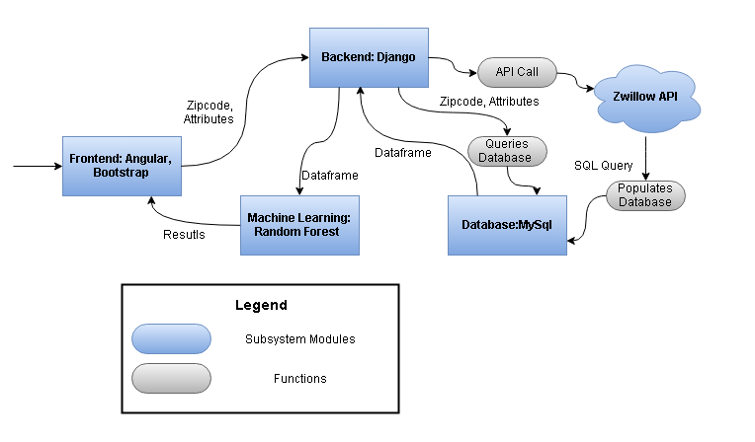
System Model

Slide 12
Front End Subsystem
Goal of the Front End Subsystem:
Fulfill the needs set forth in the Functional, User Interface, and Usability Requirements
Developed using JavaScript and HTML/CSS through the frameworks AngularJS v.1.3.14 and Bootstrap v.3.3.7
Single Page Web Application
Fulfills requirement that any part of the application can be reached within 2-3 clicks
Lends to a simple user interface

Slide 13


Slide 14
Front End Subsystem
Fulfills functional requirements that the application has About, Expert Blog, Contact Us, and Help Sections
Makes use of Angular Routing to ensure that NostraDomicile.com is a single page application, with no need for page reloads
Navigation Bar

Slide 15
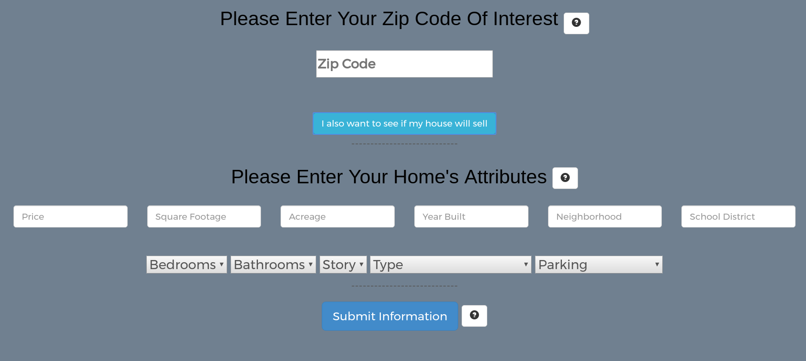

Slide 16
Front End Subsystem
User Interface and Usability Requirements are satisfied by creating text input areas, drop down boxes and submit buttons follow the same design
For longer load times a loading wheel has been created
User Input

Slide 17
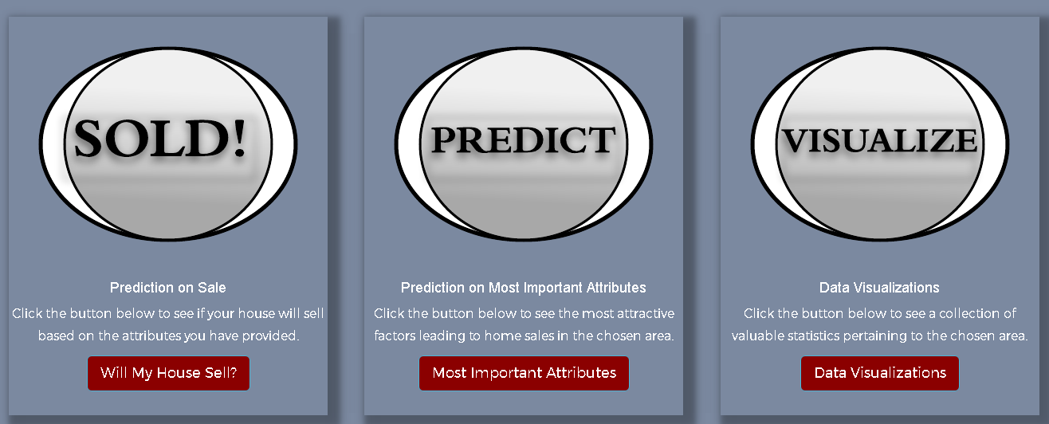

Slide 18
Front End Subsystem
Satisfies the Functional Requirements:
Users able to input attributes and location for predictive home sale analysis
Users able to view data visualizations for housing data based on zip code
Users able to view most influential factors in home sales for a given area
Results displayed in pop-up modals which continue the adherence to Single Page Web Application
Function Cards

Slide 19
Back End Subsystem
Programming language: Python
Web Framework: Django
Web Server: Apache
Host: AWS
Description: The Django backend will also be broken into many different functions, but it will follow a MVC format. Functions such as making calls to the Zillow API, querying the database, sending data to the frontend to be displayed, etc.

Slide 20
Database Subsystem
MySQL Database - data stored in relational DB. Includes, among other things:
Zipcode
Status (sold/unsold)
Home attributes (floor type, parking, etc.)
Data from Zillow (via PyZillow API).
Ideally, data would be directly from MLS database- constantly updated and more complete.

Slide 21
Machine Learning Subsystem
Machine Learning with Random Forest.
Binary classifications on categorical features is more straightforward
Generates an ensemble of decision trees and uses the majority classification of those trees to determine result
implemented using Scikit-learn library in Python
K-fold Cross validation
Tasks
Generates a trained random forest model from the data from surrounding homes
Makes predictions on whether a user’s house will sell based on the features of the home
Generate a list of features

Slide 22
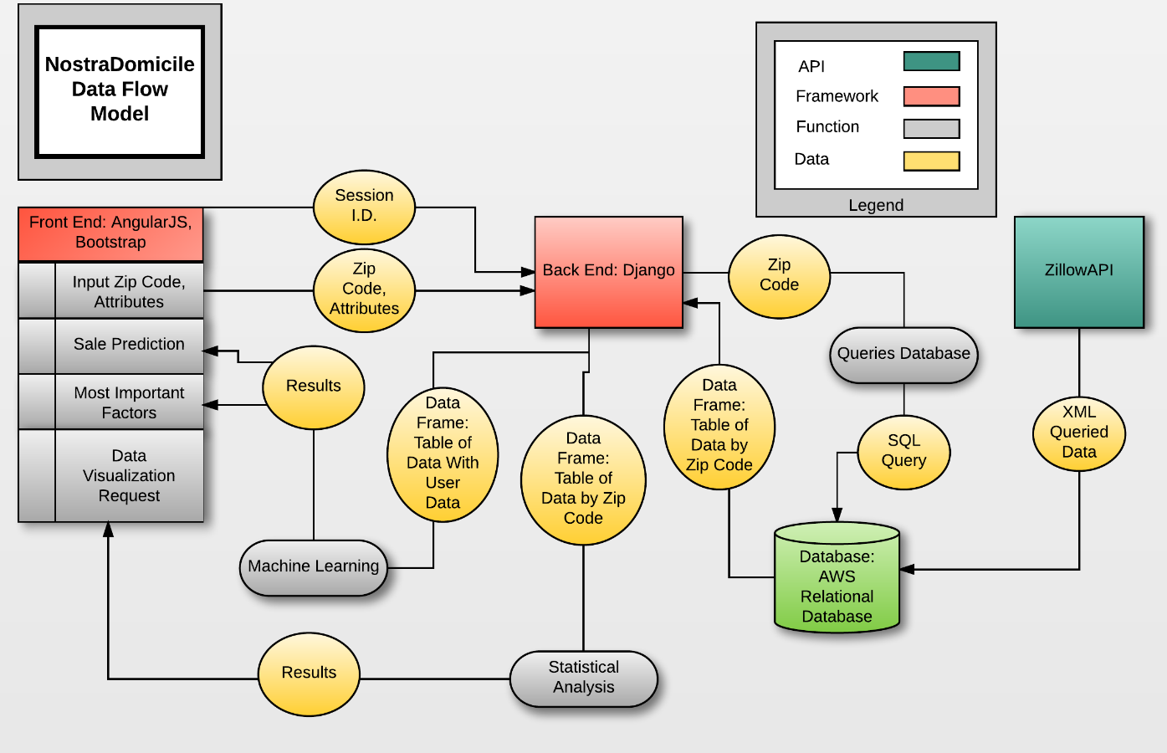

Slide 23
Demonstration

Slide 24
Future Efforts
Allow multiple data visualization options
Invite realtors to submit posts to the blog
Adjust the front-end for mobile phone browsers
Add support for more classifiers
Support Vector Machine
Deep Belief Network
Implement a login system for saving results
Predicting the price of a home sale by running multiple Random Forests
Realtor Ranking

Slide 25
References
Breiman, Leo. "Random Forests." Machine Learning 45.1 (2001): 5-32. Print.
A Study of Cross-Validation and Bootstrap for Accuracy Estimation and Model Selection. Ijcai. 1995. Stanford, CA. Print.
Data Structures for Statistical Computing in Python. Proceedings of the 9th Python in Science Conference. 2010. van der Voort S, Millman J. Print.
Pedregosa, Fabian, et al. "Scikit-Learn: Machine Learning in Python." Journal of Machine Learning Research 12.Oct (2011): 2825-30. Print.
Walt, Stéfan van der, S Chris Colbert, and Gael Varoquaux. "The Numpy Array: A Structure for Efficient Numerical Computation." Computing in Science & Engineering 13.2 (2011): 22-30. Print.

Slide 26
Thanks!

