Slide 1
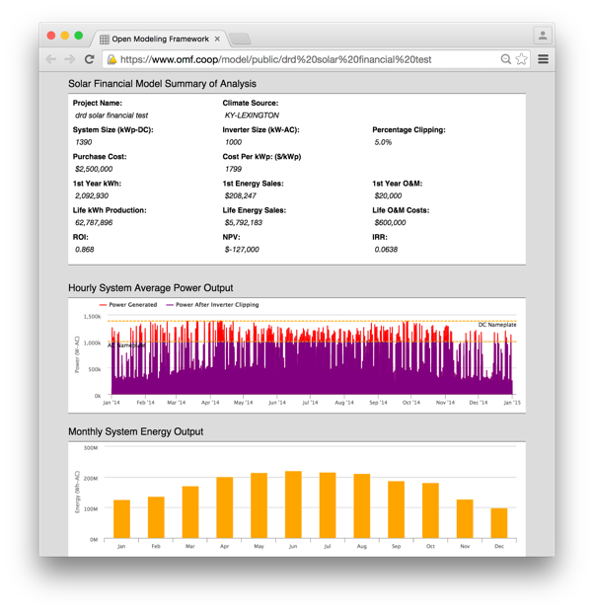
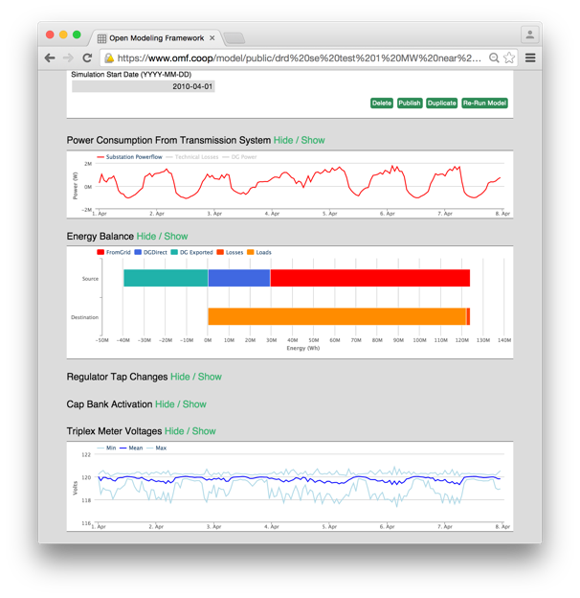
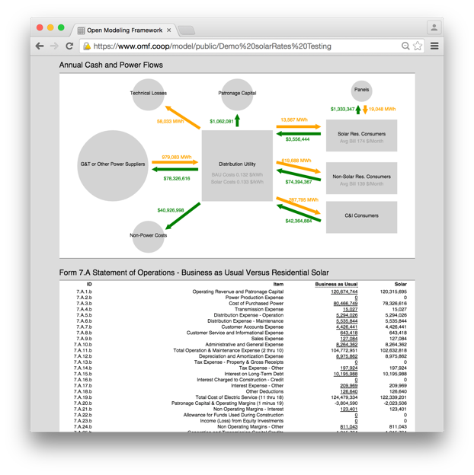
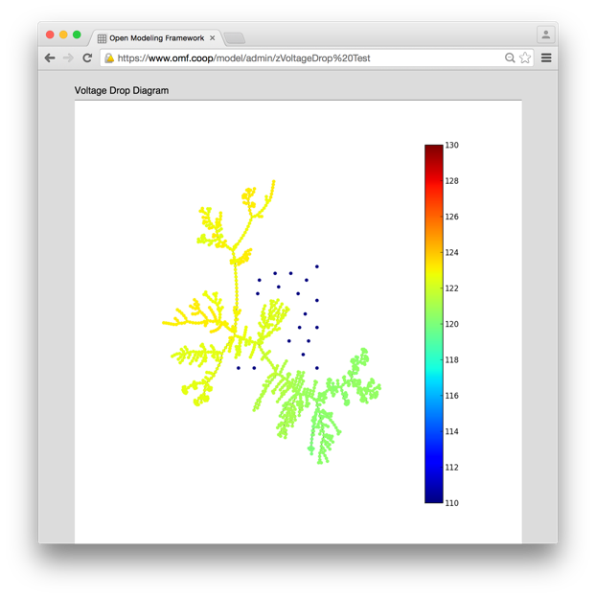
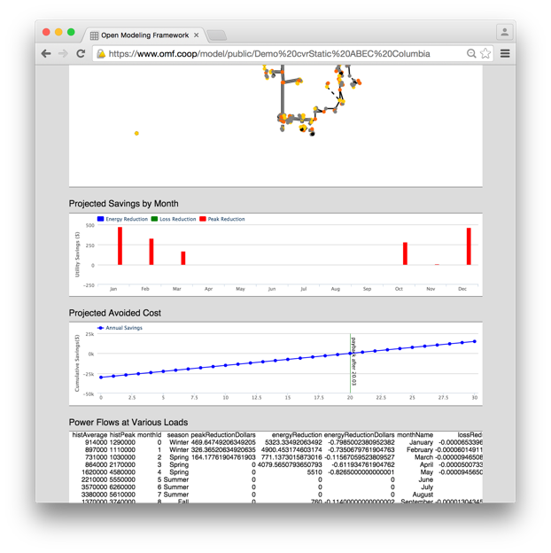
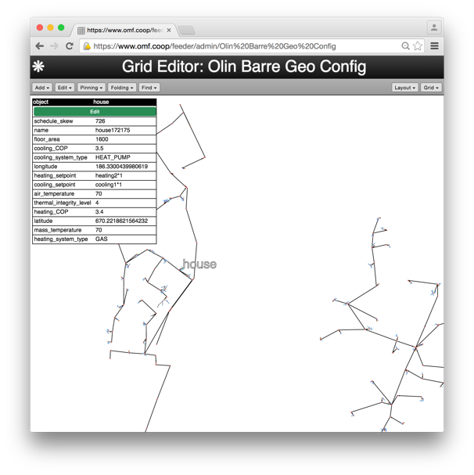
Open Modeling Framework – https://www.omf.coop
Free and open source electric utility modeling software
Built by the co-ops and the US Department of Energy (OE, EERE, ARPA-E)
Offers models to determine:
Benefits of energy storage for arbitrage, peak demand reduction and asset upgrade deferral
Cost and financing options for utility-scale solar
Cashflow and engineering impacts of distributed generation
Full distribution dynamic powerflow simulation (for the ambitious)
Users from 176 organizations (utilities, vendors, universities) as of June 2017.

