Slide 1

December 2018

Slide 2
NRE December 2018
Welcome & Agenda
Jibber
Jabber
Waffle
Pizza & Beers
Notes:
Why all the fuss about NRE?
Is it another fad?
Aren’t we all building reliable networks?
Isn’t this just for Goole, Netflix, Amazon etc?

Slide 3
NRE December 2018
?
Notes:
Why all the fuss about NRE?
Is it another fad?
Aren’t we all building reliable networks?
Isn’t this just for Goole, Netflix, Amazon etc?

Slide 4
NRE December 2018
It’s BS Bingo Time!
DevOps
DevSecOps
SecDevOps
NetOps
DevNetOps
DevNetSecOps
Site Relaibility Engineers
Observability Engineers
Chaos Engineering
Automation & Orchestration Engineers
Reliability Engineer
ENGINEERING
Notes:
Why all the fuss about NRE?
Is it another fad?
Aren’t we all building reliable networks?
Isn’t this just for Goole, Netflix, Amazon etc?

Slide 5


NRE December 2018: Litmus
“I’m going to automate the out of this…”
Answer =
“Declarative is just for building VMs!”
Answer =
Notes:
Imperative and Procedural is one engineer footstep forward. Baby steps really.
Everyone seems to love Python.

Slide 6



NRE December 2018
Current State
=
I Python
Notes:
Imperative and Procedural is one engineer footstep forward. Baby steps really.
Everyone seems to love Python.

Slide 7
NRE December 2018
Current State
Unix
Scripting
1970s
History
Solid Engineering
Notes:
Imperative and Procedural is one engineer footstep forward. Baby steps really.
Everyone seems to love Python.

Slide 8
NRE December 2018: Why
Engineers building button driven imperative versions of their activities
We’re going back to grass roots although slowly
In the land of the blind, the one eyed person is royalty…(a modern take)

Slide 9
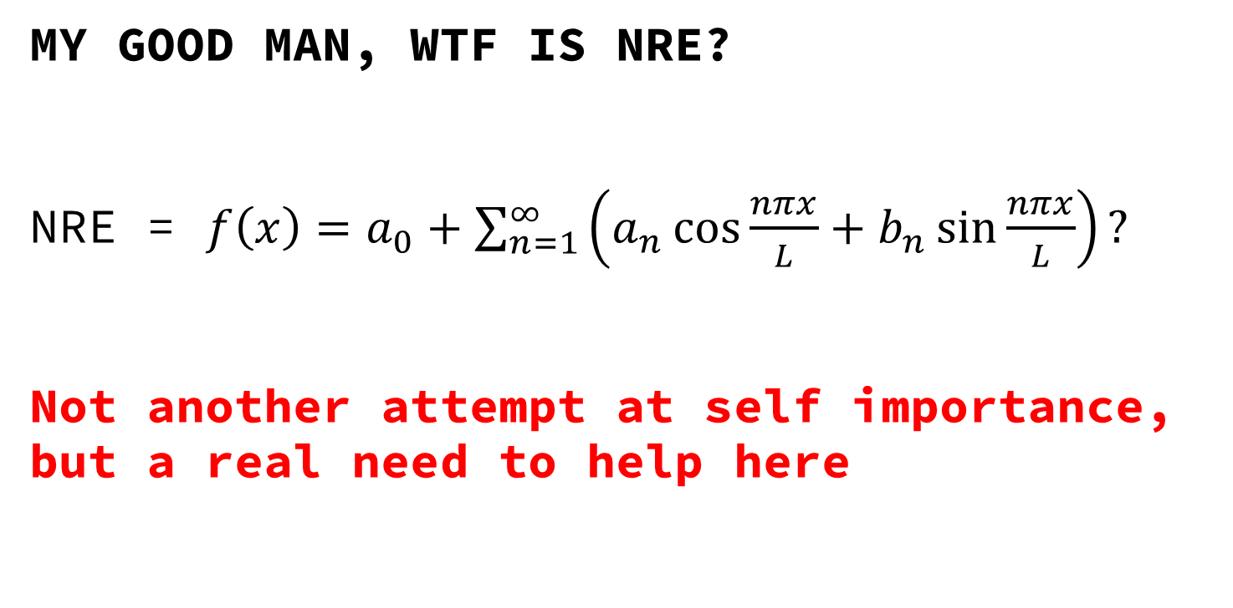
NRE December 2018: Why
MY GOOD MAN, WTF IS NRE?
NRE = $f\left(x\right)=a_{0}+\sum_{n=1}^{∞}{\left(a_{n}\cos{\frac{nπx}{L}}+b_{n}\sin{\frac{nπx}{L}}\right)}?$
Not another attempt at self importance, but a real need to help here
Notes:
We over complicate things needlessly. NRE is grass roots engineering with brain engagement.

Slide 10
NRE December 2018: What
What is NRE?
Software + Automation skill sets laid over deep network engineering
Remove hope
Focus on “reliable” approaches
Actual Engineering
Understand -> Design -> Test -> Implement -> Measure -> Optimise -> LOOP

Slide 11
NRE December 2018
How do we do this reliably?
Design patterns
Architecture
System engineering principles
Nomenclature and language to define
Educate those around us

Slide 12
NRE December 2018
NRE
To build proven, reliable , predictable, measurable and observable systems
Chaos Engineering
Strength
Observability
Events
Feedback
Orchestration
Safety Buttons
Automation
Telemetry
Empathic Understanding -> Solid Design -> Absolute Test -> Engineered Implementation -> Accurate Measurements -> Required Optimisation \r

Slide 13
NRE December 2018
Thoughts?

Slide 14
NRE December 2018
Where do we go from here?

Slide 15
NRE December 2018
Language & Blueprints

Slide 16
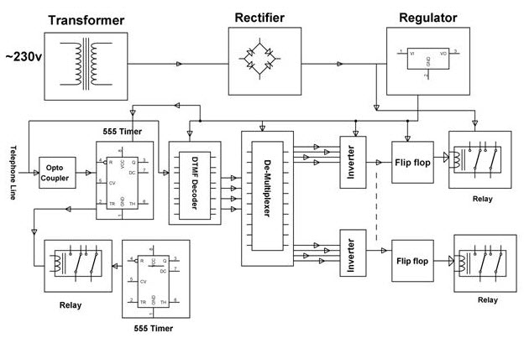
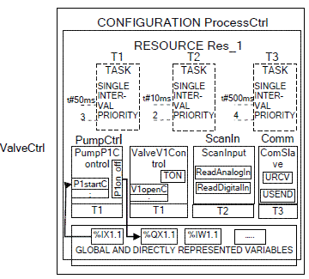
NRE December 2018
To give you a measure of our progress
Notes:
A pseudo electronic schematic and Functional Block Diagram of an industrial process.

Slide 17


NRE December 2018
And we say?
Flow charts, directed and cyclic graphs should be here instead.
Engineering 101 is missing!
Notes:
Most design documents I’ve seen point to Ansible or Salt and say “Automationz”. Great ☹

Slide 18
NRE December 2018
Actions

Slide 19
NRE December 2018
Notation Language, Real Examples, Guidance
Schematics
Flow charts
Ordered systems (1st / 2nd)
Feedback
Concurrency & Recursion
Temporal Dimensionality
Deep & Shallow Systems
Flow of data: Imperative, Declarative, Event-driven
Finite State Machines

Slide 20
NRE December 2018
This group can share, learn and educate the wider community
Short 15-20 minute pitches from members
Aim to publish articles, how-to guides and videos on best practice

Slide 21
NRE December 2018
Anyone Else?
Should we do this again?

Slide 22
NRE December 2018
GitHub: https://github.com/nremeetup
Site: https://nremeetup.net
Work to be done here as a community of good folk

