Slide 1




Fraser House Hub
White Cross Business Park
Lancaster
LA1 4XQ
Tuesday 21st November 2023
18:00 – 20:00
Speaker Name
Speaker Job, Location
Talk title might be quite long and go on multiple lines
Speaker Name
Speaker Job, Location
Talk title might be quite long and go on multiple lines
Sign up on Meetup: meetup.com/rladies-lancaster/

Slide 2
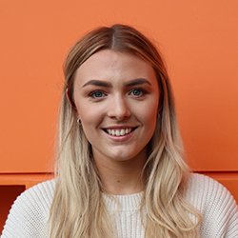
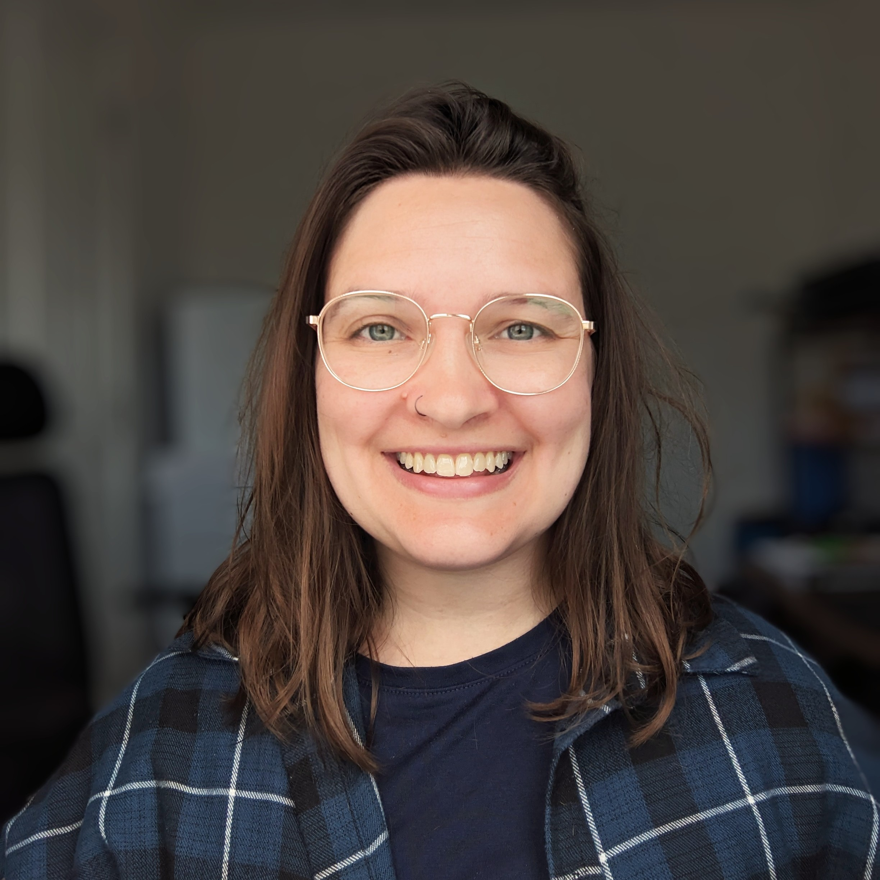
Fraser House Hub
White Cross Business Park
Lancaster
LA1 4XQ
Tuesday 21st November 2023
18:00 – 20:00
Eleanor D’Arcy
PhD Student, STOR-i
Estimating extreme sea levels with R
Cristine Rauber Oliveira
Applied Scientist, Yelp
Never trust summary statistics alone, always visualize your data
Sign up on Meetup: meetup.com/rladies-lancaster/

