Slide 1

Truck Fleet Risk Analysis using Hadoop Environment
Revati Shirish Navgale (RXN220009)
MIS 6346.002 Big Data

Slide 2
Why are we here
Problem Statement
Az National Trucking (ANT), is a fictional national trucking corporation headquartered in California. We need to ensure that all the drivers in their fleet are following the rules and regulations of the corporation and do not present an insurance risk due to factors including speeding, unsafe following, lane departure, and other unsafe driving practices.
Objectives
Accidents caused by large trucks remain one of the leading causes of injuries and deaths in the United States. The objective is identifying dangerous commercial truck drivers of ANT, nationwide,
Use Hadoop tools and techniques to process and analyze the data and, create visualizations using Tableau
Use truck fleet data to analyze and predict trucking movement to meet the organizational goals of mitigating risk
Notes:
Problem statement :
Az National Trucking (ANT) - national trucking corporation in California.
When we talk about trucking corporation we talk about trucks, drivers and other employees.
We need to ensure that all the drivers in their fleet are in compliance with the rules and regulations of the corporation
and there is no risk due to factors such as speeding, unsafe following, lane departure, and other unsafe driving practices.
Accidents by Large trucks is one of the Leading cause of injuries and deaths
Our objective here is to identify truck drivers of the corporation who are risk to the company and the nation.
Use Hadoop tools and techniques to process and analyze the data and, create visualizations using Tableau
Use truck fleet data to analyze and predict trucking movement in order to meet the organizational goals of mitigating risk

Slide 3
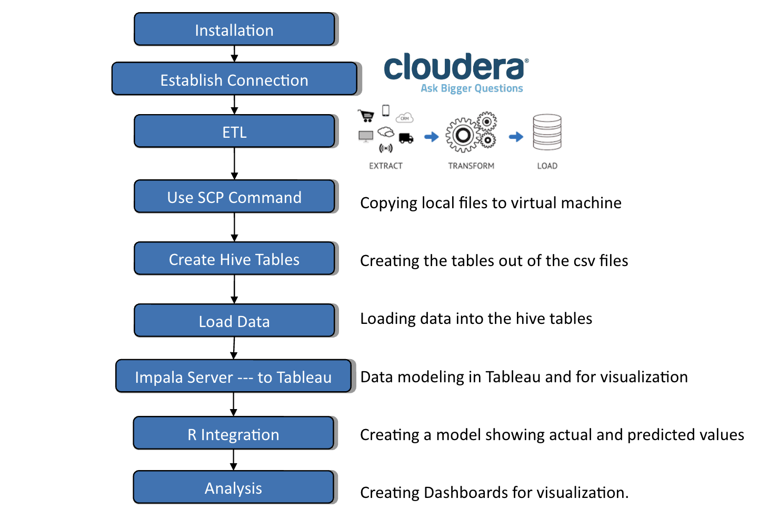
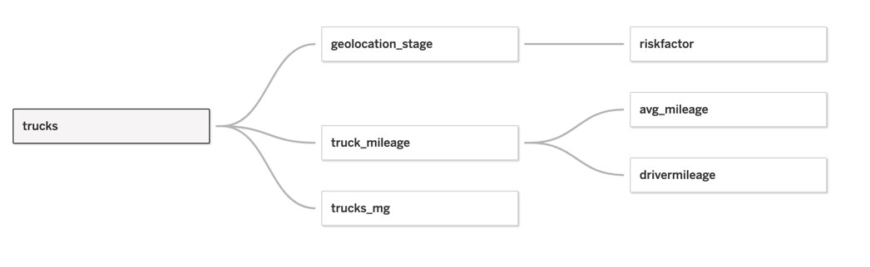
Flow Diagram and Data Exploration

Slide 4
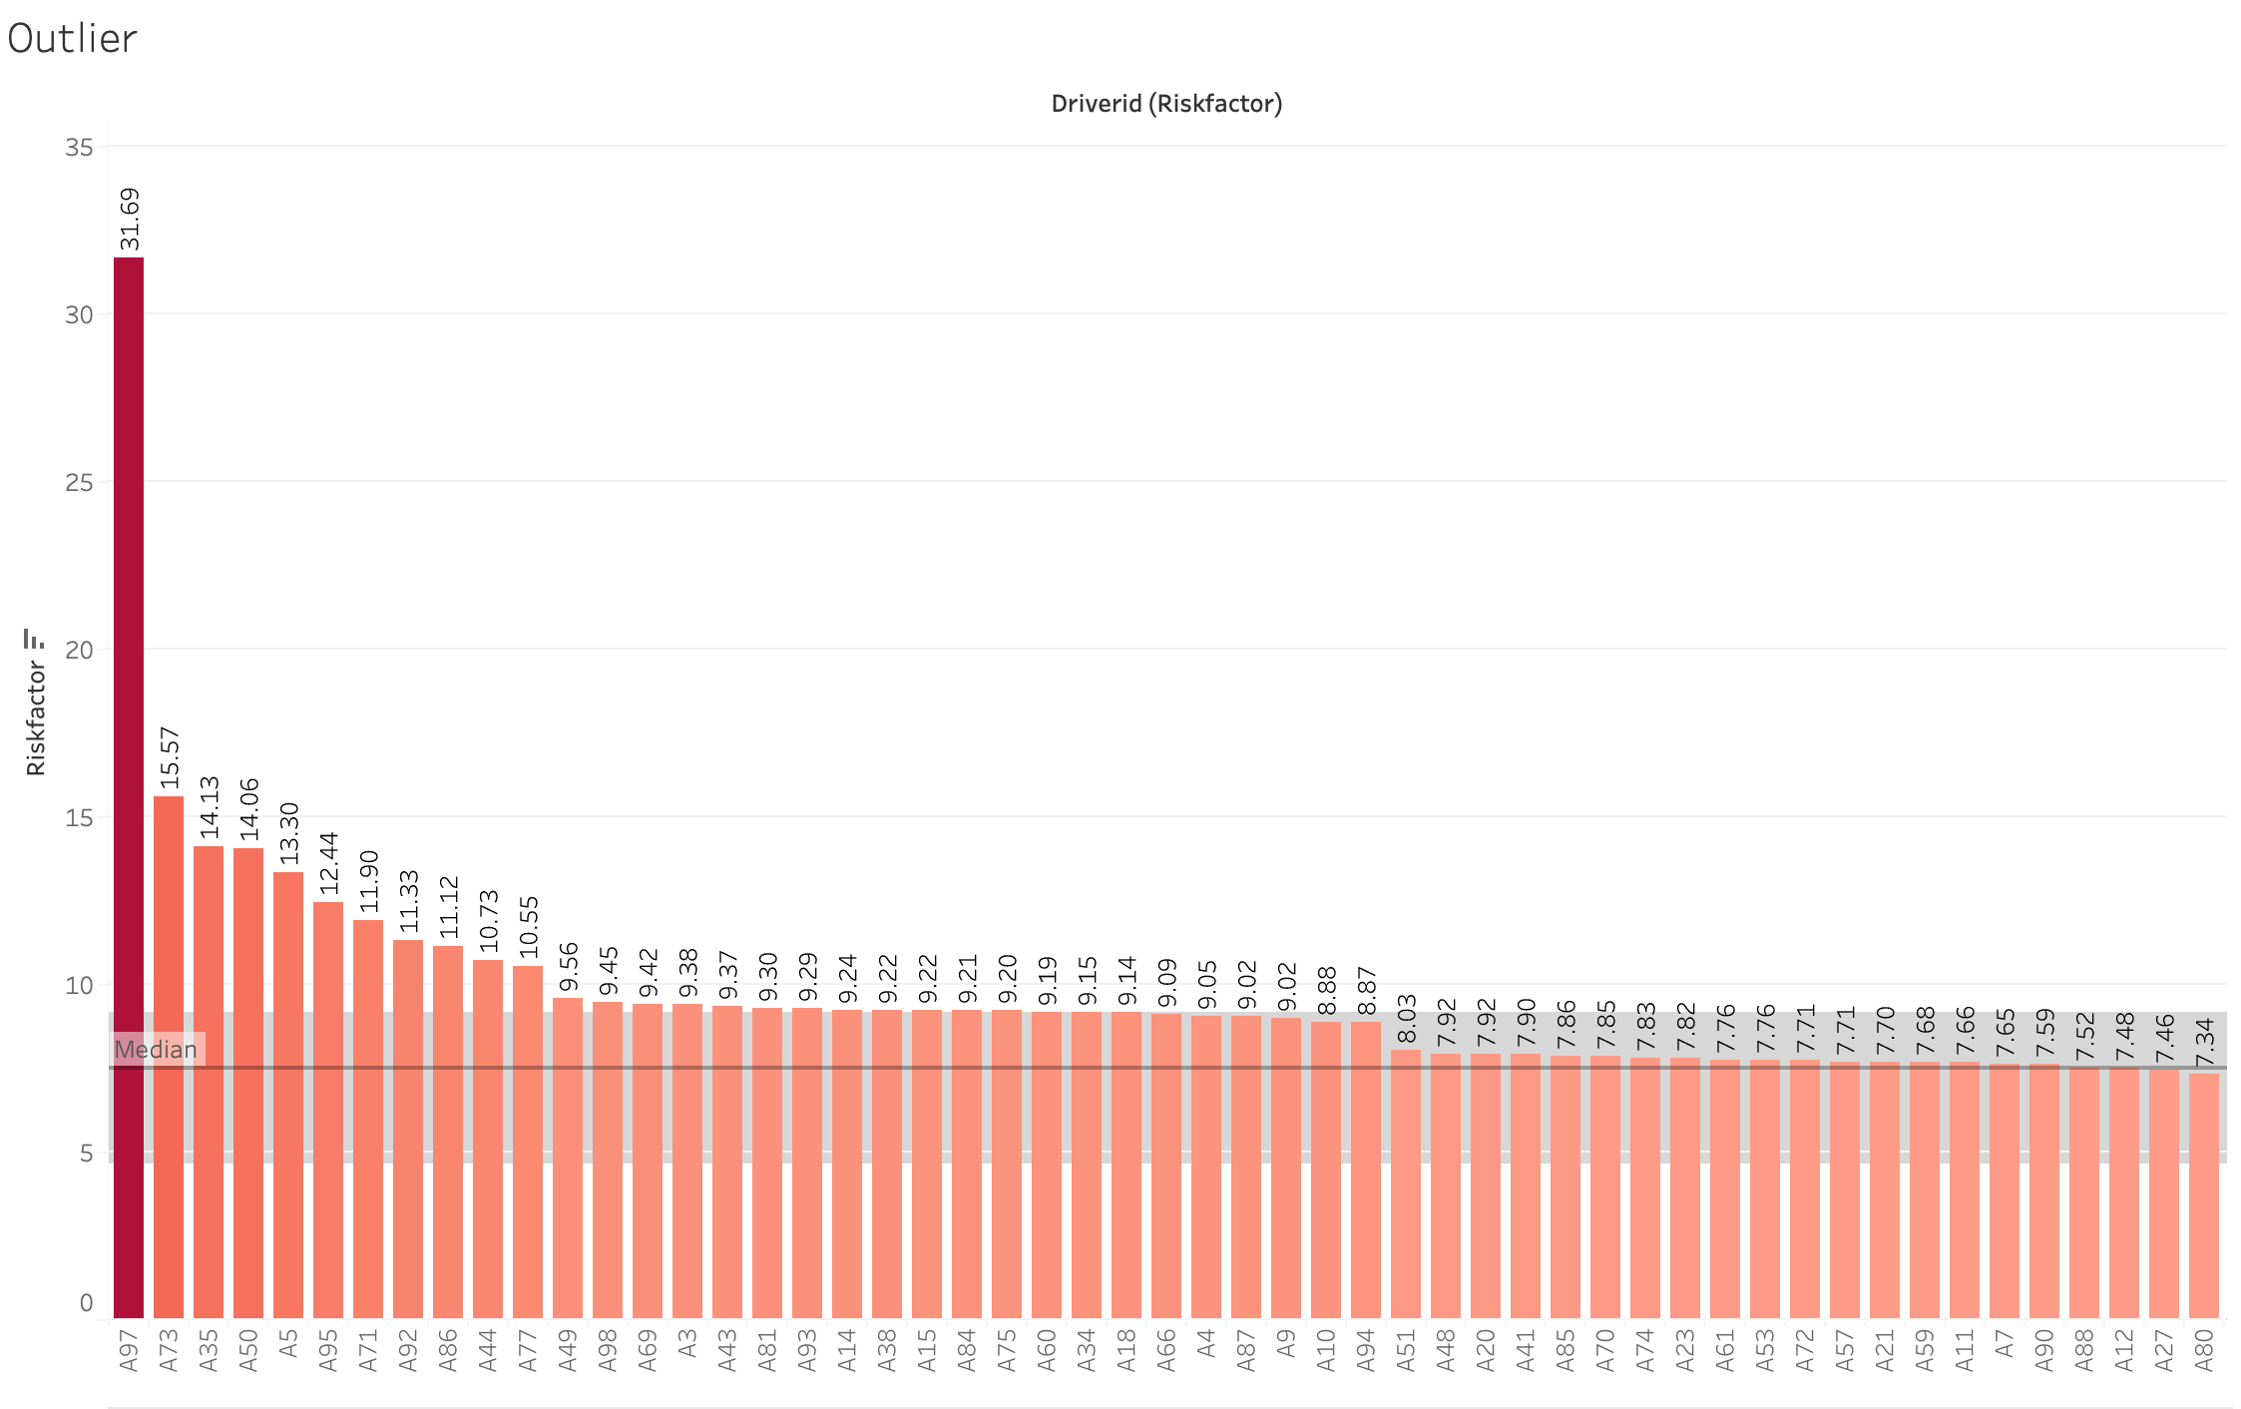
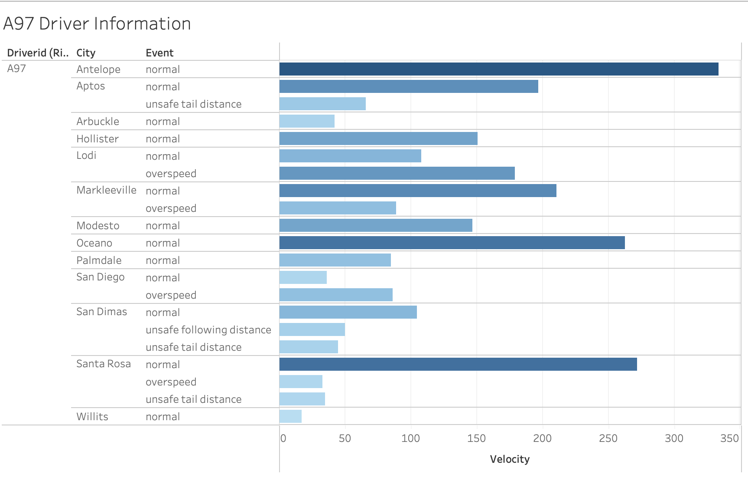
Results However, examination of the detailed information in the table reveals no abnormal incidents recorded for driver A97, with all reported events having reasonable velocities. Therefore we decide to keep the driver A97 in our analysis.
A-97 an outlier?
Insights
Histogram indicates an outlier is present in the dataset.

Slide 5
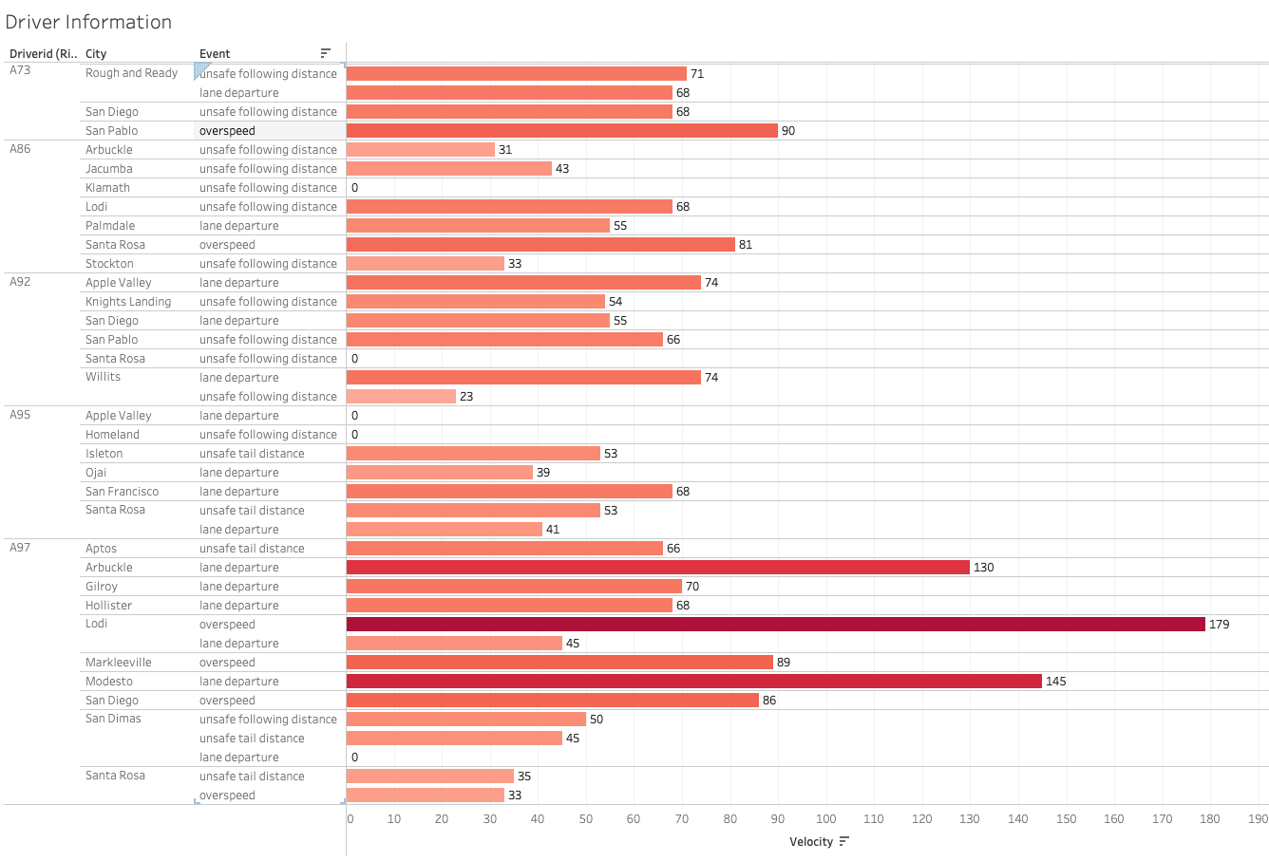

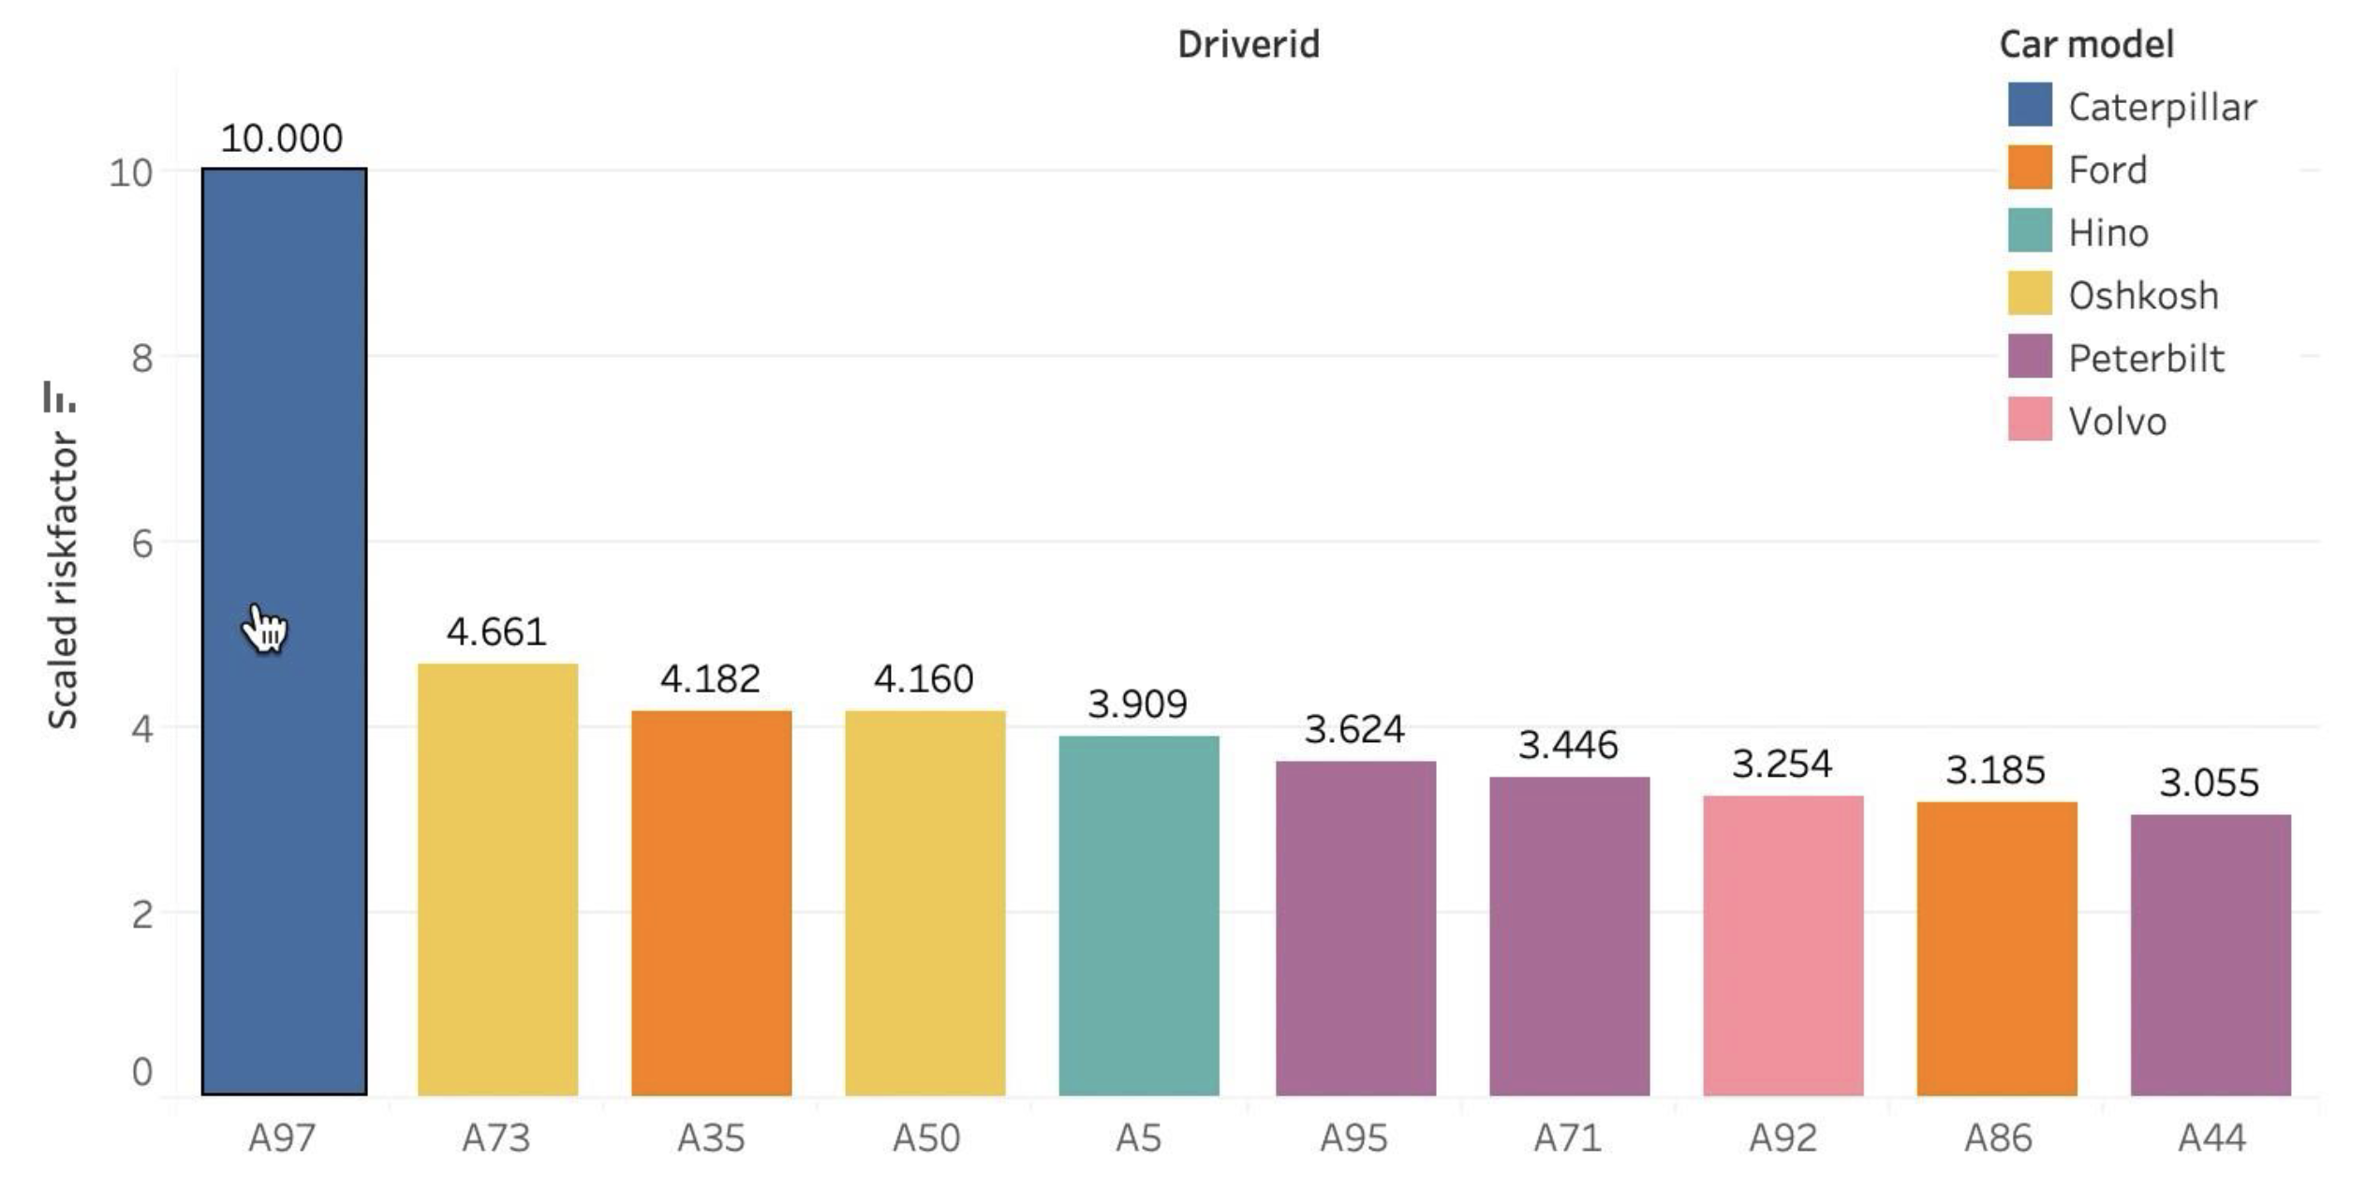
Recommendations In order to reduce the frequency and number of events, it may be beneficial for the organization to monitor the driving habits of the ten drivers, particularly driver A97 to identify any patterns that can be mitigated to reduce the risk factors.
Top 10 Risky Drivers
Insights
A97 with an unusually high-risk factor and involved in multiple events causing risk
Most number of times any event was reported was by driver A97 for overspeeding and even the second and the third most is also linked to the same driver for lane departure
Overspeeding seems to be the most common event driver A73 who is the second riskiest driver

Slide 6
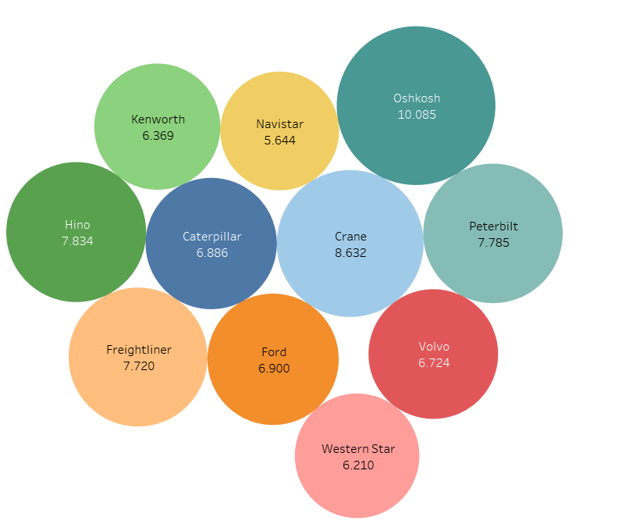
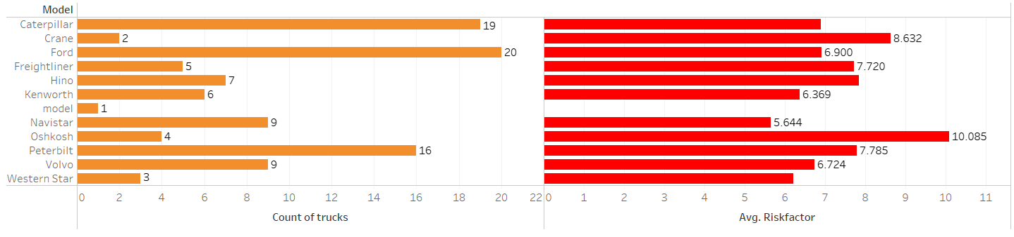
The second graph indicates the count of trucks along with the risk factor. Here we can see that Ford has the highest count of trucks and Oshkosh has comparitively lower number of trucks still the highest riskfactor.
Oshkosh: Model with the Highest Risk factor
Insights
Oshkosh model has the highest risk factor out of the rest of all which is very much evident based on the size of the bubble.
After Oshkosh we can say that Crane(8.632) and Hino(7.834) have the highest risk factor.

Slide 7
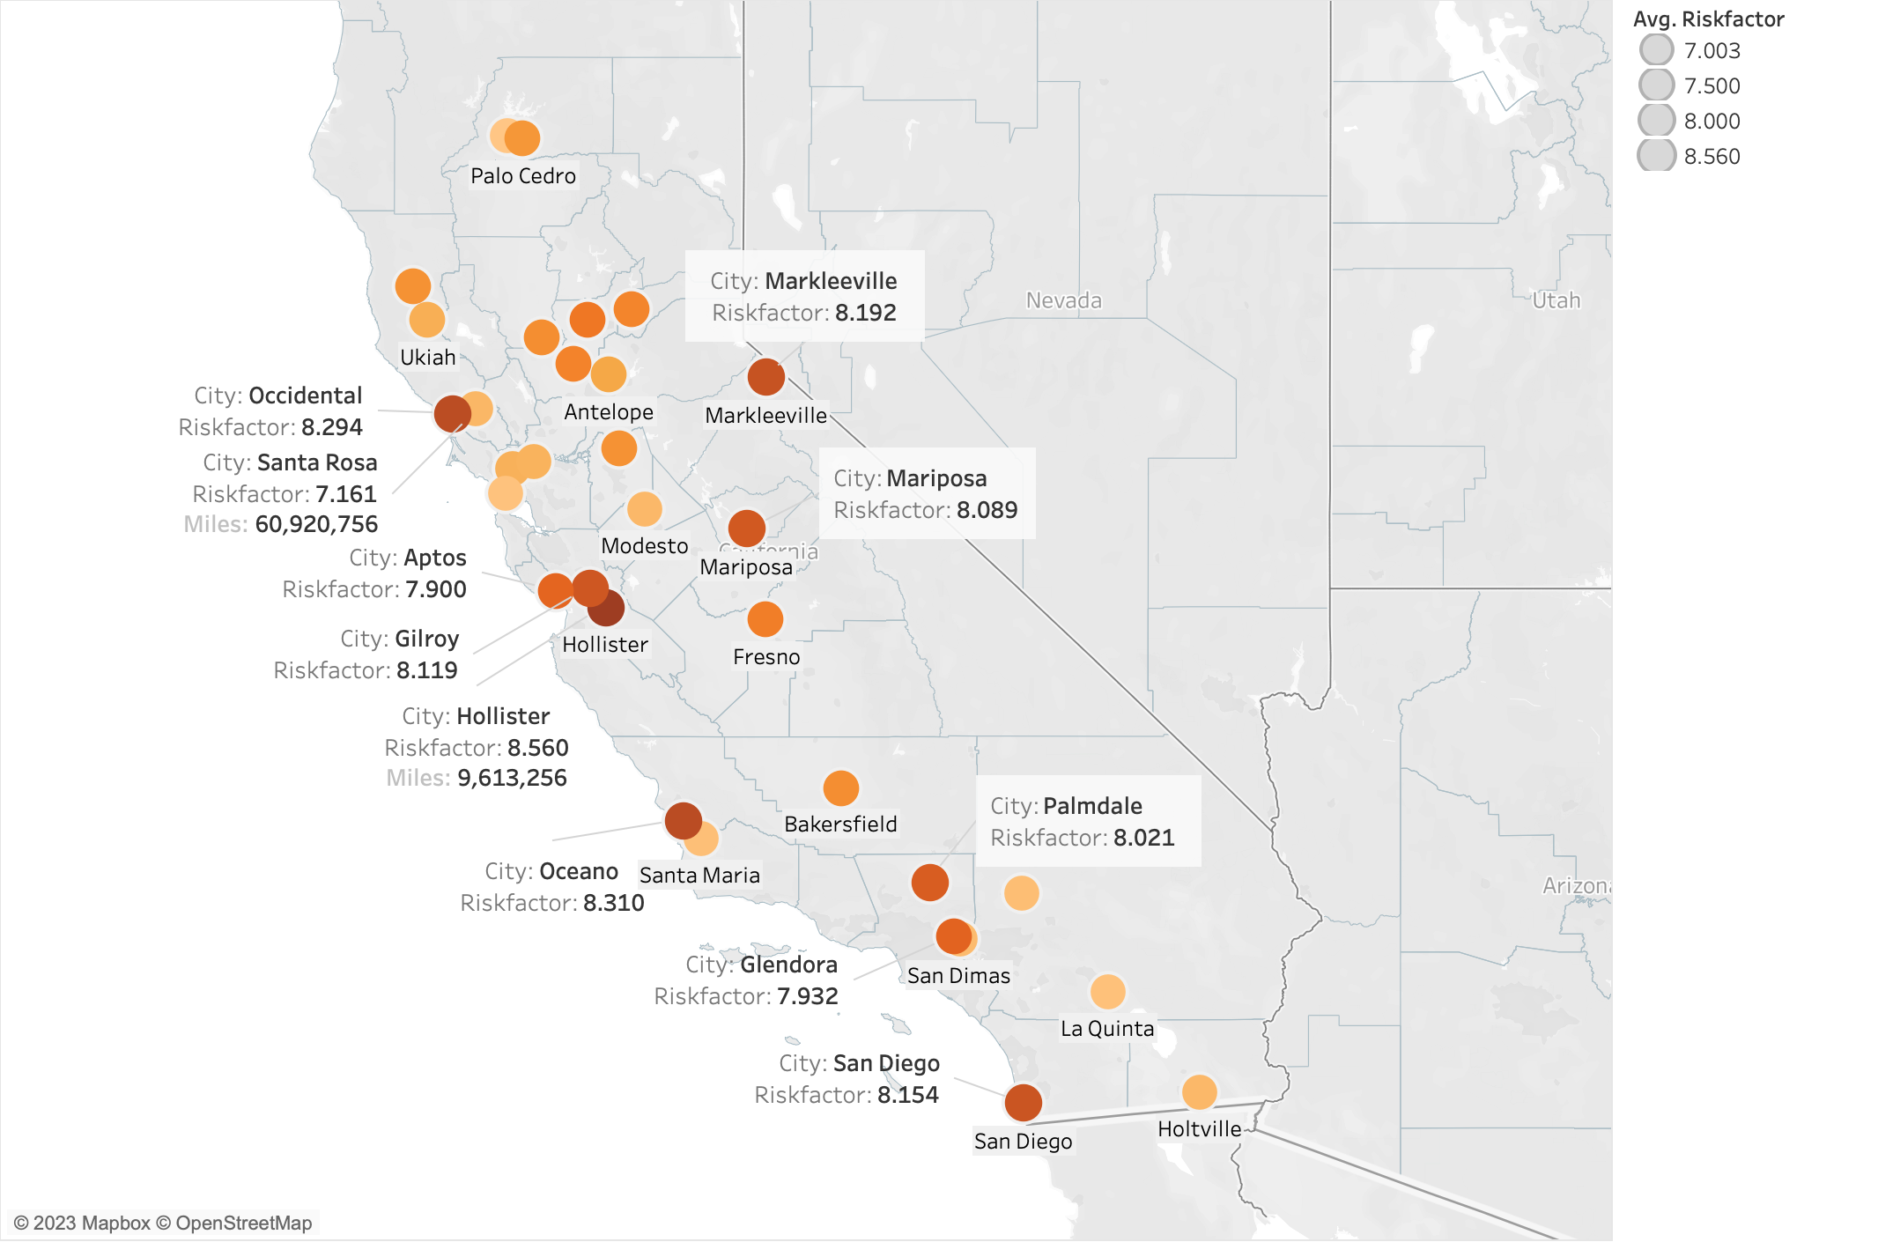
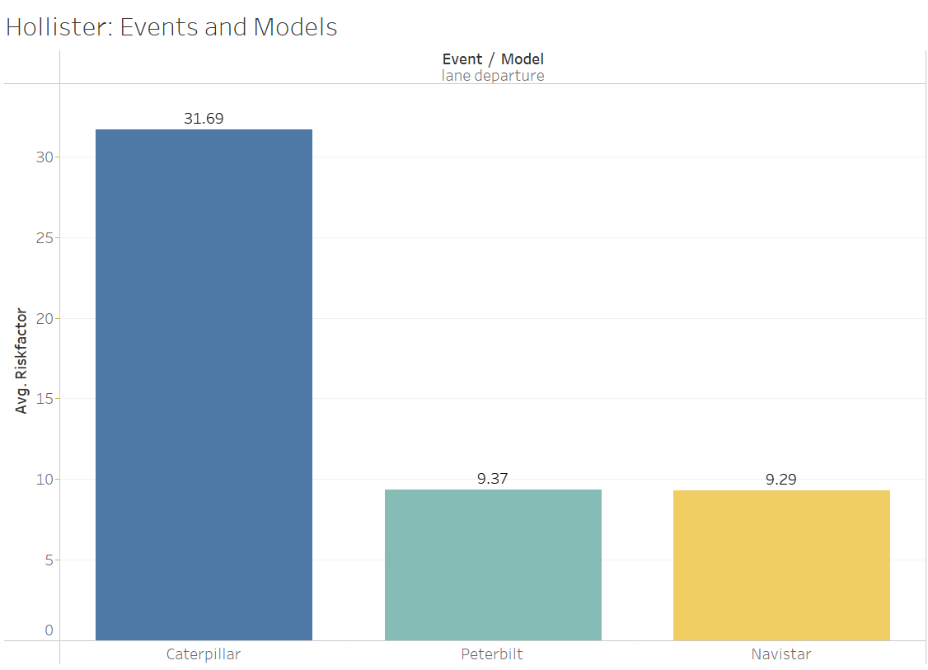
Hollister: The city with Highest Accident Rate
Insights
The bar graph depicts the events and models with their risk factors in Hollister.
The only factor that influences the risk factor in Hollister is the Lane Departure.
Caterpillar is the most unsafe model overall with the greatest level of risk.
Recommendations
By analyzing the models more prone to each of the incidents, we can suggest the appropriate fixes or upgrades accordingly to avoid accidents throughout all the cities of California.
Since the lane Departure is the prominent issue, we can assume that the issues are arising due to poor roads.

Slide 8
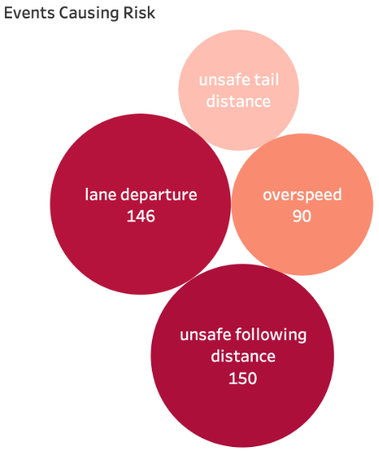
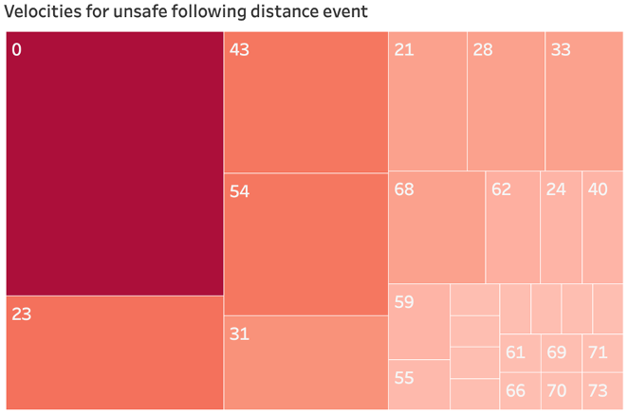
Most common risky event: Unsafe following distance
Insights
Keeping safe distance is imperative for trucks as they need twice the stopping speed as compared to a normal passenger vehicle
Lane departures is another equally major cause of risk as there are many blind spots for a truck
Looking at the velocities for unsafe following distance event revealed that the highest risk is when the truck is idle, that is when the truck is parked on the side
Recommendations
Investing in training the drivers and sensitizing them about the risks involved
Making sure to inculcate drivers with the safe driving practices listed below
Keep safe following distance
Do not change lanes frequently, and
Do not park on the side unless there is an emergency

Slide 9
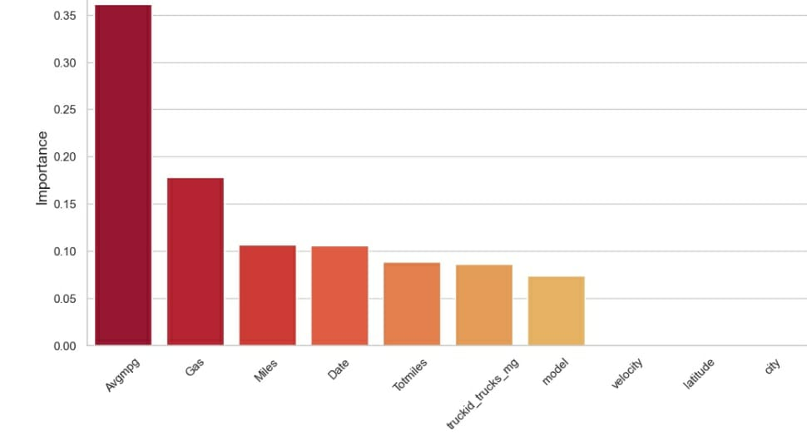
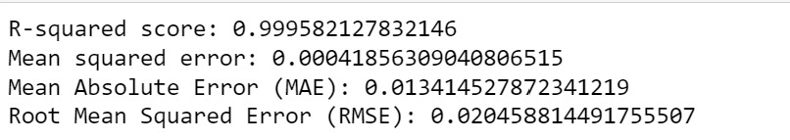
Regression Analysis
Model Performance:
Insight:
"avgmpg” and "gas" are the top 2 most important features whereas ”latitude” and “city” are the least important features in predicting risk.

Slide 10
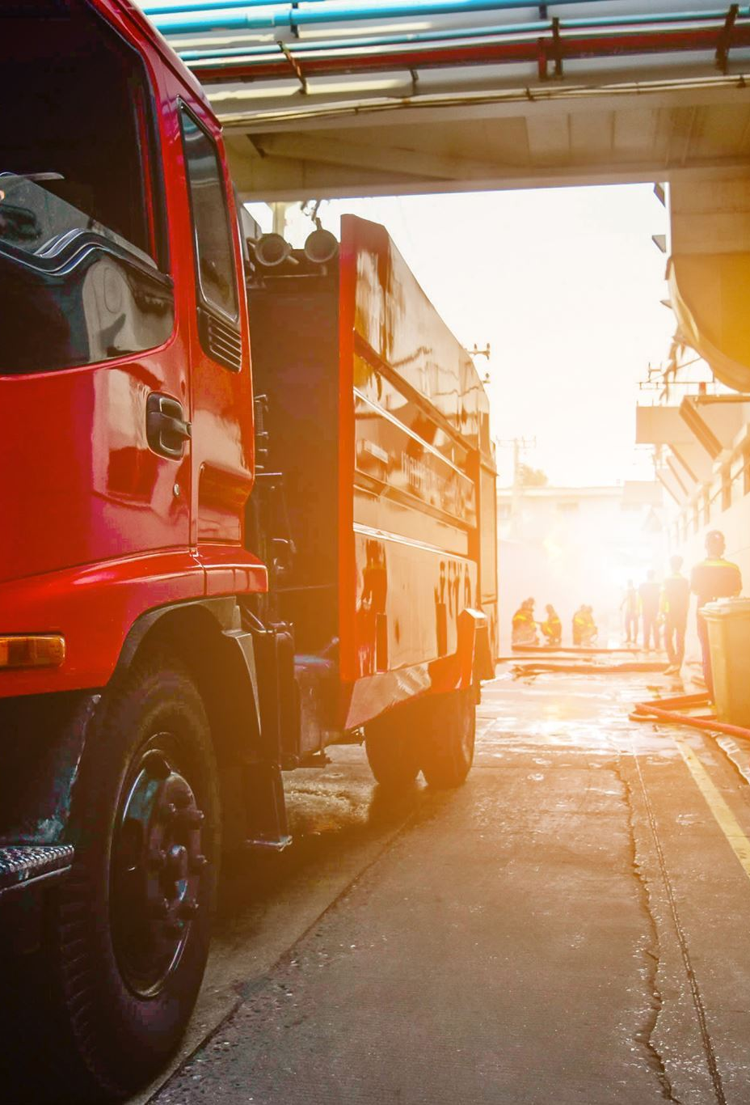
Conclusion
Conducted a study based on many parameters, including event risk, truck types, categorization of drivers' driving styles (from most dangerous to least risky), and average speed to prevent accidents.
Recommendations:
Invest in driver training by identifying driving patterns of risky and safe drivers to impart safe driving practices
Lane assists must be installed as it is one of the most common event (lane departure).
Monthly incentives can be provided if the drivers have low events for the month to encourage safe driving
Least risky drivers can be assigned to cities or routes prone to more accidents and providing training to most risky drivers.

