Slide 1
Requirements
We have an engagement with a data provider of the Sentinel mission called sentinel Hub: https://scihub.copernicus.eu/
Your task is to build a browser-based application that does the following:
Has a single page
Upon loading the application, load 2 random Sentinel 2 images over Israel, with less than 30% clouds
The application should have 2 buttons:
“Replace” - upon click, replace the previous images with 2 images with the same selection criteria.
“Brighten” - upon click increase image brightness by 10%

Slide 2
Challenges
Learn new APIs – search API and OData API
How to define the area → Polygon
How to add authorization to request
Create search request to retrieve the products ids
Limit
offset
Create OData request to get images
Add authorization to image request
Fetch with credential and create blob URL
Get next X images
How to brighten the picture

Slide 3
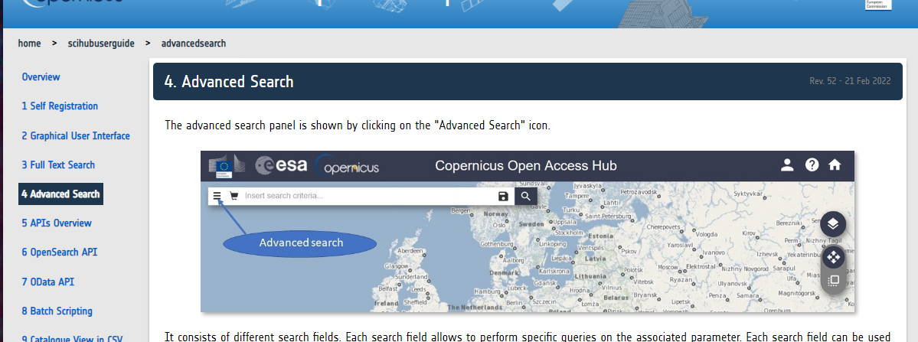
Using search bar and inspect API request

Slide 4
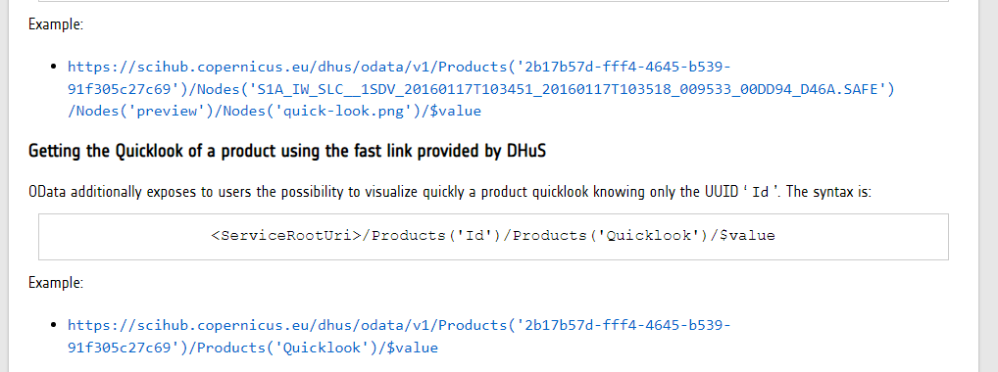
https://scihub.copernicus.eu/twiki/do/view/SciHubUserGuide/ODataAPIest

Slide 5
Add authorization to image request challenge
<img> tag with product URL returns 401 unauthorize response
Get the image through axios authenticated request
Create an object URL from the response data.
const blob = await response.blob();
const objectUrl = URL.createObjectURL(blob);
Use this URL as src for <img> tag

