Slide 1
Twenty Hats: Trivia Maze
Nathan Graham, Eric Laib, Kyle Johnson, Daniel Moore

Slide 2
Maze Structure:
Floors / Stairs
Patterns
Path Finding Algorithm
Difficulty Levels

Slide 3
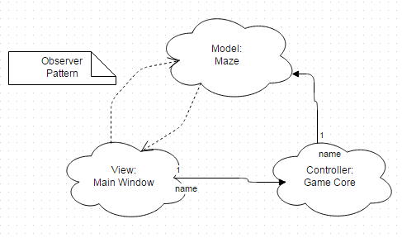
MVC Pattern:

Slide 4
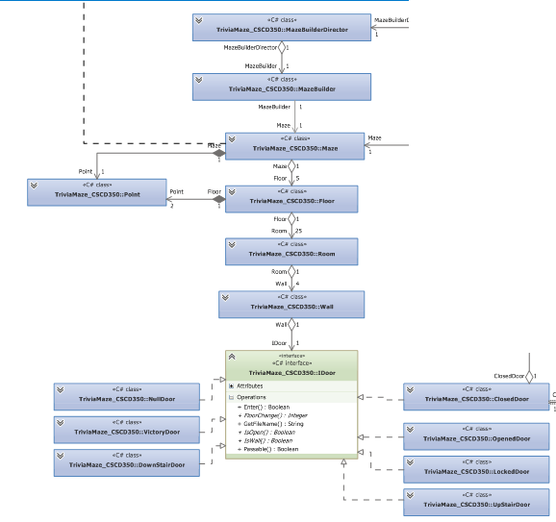
UML

Slide 5
Database:
Database Tool
Database Questions
Database Classes

Slide 6
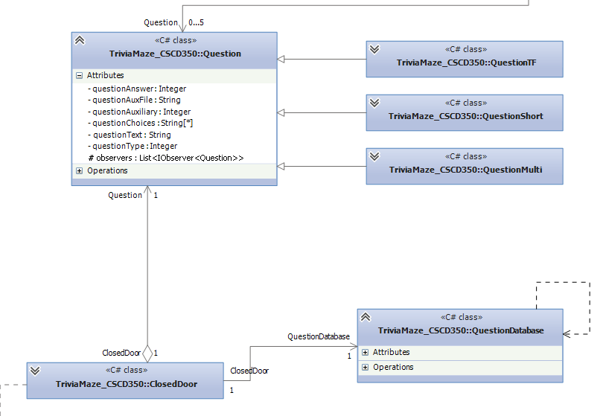
UML

Slide 7
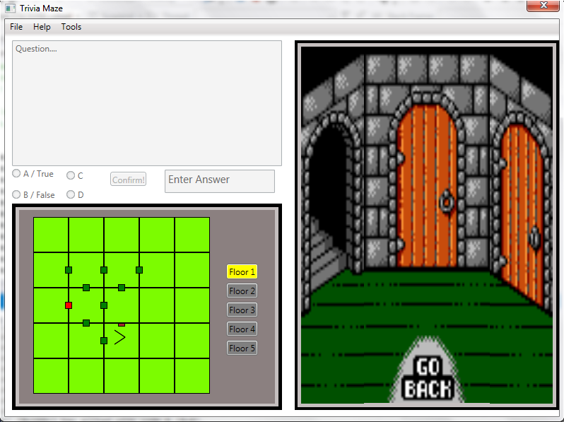
Interface:

Slide 8
User Interaction:
Question Interaction
RandomProvider
Image and Sound Question.

Slide 9
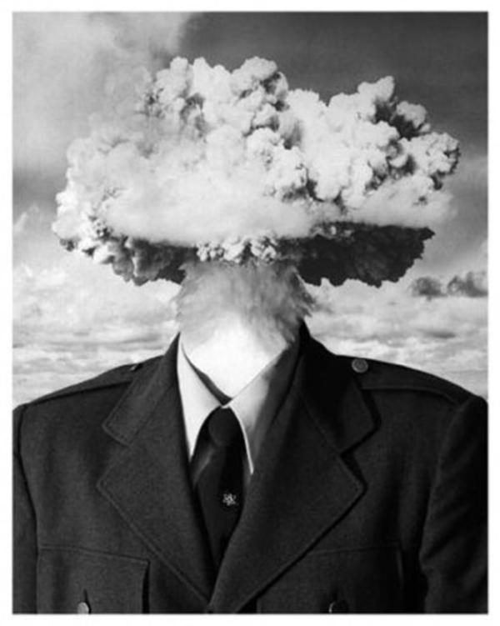
GET READY TO GET YOUR MIND BLOWN!

