Slide 1


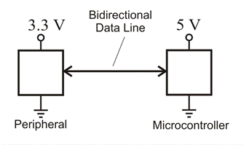
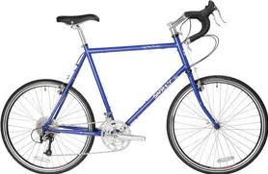

Multi-Chemistry Battery Charger
Team Members: Nickolas Kruger, Nichole Griffith
Use white background to save ink
Abstract
This project will recreate the video game “Pong” using an oscilloscope as the display. Two players will each control a dial which move vertical paddles up or down in order to deflect a bouncing ball. The oscilloscope will be configured such that graphics can be drawn directly to the display. A digital-to-analog converter will be used to produce the voltages necessary for the oscilloscope, and a speaker will provide audio feedback during the game.
Introduction
Provide a motivation for your project. For example:
The product I designed and built, was inspired by the Staple s ® “ Easy” button and our experiences as teaching assistants at The University of Iowa.
We designed and built a super-duper Easy button that one can program with various phrases. An instructor can use this to inject a bit of humor in, say Linear Systems, by pressing the button after solving partial fraction expansion. The button will then respond with phrases such as “Good job!”, “Attagirl”, etc.
Keep the font size at least 32 pt
Pictures should have short captions. For example: Our product was inspired by Staples’ ® “Easy Button”
Provide additional background material as appropriate.
System Description
Change the color, font etc. to show your creativity. Stay away from very dark fills, so we save some ink
Here give an overview of your system. A good way to do this is to provide a diagram that shows all the major components. You may even number the components and write a sentence about each. For example:
Shown are the major components the system. The ATmega88PA microcontroller (1), samples the output voltage from an analog temperature sensor (2) every 2 minutes. The voltage is compared against a reference, and used to turn on a heater (3)…
Do use too much text! Try and tell the story with pictures and some text. A poster is NOT a term paper. Talk about your design process/thinking.
Temp Sensor
1
+5 V
2
A/D
ATmega88PA
Caption: System overview.
Caption: Level-shifting.
Text in figures should be roughly the same size as body of poster. This text is too small!
Results
Annotate photographs where appropriate
Here present some results for your project. This could be a plot of data your collected. For most term project in this class, however, this will be a photograph or two showing the complete system.
For example, if you designed a “gizmo” that attaches to a bicycle, you would show an “action shot” of a person on the bicycle. The figure(s) would have a short caption(s).
The purpose of this section is to explain how it all came together. A terrible rookie mistake is to focus on what went wrong. Focus on the success stories in your project!
Gizmo
Gizmo
Caption: Photograph of gizmo attached
to bicycle
Caption: Photograph of gizmo attached
to bicycle and in use
Frames/borders can make your poster “pop”. Compared these with the other unframed images on the poster.
Lessons Learned
Conclusion
Here present some information on lessons learned. For example, you can talk about the challenges of packaging, gluing parts that operate at different voltages, etc. Turn the lemons you ran into, into lemonade. Focus on the positive. For example, “during this project, I really learned the importance of carefully reading data sheets” rather than “the data sheet was really bad and because of that, we burned up our chip”.
Write a short conclusion. End on a positive note. Perhaps talk about future work you plan for this project.
This is also a good place to acknowledge help you received packaging, etc.
Also, be sure to thanks Ms. Blanc and Ms. Kern who helped print the posters.
55:036 Embedded Systems 2018
The University of Iowa

