Slide 1
Predictive Model for Password Strength Assessment
MSBA Practicum
Mr. Nicholas R. Hartnett MGS-649
Professor Dominic Sellitto 5/12/2023

Slide 2
Introduction
Advancements are constantly being made to bolster security
Weak passwords pose a significant threat to online security
There is a growing need for more intensive methods to evaluate and optimize password strength
I aimed to develop a machine-learning model for password strength prediction using predictive analytics techniques

Slide 3
Tools Utilized
• Python version 3.9.13
• Gradio
• Pickle
• Orange Data Mining Application
• Microsoft Word
• University of Illinois at Chicago Password Strength Test
• ChatGPT

Slide 4
Business Issue Understanding
The primary objective of this project was to develop a machine learning model for password strength prediction
Sub Objectives:
Gather data containing the passwords (“RockYou.txt”) and then create password characteristic variables
Train a machine learning model on this data to accurately predict password strength based on the data at hand
Develop a deployable GUI for organization to interact with the model and assess the passwords strength

Slide 5

Data Understanding
A string is composed of individual characters that may be individually analyzed and assessed to indicate a password’s strength
For my project, I chose to focus on the following categories:
lower-case, upper-case, special character, total digits, total string length, the count of vowels, the count of consonants, and a binary variable that determines if the string is a palindrome.
These categories are the variables that the machine learning model used to predict password strength
To acquire a target variable, I used the publicly available Strength test website provided by the University of Illinois at Chicago

Slide 6
Data Dictionary
Variable Name: | Character Length: | Data Type: | Role: | Values: | Description:
Password | 128 | String/Text | Meta | Characters | This field holds the stored passwords.
PasswordLength | 128 | Numeric | feature | Any Whole Number | This field indicates the length of the password as an integer.
VowelCount | 128 | Numeric | feature | Any Whole Number | This field indicates the count of the vowel letters in the password as an integer.
ConsonantCount | 128 | Numeric | feature | Any Whole Number | This field indicates the count of the consonant letters in the password as an integer.
NumberCount | 128 | Numeric | feature | Any Whole Number | This field indicates the count of the numbers in the password as an integer.
SpecialCharacterCount | 1 | Categorical | feature | (0,1) | This field indicates the count of the special characters in the password as an integer.
IsPalindrome | 1 | Categorical | feature | (0,1) | This field indicates if the password is a palindrome.
lowercaseLetterCount | 128 | Numeric | feature | Any Whole Number | This field indicates the count of the lowercase letters as an integer.
uppercaseLetterCount | 128 | Numeric | feature | Any Whole Number | This field indicates the count of the uppercase letters as an integer.
PasswordStrength | 1 | Categorical | Target | (1,2,3) | This field indicates the strength of the password: 1 = Very Weak, 2 = Weak, and 3 = Good.

Slide 7
Data Preparation
I had to ensure that the data was properly cleaned and formatted with no missing data
When ran “SampleGenerator.py”, stored all the variables in a .csv, but it skipped every other row, leaving many blank spaces.
Excel feature “Sort and Filter” and “Delete row” functions
Variables needed to be uniform so that Orange Data Miner could decipher the data
Of the variables, I had selected from “RockYou.txt” the strength values varied between very weak, weak, and good

Slide 8

Exploratory Analysis and Modeling Pt. 1
With all variable's roles and types defined, I could then logically deduce which algorithms would be feasible for my model
My model used a categorical target value with continuous and binary predictors, so I chose random forest as my algorithm
I did test with other algorithms (forest, Naïve Bayes, etc.), but RF performed the best nonetheless

Slide 9
Exploratory Analysis and Modeling Pt. 2
Evaluation results for target “Very Weak” or “1”:
AUC = 1.0
CA = 0.994
F1 = 0.996
Precision = 0.996
Recall = 0.996
Evaluation results for target “Weak” or “2”:
AUC = 0.999
CA = 0.989
F1 = 0.973
Precision = 0.973
Recall = 0.973
Evaluation results for target “Good” or “3”:
AUC = 0.998
CA = 0.994
F1 = 0.800
Precision = 0.800
Recall = 0.800

Slide 10
Validation
The passwords are from 2009 and thus are not nearly as complex or standardized as the current day
With a lack of passwords defined as good and no passwords meeting the criteria of strong or very strong
The model can only train to be exceptionally good at distinguishing between weak and very weak passwords
The confusion matrix (next slide) confirmed my suspicions that the nature of the dataset resulted in a bias in distinguishing between “Very Weak” and “Weak” passwords

Slide 11
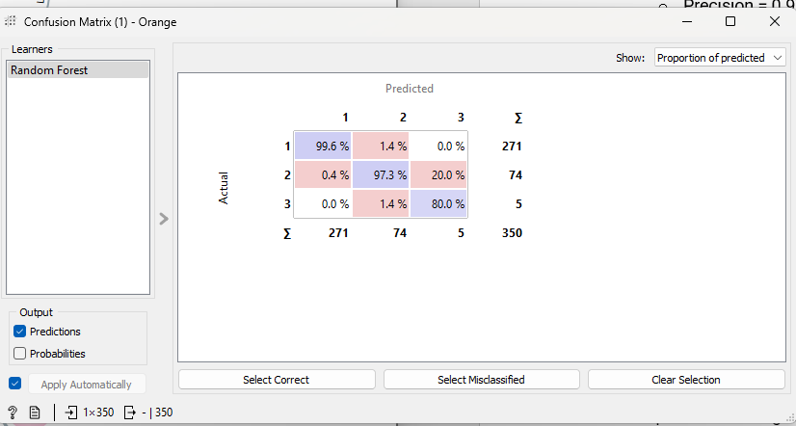
Confusion Matrix

Slide 12
Graphical User Interface
Orange Data Miner .ows file to “PasswordModel.pkcls”
Interacts with Gradio and Orange3 libraries with Python 3.9.13
Application in file: “PasswordStrengthApp.py”
The GUI contains a simple textbox labeled “Enter Password:” to insert a potential password
Returns a score in the password into a textbox labeled “Password Strength:”

Slide 13
Steps to Run Application
Have a Python version of 3.9. 14
Install Gradio and Orange3 in an accessible location for the file
At the location of the “PasswordStrengthApp.py” you must execute the file in command prompt by running the command: “py PasswordStrengthApp.py”
The app may be viewed under localhost at: “http://127.0.0.1:7860/”

Slide 14
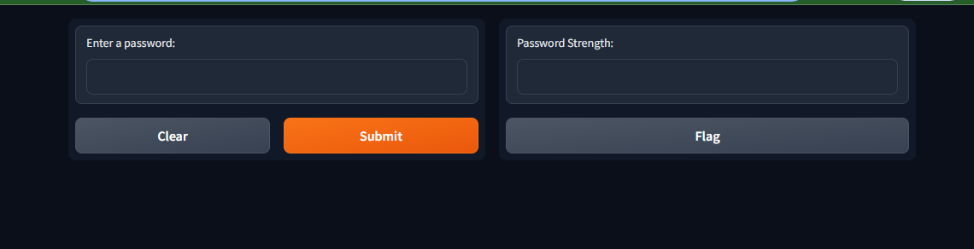
Example of GUI

Slide 15
Summary
To succeed in this field, it is obligatory to have a combination of technical skills, including programming and statistical analysis, as well as soft skills such as critical thinking, problem-solving, and communication
This project allowed me to practice such skills and develop a product
Despite the flaws of my GUI, I have learned lessons and look forward to applying what I have learned to my career

