Slide 1
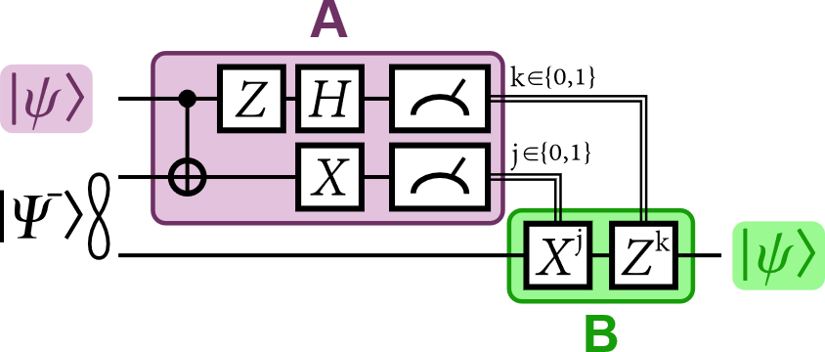
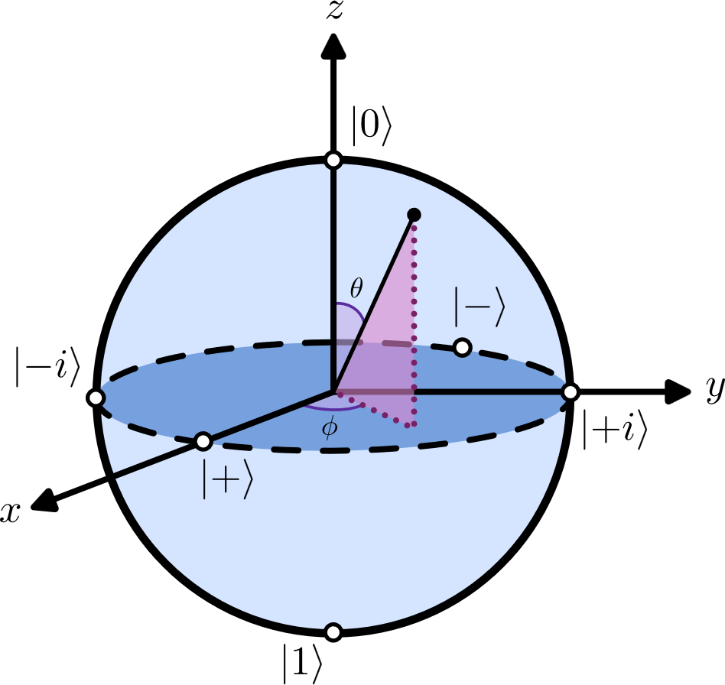
How To Get Started in Quantum Computing
Natalie Hawkins (https://www.linkedin.com/in/natalie-hawkins-seattle/)¹
¹Seattle Quantum Computing Meetup (meetup.com/seattle-quantum-computing-meetup/)
Background
Identify Questions
Start a Project
Working professionals with backgrounds in fields such as physics, chemistry, computer science, math, engineering, and others commonly ask how to get started in Quantum Computing. The answer can be long and detailed. Here is a path for a quick entry from zero and a github with free guides for more info and next steps.
Q: What does the field need?
Hardware, software, error correction, and applications;
See John Preskill’s QGSS25 talk, Qiskit Channel, YouTube
Q. What are good resources for getting/staying current?
Conferences: IEEE’s Quantum Week and Q2B
Blogs: scottaaronson.blog, ibm.com/quantum/blog
News/Articles: LinkedIn, X, BlueSky, QCR, CQE, Medium
Papers: arXiv, sciRate
Q: What is Quantum Computing, or what isn’t it?
See “What Quantum Computing Isn’t”, Scott Aaronson’s TEDx talk on YouTube
Q: How can I learn to write code for a QC?
Note: Qiskit is the most popular quantum computing SDK
Qiskit Coding Challenges – Summer School, Fall Fest
Jupyter Notebooks in the qiskit-community github
Xanadu’s QHack Coding Challenges for PennyLane
See company or uni guidance for the variety of others
Q: How can I learn about available jobs in QC?
QuantumJobs.us
QED-C Job Listings
Subscribe to the ORNL newsletter
The Quantum Computing Report (QCR) jobs list
Company and University Websites, LinkedIn
Starting a project will help you focus your learning and give you something to talk about. You can choose a topic related to your work, or something new you wish to learn or do.
You can get ideas from: (in addition to Search)
Hackathons and Challenges (live or github)
Medium (others write about their projects)
Books (some outline or suggest projects)
Company Blogs/Books/Papers (applications)
Speed ramp to getting started
You can learn in various ways:
Read books, articles, and papers
Take classes
Watch talks/lectures online - YouTube is great
Attend conferences - IRL or online
Participate in hackathons and challenges
Connect with people on social media
Identify use cases matching your interest
Write out questions you’re curious about, and start working on them
Learn to write code that can be run on a quantum computer
Attend meetups
Identify companies and universities in QC
Start a project, write an article for Medium
Conclusion
Helping people act on their enthusiasm and interest can really be a win-win-win-win, for you, for them, for QC, and for society. Visit the github to find guides to go deeper and to accelerate the journey. Feel free to reach out with ideas, and to join the meetup.
Acknowledgements
Wikimedia Commons for logos: QT circuit (JozumBjada), Bloch Sphere (Qupybara)
QC content is large. How can you prioritize?
1) Identify questions to build knowledge
2) Start a project
Free How-To Getting-Started Guides
For More Q’s and A’s, including individual scenarios, see the Free Guides →
See github.com/orgs/Seattle-Quantum-Computing-Meetup/getting-started/.

