Slide 1

CDX
Chiplet Design eXtensible Markup Language (CDXML)
September 20, 2022

Slide 2
CDXML Model
CDX
CDXML contains the following information:
Common data exchange format between the chiplets
Standard data structure with XML schema
D2D interfaces information
Mechanical information
IO information
Electrical information
Power and thermal information
Chiplet integration
Being Developed at CDX Workstream of ODSA in Collaboration with Industry Leaders. CDXML adopted the ZEF opensource model from zGlue.
A More Complete Mechanical :
Reference, Part_value, MPN, Order_Number, Container, Pieces_per_unit, Name, Pkg_type, Pkg_IPC_code, SMT_compatible, Width_x, Width_tolerance, Length_y, Length_tolerance, Thickness_z, Thickness_tolerance, Count_IO, Bump_pitch, Bump_pitch_tol, Bump_dia, Bump_dia_tol, Bump_thickness, Bump_thickness_tol, Bump_material, Mold Material, Reflow Profile
‹#›

Slide 3
CDXML File Format
CDXML format helps define key design aspect of chiplet, in particular, to support the following:
Multiple value options data such as the IO modes
Grouping of data such as min, typ, and max
Nested values
Customizable units
Optional information such as tag and description
Schema-based with XSD, the XML schema definition
Easily extensible data Backward compatible with the older version
CDXML contains the XML data file.
The filename will follow the format of <MPN>.xml. MPN stands for Manufacturer's Part Number which is a unique product identifier.
The schema.xsd XSD file defines the schema of the XML file. For example, the file for chiplet ZGL12345FC would be ZGL12345FC.xml.
There are 3 sections in CDXML; MECH, IO, and ELECT in the file, representing the mechanical, IO, and electrical information of chiplets respectively. Most of this information can be found in the datasheets.
CDX
‹#›

Slide 4
CDXML File Format
Mechanical describes all x,y,z, tolerance, solder type and material properties
IO describes pin location, functionality, mode of operation, EC (Electrical Characteristics), abs max values, operating conditions, allowable RLC, voltage references, temperate based VI (Voltage and Current) pin characteristics
Electrical contains overall electrical characteristics information to aid in power scenarios calculations, modes of operation, absolute maximum ratings, recommended operating conditions, and ESD
CDX
pin1: location, function, mode, EC Table, RLC, f, V, T
pin2: location, function, mode_a, EC Table, RLC, f, V, T
pin2: location, function, mode_b, EC Table, RLC, f, V, T
pin3: location, function, mode, EC Table, RLC, f, V, T
.
.
.
pin_n: location, function, mode, EC Table, RLC, f, V, T
Overall Electrical Characteristics
Modes of Operation
Lists of Voltages and Current Draw vs Modes
PVT (Process, Voltage and Temperature) Normalizing Data
‹#›

Slide 5
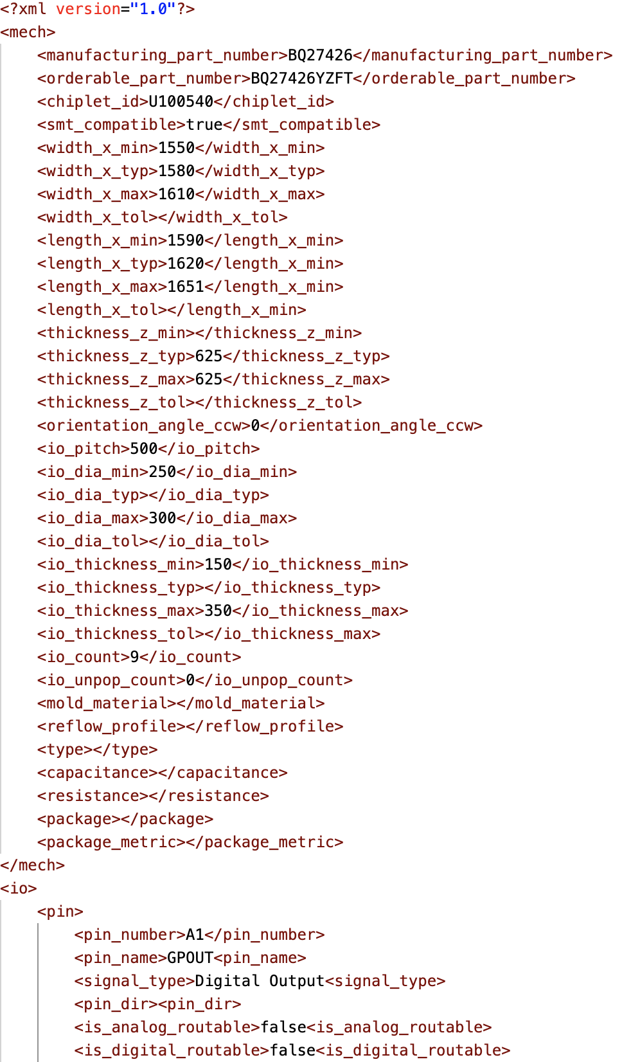
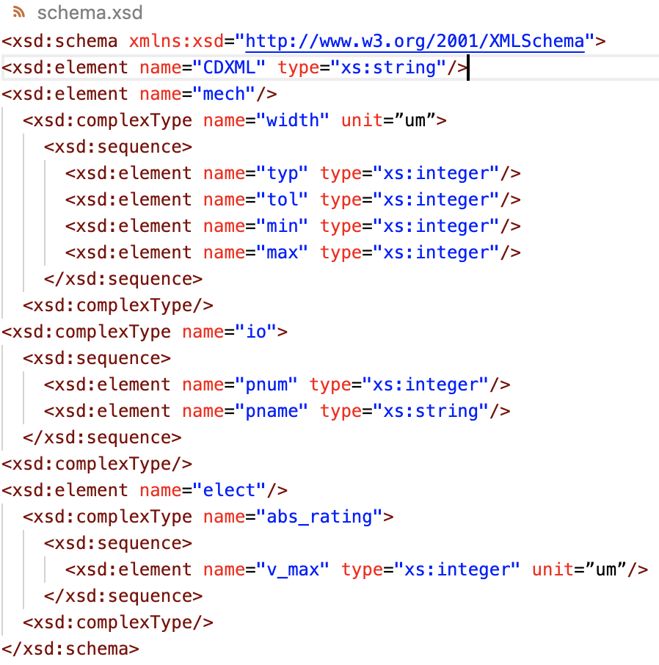
CDXML Example

Slide 6

Please Note the following Rules:
Open-Source Committee can attend the Task Group to present their changes and shepherd the discussions in the JEDEC Task Group. Open Source Committee refers to CDX workstream of OCP/ODSA. There should be no JEDEC membership fee requirement for Open Source Committee participating in the Task Group to encourage volunteer startup companies in the OCP spirit.
The JEDEC Task Group are entitled to make additional changes which will be shared with the 2 representatives open-source committee. Under no circumstances can the actual edited files by the JEDEC Task Group be shared with the community. This is to prevent illegal copies being distributed to the Industry that may be incomplete or have a work –in-progress that will later be radically modified prior to publication after ballot.
The only path to formally releasing the document that is approved by the JEDEC committee and subsequently published is via the JEDEC process.
There is no informal part to providing JEDEC work-in-progress by the Open-source development group directly to the public. OCP should be able to perform and release informal work-in-progress drafts of CDXML prior to the formal release by JEDEC without any restrictions.
JEDEC formal release shall include acknowledgement for the open source work and contribution by OCP and its volunteers. OCP will also acknowledge JEDEC part model collaboration.
JEDEC Proposal For Collaboration (8/11/2022)
(Redline feedback by OCP: 8/22/2022)
JEDEC Website
2022 B
2023 C
JEDEC Task Group
Who will review the changes and may modify the proposal to adopt it to the PartModel.
JEDEC sends the Proposal plus modifications from JEDEC Task Group to Ballot and once approved will then go to publication
JEDEC Task Group
Who will review the changes and may modify the proposal to adopt it to the PartModel.
JEDEC sends the Proposal plus modifications from JEDEC Task Group to Ballot and once approved will then go to publication
Receives a proposed set of changes to Rev A
Receives a proposed set of changes to Rev B
2019 A
ZEF/ZEFXML spec Opensource Copyright (predates OCP/ODSA/CDX)
Open-Source Development can continue to develop on Rev A or wait until Rev B is published.
Open-Source Development can continue to develop on Rev B or wait until Rev C is published.
CDXML
Pre-existing opensource by zGlue remains as-it
OCP/ODSA/CDX CDXML Open Source Development Committee (Creative Commons)

Slide 7
Thank you
‹#›

