Slide 1
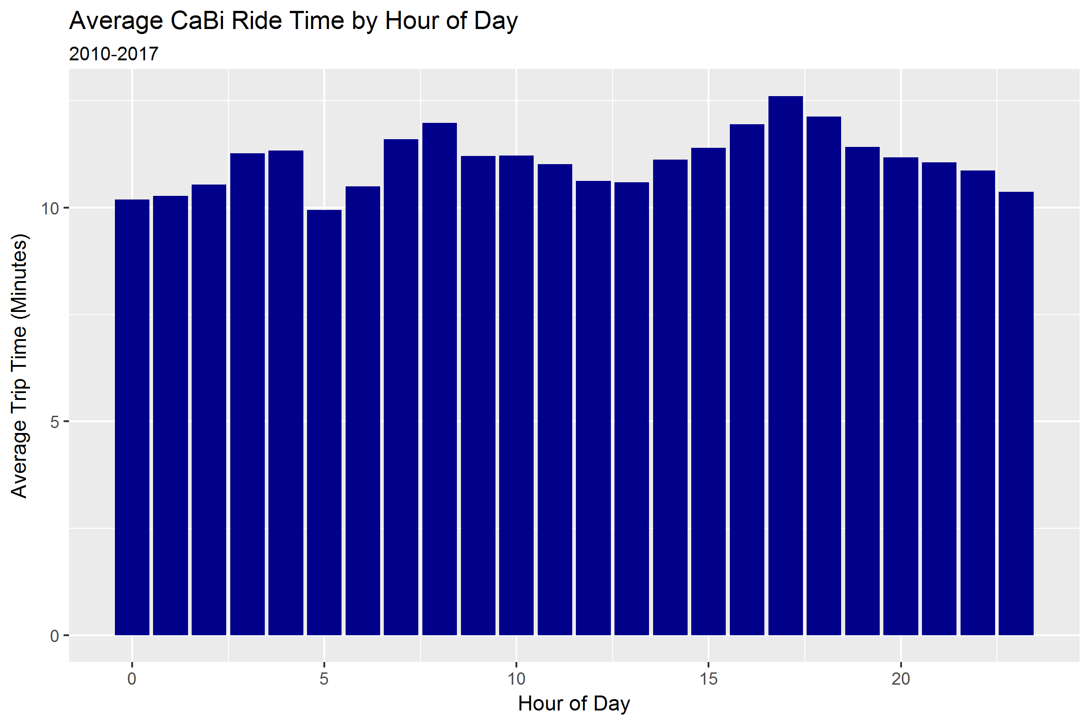
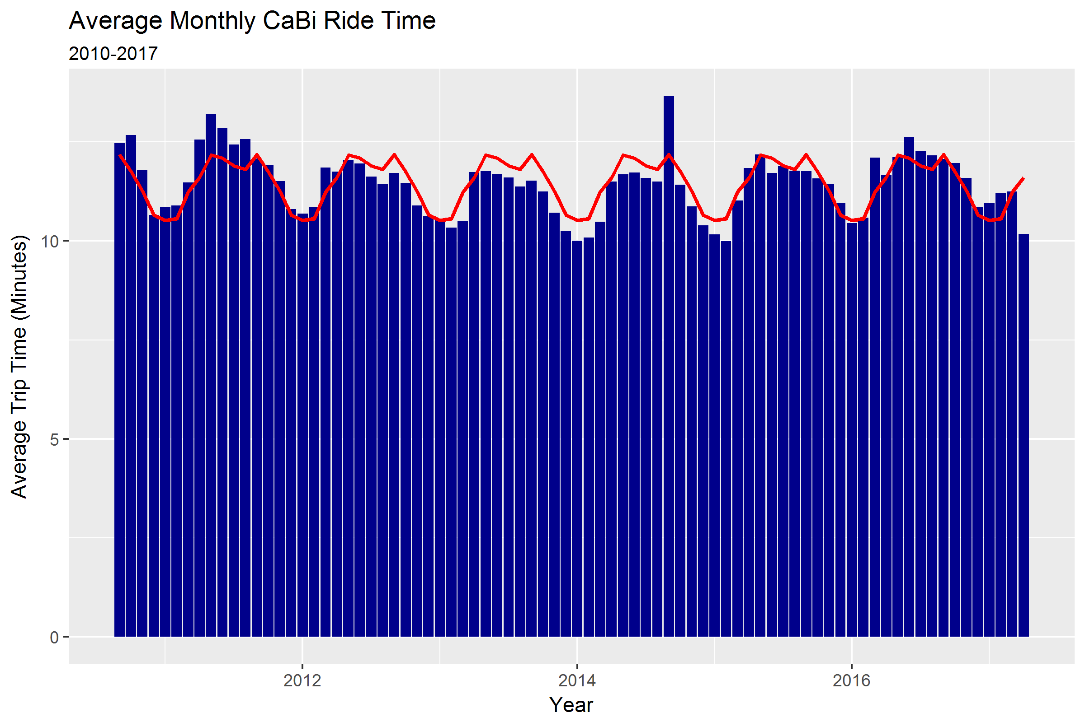
When is Capital Bikeshare faster than Uber in Washington, DC?
Nadav Rindler / Team 16
When is it faster to bicycle or take Uber in Washington D.C.?
When you rent a bikeshare, how long will it take to get to your destination?
Data Sources:
16.1 Capital Bikeshare (CaBi) rides (Oct 2010 – Mar 2017)
Summarized Uber data (Jan 2016 – Sept 2017) with mean and SD travel time by month of year, week of year, or hour of day
Data Exploration
Time of day and month of year are strong seasonal factors affecting CaBi trip duration. Trips are >1 minute longer during peak AM/PM commuting hours and during spring and summer months.

Slide 2
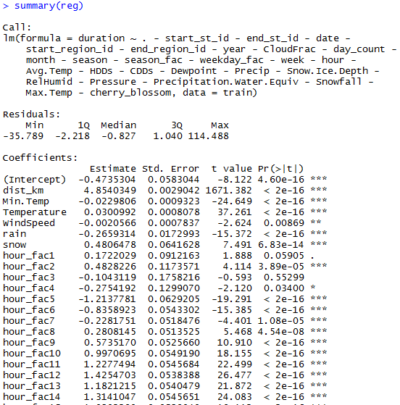
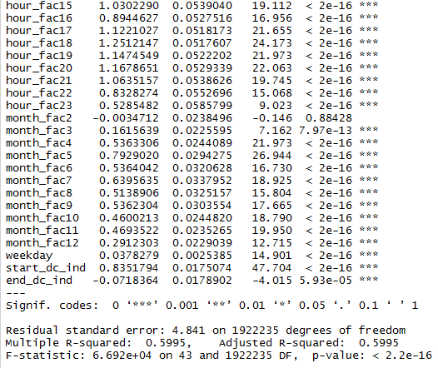
What explains Capital Bikeshare travel time?
Train data = 2015 CaBi rides
Test data = 2016 CaBi rides
Validation data = 2017 Q1 CaBi rides
Feature Engineering
Linear regression to model CaBi travel times as a function of predictors created from trip lat/lon geo-coordinates, daily/hourly weather conditions, and time series attributes
Feature Selection
I tested many of the time series attributes both as numeric and factor variables to capture non-linear relationships, and chose to model hourly and monthly seasonality as factor variables
Model Performance
On average, CaBi regression prediction is within 2.5 minutes (MAE) or 22.7% (MAPE) of the actual ride time. Additional predictors such as total ride elevation gain may enable increased prediction accuracy
Nadav Rindler / Team 16

Slide 3
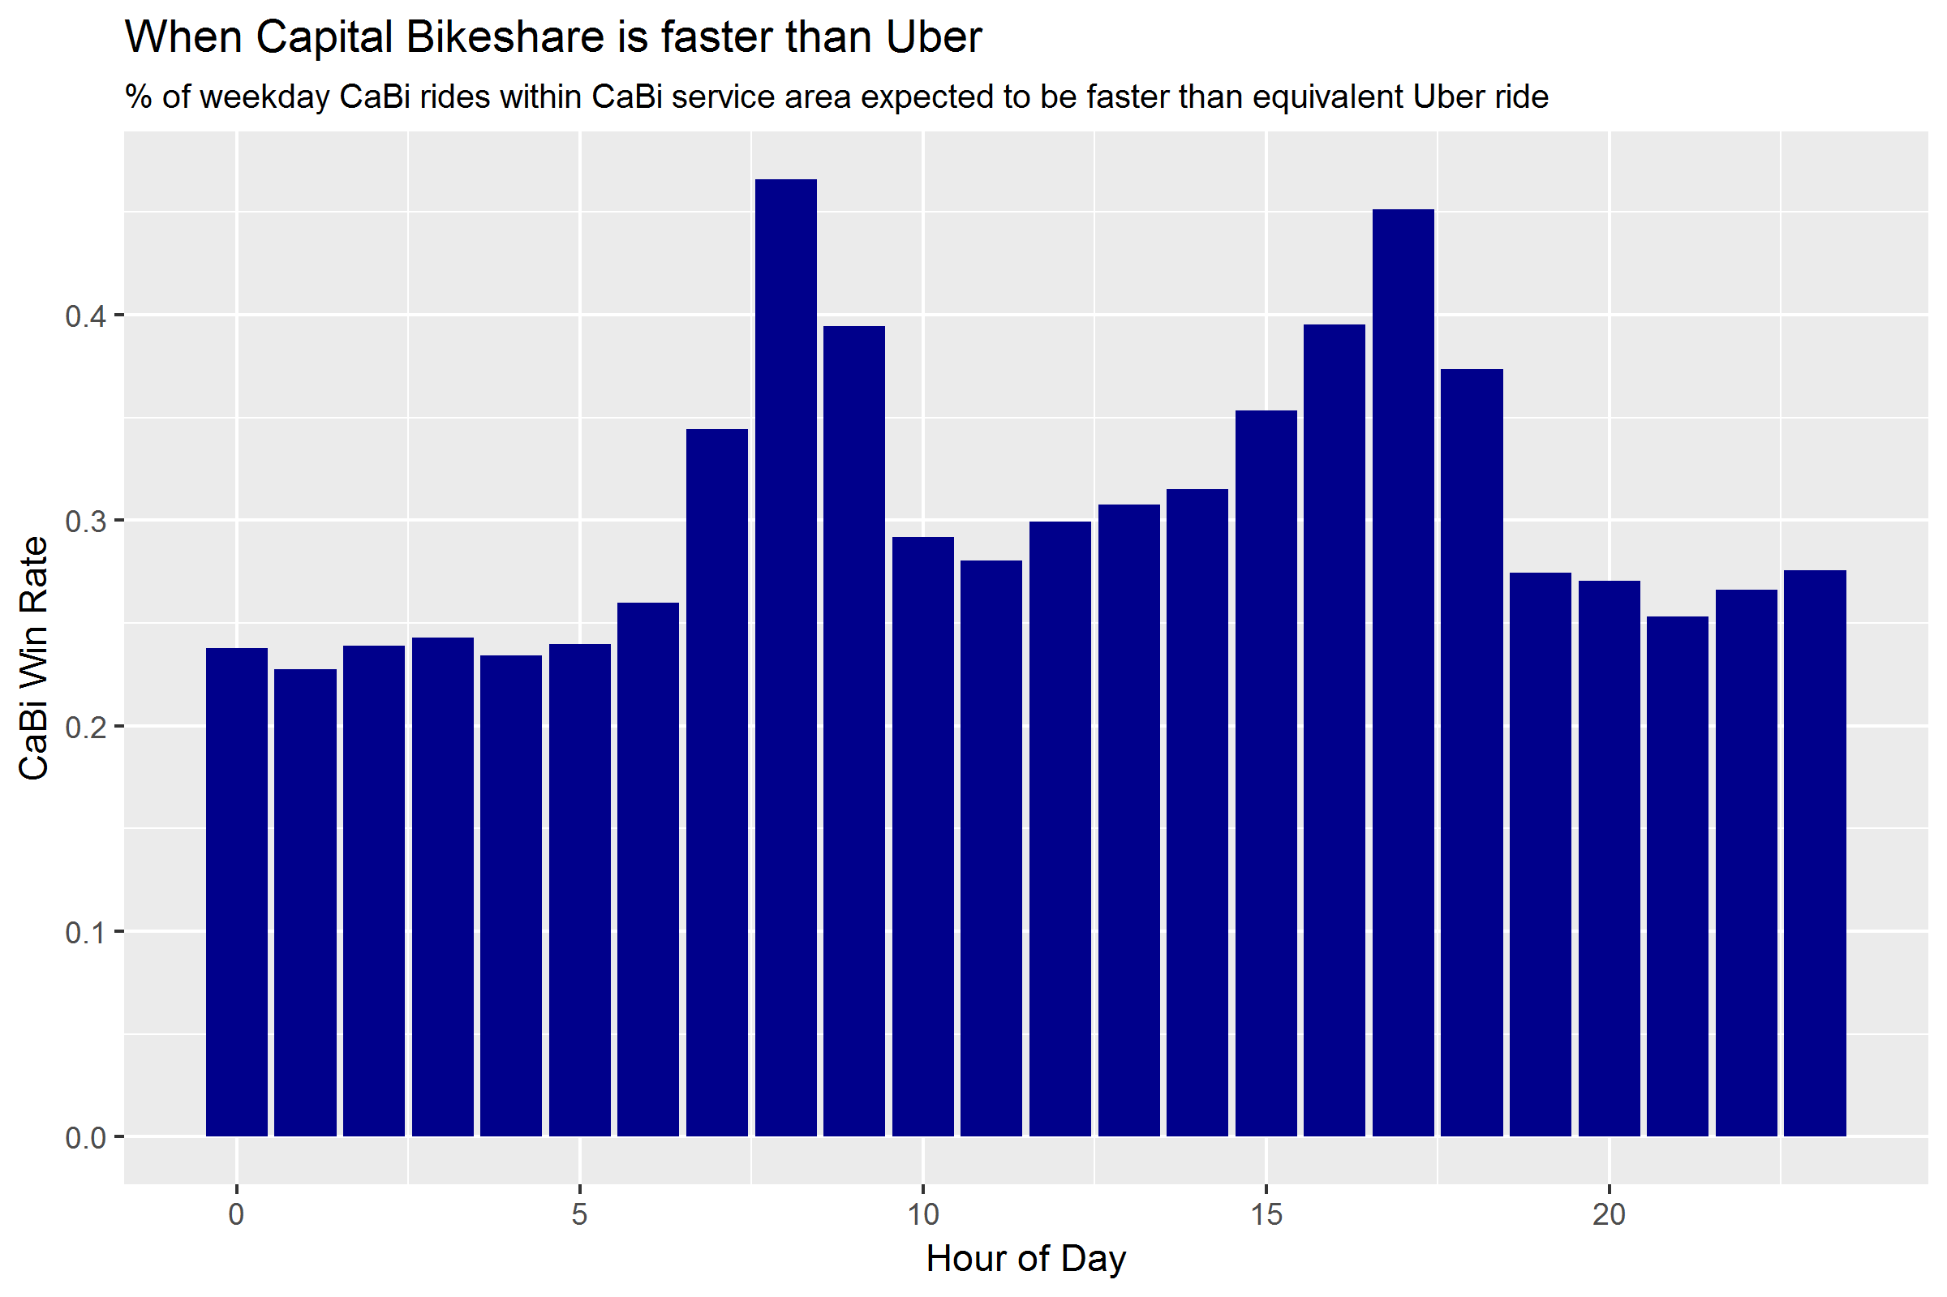
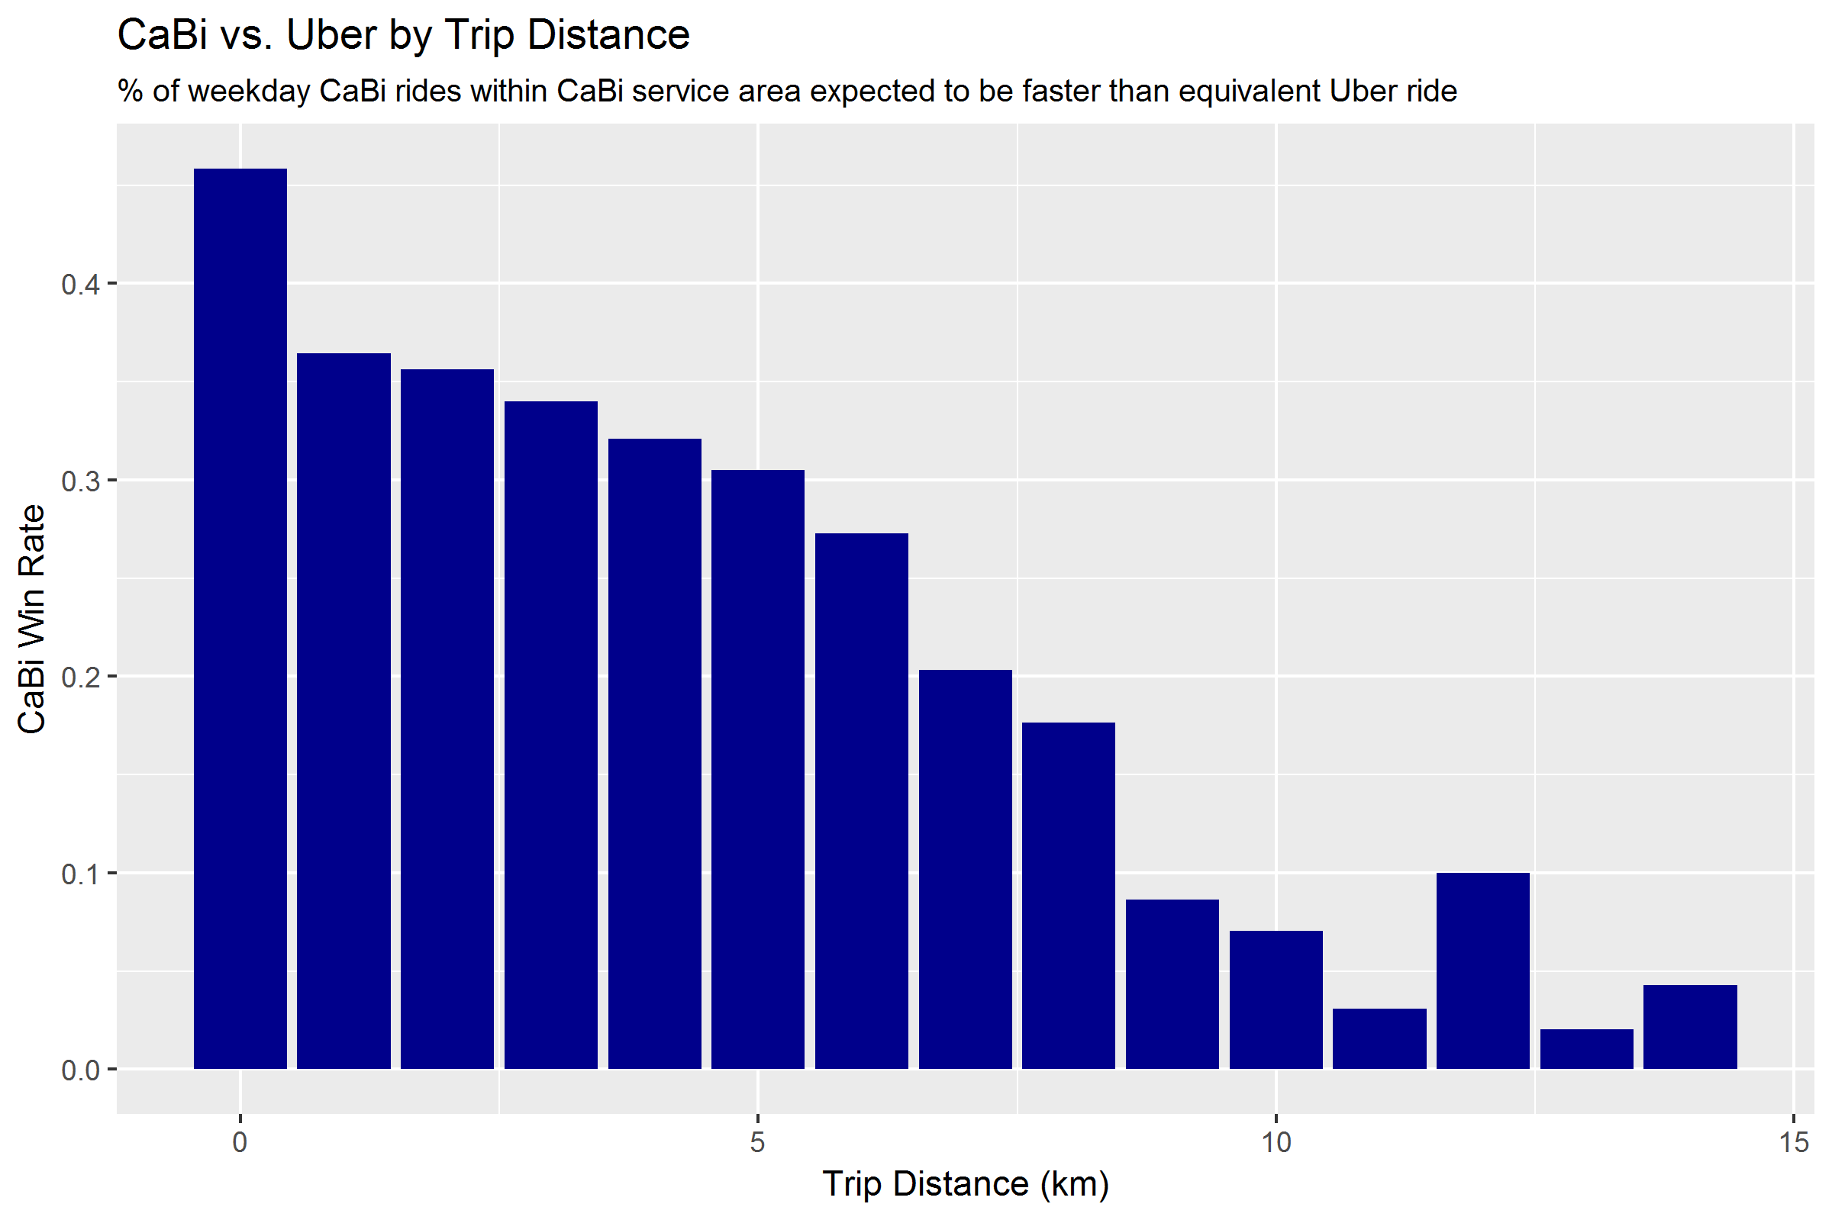
36% of weekday CaBi rides — 40% during peak hours — are faster than Uber
Nadav Rindler / Team 16
Based on comparing all available CaBi ride data (Oct 2010-Mar 2017) with the latest available quarter of Uber data (Jun-Oct 2017)
Check out this interactive map! which depicts the percentage of PM peak hour (4-7pm) trips “won” by CaBi based on the most popular starting location for CaBi rides – census tract 203, which includes Farragut Square (the heart of DC’s business district)
CaBi rides beat Uber more than 40% of the time during peak AM and PM commuting hours when traffic is heaviest
CaBi is more likely to beat Uber at trips less than 5km. CaBi average ride speed is 12.4kph vs. 22.2kph for Uber.
Notes:
Surprisingly, from Farragut Square CaBi is most advantaged not in adjacent census tracts (the shortest trip distances), but in medium (<5k) distance trips across town (Union Station, H Street NE) and uptown (Columbia Heights). These are routes that have well-developed bicycle infrastructure (15th Street cycletrack, Penn Ave cycle track), but are difficult for cars to navigate due to many traffic lights and no highway alternatives.

