Slide 1
CERAMICS
Amanda Pena
Spring 2004

Slide 2
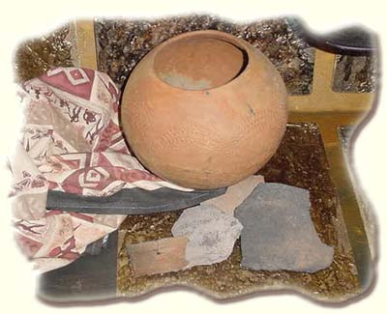
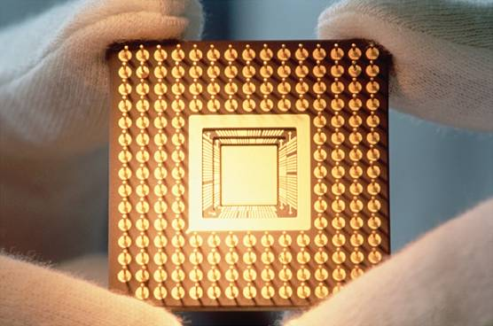
HISTORY
Greek word “keramikos” = burnt stuff
Traditional ceramics
Industrial ceramics

Slide 3
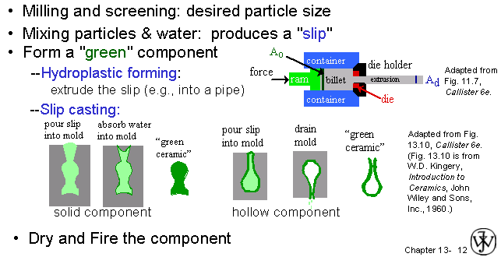
PRODUCTION

Slide 4
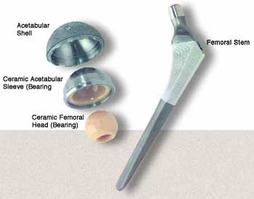
PROPERTIES
CHEMICAL
primarily oxides but carbide, nitrides
high melting points
resistant to corrosion
MECHANICAL
strong, stiff
brittle
temperature resistant

Slide 5
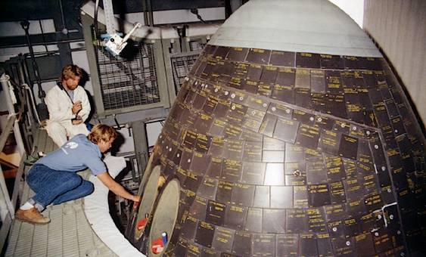
PROPERTIES
PHYSICAL
less dense
resist wear/abrasion
ELECTRICAL
certain ceramics conduct electricity
MAGNETIC
iron oxides
hard to demagnetize

Slide 6
APPLICATIONS
ELECTRICAL
insulators, superconductivty
AEROSPACE
heat sheild tiles (Apollo 13), nosecones
BIOMEDICAL
bone replacements (knee, hip)
CONSTRUCTION
cutting tools, valves, turbocharger rotos
NUCLEAR
uranium pellets

Slide 7
REFERENCES
"Ceramics," Microsoft® Encarta® Online Encyclopedia 2004
http://encarta.msn.com © 1997-2004 Microsoft Corporation.
Callister, William D. Material Science and Engineering an Introduction. 6th ed. New York John Wiley & Sons, Inc. 2003
“High Alumina Continuous Ceramic Fiber Textiles,” Armil CFS, Inc
http://www.armilcfs.com
Matroc Biometrics http://www.bioceramics.com

