Slide 1
Microwave Imager
Analysis of bandpass measurements of MWI channels 14-18
Calculation of virtual measurements
Comparison to calculated TB
Influence of integrated water vapor and clouds
MWI
Scientific Advisory Group Meeting
Nils Risse, Susanne Crewell, Mario Mech,
November 23, 2020
n.risse@uni-koeln.de

Slide 2
Agenda
Introduction
Data
  Bandpass measurements
  Atmospheric data
Methods
Results and Discussion
Conclusions

Slide 3
Introduction
Spectral sensitivity of 183 GHz MWI channels (MWI-14 to MWI-18)
Is the bandpass effect depending on the climatic region?

Slide 4
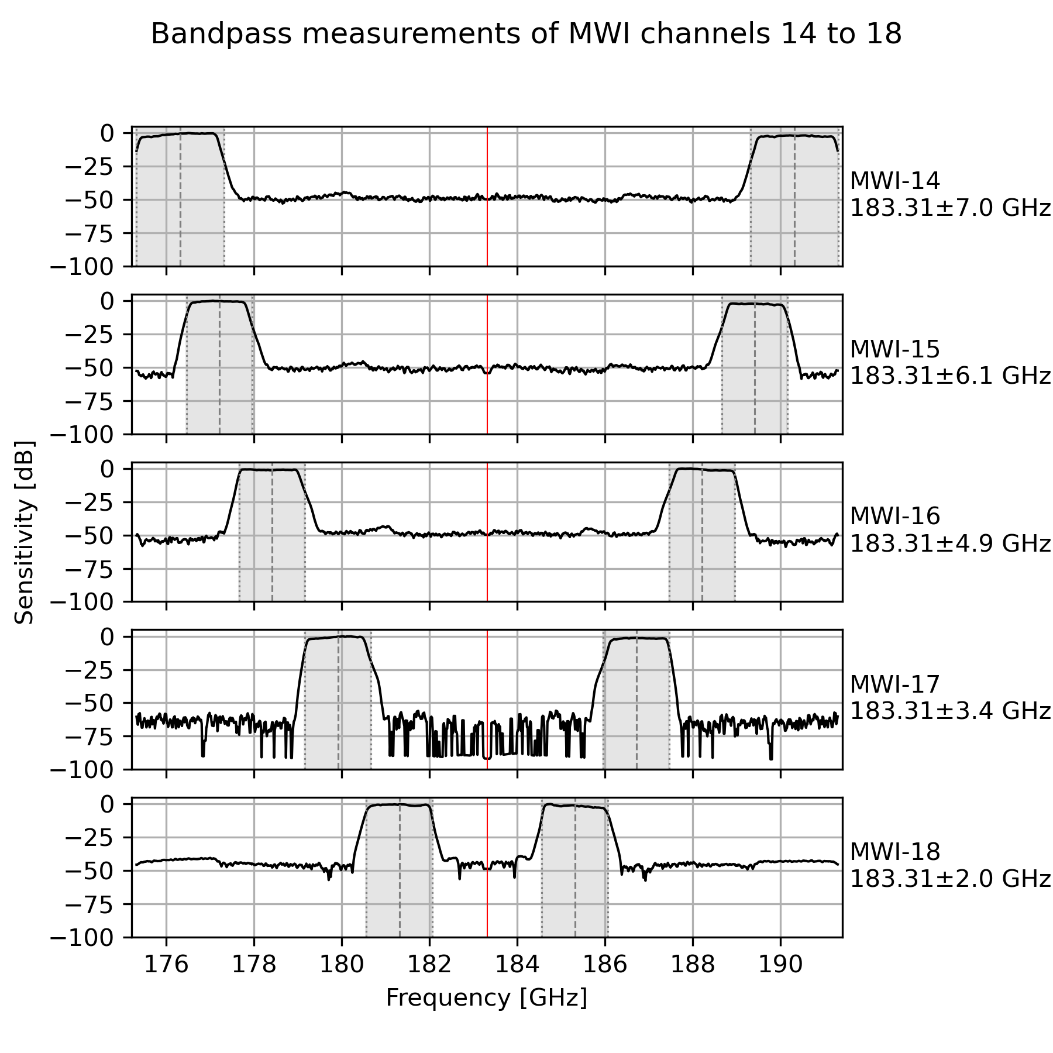
Data: Bandpass measurements
Frequency range: 175.322–191.302 GHz
Resolution: 15 MHz
No data at 183.312 GHz \pm 55 MHz
Number of measurements: 1060

Slide 5
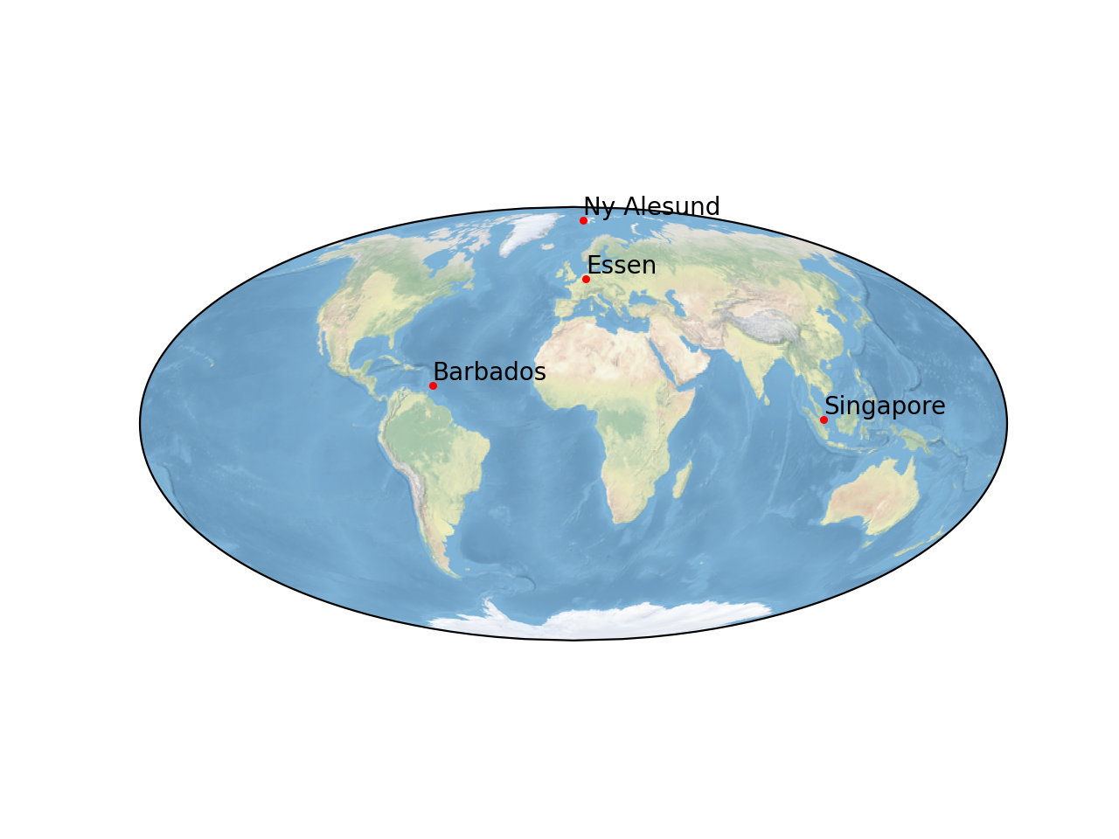
Data: Radiosonde
Daily 12 UTC radiosonde data of year 2019
  Ny Alesund (Arctic); Essen (Mid-latitude)
  Barbados (Tropics); Singapore (Tropics)
  Vertical profiles of pressure, temperature and humidity
    → “clear-sky” conditions
Data availability
  Ny Alesund: 96.7 %
  Essen: 98.9 %
  Singapore: 98.6 %
  Barbados: 73.4 %

Slide 6
Methods: Radiative transfer simulation
Model: Passive and Active Microwave TRAnsfer (PAMTRA, Mech et al. 2020)
  Brightness temperature at every frequency (vertical polarization)
  733 km nadir view
Input parameters:
  Atmospheric state: pressure, temperature and relative humidity as function of height, cloud parameters
  Add source of atmospheric state

Slide 7

Methods: Calculation of virtual MWI measurement
Normalize bandpass measurement at frequency i:
Virtual MWI measurement is then given by:

Slide 8
Results: Radiosonde profiles
Radiosonde profile
TODO: show mean seasonal profiles?

Slide 9
Results: PAMTRA simulation for radiosondes
TODO: mean profiles?
else: take examples

Slide 10
Standard atmosphere

Slide 11
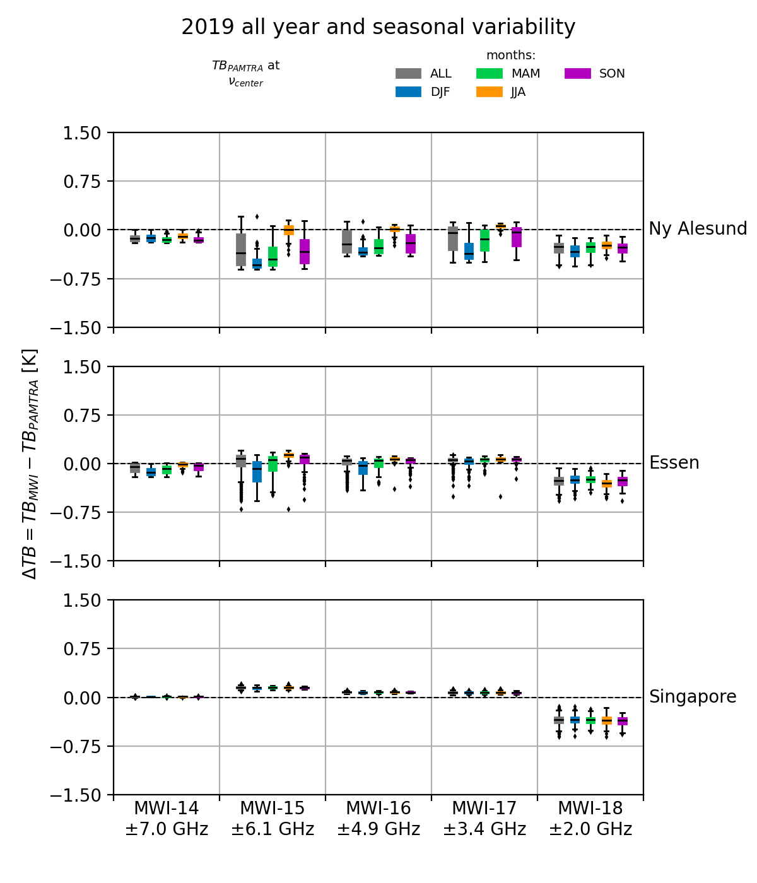
Results: Seasonal differences (center frequency)
Arctic (Ny Alesund)
  ΔTB very variable with annual cycle
Mid-latitude (Essen)
  lower variability than Arctic, small annual cycle
Tropics (Singapore)
  lowest ΔTB of all locations (channel 14-17)
Channel 14: lowest ΔTB for each location
Channel 18: ΔTB below 0 for every location

Slide 12
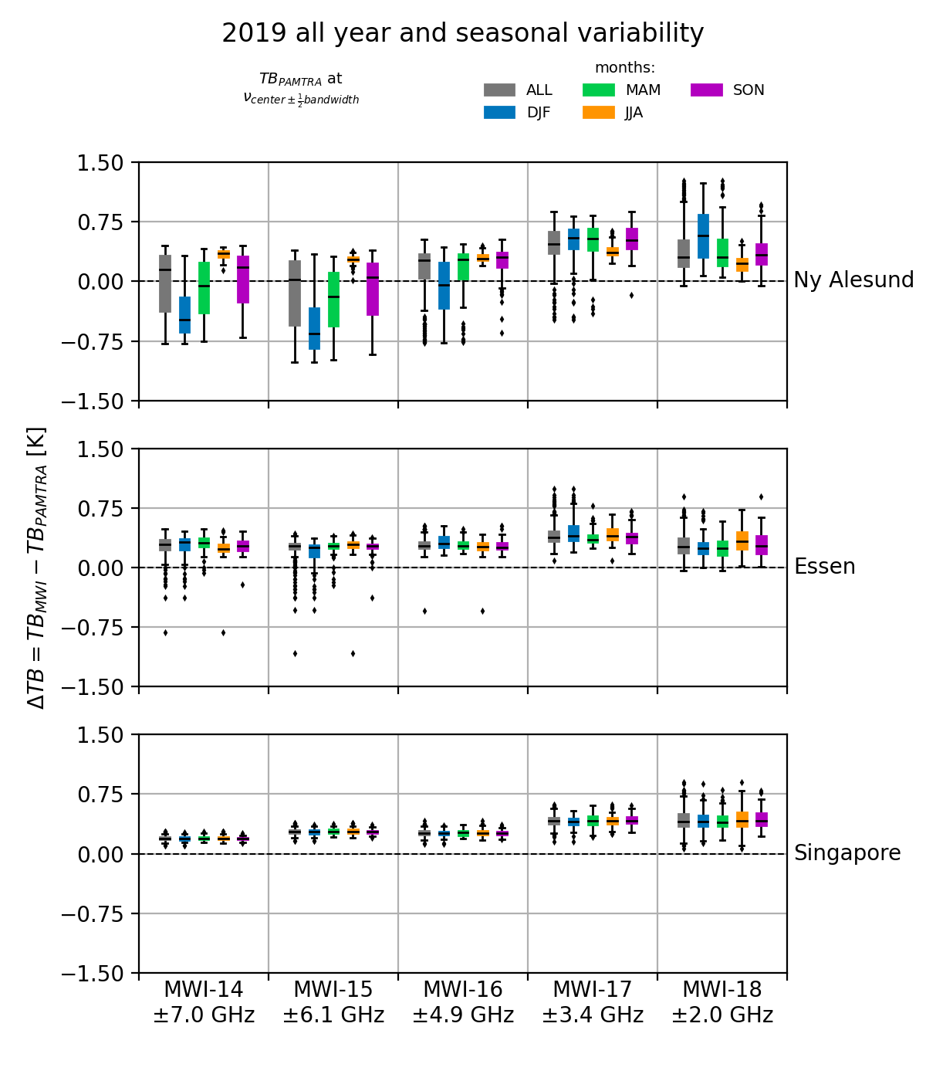
Results: Seasonal differences (frequency at bandwidth)
Arctic (Ny Alesund)
  ΔTB extremely variable with annual cycle
Mid-latitude (Essen)
  similar ΔTB for all channels
Tropics (Singapore)
  lowest ΔTB of all locations (channel 14-17)
Channel 14: lowest ΔTB for each location
Channel 18: ΔTB below 0 for every location

Slide 13
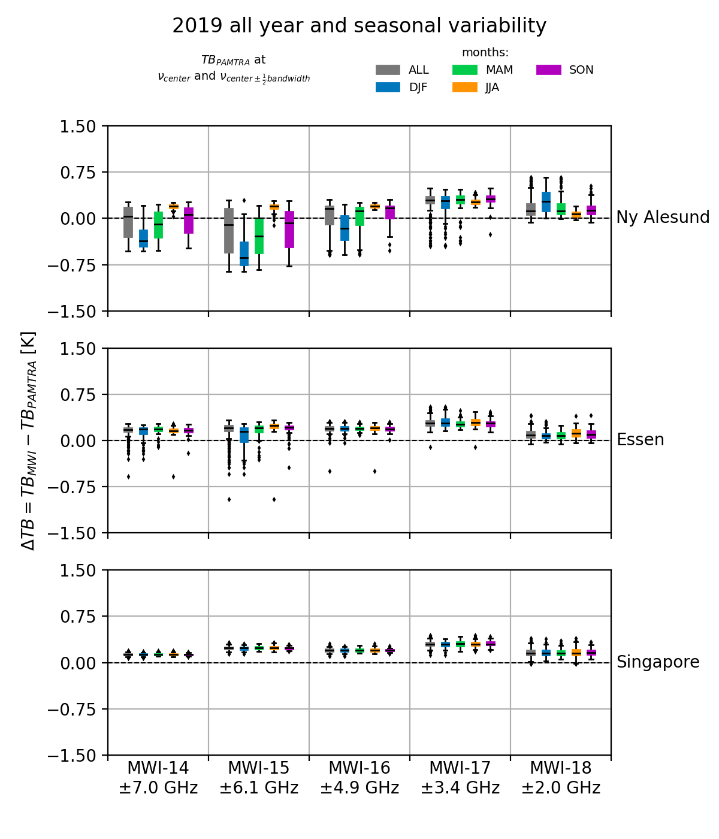
Results: Seasonal differences (center frequency and bandwidth f)
Arctic (Ny Alesund)
  ΔTB very variable with annual cycle
Mid-latitude (Essen)
  lower variability than Arctic, small annual cycle
Tropics (Singapore)
  lowest ΔTB of all locations (channel 14-17)
Channel 14: lowest ΔTB for each location
Channel 18: ΔTB below 0 for every location

Slide 14
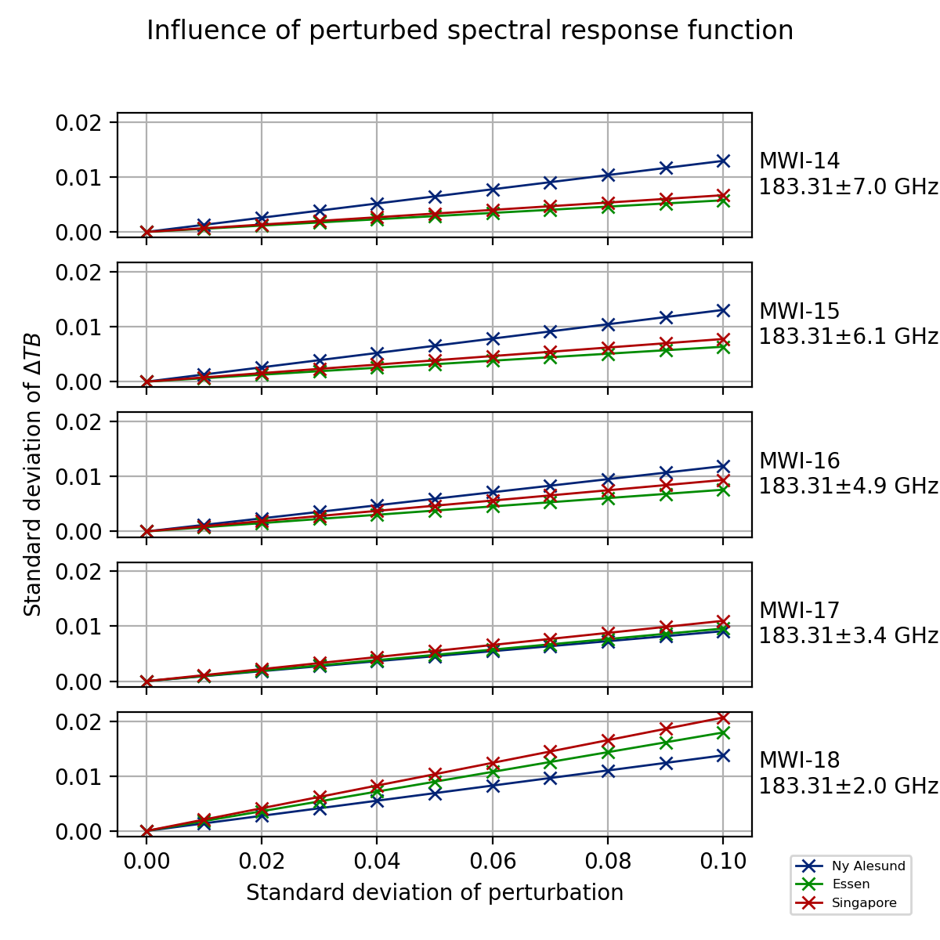
Results: Influence of perturbed SRF
Summary of 1000 realizations of perturbed SRF
Average ΔTB does not change (not shown)
Standard deviation of ΔTB increases with increasing perturbation
Strongest increase for channel 18
TODO: add fig that shows perturbation series
TODO: change to bw center

Slide 15
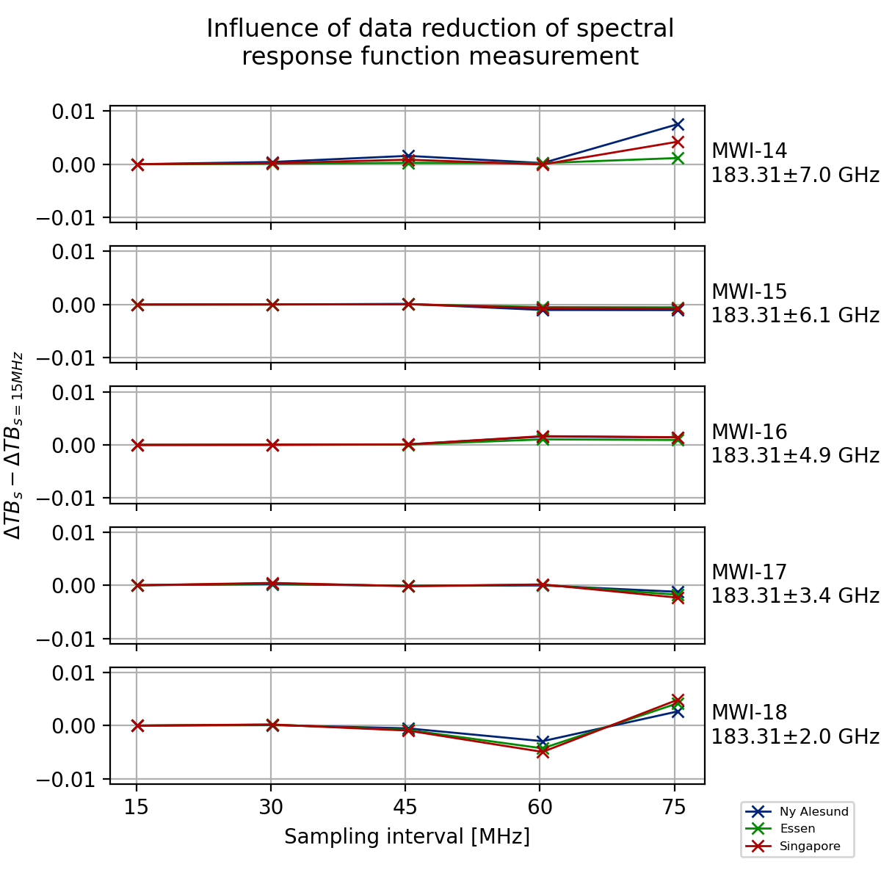
Results: Influence of increased sampling interval
Relative change of ΔTB with respect to decreasing number of measurement points
Increase of sampling interval to 30 GHz has nearly no influence
A further increase leads to fluctiating differences
TODO: change to bw center
TODO: add fig that shows perturbation series

Slide 16
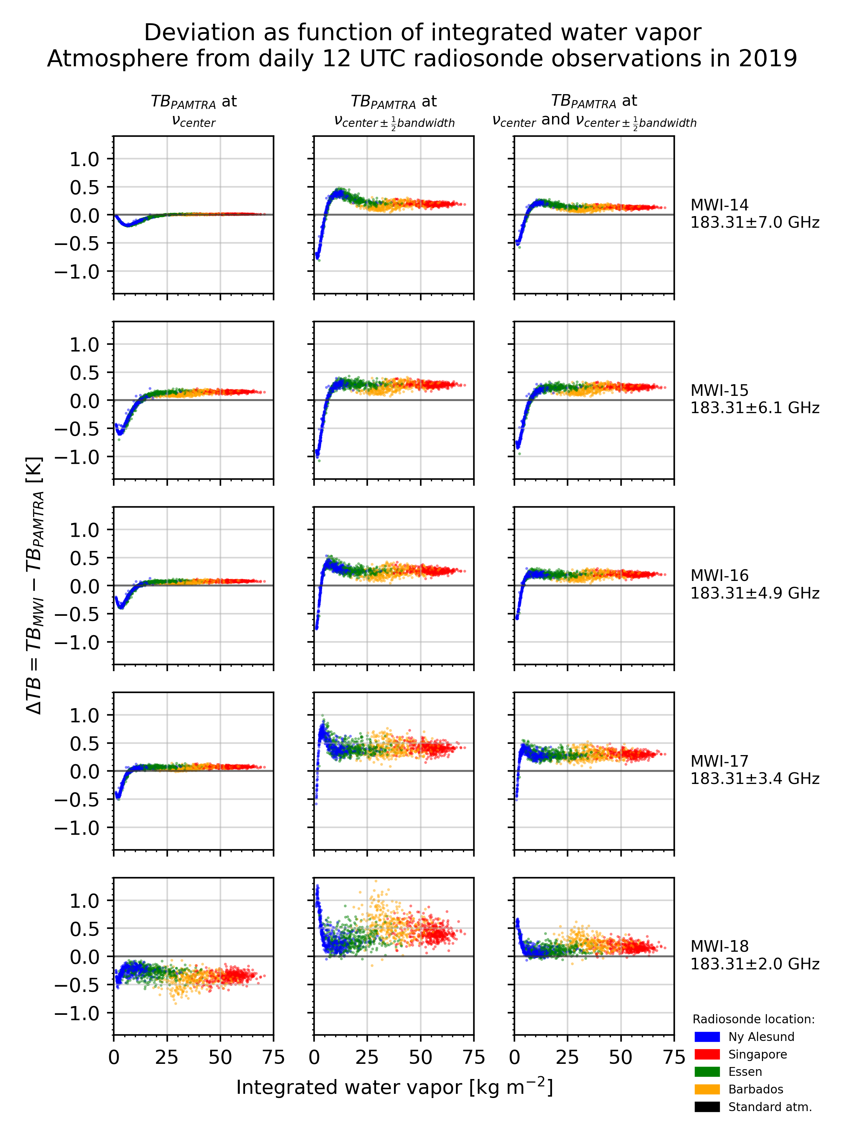
Results: Influence of column-integrated Water Vapor
IWV explains major parts of deviation for channels 14 to 17
Variance highest for channel 18
Comparison with central frequency shows lowest variability (left column)
TODO: update plot only for 2019 profiles
TODO: add wv plots for profiles

Slide 17
Results: Cloud effects

Slide 18
Conclusion

Slide 19
Outlook
Correction functions can be defined for clear-sky conditions, given a priori information about integrated water vapor

Slide 20
Literature
Radiosonde data: University of Wyoming

