Slide 1
ApoE4 v/s WT
N = (5, 6)
Circle Track Headscan
Behavioral data analyses
Day 1
Day 2
Day 3
Day 4
10 min | 10 min | 10 min | 10 min
break = 10 min
10 min | 10 min | 10 min | 10 min
break = 10 min
10 min | 10 min | 10 min | 10 min

Slide 2
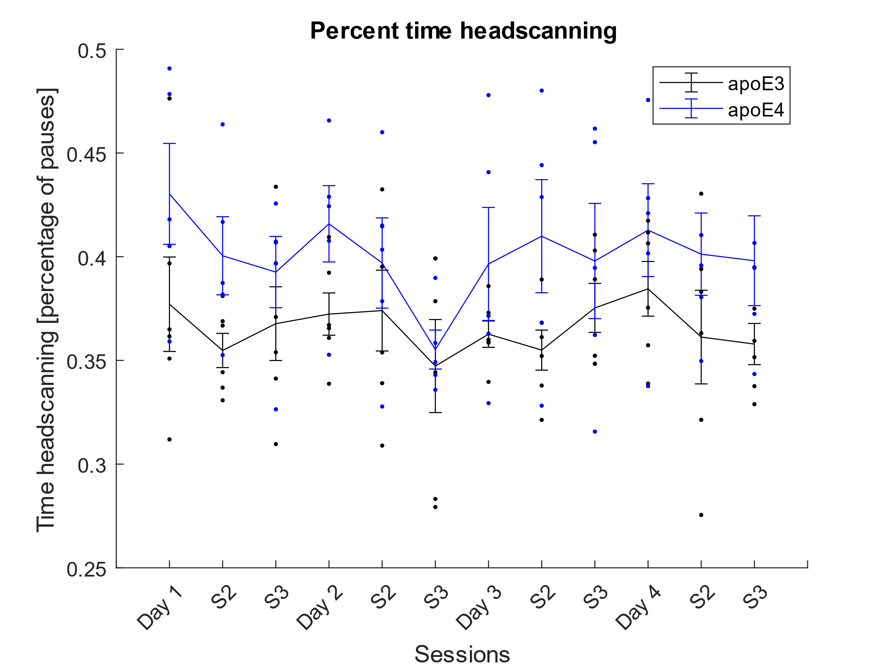
ApoE4 v/s ApoE3
N = (5, 6)
Circle Track Headscan
Behavioral data analyses
Percentage of time head scanning and pausing
ApoE4 shows increased head scanning as a percentage of time

Slide 3
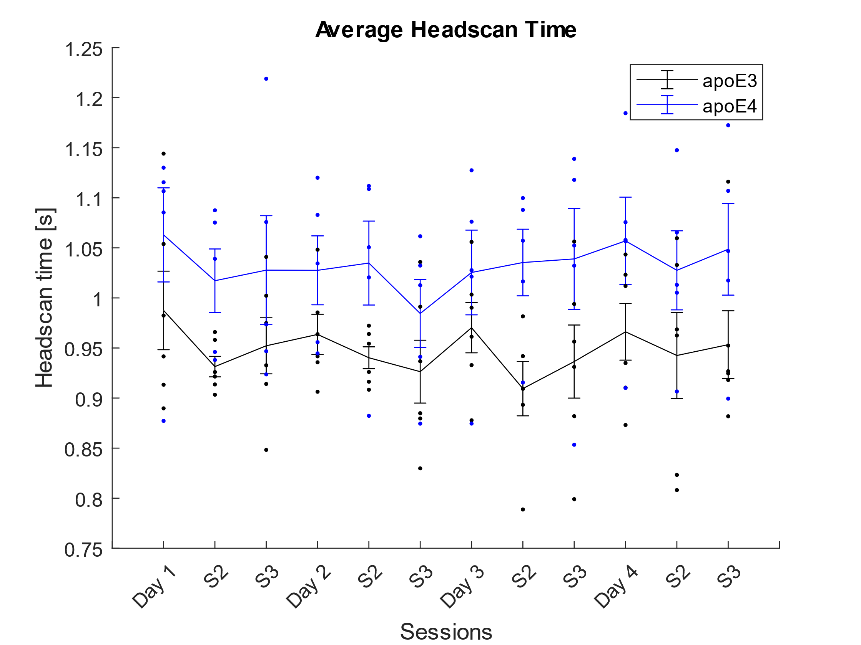
ApoE4 v/s ApoE3
N = (5, 6)
Circle Track Headscan
Behavioral data analyses
Average Headscan Time – Increased headscan duration in apoE4 model

Slide 4
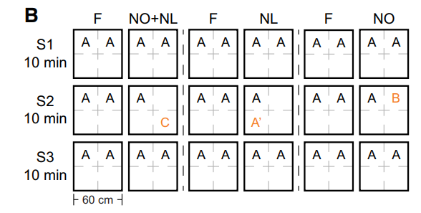
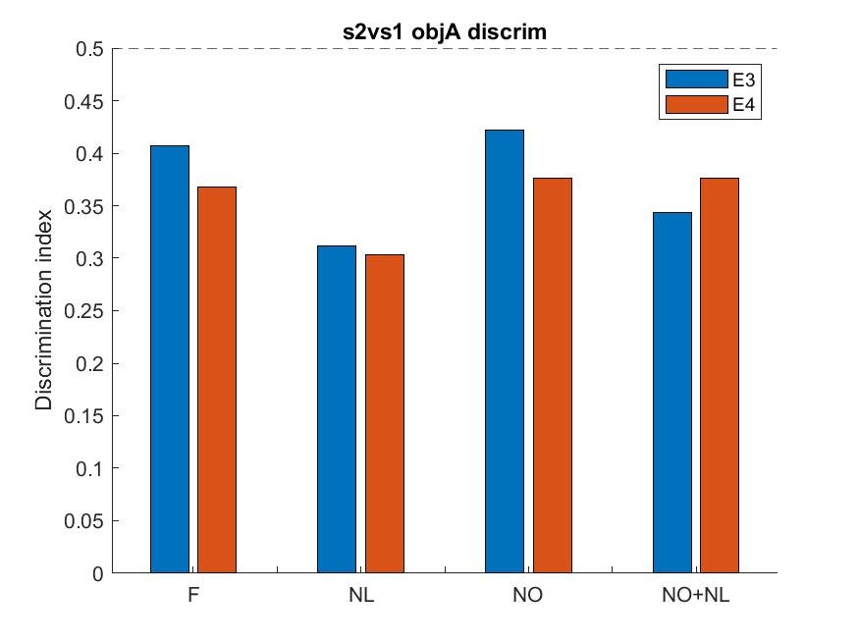
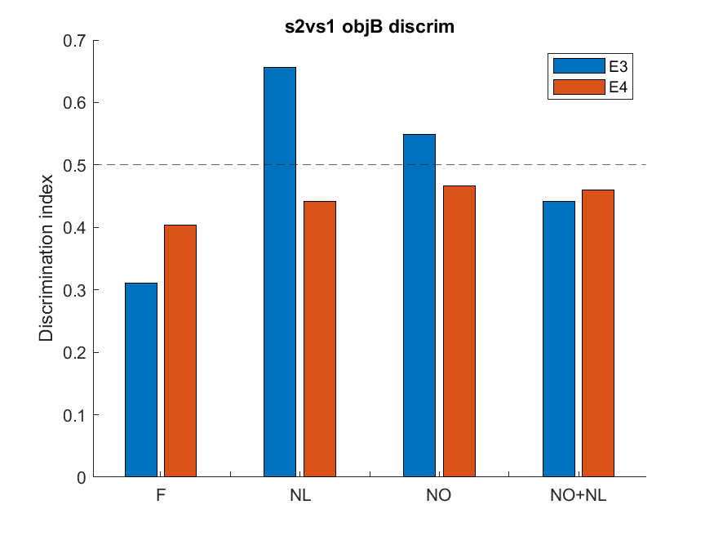
Discrimination index of an object across sessions (S2 novel vs S1/S3 familiar)
Obj A – the constant reference
Obj B – the object that was changed in NL, NO, and NO+NL conditions
chance
chance
(DI = Time near object A (or object B) / [Time near object A + Time near object B])​

