Slide 1
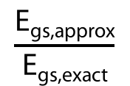

N_{a} = 2, R_{m} =2.76 Å
N_{a} = 3, R_{m} = 3.27 Å
N_{a} = 4, R_{m} = 3.51 Å
Perturbative
$$\frac{\text{E}\text{gs}\text{,}\text{approx}}{\text{E}\text{gs}\text{,}\text{exact}}$$
Variational
0.05
0.94
0.06
1.12
0.07
1.33
$\text{Dimensionless} \text{coupling}\text{ (}\text{g}\text{/}ω_{12}$)

