Slide 1


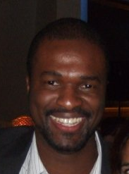
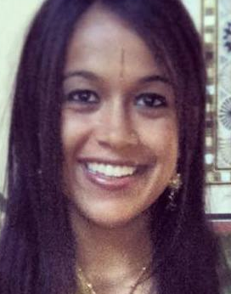
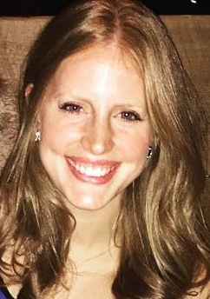
GWU MSBA Practicum Partnership with Venga
GWU MSBA Practicum Dream Team
Mokeli Nisha Rachel

Slide 2
Background
Venga helps restaurants better understand and engage with their guests in order to increase guest satisfaction and frequency by analyzing OpenTable and point-of-sale transaction data.
Venga works with restaurants to increase guest retention and visit frequency through personalized guest experiences, targeting marketing campaigns and actionable guest feedback
Notes:
Background:
Venga helps restaurants better understand and engage with their guests in order to increase guest satisfaction and frequency by analyzing OpenTable and point-of-sale transaction data. Venga works with restaurants to increase guest retention and visit frequency through personalized guest experiences, targeting marketing campaigns and actionable guest feedback. Over the last year, Venga has begun offering restaurants action plans to improve guest experience based on past guest trends. For example, Venga has provided restaurants with server feedback reports, lists of menu items most often ordered by repeat guests and alerts when a customer is likely to cancel or no show. Since 2010, Venga has collected data on over 30 million guest visits totaling $900 million in customer spending.

Slide 3
Dream Team’s Goals with Venga
Restaurants have trouble identifying what aspects of the guest experience impact that guest's decision to return the restaurant.
By partnering with GWU, Venga wants to provide restaurants more advanced and predictive analytics that enables Venga and their customers to explore and identify what behaviors lead to repeat visits.

Slide 4
Our Approach and Timeline [Now – Aug]
Goal and objective formulation
Data Access and Preparation
Data exploration
Variable transformation and selection
Begin modeling (potentially with a subset of restaurants)
Build and validate predictive models (may start with a small subset and grow number of restaurants)
Model comparison / champion model
Capture, document, and present findings
Assess next steps with Venga to determine operationalizing results using or building a tool
Scope out tool building plan
Build tool (if time permits)
Deploy tool and results (if time permits)

Slide 5
Data Access and Preparation Data exploration
Data Sources
Reservation - back to 10 years
POS:1-2 years
Currently have two restaurants (with a plan to scale)

Slide 6
Status
Completed initial data exploration
In process of merging datasets into a model ready dataset

