Slide 1

Healthcare Data security using Blockchain Technology
Project Group No: 20IT722
Presented By:
Hemant Kumar Singh(1709713048)
Mayank Varyani(1709713059)
Neeraj Srivastava (1709713065)
Project Guide: Dr. Sandeep Saxena

Slide 2
Abstract:
Blockchain technology has shown its considerable adaptability in recent years as a variety of market sectors sought ways of incorporating its abilities into their operations. While so far most of the focus has been on the financial services industry, several projects in other service related areas such as healthcare show this is beginning to change. Numerous starting points for Blockchain technology in the healthcare industry are the focus of this report. With examples for public healthcare management, user-oriented medical research and drug counterfeiting in the pharmaceutical sector, this report aims to illustrate possible influences, goals and potentials connected to this disruptive technology.

Slide 3


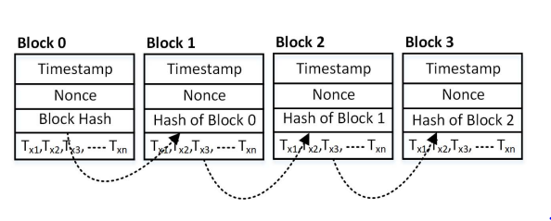

What is blockchain??
Time-stamped series of immutable records of data that is managed by a cluster of computers not owned by any single entity.
Each of these blocks of data is secured and bound to each other using cryptographic principles.

Slide 4
Source: https://www.edureka.co/blog/blockchain-tutorial/

Slide 5
Why blockchain IN HEALTHCARE?
A blockchain is a system for storing and sharing information that is secure because of its transparency.
Blockchain has many applications in healthcare, and can improve mobile health applications, sharing and storing of electronic medical records, clinical trial data, and insurance information storage.
The use of encryption, transparency and decentralized ledger removes miscommunication and mistrust
Blockchain can improve the accessibility and security of patient information.

Slide 6
A summary of the reviewed blockchain systems in healthcare.

Slide 7
Name | Use | Key Features
Health application | Mobile application
 |  | -patient records own data and healthcare provider can access this data within minutes
Healthcare Data Gateway | Mobile application | -uses a simple unified indicator-centric schema (ICS) to organize data and a secure multi-party computing (MPC) system
Blockchain based data preservation system (DPS) | Storing medical data | -prototype modeled after Ethereum system has been tested
OmniPHR | Patient health records (PHR) access and storage system | -places all patient health data into one accessible forum
 |  | -incorporates different patient datasets into different blocks on the chain
Blockchain-based secure and privacy-preserving patient health information sharing (BSPP) scheme | Sharing of health data | -uses private blockchain for patient data and semi-private/consensus blockchain for non-sensitive, activity data
Blockchain-based multi-level privacy preserving location sharing (BMPLS) scheme | Sharing of health data | -enables sharing of patient location
 |  | -proposed for telecare medical information systems
MIStore | Medical insurance storage system | -uses different hospital, patient, and insurance servers that verify each other’s activity for security

Slide 8
PAST RESEARCHES

Slide 9
INPUT PROBLEM | PROCESS SOLUTION | Academic papers
Security threats to the central system ( servers) | Blockchain is a peer-to-peer (P2P) distributed ledger technology for a new generation of transactional applications that establishes transparency and trust. Blockchain technology is based on decentralized System i.e the data is distributed on different machine across the web in an encrypted format. Blockchains distributed architecture is built-in fault tolerance and disaster recovery. Data is distributed across many servers in many different locations. There is no single point of failure and it is unlikely a disaster would impact all locations at the same time. | Amit Appari & M. Eric Johnson Information Security and Privacy in Healthcare:
Data integrity issues through concerns of confidentiality and protection | Blockchain provides opportunities to combine and encrypt digital assets, including medical records, or processing claims on a ledger. The ledger can ensure patient confidentiality and protection of relevant data as well as make certain regulatory compliance. | Yue et al., 2016

Slide 10
API issues over Security . | Blockchain technology addresses interoperability challenges, is based on open standards, provides a shared distributed view of health data and will achieve widespread acceptance and deployment throughout all industries. Third party API can prove a threat to the data , In order to overcome this we will use a Ledger having all information whether to add the data or not. | Laure A. Linn Martha B. Koo, M.D. 2017
Low transparency of contracts and high intermediary costs | (By Using Smart contracts) Decentralised consensus improves the healthcare system transparency whilst removing an intermediary party that inflates the cost of healthcare. Further benefits include a significant reduction of inefficiency and waste in the healthcare ecosystem(Zhang, Schmidt, et al., 2018). The use of encryption, transparency and decentralised ledger removes miscommunication and mistrust and promote a transition to valuebased care. | Stanciu, 2017

Slide 11

Project Objective:
To Build a Secure healthcare system with fast and efficient accessibility of data

Slide 12
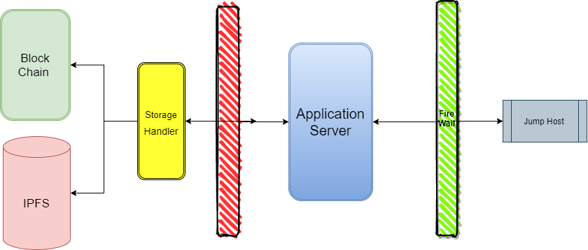
Design Methodology:

Slide 13
THANK YOU

