Slide 1
Documenting Open Source Projects
Jodie Putrino, Sr. Technical Writer
August 2016

Slide 2
Introduction

Slide 3

What
Who
You (software engineers)
make documentation part of your development process
Why
more efficient
developer is the key knowledge holder
can expose issues earlier in development cycle
Notes:
http://techbeacon.com/why-agile-teams-should-care-about-documentation

Slide 4
How
Git*:
the same workflow you already use!
Topic based authoring:
small chunks of information specific to one subject (i.e., you’re not writing a book)
Content reuse:
the ‘single source of truth’
* or other version control system

Slide 5
something about agile development and documentation
Notes:
http://techbeacon.com/why-agile-teams-should-care-about-documentation

Slide 6
Content Chunks and Reuse

Slide 7
What is a Content Chunk?
Types of chunks
focuses on a specific subject
has an identifiable purpose
can stand on its own
can be reused
concept -- the ‘what’ or ‘why’
topic-- the ‘how’
reference -- technical details or data

Slide 8
Content Reuse
Why
improves consistency of information
greater efficiency (no duplication of efforts or content)
easier to manage updates
How
individual topics are combined into documents via ‘maps’
maps can be combined to form larger documents
Notes:
http://www.slideshare.net/dclsocialmedia/introduction-to-structured-authoring-52860843

Slide 9
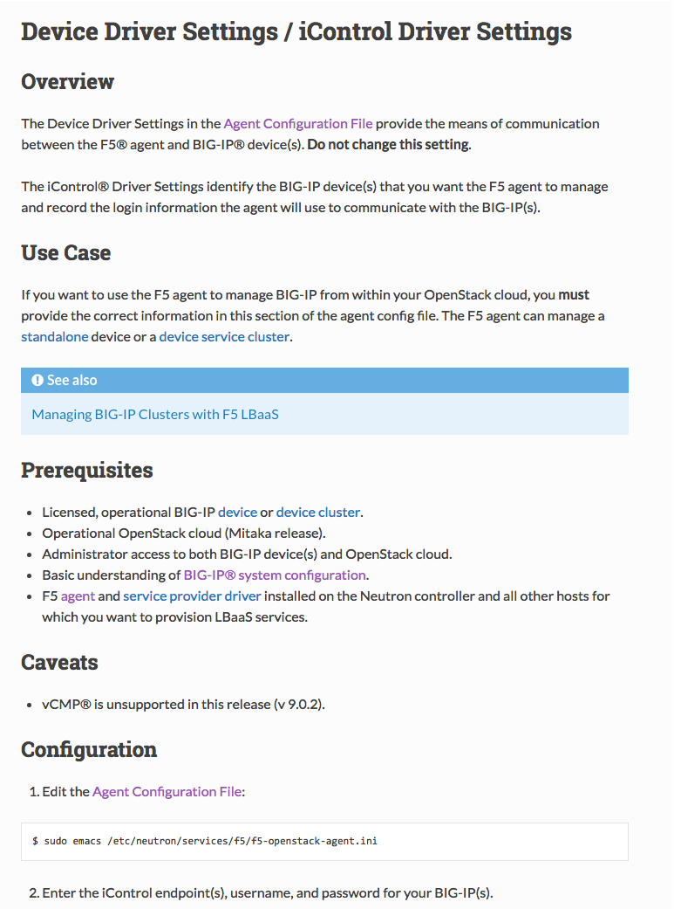
Content Model
Guidelines for how topics should be structured.
title
=====
Overview
--------
Use Case
--------
Prerequisites
-------------
-
-
-
Caveats
-------
-
-
-
Configuration
-------------
Further Reading
---------------
.. seealso::
* x
* y
* z
ensures consistent look and feel
helps writers focus on content

Slide 10
Tying It All Together
title
=====
Overview
--------
Use Case
--------
Prerequisites
-------------
-
-
-
Caveats
-------
-
-
-
Configuration
-------------
Further Reading
---------------
.. seealso::
* x
* y
* z
title
=====
.. include:: includes/concept_overview.rst
.. include:: includes/concept_use-case.rst
.. include:: includes/ref_prerequisites.rst
.. include:: includes/concept_caveats.rst
Configuration
-------------
.. include:: includes/topic_how-to-configure.rst
Further Reading
---------------
.. include:: includes/ref_further-reading.rst
concept
reference
topic
Content Model
Map

Slide 11
Training Exercise

Slide 12
Project Setup
git clone https://github.com/jputrino/f5-docs-training.git
pip install –r requirements.docs.txt

