Slide 1
WISER X MODERNA QUANTUM CHALLENGE 2026
Quantum-Assisted RNA
Secondary Structure Prediction
QUBO formulation • ViennaRNA benchmark • QAOA validation • resource scaling
Technical project presentation
NELLORE RAVI KUMAR
July 2026

Slide 2
RNA folding is biologically important and computationally hard
Secondary structure influences stability, translation efficiency, and manufacturability. The project asks whether constrained pair selection can be expressed as a QUBO and tested with quantum optimization.
Challenge sequence
GGAGCAAAACUUGUCGAUUGAGAAC
AAAAUACAGAAUUUGCUUG
44 nt
−7.90
9.10
Reference structure
Challenge sequence length
ViennaRNA MFE (kcal/mol)
Supplied candidate energy gap
.(((((((..((((...(((....)))...
))))..))))))).
02

Slide 3
A hybrid workflow keeps optimization and biological validation separate
1 Normalize
2 Generate
3 Optimize
4 Decode
5 Evaluate
Validate RNA and standardize T → U
Enumerate canonical and wobble pairs
Build QUBO; solve exactly or with QAOA
Convert selected variables to dot-bracket
Report Vienna energy and pair metrics
Design principle
The QUBO score measures combinatorial quality. ViennaRNA energy measures thermodynamic quality. They must not be treated as the same quantity.
03

Slide 4
The QUBO rewards valid pairs and penalizes structural conflicts
Linear rewards
H(x) = Σᵢ wᵢxᵢ + Σ(i,j) Pᵢⱼxᵢxⱼ
G–C / C–G
−3
A–U / U–A
−2
xᵢⱼ = 1 when candidate pair (i,j) is selected
G–U / U–G
−1
Optimization objective—not a kcal/mol energy model
Quadratic penalty +8
Applied when pairs share a nucleotide or cross to form a pseudoknot.
04

Slide 5
The 9-qubit exact QUBO reproduces the ViennaRNA optimum
Reduced sequence GGGAAACCC
(((...)))
7 / 9
9 / 9
Exact QUBO structure
MFE gap: 0.00 kcal/mol
QAOA depth/seed runs
matching exact optimum
Ideal + noisy p=1 runs
matching exact optimum
What it proves
The formulation is correct on a small instance. It does not prove that the simplified objective scales to biologically accurate full-length folding.
05

Slide 6
Greater QAOA depth increased runtime—not reliability
0.87 s
2.57 s
Fastest exact match
p=1, seed 21
Mean runtime
at p=3
Seven of nine runs matched the exact optimum.
Initialization and classical parameter optimization mattered more than simply adding circuit depth.
06

Slide 7
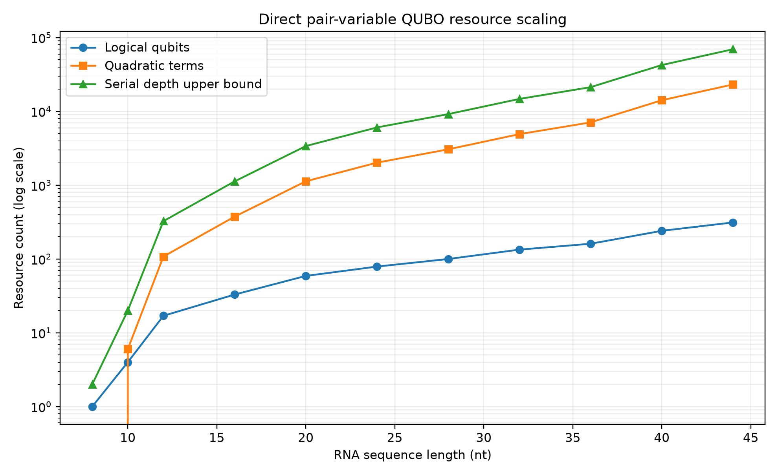
Direct encoding reaches 313 qubits and 23,187 interactions
313
23,187
logical qubits
quadratic terms
46,374
2²⁸⁷ GB
two-qubit gates
at p=1
statevector
memory estimate
Full dense statevector simulation is infeasible.
07

Slide 8
Stem encoding cuts variables while retaining MFE-pair coverage
36.1%
variable reduction at 44 nt
100%
MFE-pair candidate coverage
Trade-off: stem variables are compact but can exclude isolated pairs and need careful overlap constraints.
08

Slide 9
Structural validity did not translate into thermodynamic quality
Full 44-nt classical QUBO baseline
Noise experiment • 9-qubit instance
0
0.50
+21.7
Condition
1q / 2q
Exact
Ideal
0% / 0%
3 / 3
remaining conflicts
base-pair F1
Vienna energy gap
Low noise
0.1% / 1%
3 / 3
High noise
0.5% / 3%
3 / 3
Small-instance robustness is encouraging—but does not establish large-instance noise tolerance.
09

Slide 10
CONCLUSION
The next breakthrough is better modeling not simply more qubits
01
02
03
Add thermodynamic context
Reduce the search space
Scale the optimizer
Encode stacking, loops, bulges, and multiloops.
Use probability-guided pruning and compact stem variables.
Test warm-start, recursive, and decomposition-based QAOA.
Bottom line: the proof of concept works on 9 qubits; biologically faithful scaling requires a smarter objective and decomposition.

