Slide 1
Presentation Title, Verdana Bold 40pt
Option 1

Slide 2
Presentation Title Verdana Bold 40pt
Option 2
Notes:
This PowerPoint Template includes a series of slide masters with predefined layouts and color schemes for formatting slides
Slide Masters are displayed when you right click on a slide and select Layout from menu

Slide 4
Layout: SectionDivider, Verdana Bold 40pt
Divider Subtext Verdana 28 pt

Slide 5
Layout: Title and Content Verdana Bold 32pt
First level bullet text, Verdana 24pt
Line spacing 0.95, before paragraph 12pt
Left justified
Sentence case
First level bullet color is accent1
Second level bullet Verdana 20pt
Line spacing 0.95, before paragraph 6pt
Third level
Third level
Fourth level

Slide 6
Layout: Two Content
First level bullet, Verdana 22pt
Line spacing 0.95, before paragraph 10pt
Left justified
Sentence case
First level bullet color is accent 1
Second level bullet
Third level
First level bullet, Verdana 22pt
Line spacing 0.95, before paragraph 10pt
Left justified
Sentence case
First level bullet color is accent 1
Second level bullet
Third level

Slide 7
Color Scheme
White–Background
R255 G255 B255
Accent 1
R171 G25 B45
Black
R0 G0 B0
Accent 2
R178 G183 B187
Red R171 G25 B45
Accent 3 R44 G106 B140
Grey
R109 G109 B109
Accent 4
R183 G160 B121
Accent 5 R70 G160 B220
Accent 6
R109 G109 B109

Slide 8
Default Settings
Theme Fonts:
Verdana (heading)
Verdana (body)
Drawing Style Default:
Sample
Sample
Sample
Text Box Default:
Verdana 16pt
Color: Black
Align: Center Line Spacing: Multiple .95 Space Before: 6pt
For labels only – use layout placeholders for bulleted lists
Line Style Default:

Slide 9
Default Table Style
Heading 1 | Heading 2 | Heading 3 | Heading 4 | Heading 5
Content | Content | Content | Content | Content
Content | Content | Content | Content | Content
Content | Content | Content | Content | Content
Content | Content | Content | Content | Content

Slide 10
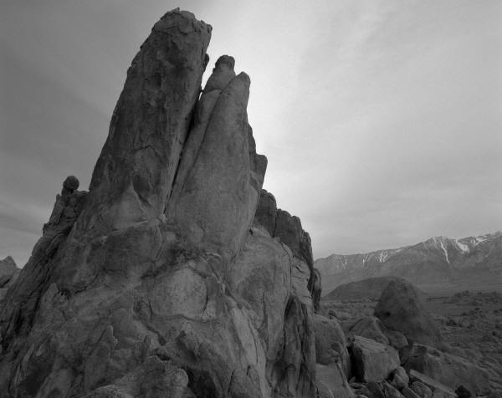
Layout: PhotoCaption
Photo description

Slide 11
Layout: Content Column Chart Sample
Notes:
BEST PRACTICES:
Open Excel 2007 before creating charts in PowerPoint
Duplicate this slide and edit data

Slide 12
Layout: Two Content Column Chart Sample
First level bullet text
Line spacing 0.95, before paragraph 12pt
Left justified
Sentence case
First level bullet color is accent 2
Second bullet level
Line spacing 0.95, before paragraph 6pt
Notes:
BEST PRACTICES:
Open Excel 2007 before creating charts in PowerPoint
Duplicate this slide and edit data

Slide 13
Layout: Content Line Chart Sample
Notes:
BEST PRACTICES:
Open Excel 2007 before creating charts in PowerPoint
Duplicate this slide and edit data

Slide 14
Layout: Two Content Line Chart Sample
First level bullet text
Line spacing 0.95, before paragraph 12pt
Left justified
Sentence case
First level bullet color is accent 2
Second bullet level
Line spacing 0.95, before paragraph 6pt
Notes:
BEST PRACTICES:
Open Excel 2007 before creating charts in PowerPoint
Duplicate this slide and edit data

Slide 15
Layout: Content Pie Chart Sample
Notes:
BEST PRACTICES:
Open Excel 2007 before creating charts in PowerPoint
Duplicate this slide and edit data

Slide 16
Layout: Two Content Pie Chart Sample
First level bullet text
Line spacing 0.95, before paragraph 12pt
Left justified
Sentence case
First level bullet color is accent 2
Second bullet level
Line spacing 0.95, before paragraph 6pt
Notes:
BEST PRACTICES:
Open Excel 2007 before creating charts in PowerPoint
Duplicate this slide and edit data

Slide 17
Presentation Title, Verdana Bold 40pt
Option 1

Slide 18
Presentation Title Verdana Bold 40pt
Option 2
Notes:
This PowerPoint Template includes a series of slide masters with predefined layouts and color schemes for formatting slides
Slide Masters are displayed when you right click on a slide and select Layout from menu

Slide 20
Layout: SectionDivider, Verdana Bold 40pt
Divider Subtext Verdana 28 pt

Slide 21
Layout: Title and Content Verdana Bold 32pt
First level bullet text, Verdana 24pt
Line spacing 0.95, before paragraph 12pt
Left justified
Sentence case
First level bullet color is accent1
Second level bullet Verdana 20pt
Line spacing 0.95, before paragraph 6pt
Third level
Third level
Fourth level

Slide 22
Layout: Two Content
First level bullet, Verdana 22pt
Line spacing 0.95, before paragraph 10pt
Left justified
Sentence case
First level bullet color is accent 1
Second level bullet
Third level
First level bullet, Verdana 22pt
Line spacing 0.95, before paragraph 10pt
Left justified
Sentence case
First level bullet color is accent 1
Second level bullet
Third level

Slide 23
Color Scheme
Background
R109 G109 B109
Accent 1
R171 G25 b45
White –Text
R255 G255 B255
Accent 2
R178 G183 B187
White -Rule
R255 G255 B255
Accent 3 R44 G106 B140
Black
R0 G0 B0
Accent 4
R183 G160 B121
Accent 5 R70 G160 B220
Accent 6
R217 G205 B149

Slide 24
Default Settings
Theme Fonts:
Verdana (heading)
Verdana (body)
Drawing Style Default:
Sample
Sample
Sample
Text Box Default:
Verdana 16pt
Color: White
Align: Center Line Spacing: Multiple .95 Space Before: 6pt
For labels only – use layout placeholders for bulleted lists
Line Style Default:

Slide 25
Default Table Style
Heading 1 | Heading 2 | Heading 3 | Heading 4 | Heading 5
Content | Content | Content | Content | Content
Content | Content | Content | Content | Content
Content | Content | Content | Content | Content
Content | Content | Content | Content | Content

Slide 26
Layout: PhotoCaption
Photo description

Slide 27
Layout: Content Column Chart Sample
Notes:
BEST PRACTICES:
Open Excel 2007 before creating charts in PowerPoint
Duplicate this slide and edit data

Slide 28
Layout: Two Content Column Chart Sample
First level bullet text
Line spacing 0.95, before paragraph 12pt
Left justified
Sentence case
First level bullet color is accent 2
Second bullet level
Line spacing 0.95, before paragraph 6pt
Notes:
BEST PRACTICES:
Open Excel 2007 before creating charts in PowerPoint
Duplicate this slide and edit data

Slide 29
Layout: Content Line Chart Sample
Notes:
BEST PRACTICES:
Open Excel 2007 before creating charts in PowerPoint
Duplicate this slide and edit data

Slide 30
Layout: Two Content Line Chart Sample
First level bullet text
Line spacing 0.95, before paragraph 12pt
Left justified
Sentence case
First level bullet color is accent 2
Second bullet level
Line spacing 0.95, before paragraph 6pt
Notes:
BEST PRACTICES:
Open Excel 2007 before creating charts in PowerPoint
Duplicate this slide and edit data

Slide 31
Layout: Content Pie Chart Sample
Notes:
BEST PRACTICES:
Open Excel 2007 before creating charts in PowerPoint
Duplicate this slide and edit data

Slide 32
Layout: Two Content Pie Chart Sample
First level bullet text
Line spacing 0.95, before paragraph 12pt
Left justified
Sentence case
First level bullet color is accent 2
Second bullet level
Line spacing 0.95, before paragraph 6pt
Notes:
BEST PRACTICES:
Open Excel 2007 before creating charts in PowerPoint
Duplicate this slide and edit data

