Slide 1
Kinova Extra DOF
Garrison Johnston

Slide 2
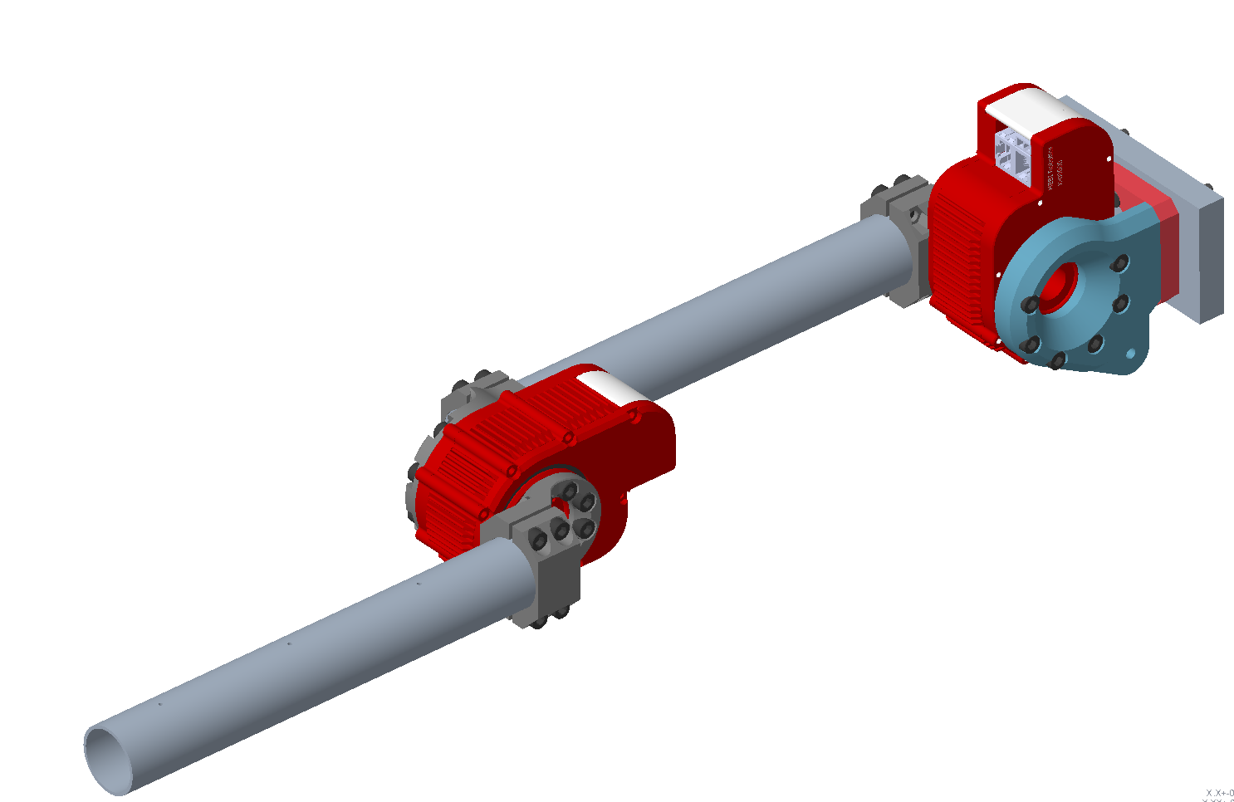
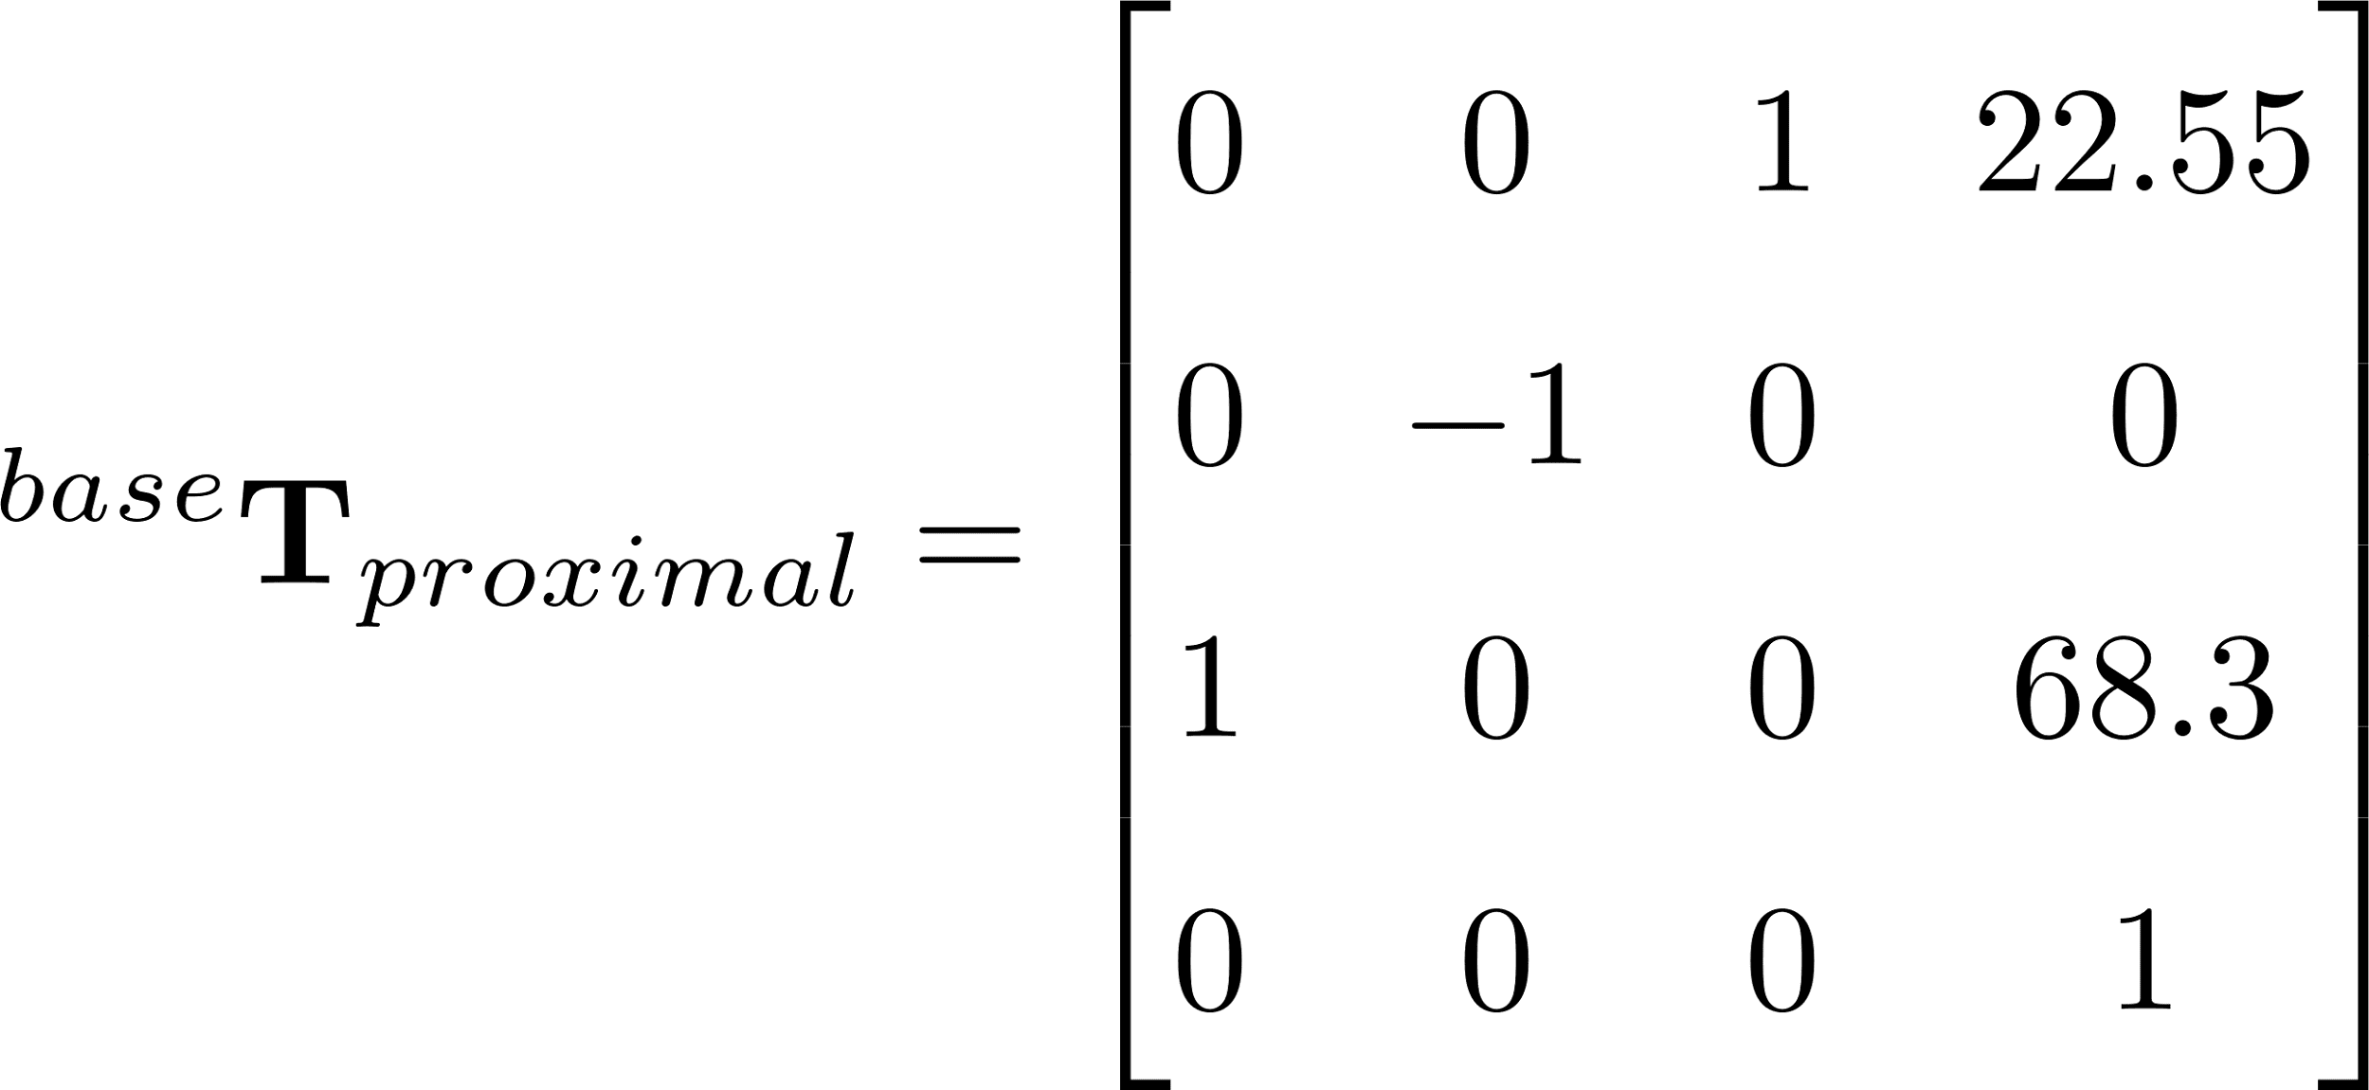
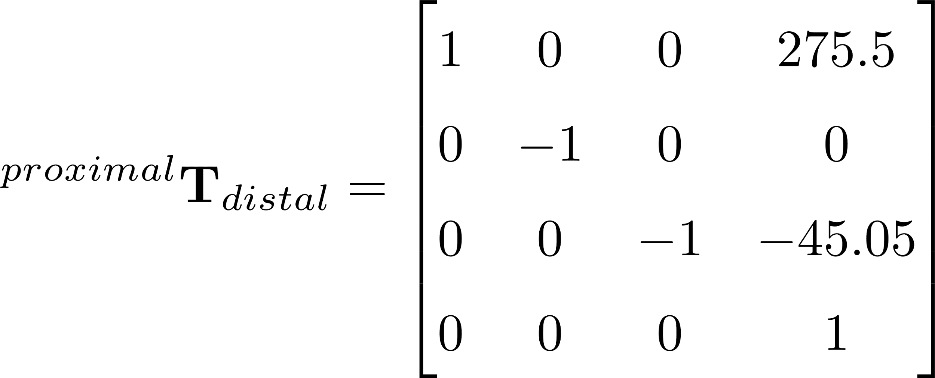
Transformations
Base
Proximal Arm
Distal Arm
All units mm

Slide 3
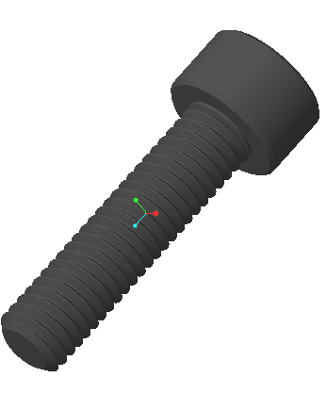
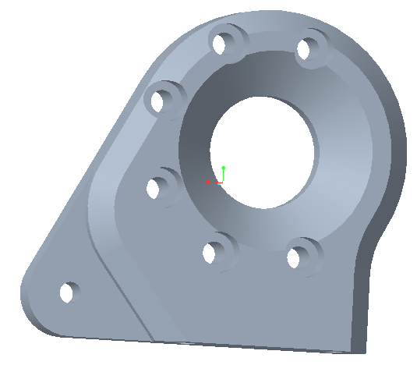
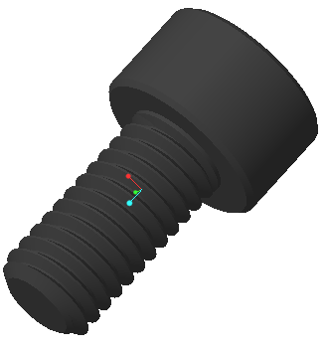
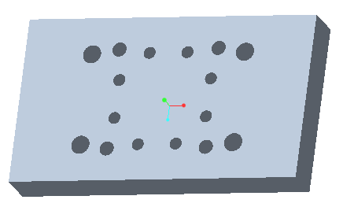
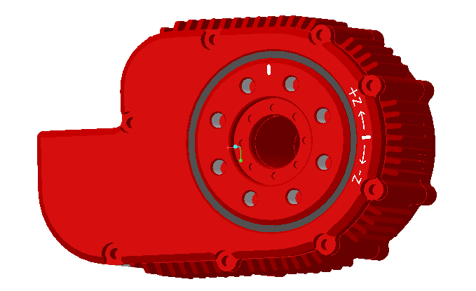
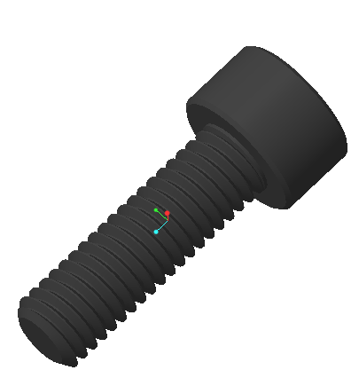
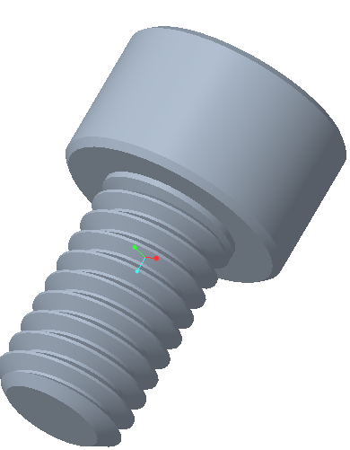
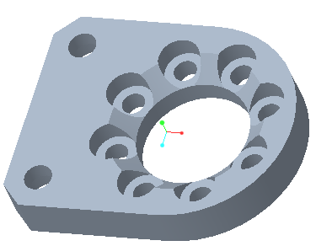
4.1 g (x4)
144.0 g
2.9 g (x5)
191.6 g
M5 -10mm
M5 -20mm
491.8 g
46.9 g
3.7 g (x8)
4.5 g (x2)
M5 -16mm
M6 -10mm

Slide 4

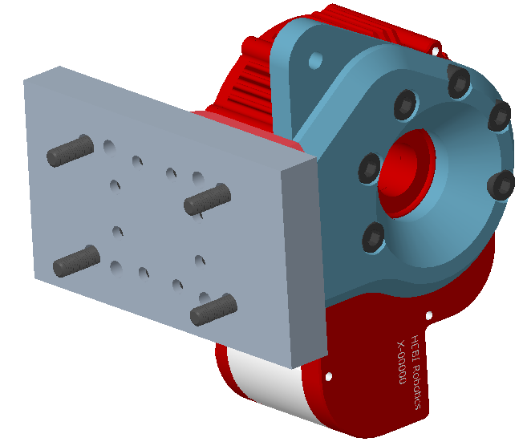


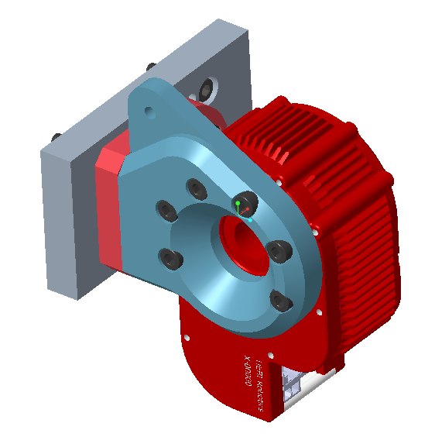
Base
FROM CAD
Mass (kg):
9.1943084e-01
Center of Gravity (mm):
X Y Z -6.8746701e+00 -6.5597779e+00 4.6690475e+01
Inertia Tensor at center of mass w.r.t. base frame (kg-mm^2):
Ixx Ixy Ixz 1.3999746e+03 6.6849666e+01 4.2856060e+01
Iyx Iyy Iyz 6.6849666e+01 1.2429579e+03 1.1430982e+02
Izx Izy Izz 4.2856060e+01 1.1430982e+02 9.2174211e+02

Slide 5
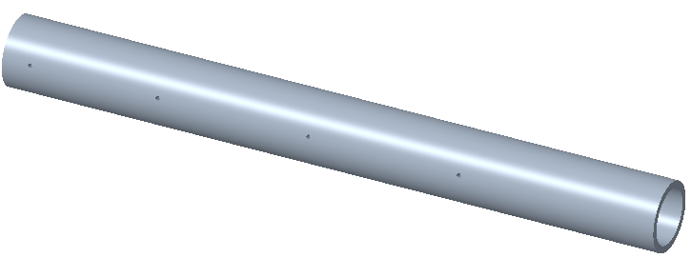
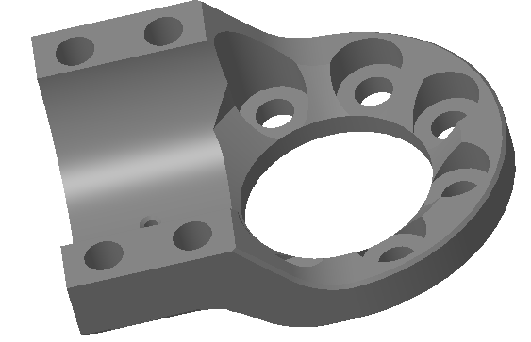
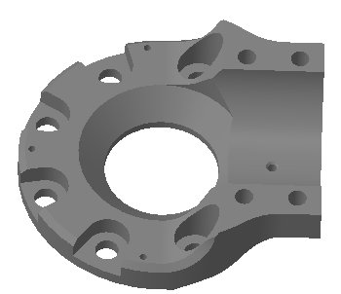
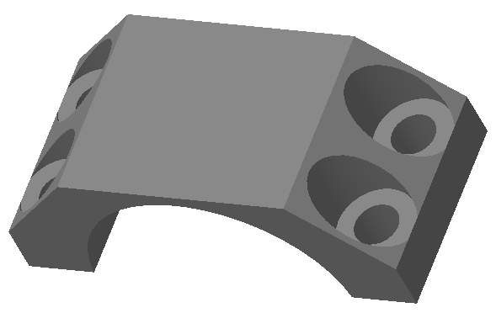
102.9 g
39.0 g
491.8 g
250mm
60.3 g
2.9 g (x12)
3.7 g (x8)
15.6 g (x2)
M5 -16mm
M5 -10mm

Slide 6
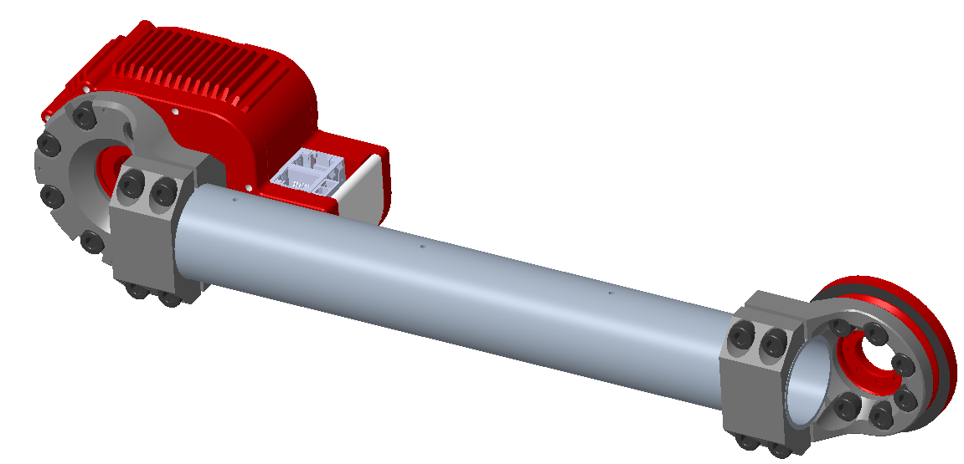



FROM CAD
Mass (kg):
7.8978485e-01
Center of Gravity (mm):
X Y Z 2.0881670e+02 1.0052440e+00 -6.7516845e+00
Inertia Tensor at center of mass w.r.t. base frame (kg-mm^2):
Ixx Ixy Ixz 5.8191922e+02 -1.1278085e+01 7.6810856e+02
Iyx Iyy Iyz -1.1278085e+01 7.8712752e+03 1.1405514e+01
Izx Izy Izz 7.6810856e+02 1.1405514e+01 7.7696140e+03
Proximal Arm

Slide 7
100.2 g
39.0 g
241mm
2.9 g (x8)
3.7 g (x4)
15.6 g (x1)
M5 -16mm
M5 -10mm

Slide 8
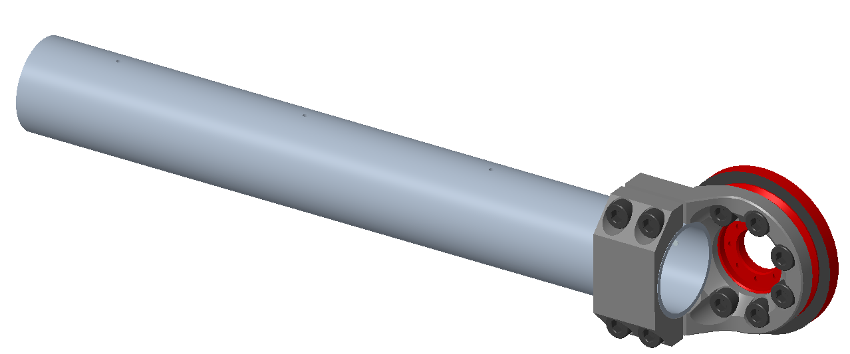



Distal Arm
FROM CAD
Mass (kg):
2.1441146e-01
Center of Gravity (mm):
X Y Z 6.7590151e+01 3.8119524e-03 1.4127141e+01
Inertia Tensor at center of mass w.r.t. base frame (kg-mm^2):
Ixx Ixy Ixz 7.6011300e+01 -4.6379915e-02 -8.6165554e+01
Iyx Iyy Iyz -4.6379915e-02 1.3587723e+03 -4.9685503e-03
Izx Izy Izz -8.6165554e+01 -4.9685503e-03 1.3614842e+03

