Slide 1

Hyperhive
PERSONALIZES ADAPTIVE LEARNING SYSTEM
For Sekolah Sri Acmar

Slide 2
1.0 Introduction – Background
About Ever Core Labs ( Company’s Overview )
Project Undertaken ( HyperHive )
HyperHive

Slide 3
1.0 Introduction – Background
About Ever Core Labs ( Company’s Overview )
Founded in 2020, Ever Core Labs is a forward-thinking technology company headquartered in Shah Alam, Selangor. Ever Core Labs is currently focused on designing several groundbreaking projects, with a strong emphasis on advancing student learning platforms and systems. One of the main project Ever Core Labs currently focusing on is HyperHive; Personalized Adaptive learning System.
Project Undertaken ( HyperHive )
Hyperhive

Slide 4
1.0 Introduction – Background
About Ever Core Labs ( Company’s Overview )
Project Undertaken ( HyperHive )
The company is currently undertaking a project to design the Personalized Adaptive Learning System (PALS), HyperHive, a concept tailored specifically for Sekolah Sri Acmar, aiming to revolutionize the school’s approach to education.
Hyperhive

Slide 5
1.0 Introduction – Background
About Ever Core Labs ( Company’s Overview )
Project Undertaken ( HyperHive )
Hyperhive
The HyperHive; Personalized Adaptive Learning System is a study management system designed to assist users in organizing their study sessions with the implementation of Pomodoro technique. This system allows users to register, log in, manage subjects, and track their study progress. The primary goal of HyperHive is to enhance productivity and learning efficiency by providing a structured approach to studying.

Slide 6
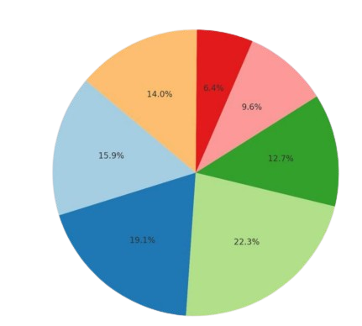
2.0 Problem Statement
According to the data gathered, STEM students of Sekolah Sri Acmar struggle with varied learning paces, limited support, and poor time management. This project aims to design a learning system for high school STEM students to address these challenges.
Lack of Resources
14.0%
6.4%
9.6%
Unclear Goals / Priorities
Innefective Study Techniques
12.7%
15.9%
Lack of Motivation
Difficulty
Understanding Material
19.1%
22.3%
Poor Time Management
Statistics on students' difficulties in studying
Inability to Track Progress

Slide 7
3.0 Objective
i. To analyze Personalized Adaptive Learning System requirements
vi. | To test algorithm of Personalized Adaptive Learning System using Flowgorithm
ii. | To construct Personalized Adaptive Learning System modules
v. | To see the expected screen of Personalized Adaptive Learning System
iii. | To draw flowchart for the Personalized Adaptive Learning System
iv. | To create pseudocodes for Personalized Adaptive Learning System

Slide 8
4.0 Methodology
Problem Analysis
01
Program Documentation
05
02
Algorithm Design
04
03
Program Testing & Debugging
Algorithm Implementation

Slide 9


4.0 Methodology
Personalized Adaptive Learning System (PALS) adheres to the Programming Development Life Cycle (PDLC) to ensure a systematic and structured approach to creating a robust and efficient system
The designing of PALS system is only up until the second phase of PDLC that is Algorithm Design and one of the fifth phase that is System Documentation

Slide 10
4.0 Methodology
Problem Analysis
Problem analysis is to analyze the problem that high school students in STEM faced, and to come up a solution that works for them to ensure their learning journey goes smoothly.
PALS identifies the need for an adaptive learning system that personalizes study plans and enhances productivity using suitable techniques according to their learning styles.
Algorithm Design
Algorithm Implementation
Program Testing & Debugging
Program Documentation

Slide 11
4.0 Methodology
Problem Analysis
Algorithm Design
To visualize the problem where we focused on planning and creating the module or structure of a solution to the problem. The main goal is to break down the problem into sets of modules and efficiently solve it step by step.
Algorithm Implementation
Program Testing & Debugging
Program Documentation

Slide 12
4.0 Methodology
Problem Analysis
Algorithm Design
Algorithm Implementation
To transform the designed algorithm into a functional system using c++ programming language that automates tasks, optimizes processes, and adapts dynamically to meet the user needs effectively.
Program Testing & Debugging
Program Documentation

Slide 13
4.0 Methodology
Problem Analysis
Algorithm Design
Algorithm Implementation
Program Testing & Debugging
To test the program which is the process of executing a program with the intent of finding errors in the system.
PALS undergoes rigorous testing to ensure functionality, reliability, and usability.
Program Documentation

Slide 14
4.0 Methodology
Problem Analysis
Algorithm Design
Algorithm Implementation
Program Testing & Debugging
Program Documentation
Provides clear user guides, technical details, and maintenance logs to support usability, development, and system evolution. PALS includes built-in mechanisms for updates and bug fixes, ensuring it remains scalable and adaptive to user needs.

Slide 15
5.0 SOLUTIONS
Solution of the Personalized Adaptive Learning System (PALS)
The system solution of the Personalized Adaptive Learning System (PALS) refers to the comprehensive set of features, processes, and technologies designed to address the identified problems in personalized learning and productivity.
1. User -Friendly Interface:
Design an intuitive interface that simplifies the scheduling and tracking of study sessions, making it accessible for all users
2 Main Examples of PALS potential solution :
2. Algorithm Development:
Implement hyper-heuristics to create adaptive study schedules that respond to individual learning patterns and performance metrics.

Slide 16
5.0 SOLUTIONS
Solution of the Personalized Adaptive Learning System (PALS)
The system solution of the Personalized Adaptive Learning System (PALS) refers to the comprehensive set of features, processes, and technologies designed to address the identified problems in personalized learning and productivity.
1. User -Friendly Interface:
Design an intuitive interface that simplifies the scheduling and tracking of study sessions, making it accessible for all users
2 Main Examples of PALS potential solution :
2. Algorithm Development:
Implement hyper-heuristics to create adaptive study schedules that respond to individual learning patterns and performance metrics.

Slide 17
5.0 SOLUTIONS
Solution of the Personalized Adaptive Learning System (PALS)
The system solution of the Personalized Adaptive Learning System (PALS) refers to the comprehensive set of features, processes, and technologies designed to address the identified problems in personalized learning and productivity.
1. User -Friendly Interface:
Design an intuitive interface that simplifies the scheduling and tracking of study sessions, making it accessible for all users
2 Main Examples of PALS potential solution :
2. Algorithm Development:
Implement hyper-heuristics to create adaptive study schedules that respond to individual learning patterns and performance metrics.

Slide 18
5.1 Analyzing System Requirements
Analyzing system requirements is a critical step in the development of the Personalized Adaptive Learning System (PALS). Key insights were gathered during a stakeholder meeting with educators from Sekolah Sri Acmar, who provided valuable feedback based on their expertise and understanding of student needs. Their input emphasized in the list below :
The system shall provide a Main Module that serves as the entry point and navigation hub for the system.
The system shall provide a Register Module that allows users to create a new account.
The system shall provide a Login Module that authenticates existing users to access the system.
The system shall provide a Forgot Password Module that enables users to securely reset their account password.
The system shall provide a Main Menu Module that displays the primary navigation options for the user.
The system shall provide a Pomodoro Timer Module that lets users start and track their Pomodoro sessions.
The system shall provide a Progression Tracking Module that monitors and updates the user’s study progress.
The system shall provide a Settings Module that allows users to customize their system preferences.
The system shall provide a Manage Subjects Module that enables users to add or edit study subjects.
The system shall provide a Delete Subject Module that allows users to remove unwanted subjects.
The system shall provide a View Subjects Module that displays all active study subjects.
The system shall provide a User Preferences Module that lets users set and save personalized preferences

Slide 19
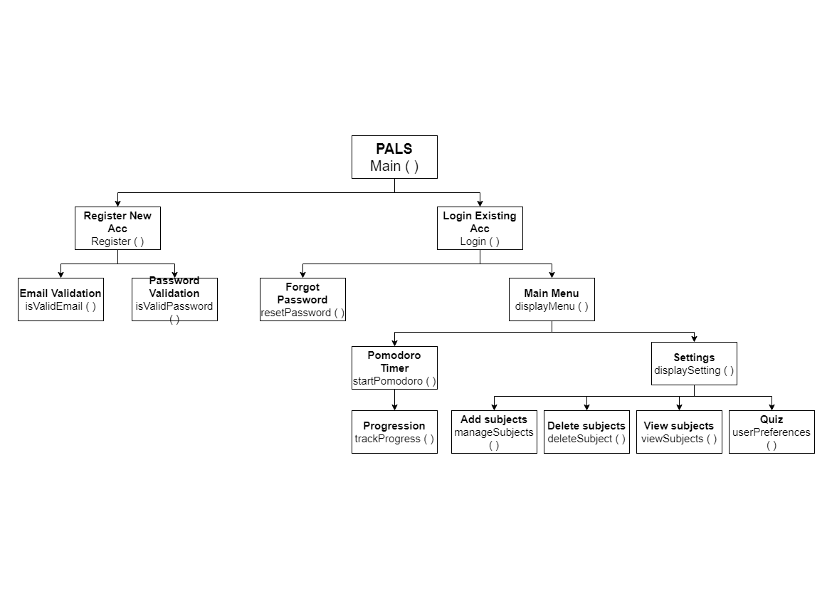
5.2 Designing Module
The System Module of Personalized Adaptive Learning System (PALS)

Slide 20
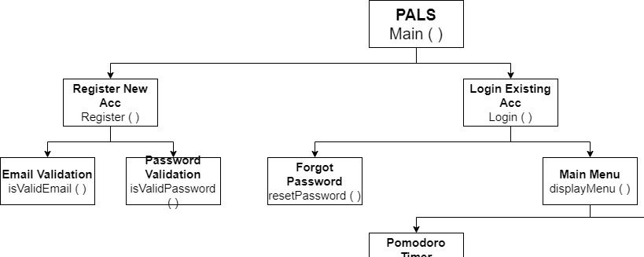
5.2 Designing Module
The Main Module serves as the entry point and navigation hub for the system.
The Register Module allows users to create a new account.
The Login Module authenticates existing users to access the system.
The Forgot Password Module enables users to securely reset their account password.
The Main Menu Module displays the primary navigation options for the user.

Slide 21
5.2 Designing Module
6. The Pomodoro Timer Module lets users start and track their Pomodoro sessions.
7. The Progression Module monitors and updates the user’s study progress.
8. The Settings Module allows users to customize their system preferences.

Slide 22
5.2 Designing Module
9. The Manage Subjects Module enables users to add or edit study subjects.
10. The Delete Subject Module allows users to remove unwanted subjects.
11. The View Subjects Module displays all active study subjects.
12. The User Preferences Module lets users set and save personalized preferences

Slide 23



5.3 Formula / Calculation
Total Session
Learning Style Quiz
Pomodoro

Slide 24
5.3 Formula / Calculation
Total Session Done

Slide 25
5.3 Formula / Calculation
Learning Style Quiz

Slide 26
5.3 Formula / Calculation
Pomodoro

Slide 27
5.4 Designing Flowchart

Slide 28
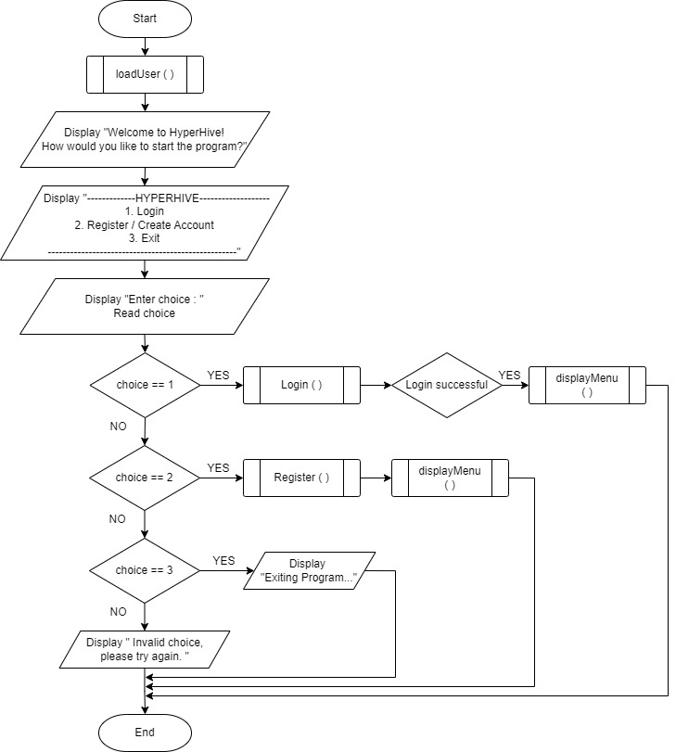
Main Module : Main()
The program will call loadUsers() to load and retrieve data
The program will display welcome note and then prompt user with selections
Call of module or the next action will be taken based on selection chosen.

Slide 29
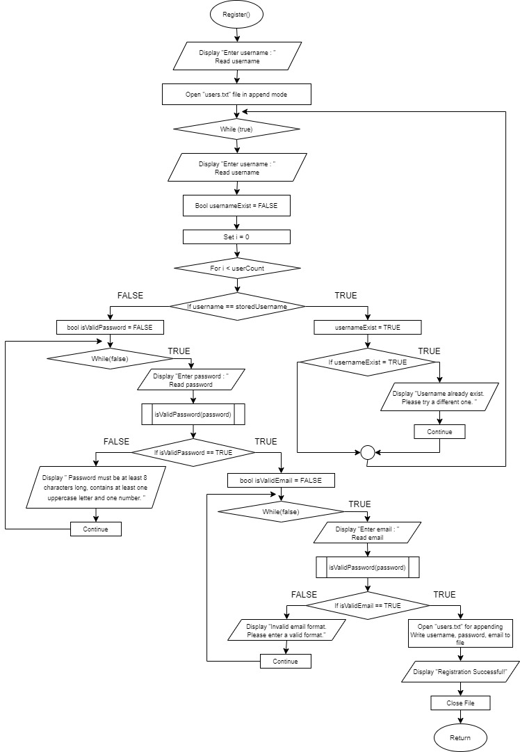
Register Module : Register()
The program will prompt user with enter username.
The program will open file “users.txt” to read and ensure username is yet to be written.
If username entered is yet taken, it will then prompt for password and email, and program will validate both password and email.
The data that was input will be written in the file sequentially.
The program will close file and return bool value back to Main().

Slide 30
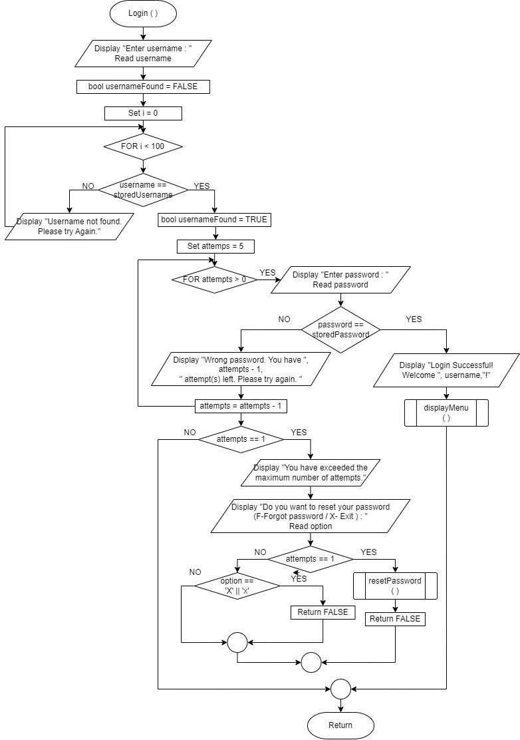
Login Module : Login()
The program will prompt user with enter username.
The program will open file “users.txt” to read, skim through the file to check if the username existed.
If the username existed, program will then prompt user for password.
If password is the same as stored password in the file “users.txt” it will then call module for displayMenu().
If not, the program will then display wrong password, and prompt user again with password within 5 attempts.
If user still input wrong the password, it will then prompt user if they want to reset password.
If yes, it will call resetPassword. If no. it’ll return to main() and return False value.

Slide 31
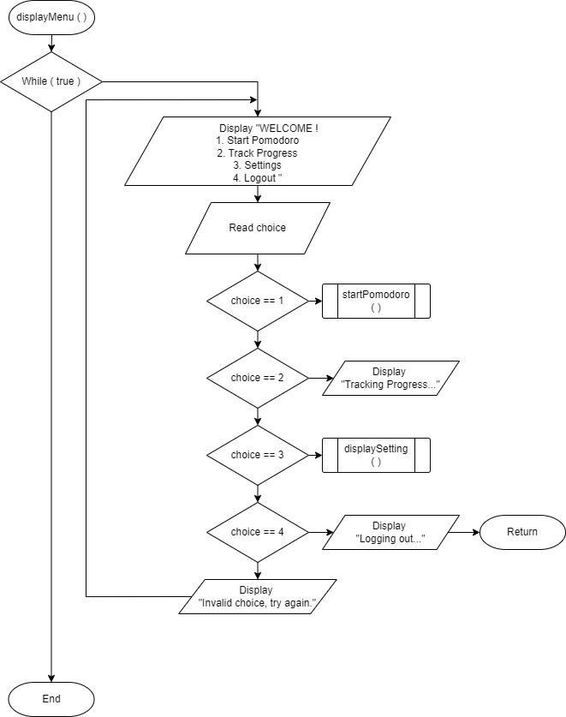
Display Menu Module : displayMenu()
While true, the program will provide and display selection for the user to take .
If first, it will call startPomodoro() module
If second, it will call display Tracking progress and call on trackProgress()
If third, it will call displaySettings().
If fourth, it will log out, and delete temporary data.

Slide 32
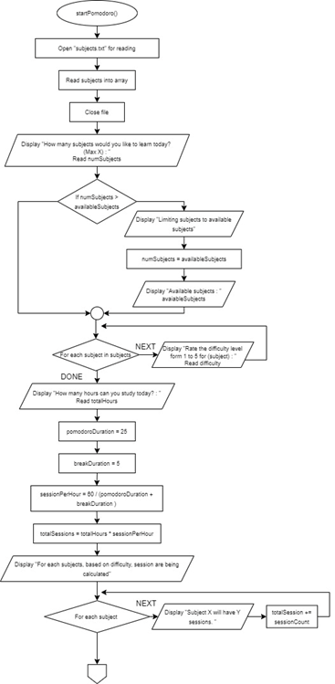
Start Pomodoro Module : startPomodoro() part 1
The program will open file “users.txt” for reading, to read subjects into array, then close the file.
It will then prompt user number of subjects they want to learn with max count from the subjects that was retrieve from the file.
Then it will display the available subjects as a reference for user to input.
Then using while loop, to get input for difficulty level for each subject chosen.
Program will ask user for the total hours they will like to learn for.

Slide 33
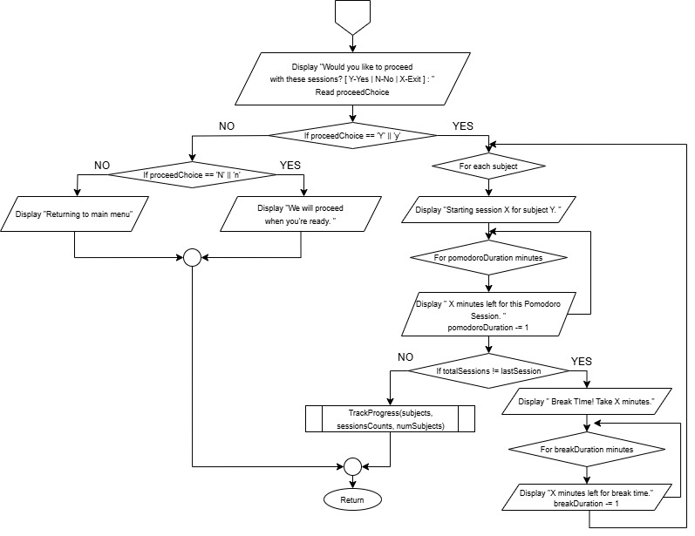
Start Pomodoro Module : startPomodoro() part 2 and part 3
Program will then calculate the number of sessions for each subject based on it’s level of difficulty.
Then it will use for loop, to display each subject calculated sessions.
Program will prompt user if they want to proceed with the pomodoro sessions.
If yes, pomodoro starts and continue with break time until last session is completed.
If no, it will display an appropriate message.
If exit, it will return to displayMenu().

Slide 34
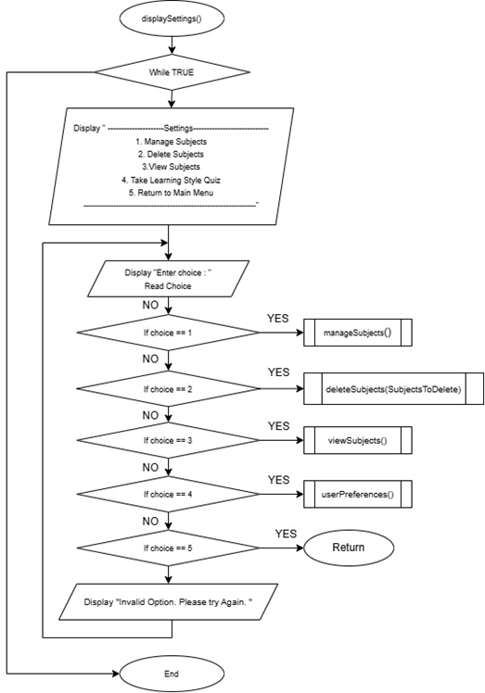
Display Settings module : displaySettings()
While true, the program will provide and display selection for the user to take .
If first, it will call manageSubjects() module,
If second, it will call deleteSubjects(subjectToDelete) module.
If third, it will call viewSubjects() module.
If fourth, it will call userPreferences() module.
If fifth, it will return to displayMenu().
If none the above, it will display “ Invalid Option. Please Try Again”

Slide 35
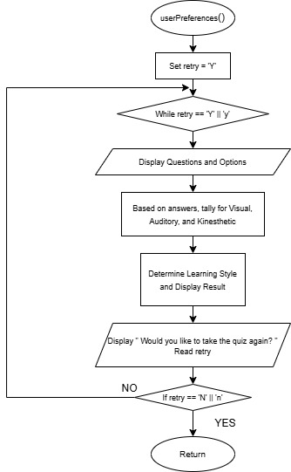
User Preferences Module : userPreferences()
The program will set retry to Y
Using while loop, the program will display sets of questions and get input from user with 3 options that is A,B or C.
Based on the option, it will then calculate and determine what type of learner user is and display for user.
After done the program will prompt user if they want to retry, if yes it will redo and re-prompt the same questions.
If no, it will return to displaySettings().

Slide 36
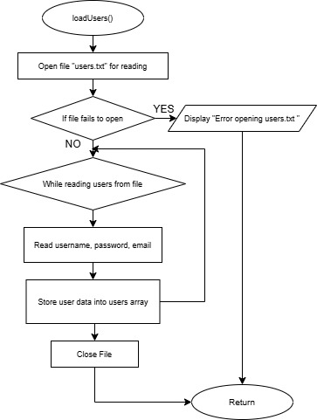
Load Users Data Module : loadUsers()
This module function is only for opening file for reading and read username, password and email and store them into array, then close file.
If file fails to open, it will display appropriate message.

Slide 37
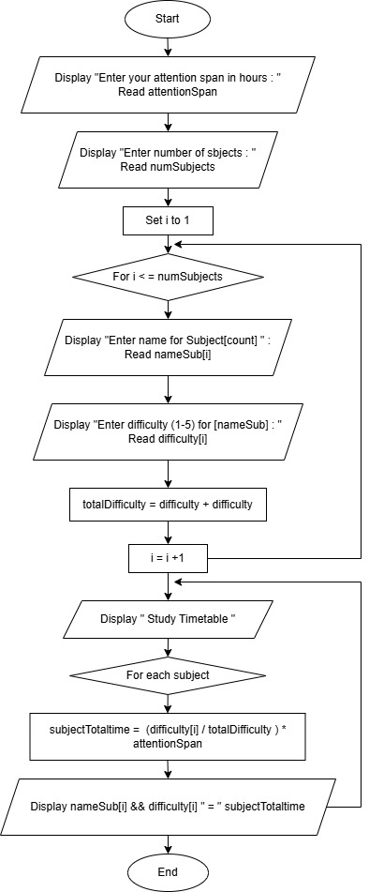
Timetable : studyTime()
Program will prompt user for their attention span and number of subjects they want to learn.
For each subject, it will loop to enter name of the subjects and their difficulty.
It will then calculate total of hours user must spend for each subjects.
It then generates a timetable base on the calculation using for loop for each subject.

Slide 38
5.5 Pseudocode

Slide 39
Pseudocode – Main()

Slide 40
Pseudocode – Register() part 1

Slide 41
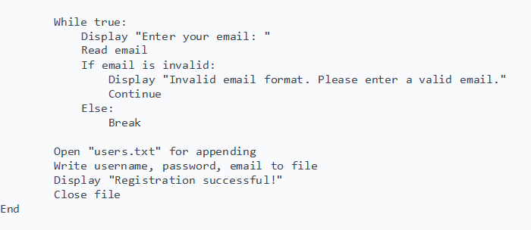
Pseudocode – Register() part 2

Slide 42
Pseudocode – Login()

Slide 43
Pseudocode – displayMenu()

Slide 44
Pseudocode – startPomodoro() part 1

Slide 45
Pseudocode – startPomodoro() part 2

Slide 46
Pseudocode – startPomodoro() part 3

Slide 47
Pseudocode – trackProgress()

Slide 48
Pseudocode – displaySettings()

Slide 49
Pseudocode – manageSubjects() and addSubject(newSubject)

Slide 50
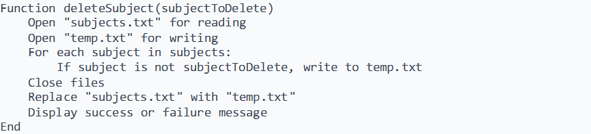
Pseudocode – deleteSubject(subjectToDelete) and viewSubjects()

Slide 51
Pseudocode – userPreferences()

Slide 52
Pseudocode – loadUsers()

Slide 53
Pseudocode – isValidEmail(email) and isValidPassword(password)

Slide 54
5.6 Example of Expected Screen

Slide 55
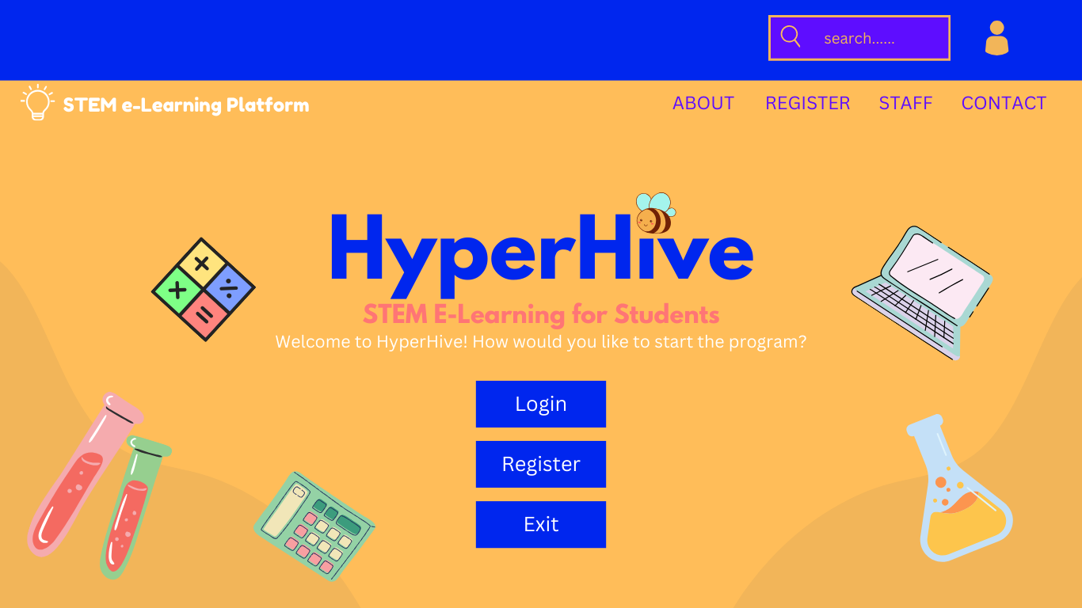

Slide 56
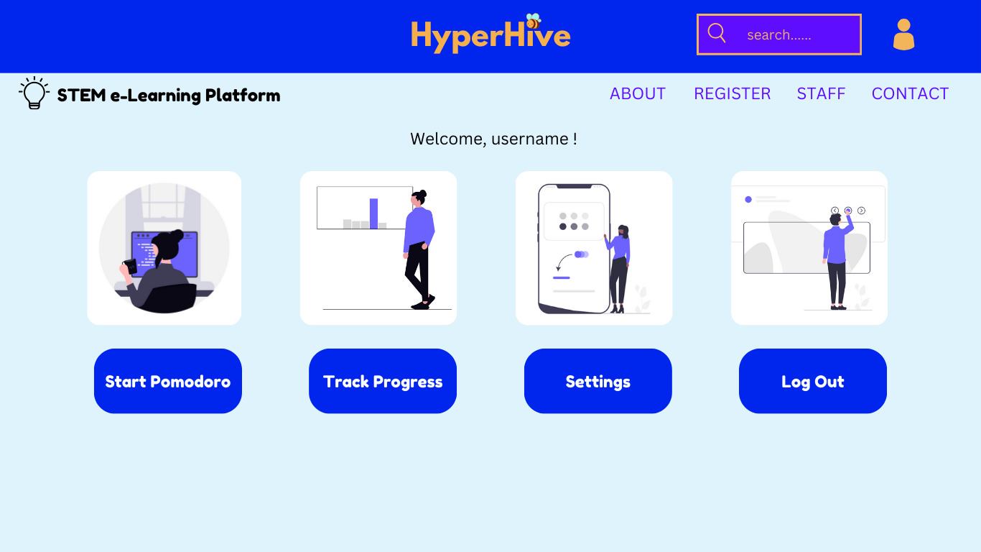

Slide 57
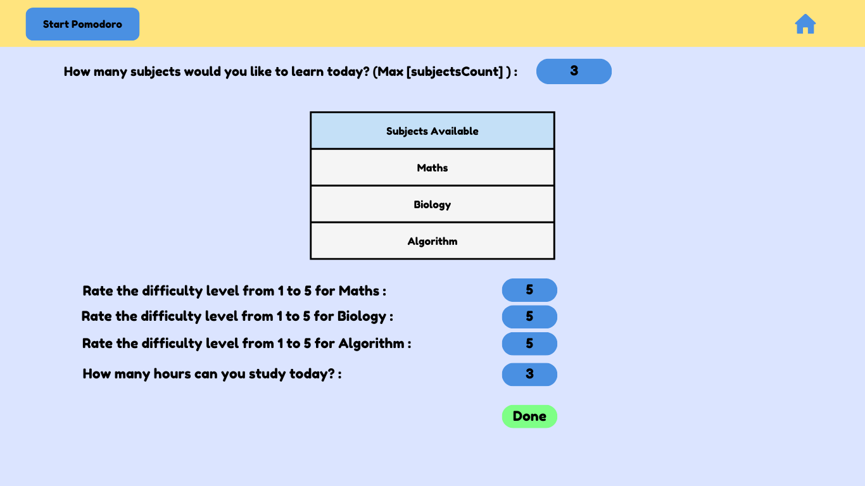

Slide 58
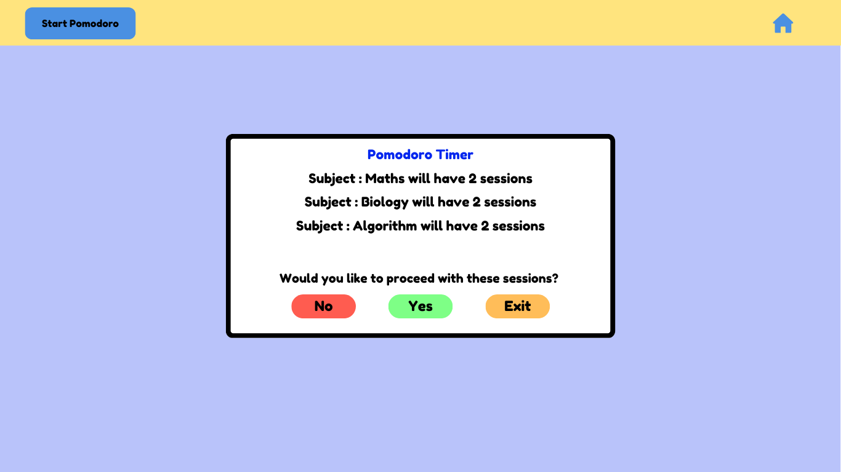

Slide 59
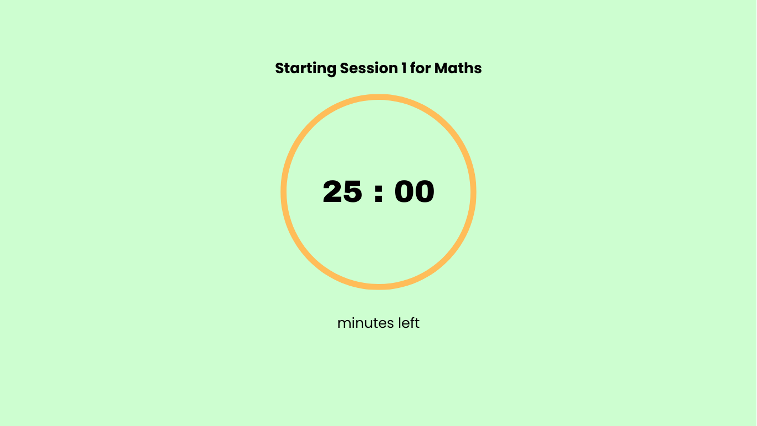

Slide 60
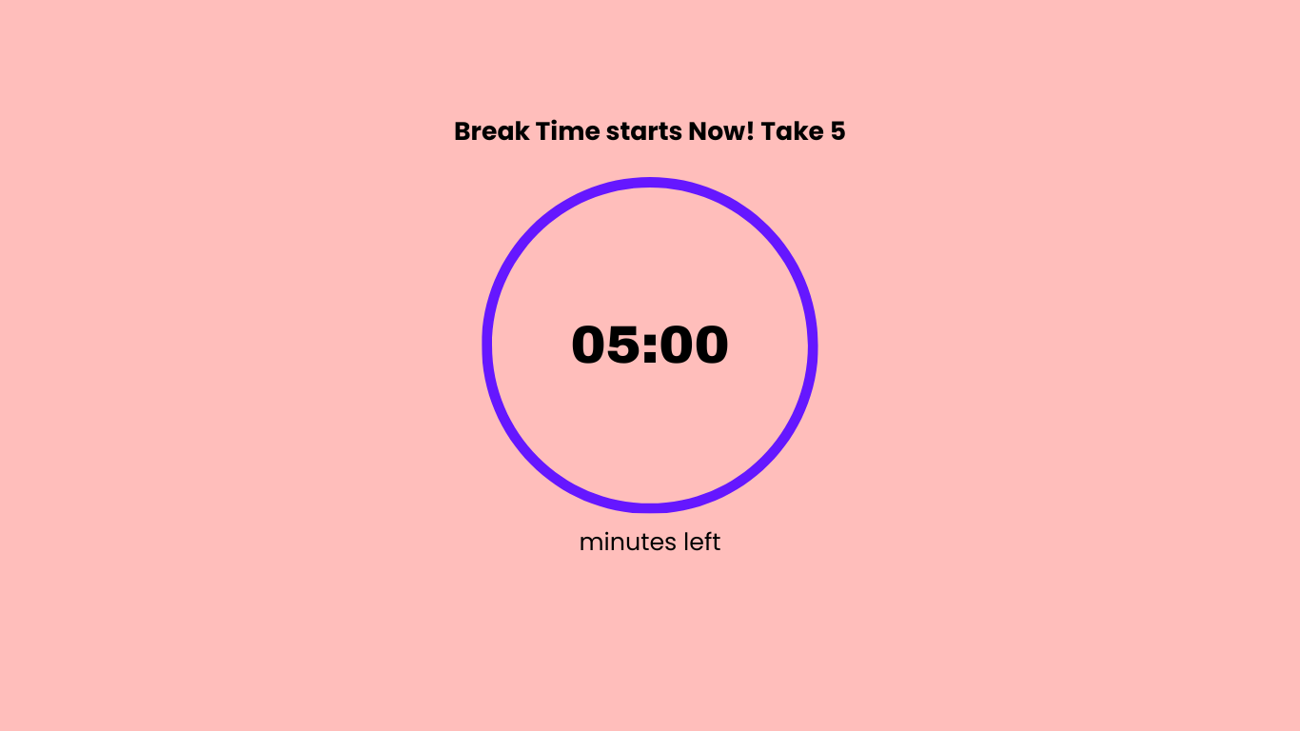

Slide 61

6.0 Outcome
6.1 Benefits of the System
The system enhances efficiency in learning by automating study session tracking, adaptive learning path generation, and progress analytics. It dynamically adjusts study plans based on performance data and provides curated content to suit different learning styles. Its streamlined operations ensure effective time management and consistent progress monitoring.
6.2 Solutions Provided by the System
The system simplifies learning management by automating content recommendations, performance analysis, and study session scheduling. It ensures flexibility through customizable settings and integration with adaptive algorithms, enabling real-time adjustments to study plans. Notifications and reminders optimize system functionality by maintaining consistent engagement and reducing missed sessions.

Slide 62
6.0 Outcome
6.3 Limitations of the System
The system relies heavily on stable internet connectivity and frequent updates, which may lead to technical issues during downtime. Compatibility challenges with diverse curriculum standards could limit its scalability in some regions. Additionally, high development and maintenance requirements may impact long-term cost-effectiveness for smaller institutions.

Slide 63
6.0 Outcome
Outcome for our HyperHive, Personalized Adaptive Learning System
The Personalized Adaptive Learning System is designed to optimize learning by automating key processes such as personalized study plan generation, progress tracking, and adaptive content recommendations. It aims to provide learners with a structured, efficient, and engaging study experience. The system is intended to enhance productivity, reduce learning gaps, and foster consistent academic growth, resulting in improved performance and better time management.

Slide 64
7.0 Conclusion
The HyperHive documentation serves as a detailed blueprint for future projects, reducing development time and enhancing code quality. Its focus on user-centric design helps create intuitive systems tailored to user preferences, while its adaptable principles allow expansion into new domains like training and wellness. Insights from user feedback drive innovation and iterative improvements, supported by rapid prototyping and testing. The documentation also streamlines quality assurance, simplifies onboarding for new developers, and ensures efficient maintenance, making it a key resource for long-term growth and innovation.

