Slide 1




iAlertU
Mamburao
Username
Password
Forgot Password
Login

Slide 2

















2023-2024
Send Report
iAlertU
PCG
PNP
PDRRMO
Dashboard
Records
Archive
Settings
About
Total Population
Total Reports
Male
Female
Logout
50
44
26
18

Slide 3
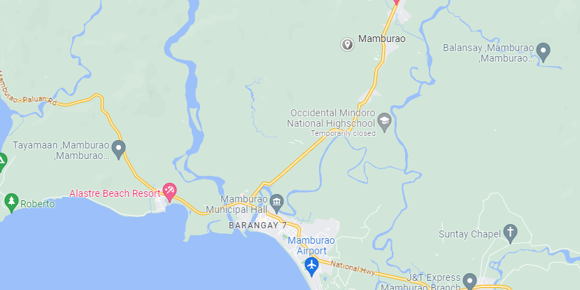
Location:
Name of Reporter:
Mobile Number:
Type of Accident:
Number of Victims:
2023-2024
Total Population
RECEIVED
1,353
iAlertU
Total Reports
Dashboard
1,500
Records
Archive
Male
Settings
897
About
Female
Logout
456

Slide 4


Search
2023-2024
iAlertU
Entries
1 / 1
Id Number | Last Name | First Name | Middle Name | Report | Options
00040 | Abulag | Lovely | Torrente | Vehicular Accident | View Report
Dashboard
Records
Archive
Settings
About
Archive Selected
Logout

Slide 5

Search
2023-2024
iAlertU
Entries
1 / 1
Id Number | Last Name | First Name | Middle Name | Report | Options
00040 | Abulag | Lovely | Torrente | Vehicular Accident | View Report
Dashboard
Records
Archive
Settings
About
Restore
Logout

Slide 6
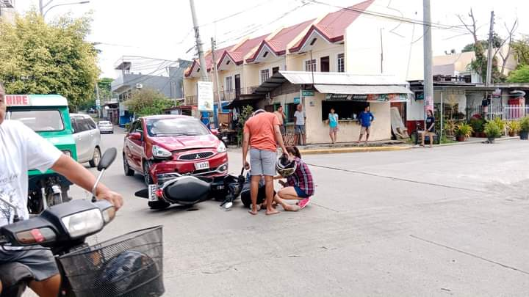
ID Number: 00040
Report: Vehicular Accident
Last Name: Abulag
First Name: Lovely
Middle Name: Torrente
Complete Address: Payompon, Mamburao, Occidental Mindoro, 5106.
Summary of Report
Type of Accident: Vehicular Accident
Number of Victims: 3
Attachment:
iAlertU
Dashboard
Records
Archive
Settings
About
Logout

Slide 7



Username | Password
iAlertU
Municipal Disaster Risk Reduction
and Management Office
Dashboard
Last Name
Dela Cruz
First Name
Juan
Records
Juana
Middle Name
Garcia
Archive
Username
admin123
Password
Add Staff Account
Settings
***********
Retype Password
***********
About
Email
namixcz@gmail.com
Logout
Update

Slide 8






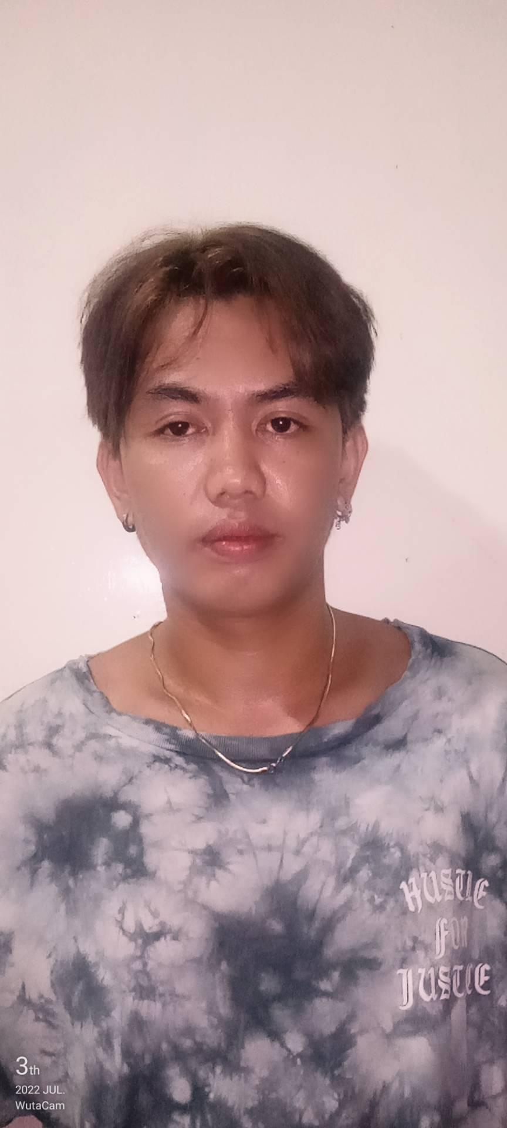

iAlertU
iAlertU
Mamburao
iAlertU is a system that was developed to enhance the emergency response
in Occidental Mindoro, specifically in Mamburao Area. With this system,
the emergency response will be enhanced in a way that the respective departments
will receive notification directly from the user which is either a victim or concern
citizen by just tapping an emergency button for the quick response and action
in the exact location.
Dashboard
Records
Archive
Developers
Settings
About
Logout
Basilio, Jaycelyn
Abulag, Lovely
Balaes, Elaine
Almencion, Ruth
De Padua, Jessica
Alegre, Dhexter

