Slide 1

iAlertU
Enter your mobile number:
+63
977 338 1153
MPIN Login
Don’t have an account yet?
Register

Slide 2
iAlertU
Mamburao
Enter your mobile number:
+63
977 338 1153
1
2
3
4
5
6
7
8
9
0
Forgot MPIN?

Slide 3


Registration
00040
ID Number:
Basic Information
*
Last Name
Dela Cruz
*
Juan
First Name
*
Middle Name
Suffix
*
Male
Female
Sex
*
Birthday
Aug. 3, 2002
*
20
Age
*
Complete Address
Country
Philippines
Province
Occidental Mindoro
City/Municipality
Mamburao
Barangay
Payompon
Zip Code
5106
Cancel
Next

Slide 4
Registration
Security
Set 4 digits MPIN
Retype MPIN
Mobile Number
Send Code
Verification Code
Back
Submit

Slide 5








Hello, Nami
+63 977 338 1153
Municipal Disaster Risk Reduction
and Management Office
Bureau of Fire Protection
Home
History
My Account

Slide 6

Hello, Nami
+63 977 338 1153
Dial MDRRMO
Dial BFP
Municipal Disaster Risk Reduction
and Management Office
Bureau of Fire Protection
Home
History
My Account

Slide 7

Hello, Nami
+63 977 338 1153
Inbox
We received your report.
Municipal Disaster Risk Reduction
and Management Office
Bureau of Fire Protection
Home
History
My Account

Slide 8







Hello, Nami
+63 977 338 1153
Municipal Disaster Risk Reduction
and Management Office
Location:
Type of Accidents:
Vehicular Accident
Number of Victim/s:
3
Attachment:
Send
Home
History
My Account

Slide 9


Hello, Nami
+63 977 338 1153
Bureau of Fire Protection
Location:
Establishment:
House
Color of Smoke:
Nearly White
Grey
Brown
Black
Send
Home
History
My Account

Slide 10



Hello, Nami
+63 977 338 1153
History of Report
MDRRMO
Date | Report | Options
2023 – 05 - 01 | MDRRMO | View Report
2024 – 06 - 02 | MDRRMO | View Report
Home
History
My Account

Slide 11

Hello, Nami
+63 977 338 1153
2023 – 05 – 01
MDRRMO
Type of Accident: Vehicular Accident
Number of Victims: 3
Attachment:
Action: Responded
Home
History
My Account

Slide 12





Hello, Nami
+63 97 7 338 1153
Edit Basic Information
About
Developers
Logout
Home
History
My Account

Slide 13
Hello, Nami
+63 97 7 338 1153
Edit Basic Information
*
Last Name
Dela Cruz
*
First Name
Juan
Middle Name
Suffix
*
Female
Sex
Male
*
Aug. 3, 2002
Birthday
*
Age
20
*
Complete Address
Country
Philippines
Province
Occidental Mindoro
City/Municipality
Mamburao
Barangay
Payompon
Zip Code
5106
Update
Home
History
My Account

Slide 14

Hello, Nami
+63 97 7 338 1153
About
Municipal Disaster Risk Reduction
and Management Office
MDRRMO- Building, Municipal Compound Brgy.8, Mamburao, Philippines, 5106
Address
0977 337 9723
Mobile
mdrrmomamburao@gmail.com
Email
Bureau of Fire Protection
Brgy.9, Mamburao, Philippines, 5106
Address
0945 726 4206
Mobile
bfpmamburao@gmail.com
Email
Home
History
My Account

Slide 15
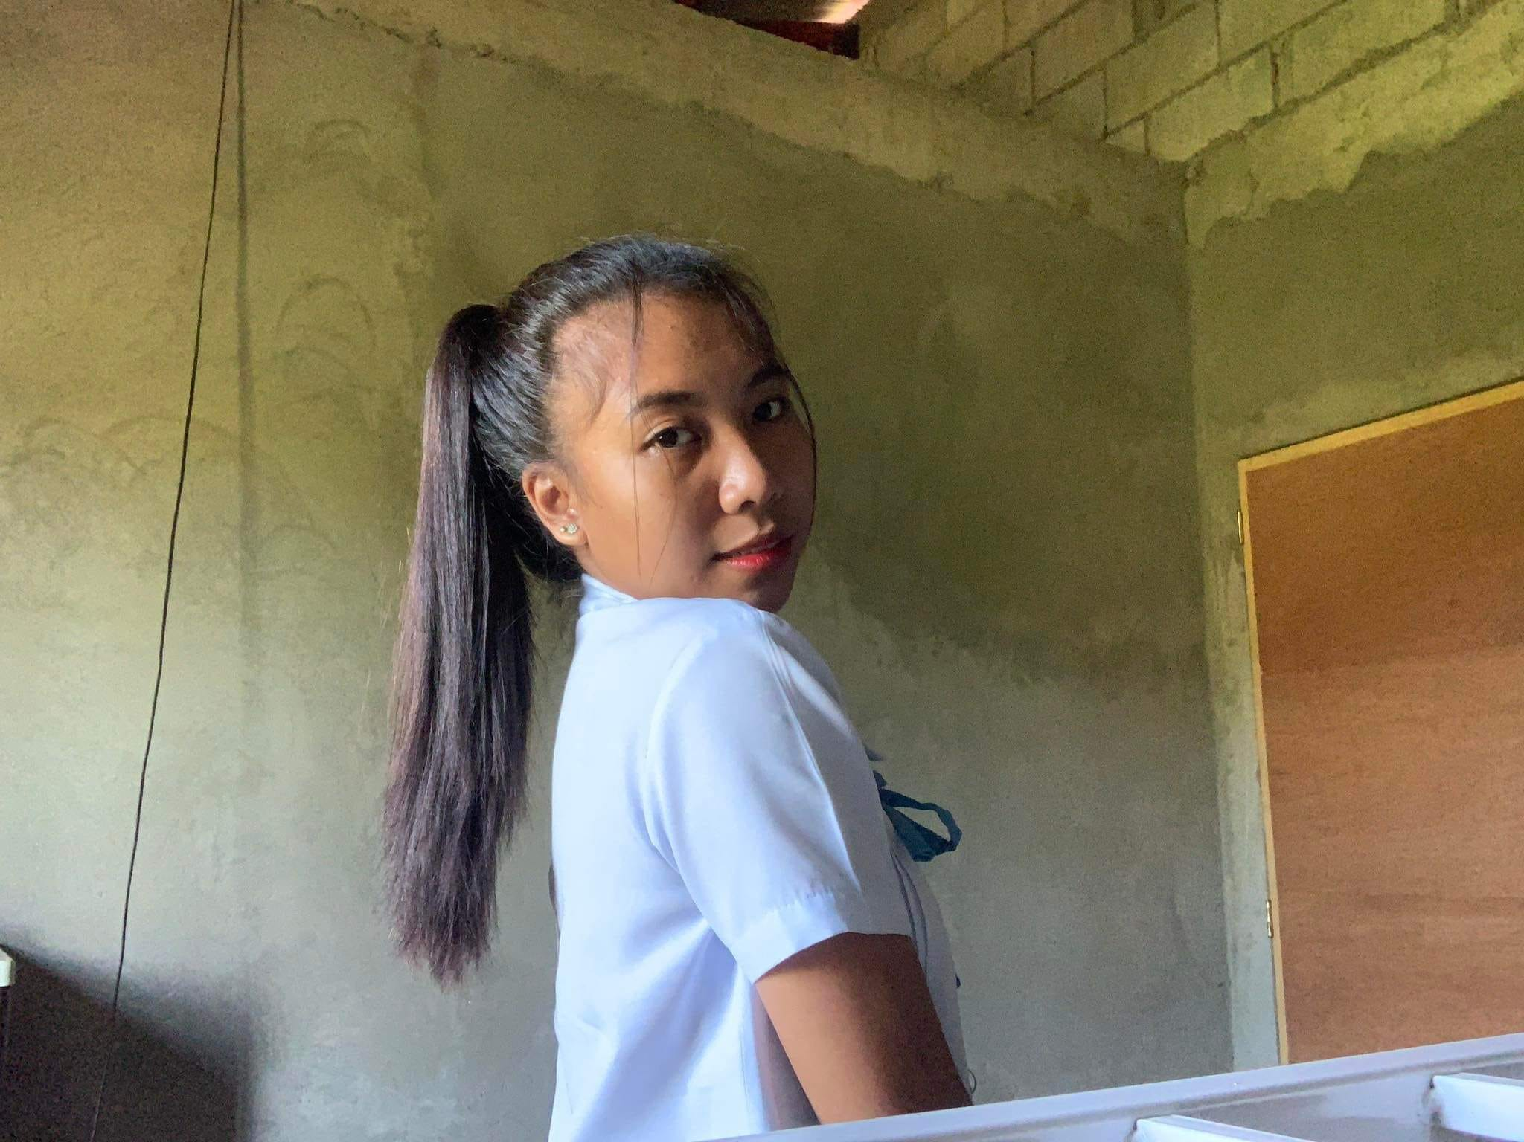


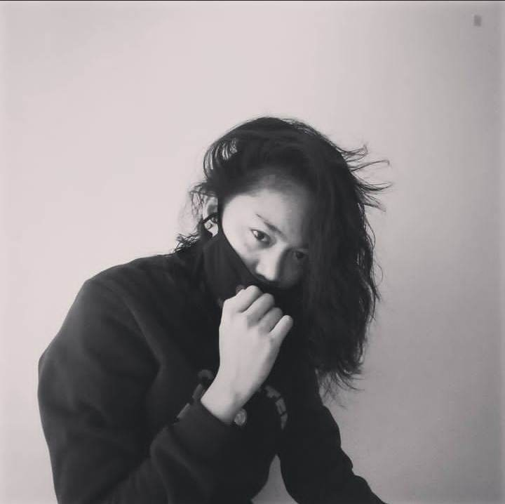
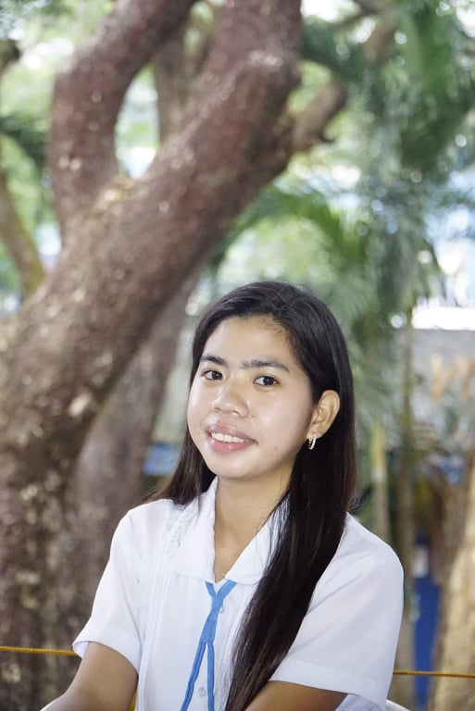
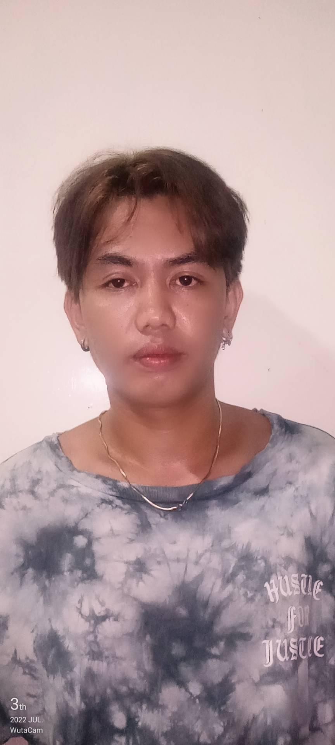
Hello, Nami
+63 97 7 338 1153
Developers
Jaycelyn Mendez Basilio
Lovely Torrente Abulag
Ma. Elaine Jane Balaes
Ruth Mae Lacupa Almencion
Jessica Nacario De Padua
Dhexter Perez Alegre
Home
History
My Account

