Slide 1
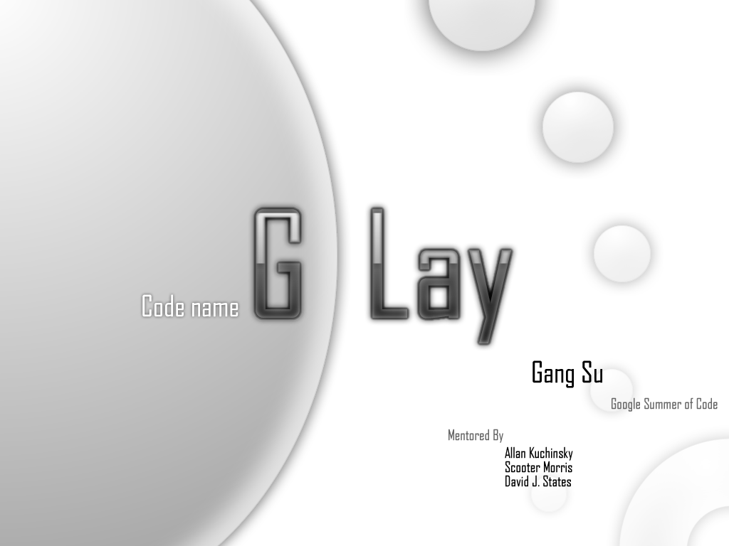

Slide 2
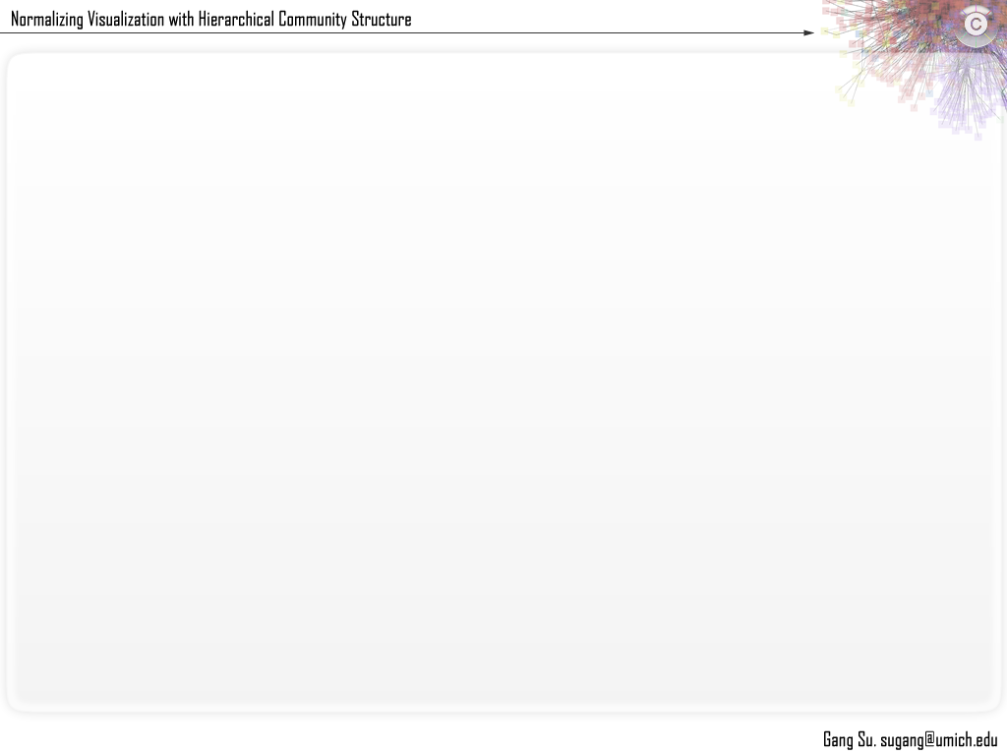
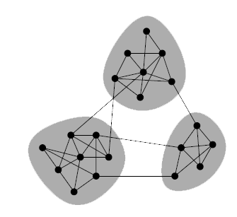
Background
Community Structure
Partition the graph to maximize intra-cluster edge density and minimize inter-cluster edge density w.r.t. to a random graph.
Measure
Modularity Q put forward by Mark Newman
For a Erdos Renyi random graph, q is usually < 0.3
For real world graph with high quality community structure, q > 0.7
Algorithm Implemented
Greedy Algorithm, A. Clauset et. al
Greedy w/ consolidation ratio, K. Wakita et. al.
M. E. J. Newman, 2006

Slide 3
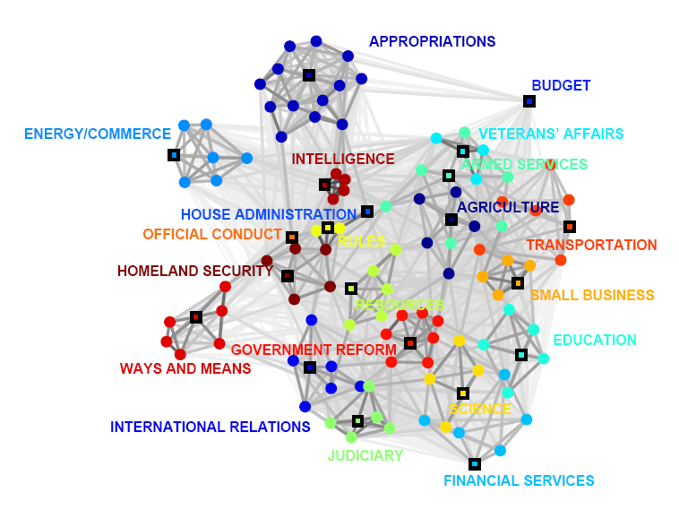
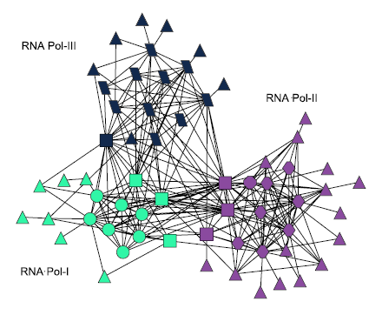
Social Network and Protein-protein interaction network example.
Mason A. Porter,et al, 2006, Jianhua Ruan et. al, 2008

Slide 4
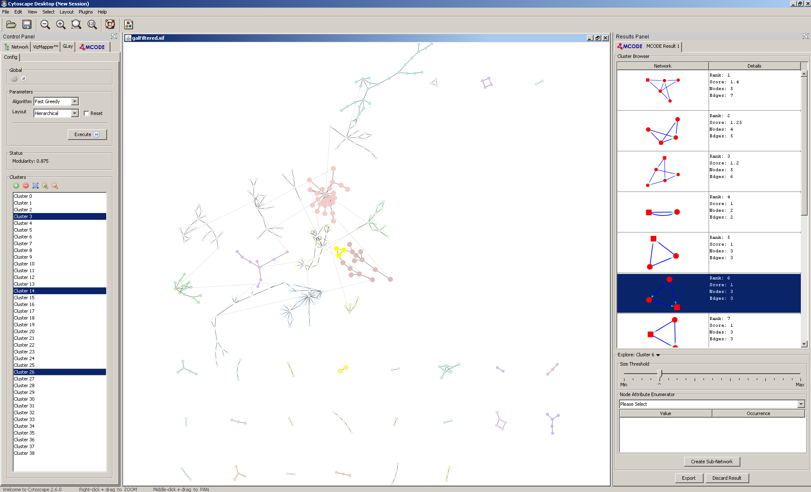
Screenshot of current build work with M-Code

Slide 5
Demo
Require Cytoscape 2.6.1, metaNodePlugin2 with hot fixes
Download will be released soon.

Slide 6
Acknowledgements
Mentors
Allan Kuchisky
Scooter Morris
David J. States
Coding/Algorithm
Mark Newman
igraph developers
Ken Wakita (Tokyo Institute of technology)
Jing Gao
Organizations
GenMAPP/Cytoscape foundation
Google a.k.a. “skynet” a.k.a. “matrix”

Slide 7
