Slide 1
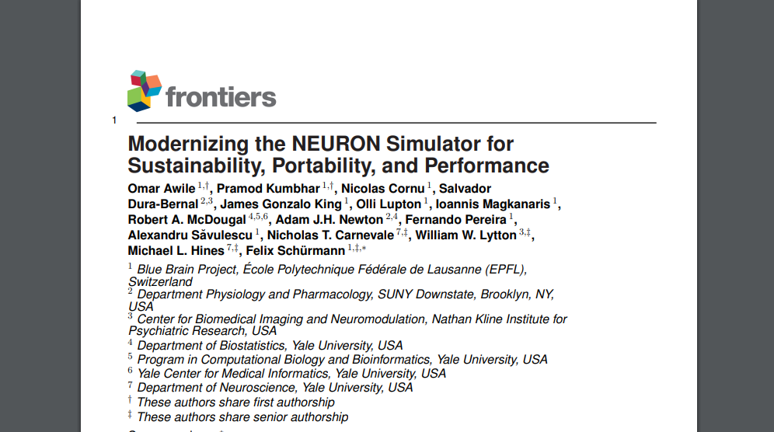
Acknowledgments

Slide 2
