Slide 1
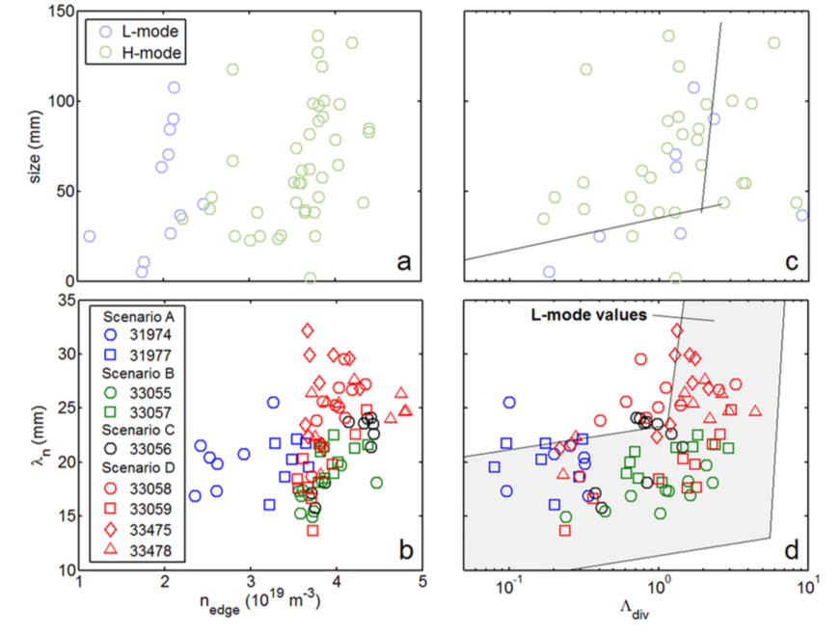
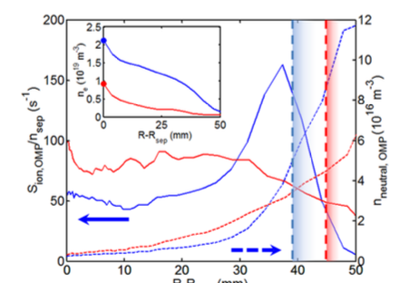
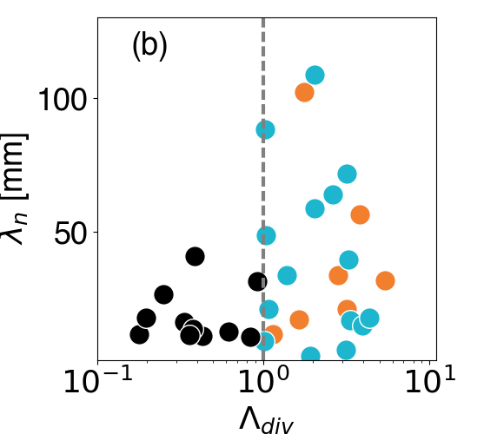
Filamentary transport in high density (high-power) regimes
Filamentary transport studies extended to low power H-Mode in 2016 in AUG
Dependence on divertor collisionality less robust in H-Mode with strong dependence on total fueling
Carralero D, et al Nuclear Materials and Energy 2016
Role of neutrals at the midplane investigated so far by EIRENCE numerical simulations
TCV L-Mode confirms complex dependence
on Divertor collisionality (Vianello IAEA 2016)
Carralero D, et al Nuclear Fusion 57 056044

Slide 2
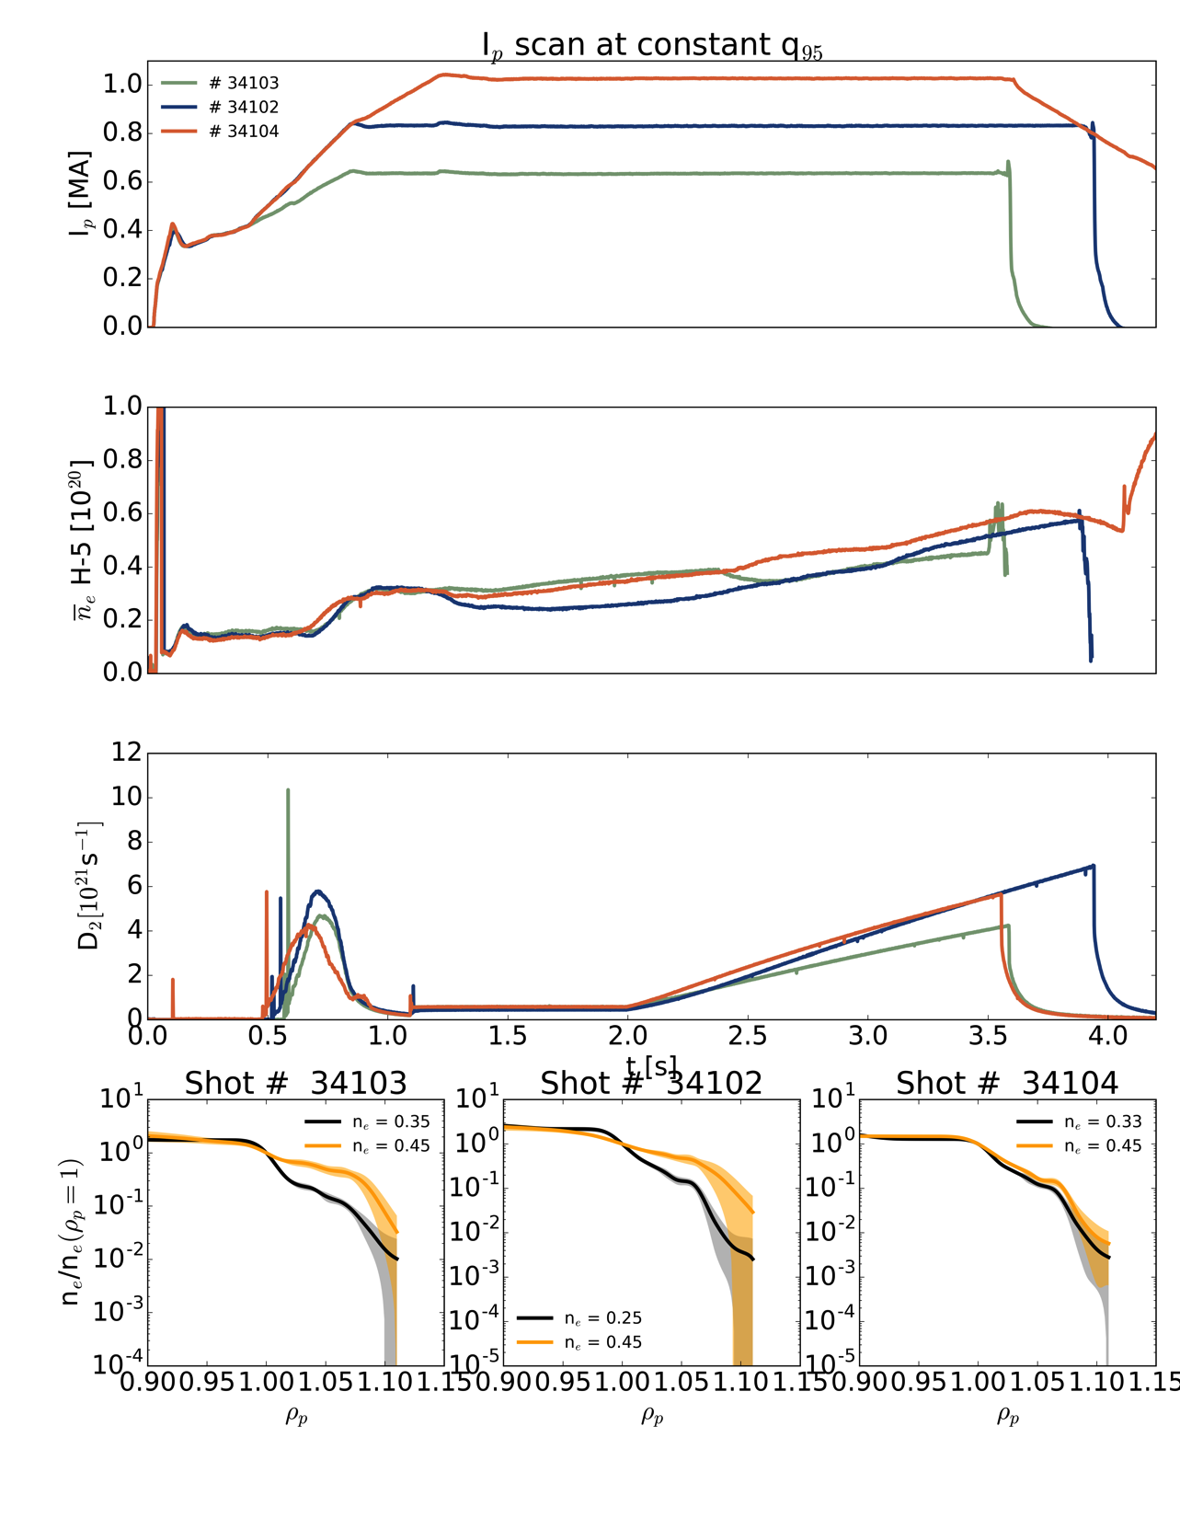
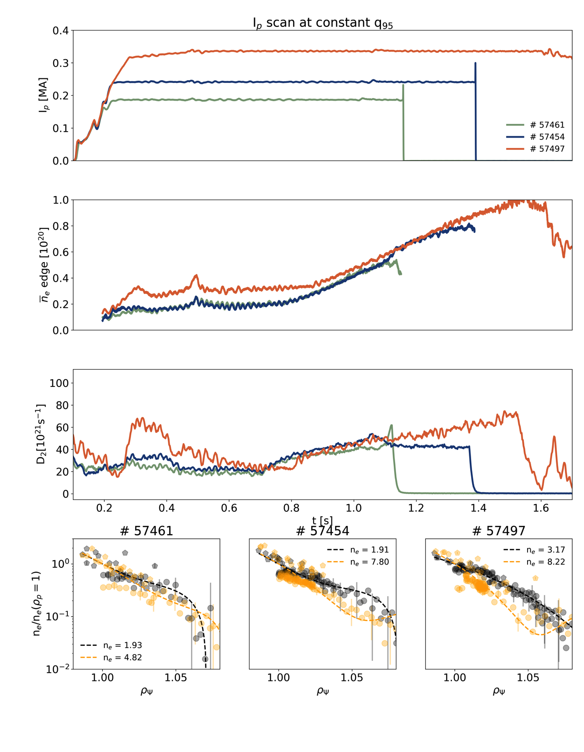
Highlights from 2017 campaign
AUG
TCV
I_{p} scans at constant q₉₅ to compare the effect of I_{p} on evolution of upstream profiles
Performed also at constant B_{t}

Slide 3
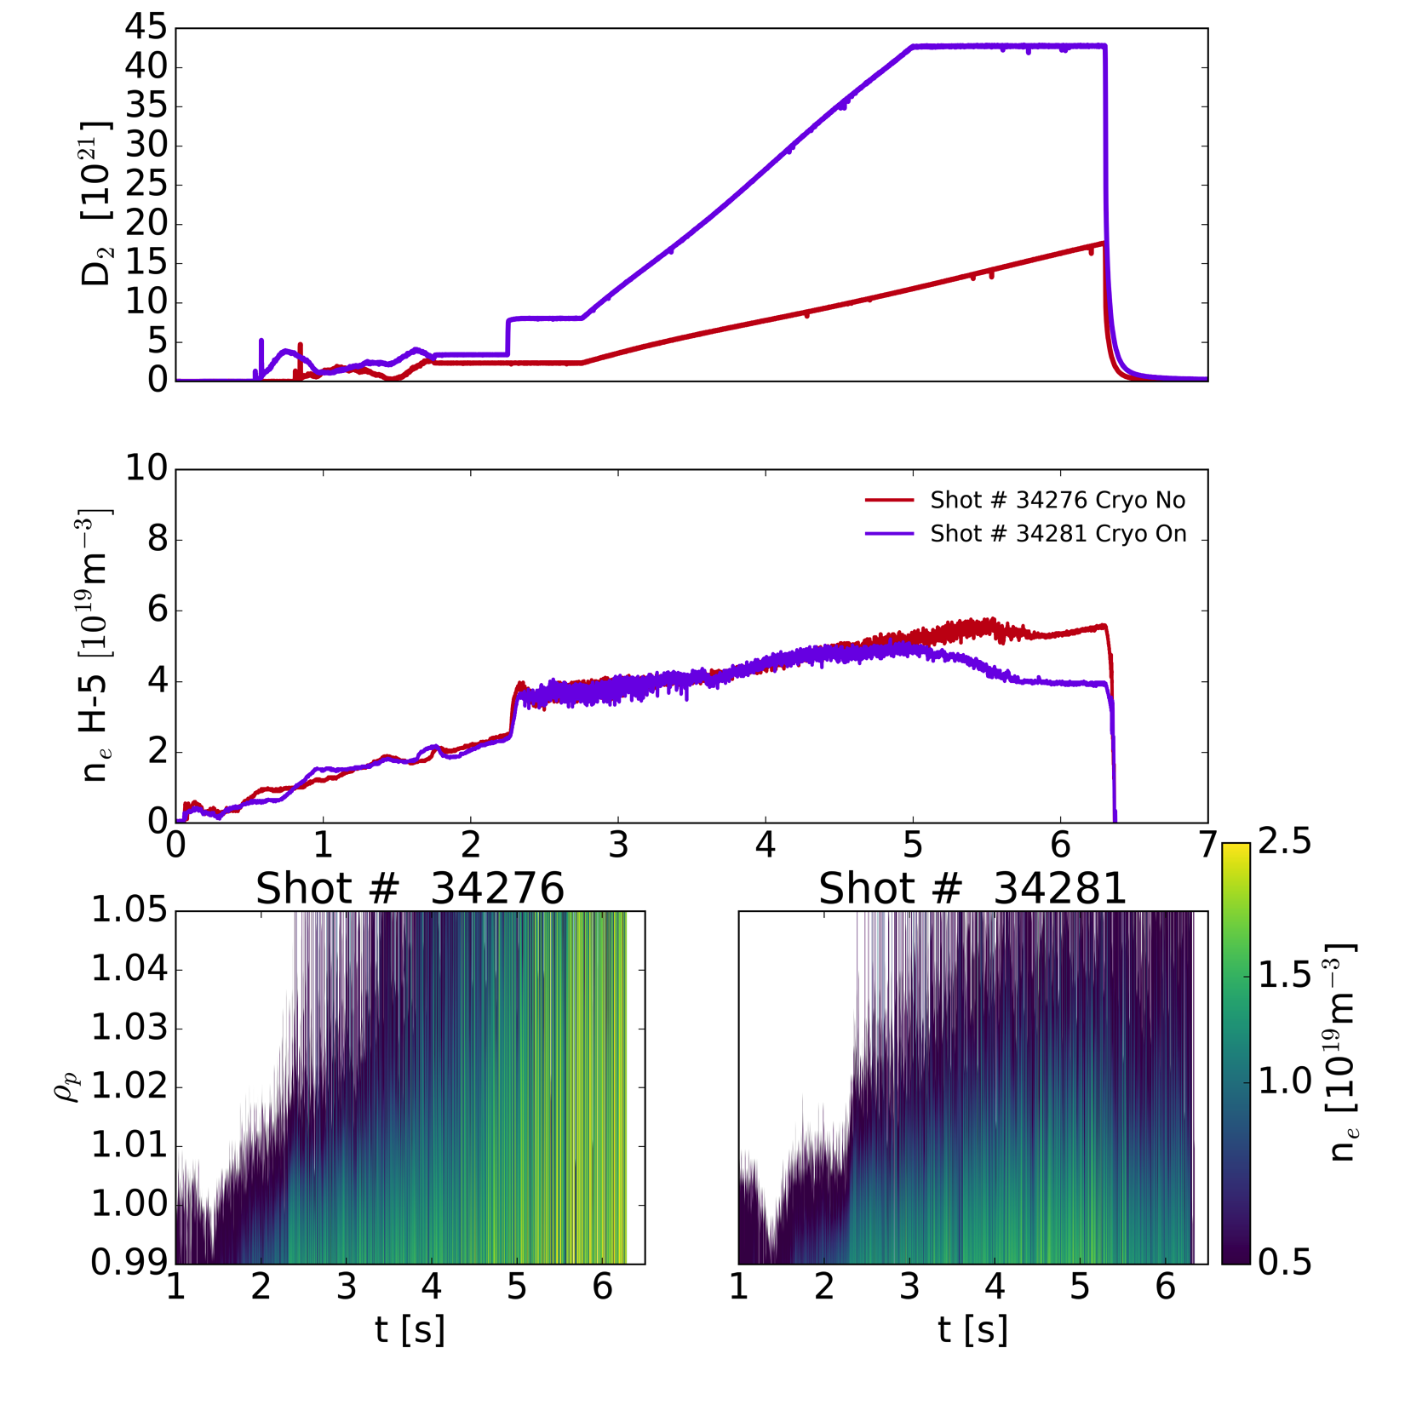
Highlights of 2017 campaign
6 MW total heating power
Density ramps performed with/wo cryopumps in order to match similar edge density
Much higher fueling with cryopumps and degraded H-mode phase reached earlier
SOL saturation observed in both case, more pronounced w/o cryopumps
Work in progress to assess the role of neutrals in this process

