Slide 1
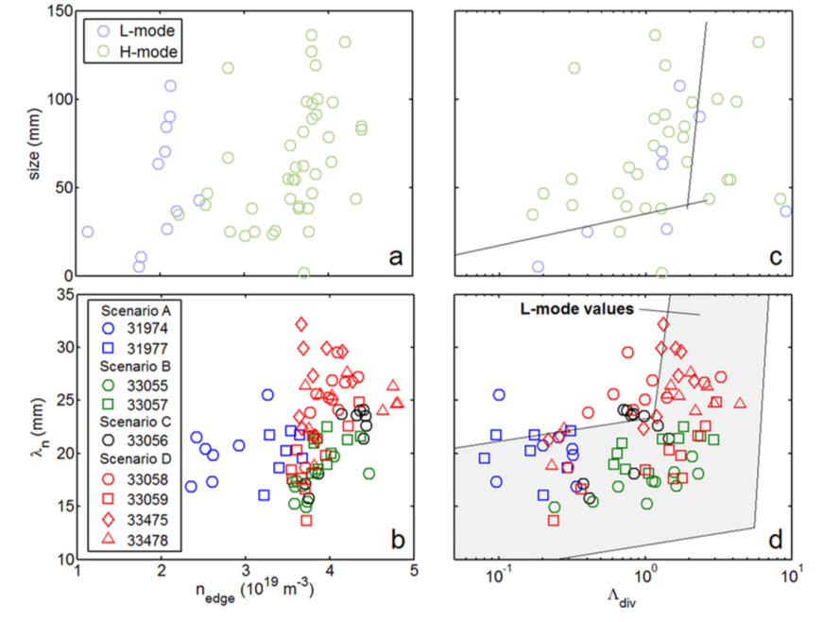
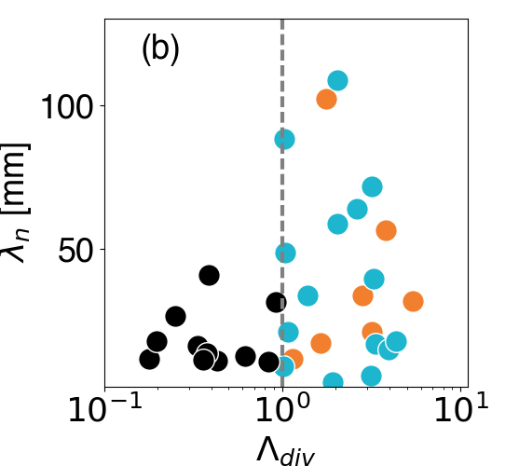
Filamentary transport in high density (high-power) regimes
Filamentary transport studies extended to low power H-Mode in 2016 in AUG
Dependence on divertor collisionality less robust in H-Mode with strong dependence on total fueling
Role of neutrals at the midplane investigated so far by EIRENCE numerical simulations. Steady state simulation missing intermittent character
Carralero D, et al Nuclear Materials and Energy 2016
Carralero D, et al Nuclear Fusion 57 056044
TCV L-Mode confirms complex dependence
on Divertor collisionality and different behavior of near and far SOL (Vianello NF https://doi.org/10.1088/1741-4326/aa7db3)

Slide 2
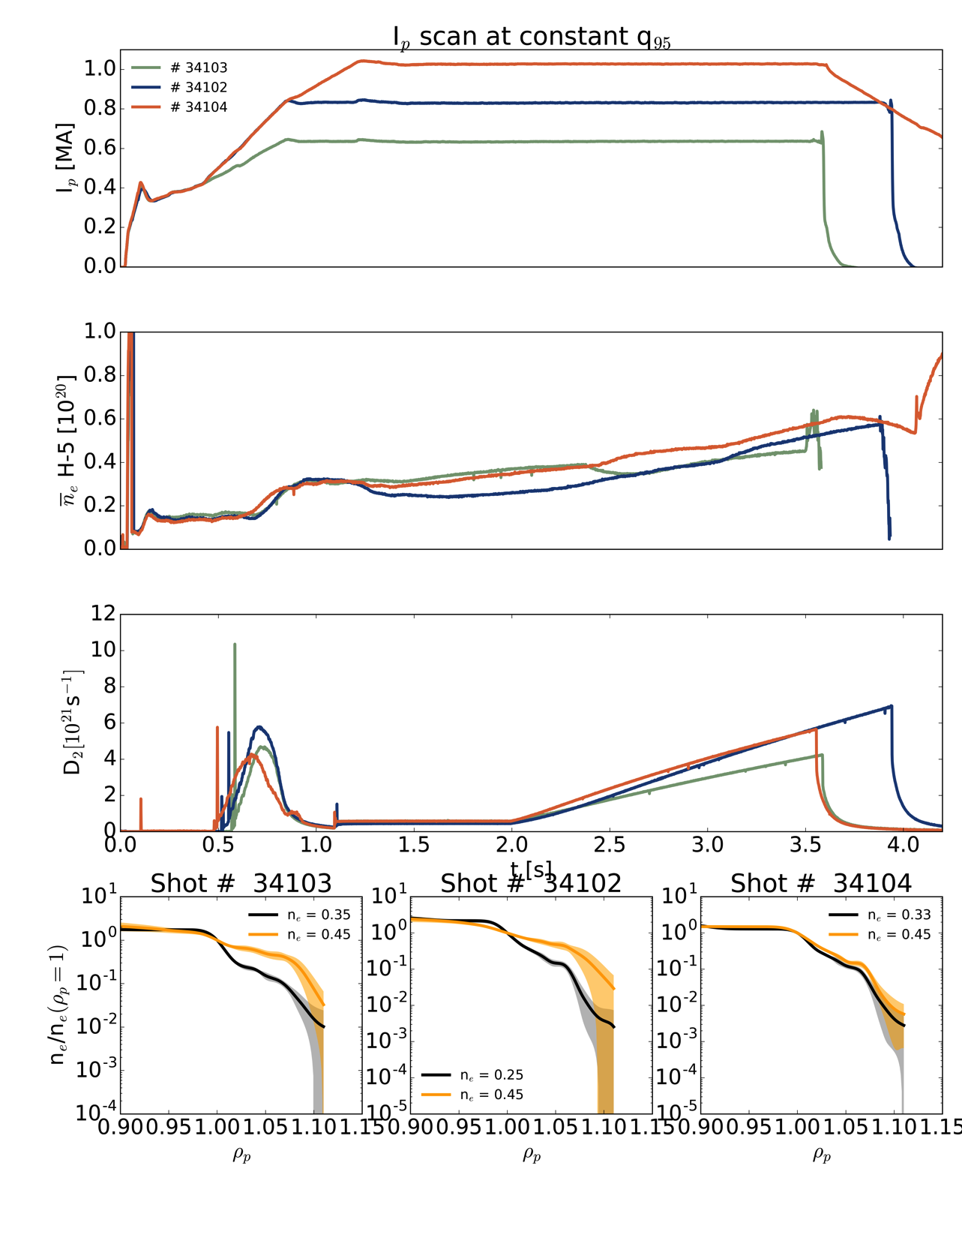
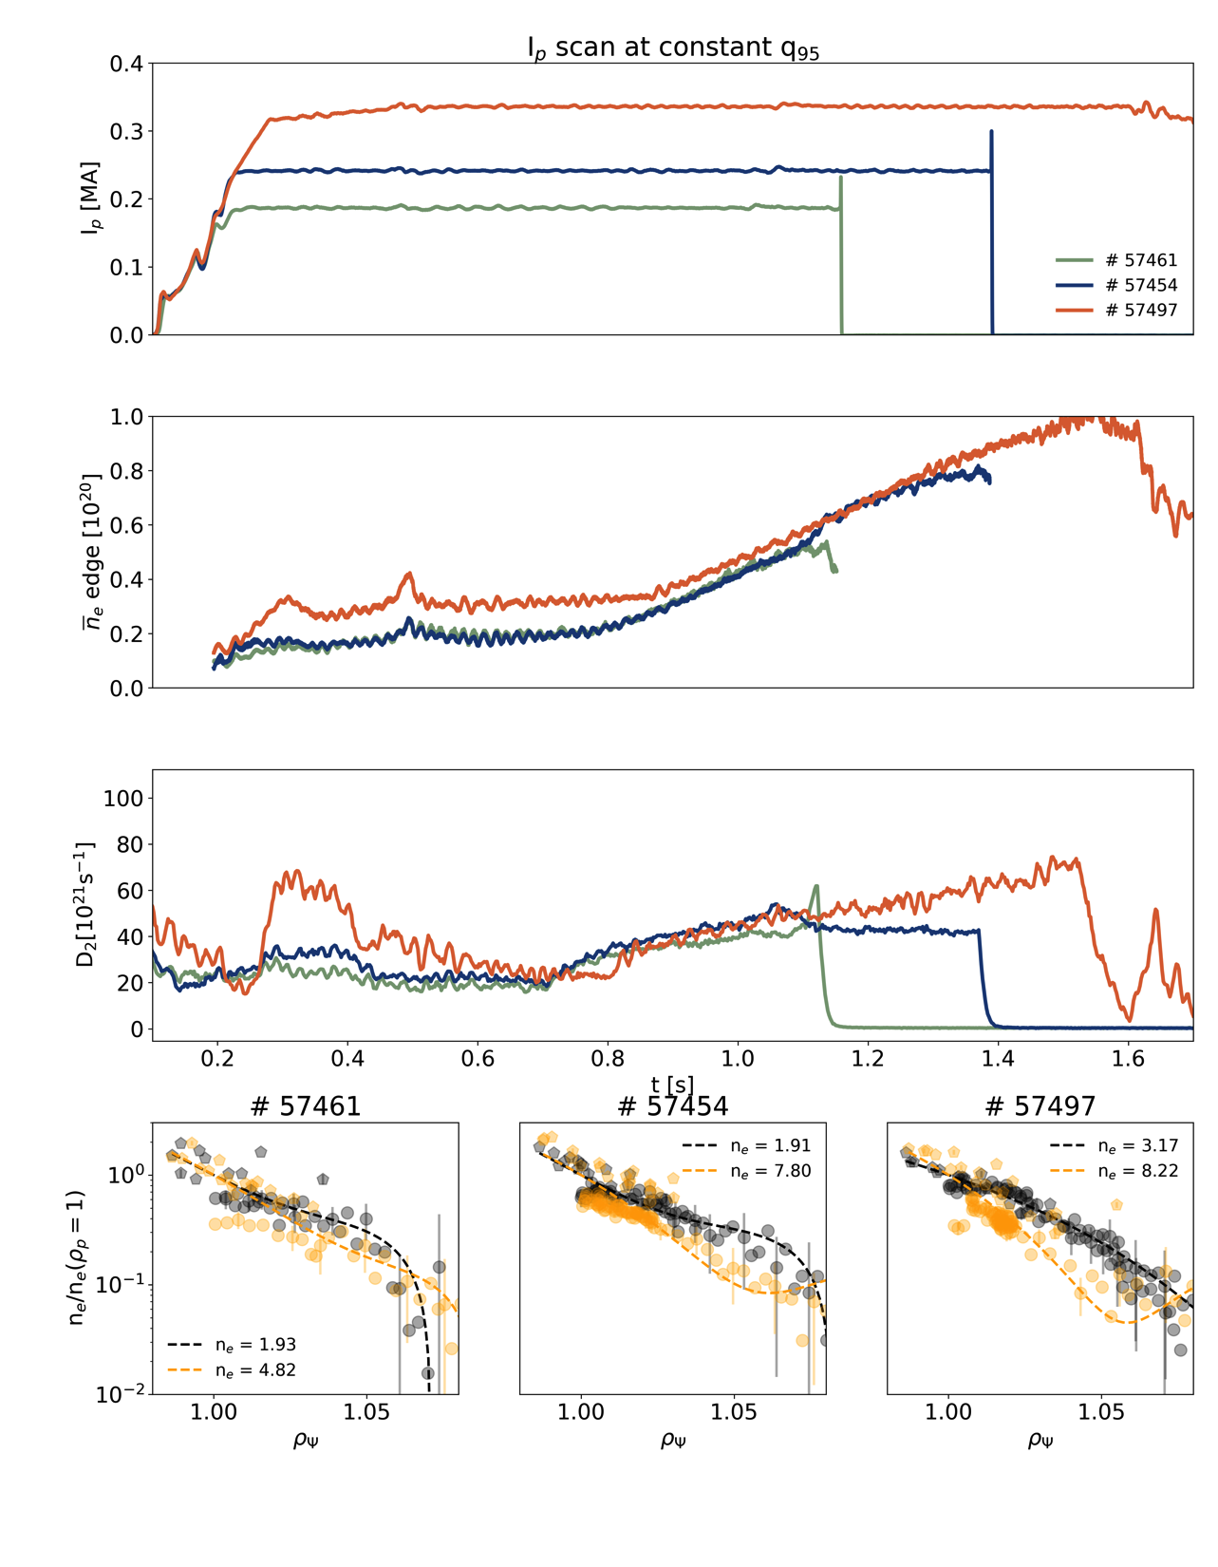
Highlights from 2017 campaign
AUG
TCV
I_{p} scans at constant q₉₅ to compare the effect of I_{p} on evolution of upstream profiles
Performed also at constant B_{t}

Slide 3
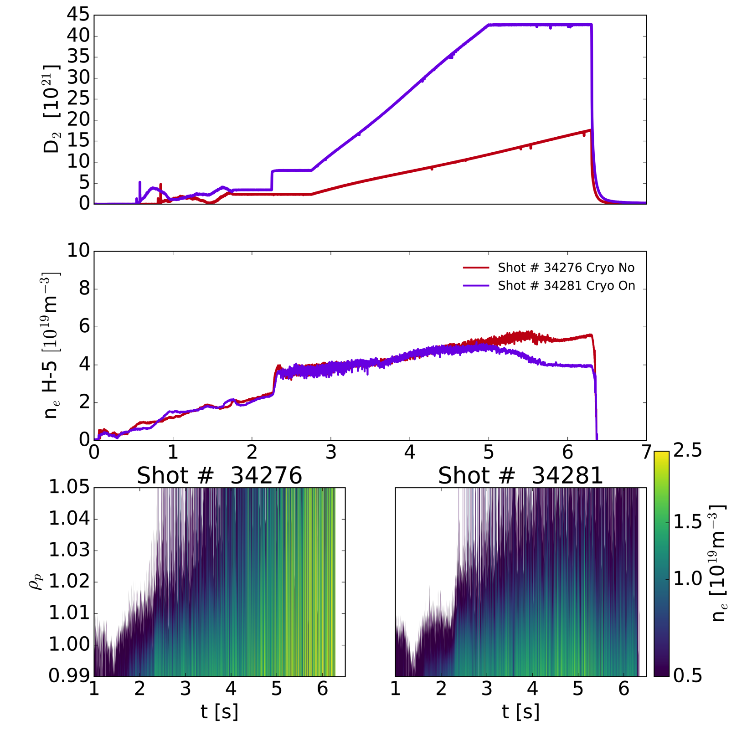
Highlights of 2017 campaign
6 MW total heating power
Density ramps performed with/wo cryopumps in order to match similar edge density
Much higher fueling with cryopumps needed and degraded H-mode phase reached earlier
SOL saturation observed in both case, more pronounced w/o cryopumps
Work in progress to assess the role of neutrals in this process

