Slide 1
Highlights of the EUROfusion MST1 campaigns 2015-2016
The MST1 Task Force Leaders

Slide 2
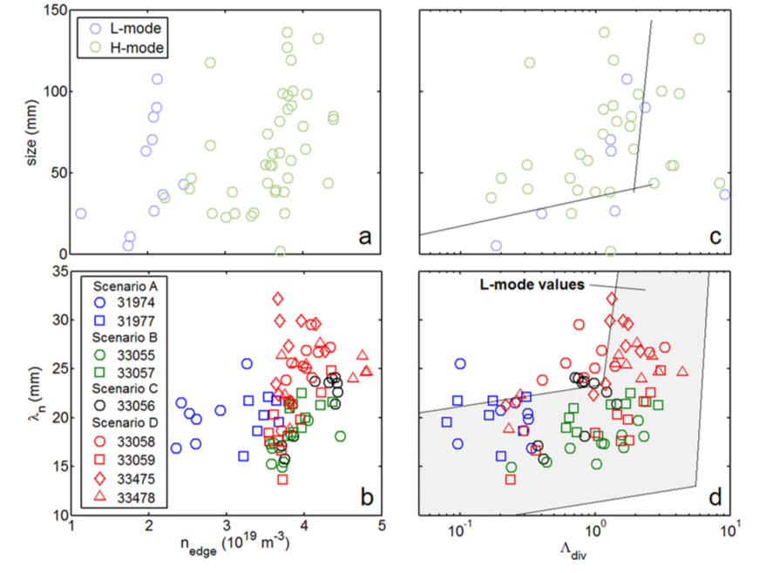
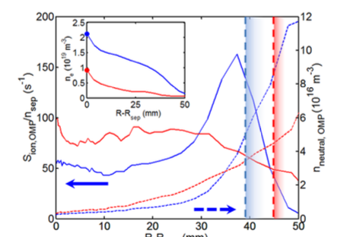
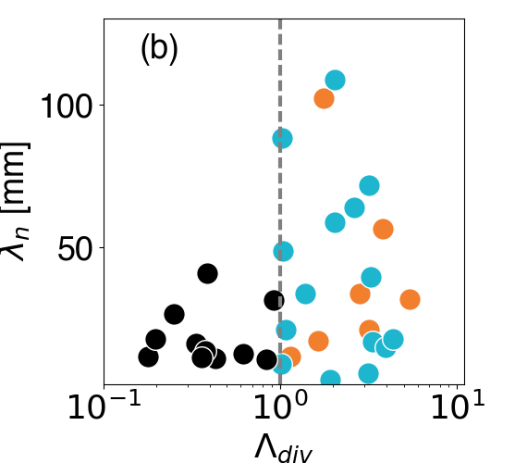
Filamentary transport in high density (high-power) regimes
Filamentary transport studies extended to low power H-Mode in 2016 in AUG
Dependence on divertor collisionality less robust in H-Mode with strong dependence on total fueling
Role of neutrals at the midplane investigated so far by EIRENCE numerical simulations
TCV L-Mode confirms complex dependence
on Divertor collisionality (Vianello IAEA 2016)
Carralero D, et al Nuclear Fusion 57 056044

