Slide 1



T3: Reliable measurements with BGP and RPKI Part II - RPKI
Mattijs Jonker, m.jonker@utwente.nl
Nils Rodday, nils.rodday@unibw.de

Slide 2
Timeline
Introduction to RPKI (20min)
Which address space is covered by RPKI?
Exercise 1 – Hands On (15min)
Exercise 1 – Solution (5min)
Controlled vs. uncontrolled experiments (15min)
Which Autonomous Systems are performing ROV?
Exercise 2 – Hands On (20min)
Exercise 2 – Solution (5min)
Wrap-Up (10min)

Slide 3





Introduction to RPKI – BGP Routing
Regular scenario:
172.217.20.0/23 680 3320 7018 15169
172.217.20.0/23 15169
AS7018
172.217.20.0/23 3320 7018 15169
AS680
172.217.20.0/23 7018 15169
AS15169
AS3320

Slide 4
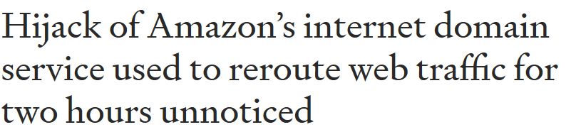
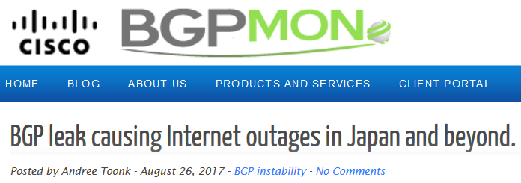
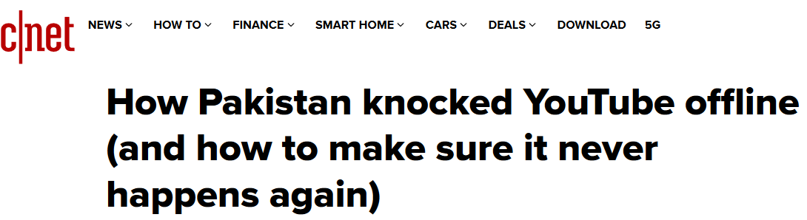
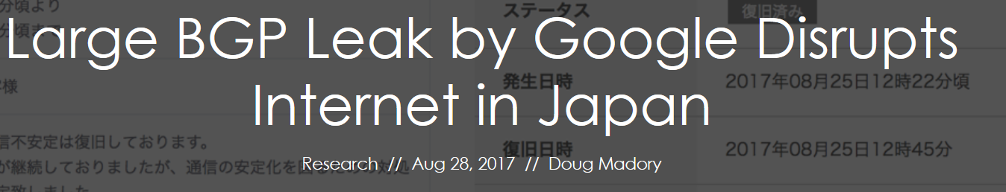
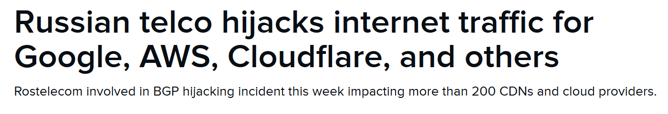
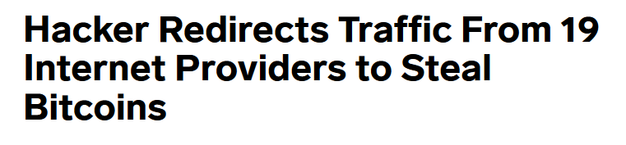
Introduction to RPKI – The Problem
BGP Hijacking
Notes:
Intentional Hijacks
Misconfiguration
Youtube/Pakistan example, 2008. Internet censorship -> BGP prefixes propagated via upstream and affected the whole Internet.

Slide 5

Introduction to RPKI – The Problem
Exact Prefix Hijack:
172.217.20.0/23 680 3320 7018 15169
172.217.20.0/23 15169
172.217.20.0/23 680 3320 1234
172.217.20.0/23 3320 7018 15169
AS7018
172.217.20.0/23 3320 1234
AS680
172.217.20.0/23 7018 15169
AS15169
AS3320
172.217.20.0/23 1234
AS1234
would choose the hijacked route as it is shorter towards the destination.
would still choose the correct route as it is shorter towards the destination.

Slide 6
Introduction to RPKI – The Problem
More-Specific Prefix Hijack:
172.217.20.0/23 680 3320 7018 15169
172.217.20.0/23 15169
172.217.20.0/24 680 3320 1234
172.217.20.0/24 7018 3320 1234
172.217.20.0/23 3320 7018 15169
AS7018
172.217.20.0/24 3320 1234
AS680
172.217.20.0/23 7018 15169
AS15169
AS3320
172.217.20.0/24 1234
AS1234
Everyone chooses the hijacked route as it is more specific (/24 instead of /23)!

Slide 7
Introduction to RPKI – Origin Validation
Problem: No proof of address ownership
Solution: Resource Public Key Infrastructure
Each owner of an address space holds an end-entity certificate from the RIR (e.g. RIPE NCC). This will be used to sign Route Origin Authorization objects. ROAs will be used by ASes to validate announcements.
The RPKI has two sides:
ROAs need to be created by resource owners
→ Exercise 1
ASes on the Internet need to perform Origin Validation and filter invalid announcements
→ Exercise 2
Notes:
RPKI vs. BGPSec

Slide 8
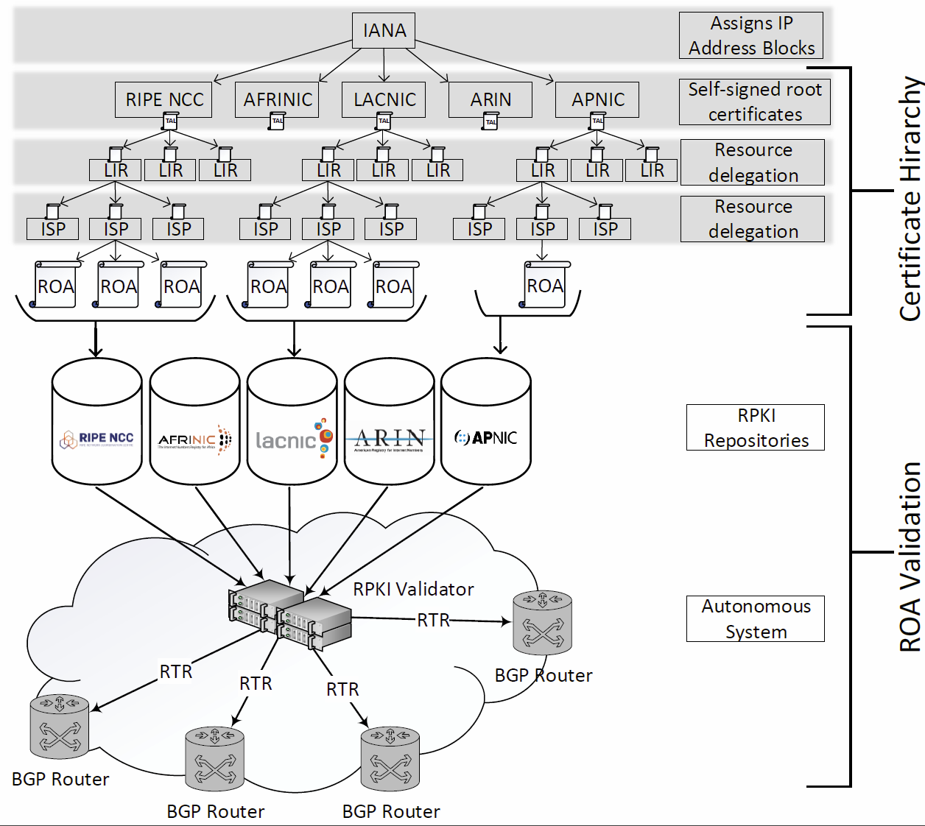
Introduction to RPKI – Origin Validation
RPKI – Resource Public Key Infrastructure
The Resource Public Key Infrastructure (RPKI) describes an approach to build a formally verifiable database of IP addresses and AS numbers as resources. [RFC6811]
The RPKI allows an AS to prove whether the origin AS of that announcement is indeed allowed to announce this prefix.
Notes:
Resource allocation & delegation
TAL at each RIR
ROA signed with resource owner certificate
ROAs stored in RPKI repositories (different publication points, managed/delegated mode)
Validation is performed within each AS

Slide 9
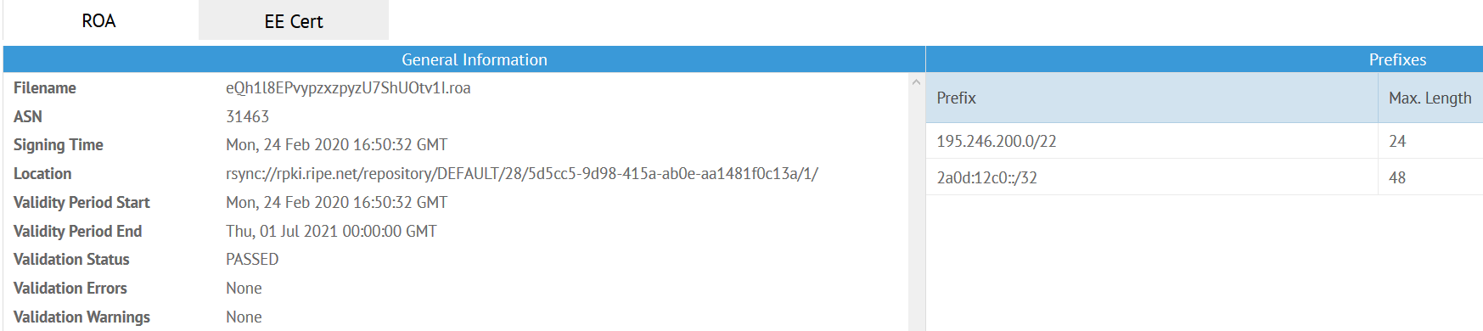
Introduction to RPKI – Route Origin Authorization
What is a ROA?
A ROA is an attestation that the holder of a set of prefixes has authorized an autonomous system to originate routes for those prefixes [RFC6480]. According to RFC6482, it contains:
Prefix
Max-Length
ASN
http://rpki-browser2.realmv6.org/
Nice tutorial to play around: https://www.securerouting.net/tutorial/

Slide 10
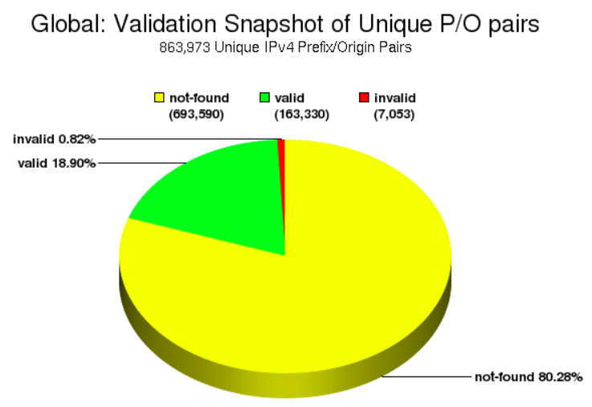
Introduction to RPKI – Exercise 1
How much of the address space is covered by RPKI?
Input:
BGP Collector dump from 14th April
Validated ROAs from 14th April 2020
Output:
Distribution of valid / invalid / not found BGP announcements:
Methodology:
Correlate the BGP data with the RPKI data to observe how many of the BGP announcements are protected. Simplification: Only look for exact prefix/ROA matches (do not look for covering ROAs)
Time: 15min
https://rpki-monitor.antd.nist.gov/

Slide 11

Introduction to RPKI – Exercise 1 – 15min
Questions: WebEx chat

Slide 12
Introduction to RPKI – ROV-enforcing ASes
The first part was about identifying which share of address space is covered by RPKI.
The second part will be about how many ASes actually use the information to drop invalid announcements.
Experiment types:
Uncontrolled
(passive)
Uses preexisting data
No control over ROAs
No control over BGP
announcements
Draw conclusions from
observations that might
change due to limited
control
Controlled
(active)
Generates data
Controlling own ROAs
Advertising own address
space in BGP
Draw conclusions from
observations we can
influence
Notes:
Uncontrolled -> Measure eventually Traffic Engineering

Slide 13
Introduction to RPKI – Controlled Experiments
BGP
RPKI
Announce prefixes P_{A} (Anchor) and P_{E} (Experiment)
Issue ROAs for
both prefixes
Same RIR DB route object
Same prefix length
Announced at the same time
Announced to same peers
Announced from same origin AS
P_{A} announcement is always valid.
Periodically change ROA for P_{E} :
Flips announcement from valid to invalid to valid daily.
Credit for slide content: Matthias Wählisch
Reuter, A., Bush, R., Cunha, I., Katz-Bassett, E., Schmidt, T.C. and Wählisch, M., 2018. Towards a rigorous methodology for measuring adoption of RPKI route validation and filtering. ACM SIGCOMM Computer Communication Review, 48(1), pp.19-27.

Slide 14
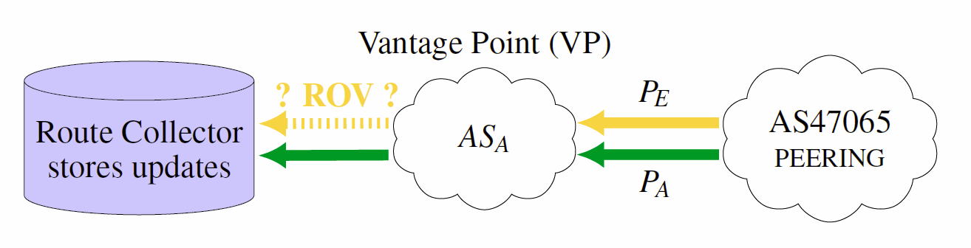
Introduction to RPKI – Controlled Experiments
147.28.241.0/24
147.28.240.0/24
Requirements:
Connectivity requirement: Each tested AS must be directly peering with PEERING*.
Visibility requirement: Each tested AS must be a Vantage Point (VP), e.g. export routes to RIS/Routeviews**.
Observation:
(O1) VP has the same route for both prefixes P_{A} and P_{E} → no ROV.
(O2) VP has a different route for prefix P_{E} → ROV @ AS on path.
(O3) VP has no route to P_{E} → ROV @ VP.
* https://peering.ee.columbia.edu/peers/
** http://routeviews.org/
Reuter, A., Bush, R., Cunha, I., Katz-Bassett, E., Schmidt, T.C. and Wählisch, M., 2018. Towards a rigorous methodology for measuring adoption of RPKI route validation and filtering. ACM SIGCOMM Computer Communication Review, 48(1), pp.19-27.

Slide 15
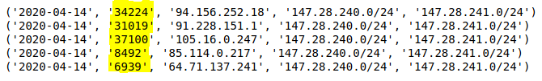
Introduction to RPKI – Exercise 2
Which ASes perform Route-Origin-Validation?
Input:
BGP Collector dump from 14th April (filtered for P_{A} + P_{E})
Knowledge that the ROA for P_{E} is swapped while for P_{A} it is not
Output:
List of Route-Origin-Validation enforcing Ases:
Methodology:
Work through the dataset and determine when a Vantage Point
(1) while P_{A} was present and had a direct route
(2) had a different route (or none at all) for P_{E}
Time: 20min

Slide 16

Introduction to RPKI – Exercise 2 – 20min
Questions: WebEx chat

Slide 17

Reliable measurements with BGP and RPKI – RECAP
Introduction to BGP
What BGP is
How the protocol works
Working with BGP data
What can you do with control plane data?
How can you collect data
Where to get readily available data
Data types
How to process and analyze data
Introduction to RPKI
Origin Validation
RPKI aims at solving BGP Hijacking
RPKI hierarchy + ROA creation
Measurements with RPKI data
How much prefix space is covered by RPKI?
Controlled vs. Uncontrolled Measurements
How many ASes are using the RPKI?
Mattijs Jonker, m.jonker@utwente.nl
Nils Rodday, nils.rodday@unibw.de

