Slide 1

AI and the State of Real Estate in the U.S.
AI4ALL Final Project
Group 1: Nicolas Rodriguez, Christina Appadoo, Marcelo Espinosa

Slide 2

Background information on AI in Real estate
Impact of AI in Real estate
House modifications
Debt levels
Property values
Personal details about homeowners
AI Background in real estate
Property's potential financial value
Property's features and key performance indicators
Likelihood of natural disasters in the area
Supply of the soon-to-be-released units
State of the neighborhood real estate market.

Slide 3

How can AI be beneficial Process improvements Fine-tuning existing products and services Gaining a competitive advantage Saves money and time It never stops Disadvantage Unemployment Building an AI may be expensive Racial & Demographic disparities African American Discrimination Inequalities in the housing market Residential segregation in the long run

Slide 4
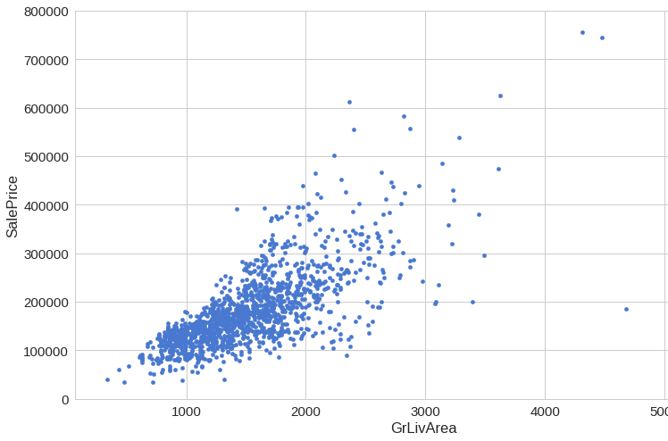
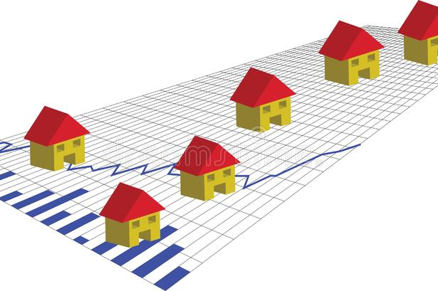
How AI can make Predictions about the Housing Market
What is the best price possible to rent/buy? Where or when should I invest? Which property should I develop or purchase to maximize returns?
Commonly ways of valuating a property:
Comparison approach
Cost approach
Income approach
Real estate price prediction using machine learning

Slide 5
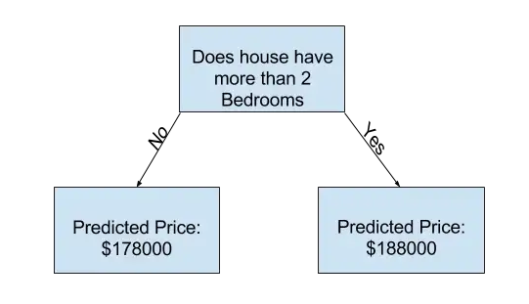
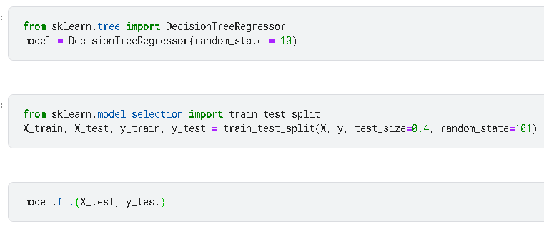
Code Breakdown
In this project we chose to go with a decision tree algorithm that compares, and graphs houses according to current listing status, number of bedrooms, number of bathrooms, size of lot in acres, and the size of the house in square footage.
Decision trees are a non-parametric supervised learning algorithm which is utilized for both classification and regression tasks.
In this example a decision tree algorithm was the best learning technique because it not only works on classifying houses based on certain parameters, but it can also be used to determine the accuracy of the model's predictions based on the input data.
In this sample decision tree, houses are compared by number of bedrooms which is extracted from the data set. Depending on the number of bedrooms a predicted price is generated for each input (more/less than 2 bedrooms). At the end of the project the model predictions are subtracted from the actual values which gives us the measure of the quality of the model.

Slide 6
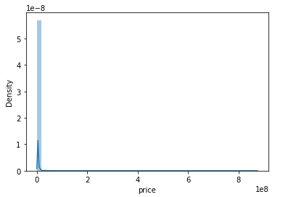
Visuals
Distribution Plot
Depicts the variation in the distribution of data. In this example, the distribution plot measures the density of housing prices based on the data set.

Slide 7
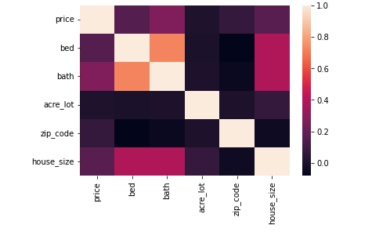
Visuals
Heatmap
Heatmaps are a good way to check correlations among columns by visualizing the correlation matrix. In this example the heatmap compares different aspects of a property. Lighter colors symbolize a positive correlation between each criteria and darker colors symbolize a negative correlation between each criteria. The stronger a color is means that there is a smaller correlation magnitude between each criteria.

Slide 8
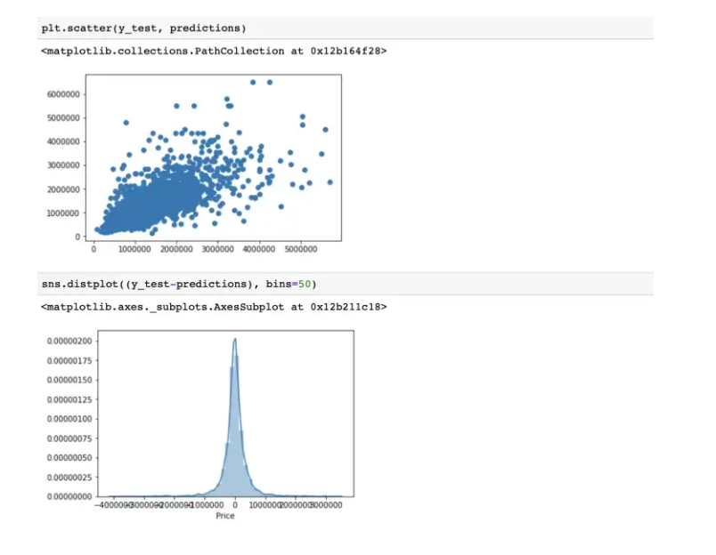
Code Breakdown (Output)
Link to live project:
https://www.kaggle.com/code/nickrod068/ai4all-final-project

Slide 9
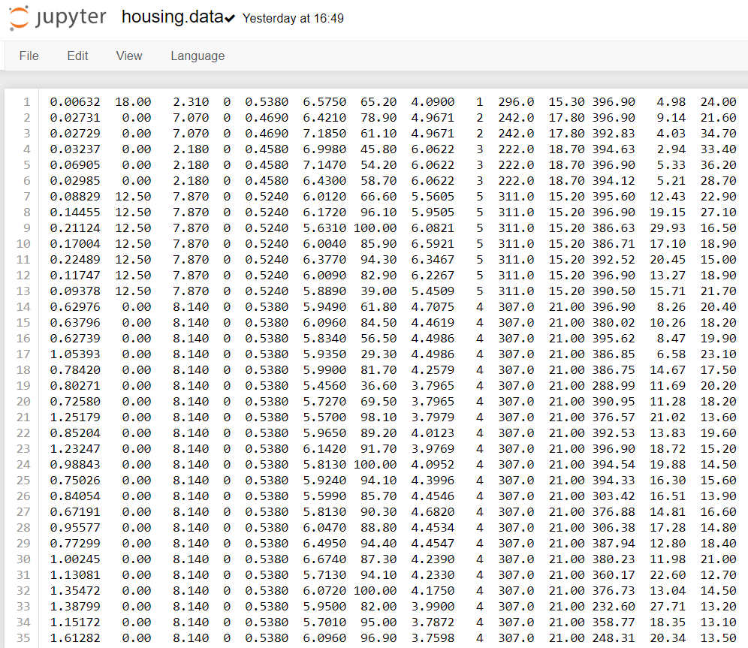
What's next
One of the next steps would be to incorporate a larger dataset with more characteristics
A larger dataset may improve results but could also make the algorithm run less accurately

Slide 10
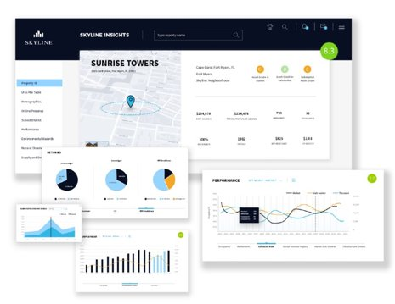
What's next
UI/UX Implementation
An additional step would be a frontend web application that uses the data and displays housing price predictions in a creative, user-friendly platform
This information would be useful for potential home buyers to better understand the housing market and see where prices are trending in the future based on different aspects of a property

Slide 11

What's next
There are various applications being developed that utilize AI in many aspects of real estate
Applications can be used not only to help potential buyers find a home that fits their desires but to:
Help with office space management
Help potential buyers find a real estate agent
Help realtors keep up with customer activity
Creating a fully functioning website that could possibly incorporate all of these aspects would take various algorithms

Slide 12
Citations
Author: admin. (2022, January 11). 4 ways artificial intelligence is Changing Real Estate. Venture Leap | Sicher. Digital. Erfolgreich. | Software aus Berlin. Retrieved November 30, 2022, from https://venture-leap.com/en/the-leap/4-ways-artificial-intelligence-is-changing-real-estate/
Dev@kodzilla.pl. (2022, August 19). Artificial Intelligence in real estate: Use cases. Addepto. Retrieved November 30, 2022, from https://addepto.com/blog/ai-in-real-estate-use-cases/#
Gofus, A. E. (2022, January 4). Artificial Intelligence is transforming the real estate market. Worldwide ERC. Retrieved November 30, 2022, from https://www.worldwideerc.org/news/technology/artificial-intelligence-is-transforming-the-real-estate-market
Kozubska, D. (n.d.). Ai in real estate: Top 30 apps and startups to get inspired. ByteAnt. Retrieved November 30, 2022, from https://www.byteant.com/blog/ai-in-real-estate-top-30-apps-and-startups-to-get-inspired/
Olick, D. (2021, September 17). Diana Olick breaks down artificial intelligence's presence in real estate. CNBC. Retrieved November 30, 2022, from https://www.cnbc.com/video/2021/09/17/diana-olick-breaks-down-artificial-intelligences-presence-in-real-estate.html
Sakib, A. S. (2022, August 12). USA Real Estate Dataset. Kaggle. Retrieved November 30, 2022, from https://www.kaggle.com/datasets/ahmedshahriarsakib/usa-real-estate-dataset/code
Enerrio. (2017, August 19). Scikit-Learn ML from start to finish. Kaggle. Retrieved November 30, 2022, from https://www.kaggle.com/code/enerrio/scikit-learn-ml-from-start-to-finish/notebook
Kozubska, D. (n.d.). Ai in real estate: Top 30 apps and startups to get inspired. ByteAnt. Retrieved November 30, 2022, from https://www.byteant.com/blog/ai-in-real-estate-top-30-apps-and-startups-to-get-inspired/
Normplot. Distribution Plots - MATLAB & Simulink. (n.d.). Retrieved November 30, 2022, from https://www.mathworks.com/help/stats/distribution-plots.html
Seaborn.heatmap#. seaborn.heatmap - seaborn 0.12.1 documentation. (n.d.). Retrieved November 30, 2022, from https://seaborn.pydata.org/generated/seaborn.heatmap.html
Visualizing distributions of data#. Visualizing distributions of data - seaborn 0.12.1 documentation. (n.d.). Retrieved November 30, 2022, from https://seaborn.pydata.org/tutorial/distributions.html
Artificial intelligence in real estate: Use cases https://addepto.com/blog/ai-in-real-estate-use-cases/# Property management
Artificial Intelligence is Transforming the Real Estate Market Gofus https://www.worldwideerc.org/news/technology/artificial-intelligence-is-transforming-the-real-estate-market
Racial Disparities in Home Appreciation Director et al. https://www.americanprogress.org/article/racial-disparities-home-appreciation/
Property Price Prediction Using Machine Learning Pi.exchange https://www.pi.exchange/use-cases/property-price-prediction-with-machine-learning

