Slide 1
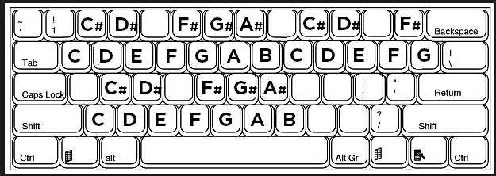
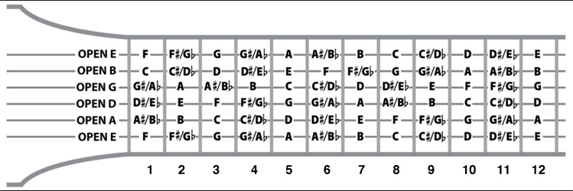
2
3
5
6
7
9
0
Q
W
E
R
T
Y
U
I
O
P
[
]
STOP
A
S
D
G
H
J
L
Z
X
C
V
B
N
M
,
.
RECORD
Octave 1
Octave 2
Octave 3
U
9
O
[
T
Y
O
P
Y
7
U
O
N
M
L
3
E
5
T
6
C
G
B
H
M

Slide 2
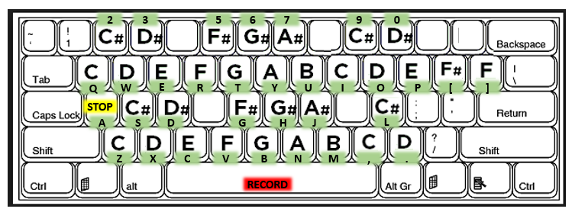

Slide 3
Effects:
Arpeggio: 0, second two digits half step increases so example for C base note is : 037 =C-Dflat-G
Vibrato: 4, second digit is speed, third is increase in half steps for C base note: 464 = C-D vibrato, 468 = C-E vibrato
Channel Fade: A, second digit unused, third digit rate of fade ( lower = slower) : A02 = slow fade , Note this affects channel not note so use A00 or “F” in volume column to remove channel fade. Fade doesn’t work on Triangle channel.
Skip Frame: D, jumps to next frame, second and third digits specify row of next frame to jump to. Example D00
Delay: G, delays notes by number of frames
Note Slide Up: Q, second digit speed, third digit how many tones up it goes, example Q2C (C = 12 = an octave)
Note Slide Down: R, same as Q only down
Mute Delay: S, cuts note off after specified number of frames (similar to delay)
Pulse Width: V, change pulse width
Good combos:
Use Triangle with R effect (or Arpeggio down or Pitch Loop)

