Slide 1

IEEE JOURNAL OF BIOMEDICAL AND HEALTH INFORMATICS, VOL. 17, NO. 4, JULY 2013

Slide 2
A neurodegenerative disorder of central nervous system that causes partial or full loss in motor reflexes, speech, behavior, mental processing, and other vital functions
PARKINSON’s
10 million people all around the world and approximately 100 000 in Turkey are suffering from this disease

Slide 3
Aim of article
Design a computer-aided data collection, storage, and analysis system to simplify the process of diagnosis and treatment of PD
Collected speech recordings
Features are extracted from the voice samples

Slide 4
Pervious works
Selection of dysphonia measure subsets used support vector machines
Nonlinear speech analysis algorithms
UPDRS (Unified PD Rating Scale) using regression and classification
A mutual information-based feature selection algorithm with the permutation test
Voice features using signal processing

Slide 5
Pervious works
Optimum-path Forest Classifier to detect
Feature selection method based on the fuzzy entropy measure and used similarity classifiers
Parallel feed-forward neural network
Adaptive Neuro-Fuzzy Inference system (ANFIS)

Slide 6
Dataset
The voice samples are selected by a group of neurologists from a set of speaking exercises

Slide 7
Feature Extraction
Dysphonia leads to reduced loudness, breathiness, roughness, decreased, and exaggerated vocal tremor in voice. These indications can be detected by analyzing various frequencies in voice

Slide 8
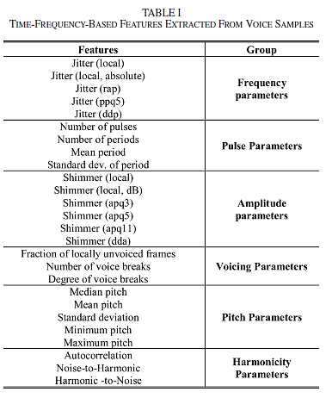
Features

Slide 9
Models
K nearest neighbor
SVM

Slide 10
Classification With Leave-One-Subject-Out
Classification With Summarized Leave-One-Out
Classification

Slide 11
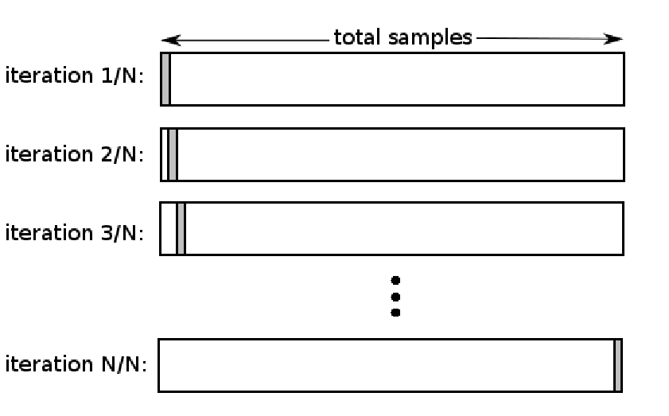
Classification With Leave-One-Subject-Out
Classification

Slide 12
Classification With Summarized Leave-One-Out
Classification
summarized-leave-one-out
feature values of 26 voice samples of each subject are summarized using central tendency and dispersion metrics such as mean, median, trimmed mean (10% and 25% removed), standard deviation, interquartile range, mean absolute deviation, and a new form of dataset consisting of N samples is formed where N is the number of subjects.

Slide 13


Evaluation Metrics

Slide 14
Results

Slide 15
Results

Slide 16
Results

Slide 17
A Nonlinear Decision Tree based Classification Approach to Predict the Parkinson’s disease using Different Feature Sets of Voice Data
International Conference on Advanced Communications Technology(ICACT)

Slide 18
Aim
In this paper we have tried a different way of selecting feature by using Principal component Analysis (PCA) approach and compared the performance metrics with the original feature sets using nonlinear classifiers with decision tree.

Slide 19
Dataset
Used the dataset created by Max little University Oxford, in collaboration with the National Centre for Voice and Speech, Denver, Colorado, who recorded the speech signals

Slide 20
Method
We have used nonlinear classifier with decision tree for classification of groups are as follows
RPART, C4.5, PART, Bagging classification and Regression tree(Bagging CART), Random Forest and Boosted C5.0

Slide 21
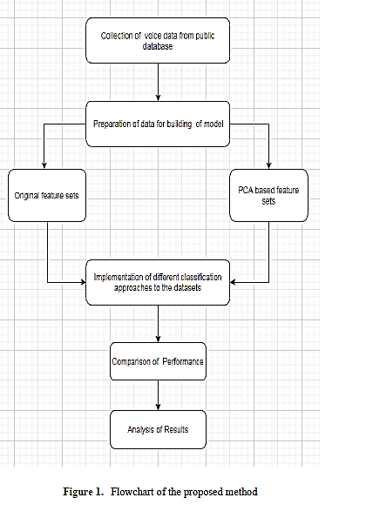
Method

Slide 22
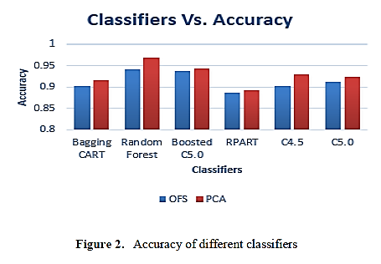
Result

Slide 23
References
[1] A. Tsanas, M. A. Little, P. E. McSharry, J. Spielman, and L. O. Ramig,
“Novel speech signal processing algorithms for high-accuracy classification of Parkinson’s disease,” IEEE Trans. Biomed. Eng., vol. 59, no. 5, pp. 1264–1271, May 2012.
[2] A. Tsanas, M. A. Little, P. E. McSharry, and L. O. Ramige, “Nonlinear speech analysis algorithms mapped to a standard metric achieve clinically useful quantification of average Parkinson’s disease symptom severity,” J. Royal Society Interface, vol. 8, pp. 842–855, 2011.
[3] A. Tsanas, M. A. Little, P. E. McSharry, and L. O. Ramig, “Accurate telemonitoring of Parkinson’s disease progression by noninvasive speech tests,” IEEE Trans. Biomed. Eng., vol. 57, no. 4, pp. 884–893, Apr. 2010.
[4] A. Tsanas, M. A. Little, P. E. McSharry, B. K. Scanlon, and S. Papapetropoulos, “Statistical analysis and mapping of the Unified Parkinson’s Disease Rating Scale to Hoehn and Yahr staging,” Parkinsonism Relat. Disord., vol. 18, no. 5, pp. 697–699, 2012.
[5] C. O. Sakar and O. Kursun, “Telediagnosis of Parkinson’s disease using measurements of dysphonia,” J. Med. Syst., vol. 34, no. 4, pp. 591–599, 2010
[6] O. Kursun, E. Gumus, A. Sertbas, and O. Favorov, “Selection of vocal features for Parkinson’s disease diagnosis,” Int. J. Data Mining Bioinf., vol. 6, no. 2, pp. 144–161, 2012.
[7] I. Bhattacharya andM. Bhatia, “SVM classification to distinguish Parkinson disease patients,” in A2CWiC ’10 Proc. 1st Amrita ACM-W Celebration on Women in Computing in India, New Delhi, 2010, doi: 10.1145/1858378.1858392.
[8] Sakar, Betul Erdogdu, M. Erdem Isenkul, C. Okan Sakar, Ahmet Sertbas, Fikret Gurgen, Sakir Delil, Hulya Apaydin, and Olcay Kursun. "Collection and analysis of a Parkinson speech dataset with multiple types of sound recordings." IEEE Journal of Biomedical and Health Informatics 17, no. 4 (2013): 828-834
[9] Aich, Satyabrata, Kim Younga, Kueh Lee Hui, Ahmed Abdulhakim Al-Absi, and Mangal Sain. "A nonlinear decision tree based classification approach to predict the Parkinson's disease using different feature sets of voice data." In Advanced Communication Technology (ICACT), 2018 20th International Conference on, pp. 638-642. IEEE, 2018.

Slide 24
Thank you.

