Slide 1
TEST DESIGN TECHNIQUEs
Homework

Slide 2
1.Equivalence partitioning and Boundary value analysis
Task
In a system designed for postal services' payment: Letters up to 100g are called as ‘light letters’. Postal rates for sending the light letters up to 10g are $25. The next 40g should be played by $35. Each next 25g up to 100g should be played by an extra $10.
Partitions should be designed for “grams”.
Build equivalence classes (partitions) based on given information
Stand Out boundary values
Cover requirements above by tests (write test cases’ names and objectives) based on equivalence partitioning and boundary value analysis
Light letters
 | Invalid | Valid for 25$ | Valid for 35$ | Valid for 45$ | Valid for 55$ | Invalid
Class | 0g | 1g to 9g | 10g to 49g | 50g to 74g | 75g to 99g | 100 and more
EP | -5 | 5 | 12 | 70 | 86 | 110
BVA | 0 | 1 and 9 | 10 and 49 | 50 and 74 | 75 and 99 | 100

Slide 3
Equivalence partitioning Input and Result
Condition EP | Expected result
Put '0g' into the input field | Error message 'You have entered an incorrect weight of the 'Light letters' category'
Put '5g' into the input field | The letter is accepted for sending at rate of 25$
Put '12g' into the input field | The letter is accepted for sending at rate of 35$
Put '70g' into the input field | The letter is accepted for sending at rate of 45$
Put '86g' into the input field | The letter is accepted for sending at rate of 55$
Put '110g' into the input field | Error message 'You have entered an incorrect weight of the 'Light letters' category'
Put 'qwe!@#$%^&' into the input field | Error message 'You have entered an incorrect weight of the 'Light letters' category'

Slide 4
Boundary Value analysis Input and Result
Condition BVA | Expected result
Put '0g' into the input field | Error message 'You have entered an incorrect weight of the 'Light letters' category'
Put '1g' into the input field | The letter is accepted for sending at rate of 25$
Put '9g' into the input field | The letter is accepted for sending at rate of 25$
Put '10g' into the input field | The letter is accepted for sending at rate of 35$
Put '49g' into the input field | The letter is accepted for sending at rate of 35$
Put '50g' into the input field | The letter is accepted for sending at rate of 45$
Put '74' into the input field | The letter is accepted for sending at rate of 45$
Put '75g' into the input field | The letter is accepted for sending at rate of 55$
Put '99' into the input field | The letter is accepted for sending at rate of 55$
Put '100g' into the input field | Error message 'You have entered an incorrect weight of the 'Light letters' category'

Slide 5
EP and BVA items test items
Test items | Test Data | Test result
Verify that the letter will be accepted at rate of $25 if its weight is less than 10g | 1. 1 2. 9 3. any value from 1 to 9 (e.g. 5) | The letter is accepted for sending at rate of 25$
Verify that the letter will be accepted at rate of $35 if its weight is between 10g and 49g | 1. 10 2. 49 3. any value from 10 to 49 (e.g. 12) | The letter is accepted for sending at rate of 35$
Verify that the letter will be accepted at rate of $45 if its weight is between 50g and 74g | 1. 50 2. 74 3. any value from 50 to 74 (e.g. 70) | The letter is accepted for sending at rate of 45$
Verify that the letter will be accepted at rate of $55 if its weight is between 75g and 99g | 1. 75 2. 99 3. any value from 75 to 99 (e.g. 86) | The letter is accepted for sending at rate of 55$
Verify that error message 'You have entered an incorrect weight of the 'Light letters' category' when user enters incorrect data | 1. any value <0 (e.g. -3) 2. 0 3. 100 4. any value >100 (e.g. 110) 5. decimal value (e.g 15,45) 6. decimal value (e.g. 20.07) 7. alphabetic characters 8. special characters 8. (empty field) | Error message 'You have entered an incorrect weight of the 'Light letters' category'

Slide 6
2. Decision tables
Task
If you are a new customer of Apple store and you made a purchase on $500 and more, you will get a voucher on 10% discount for today’s purchase. If your purchase worth is less than $500, then you will get a voucher on 5% discount for today’s purchase. If you are a gold customer of Apple store, then you will have 30% discount on all store assortments.
Build decision table based on given information

Slide 7
Decision making table
Causes (inputs) | R1 | R2 | R3 | R4
New customer buys $500 and more | Y | N | N | Y
GOLD customer | N | N | Y | Y
Output
Discount | 10% | 5% | 30%
Message |  |  |  | error

Slide 8
DMT Input and Result
Condition | Outcome
New customer buys $500 and more | Gets 10% discount voucher for todays purchase
New customer buys less than $500 | Gets 5% discount voucher for todays purchase
GOLD customer buys at any amount | Gets 30% discount to all goods

Slide 9
3. State transition
Task
To open a visa you need to pass a list of steps in standard procedure. At first you need to get consultation or read some materials about documents which should be provided. Then you should prepare these documents according to templates and give them to tour agency for verification. If there are mistakes in the documents, they should be re-developed. If documents are prepared correctly, then you should pay $80 for consular fee and pass interview with consul. If embassy accepts documents and you passed interview successfully, then you will get visa. If not, then you will need to try again.
Build state transition diagram based on given information

Slide 10
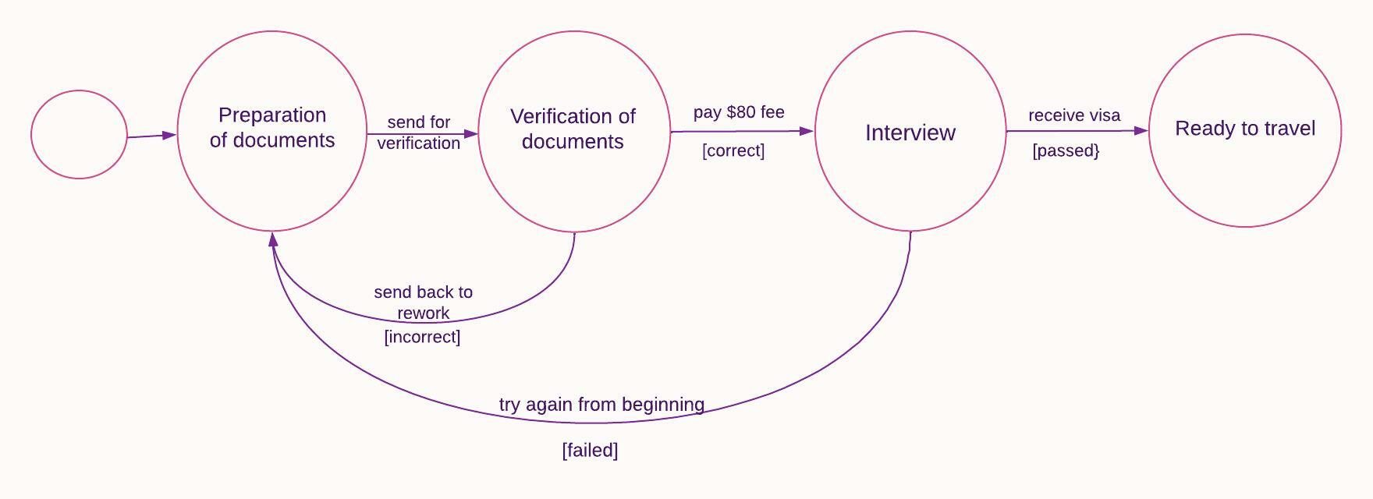
State transition map for obtaining visa

