Slide 1
Variant 5 - Liza
Equivalence partitioning and Boundary value analysis A system designed for replenishing mobile phone where min replenishment is 5$ and max replenishment is 1000$. There is no commission if user enters less than 50$. User will pay 1% of replenishment when it is less than 500$. In case the replenishment is equal or bigger than 500$, the user will pay 3% of commission.
Build equivalence classes (partitions) based on given information
Stand Out boundary values
Decision tables You want to buy travel card of some transport network (works during 1 month). The following types of discount exist:
For Student – gives you 20% discount if you are student;
Pensioner– gives you 10% discount, available if you are 60 years old and more (cannot be used with Student discount) You can get additional 5% discount if you are buying such travel cards during the last 6 months in a row.
Build decision table based on given information.
Cover requirements above by tests (write test cases’ names and objectives) based on decision table analysis
State transition User wants to pay for using the Internet with Payment card. He enters amount of money he needs to pay, e-mail and press the “Next” button. If entered amount of money is not allowed the user will be asked to correct the sum. In other case will be redirected on payment page. On this page user should enter the 16-digit number of card, period of validity and code of CVV2/CVC2 and then press “Pay”. If entered info is correct user will get email-notification on his email that operation completed success. If some data were entered incorrectly, user will get error-notification on the screen and he should correct it and again press “Pay”.
Build state transition diagram based on given information

Slide 2
Equivalence classes
 | Invalid | Valid for 0% commision | Valid for 1% commission | Valid for 3% commission | Invalid
Class | $0 - <5 | $5-49 | $50-499 | $500-1000 | >$1000
EP | 0 | 40 | 301 | 670 | 1200
Equivalence partitioning and Boundary value analysis A system designed for replenishing mobile phone where min replenishment is 5$ and max replenishment is 1000$. There is no commission if user enters less than 50$. User will pay 1% of replenishment when it is less than 500$. In case the replenishment is equal or bigger than 500$, the user will pay 3% of commission. User can put only positive integers. numbers. Build equivalence classes (partitions) based on given information.
# | Condition | Expected Result
1 | Put value `0$` into input field | Error system message appears "You can’t make replenishment less than 5$".
2 | Put value `40$` into input field | System allows to make replenishment with no commission
3 | Put value `301$` into input field | System makes replenishment with 1% commission from sum entered by user.
4 | Put value `670$` into input field | System makes replenishment with 3% commission from sum entered by user.
5 | Put value `1200$` into input field | Error message appears “You can’t make replenishment bigger than 1000”
6 | Put value `-+=#$%^` into input field | Error message appears "You have entered an incorrect value for the amount for replenishment money”.

Slide 3
BVA
 | Invalid | Valid for 0% commision | Valid for 1% commission | Valid for 3% commission | Invalid
Class | $0-<5 | $5-49 | $50-499 | $500-1000 | >$1000
BVA | 0 4 | 5 49 | 50 499 | 500 1000 | 1001
# | Condition | Expected Result
1 | Put value `0$` into input field | Error system message appears "You can’t make replenishment less than 5$".
2 | Put value `5$` into input field | System allows to make replenishment with no commission
3 | Put value `49$` into input field | System allows to make replenishment with no commission
4 | Put value `50$` into input field | System makes replenishment with 1% commission from sum entered by user.
5 | Put value `499$` into input field | System makes replenishment with 1% commission from sum entered by user.
6 | Put value `500$` into input field | System makes replenishment with 3% commission from sum entered by user.
7 | Put value `1000$` into input field | System makes replenishment with 3% commission from sum entered by user.
8 | Put value `1001$` into input field | Error message appears “You can’t make replenishment bigger than 1000”
6 | Put value `-+=#$%^` into input field | Error message appears "You have entered an incorrect value for the amount for replenishment money”.

Slide 4
EP and BVA: Test Items
# | Test Items | Test Data
1 | Verify that System allows to make replenishment with no commission | 1. Any number from 5 to 49 (e.g. 25) 2. 5 3. 49
2 | Verify that System makes replenishment with 1% commission | 1. Any number from 50 to 499 (e.g. 322) 2. 50 3. 499
3 | Verify that System makes replenishment with 3% commission | 1. Any number from 500 to 1000 (e.g. 655) 2. 500 3. 1000
4 | Verify that error message appears if user entering incorrect data | Any number from 0 and <5 Any number >1000 (e.g. 1201) Alphabetical characters Special characters Decimal number (e.g. 125.06) Decimal number (e.g. 22,45)
5 | Verify that error message appears if user leaves field empty

Slide 5
Decision table
Decision tables You want to buy travel card of some transport network (works during 1 month). The following types of discount exist: For Student – gives you 20% discount if you are student; Pensioner– gives you 10% discount, available if you are 60 years old and more (cannot be used with Student discount) You can get additional 5% discount if you are buying such travel cards during the last 6 months in a row.
Causes (inputs) | R1/R3 | R2/R4 | R5 | R6 | R7 | R8
For Student | Y | Y | N | N | N | N
Pensioner over 60s | Y/N | Y/N | Y | Y | N | N
Multiply buying card during 6 month | Y | N | Y | N | Y | N
Effects (outputs)
Discount | 25 | 20 | 15 | 10 | 5 | 0
Message* | + | +
# | Decision | Outcome
1 | If a person is a student and pensioner (or not pensioner) and buying card again during 6 month. He chooses more more advantageous option | 25% discount will be given for the travel card
2 | A person is a student and pensioner or just a student. He chooses more more advantageous option. | 20% discount will be given for the travel card
3 | A person is a pensioner and buying card again during 6 month | 15 % discount will be given for the travel card
4 | A person is a pensioner | 10 % discount will be given for the travel card
5 | A person buying travel card again during last 6 month | 5 % discount will be given for the travel card
6 | A person not a student not pensioner | No discount will be given for the travel card

Slide 6
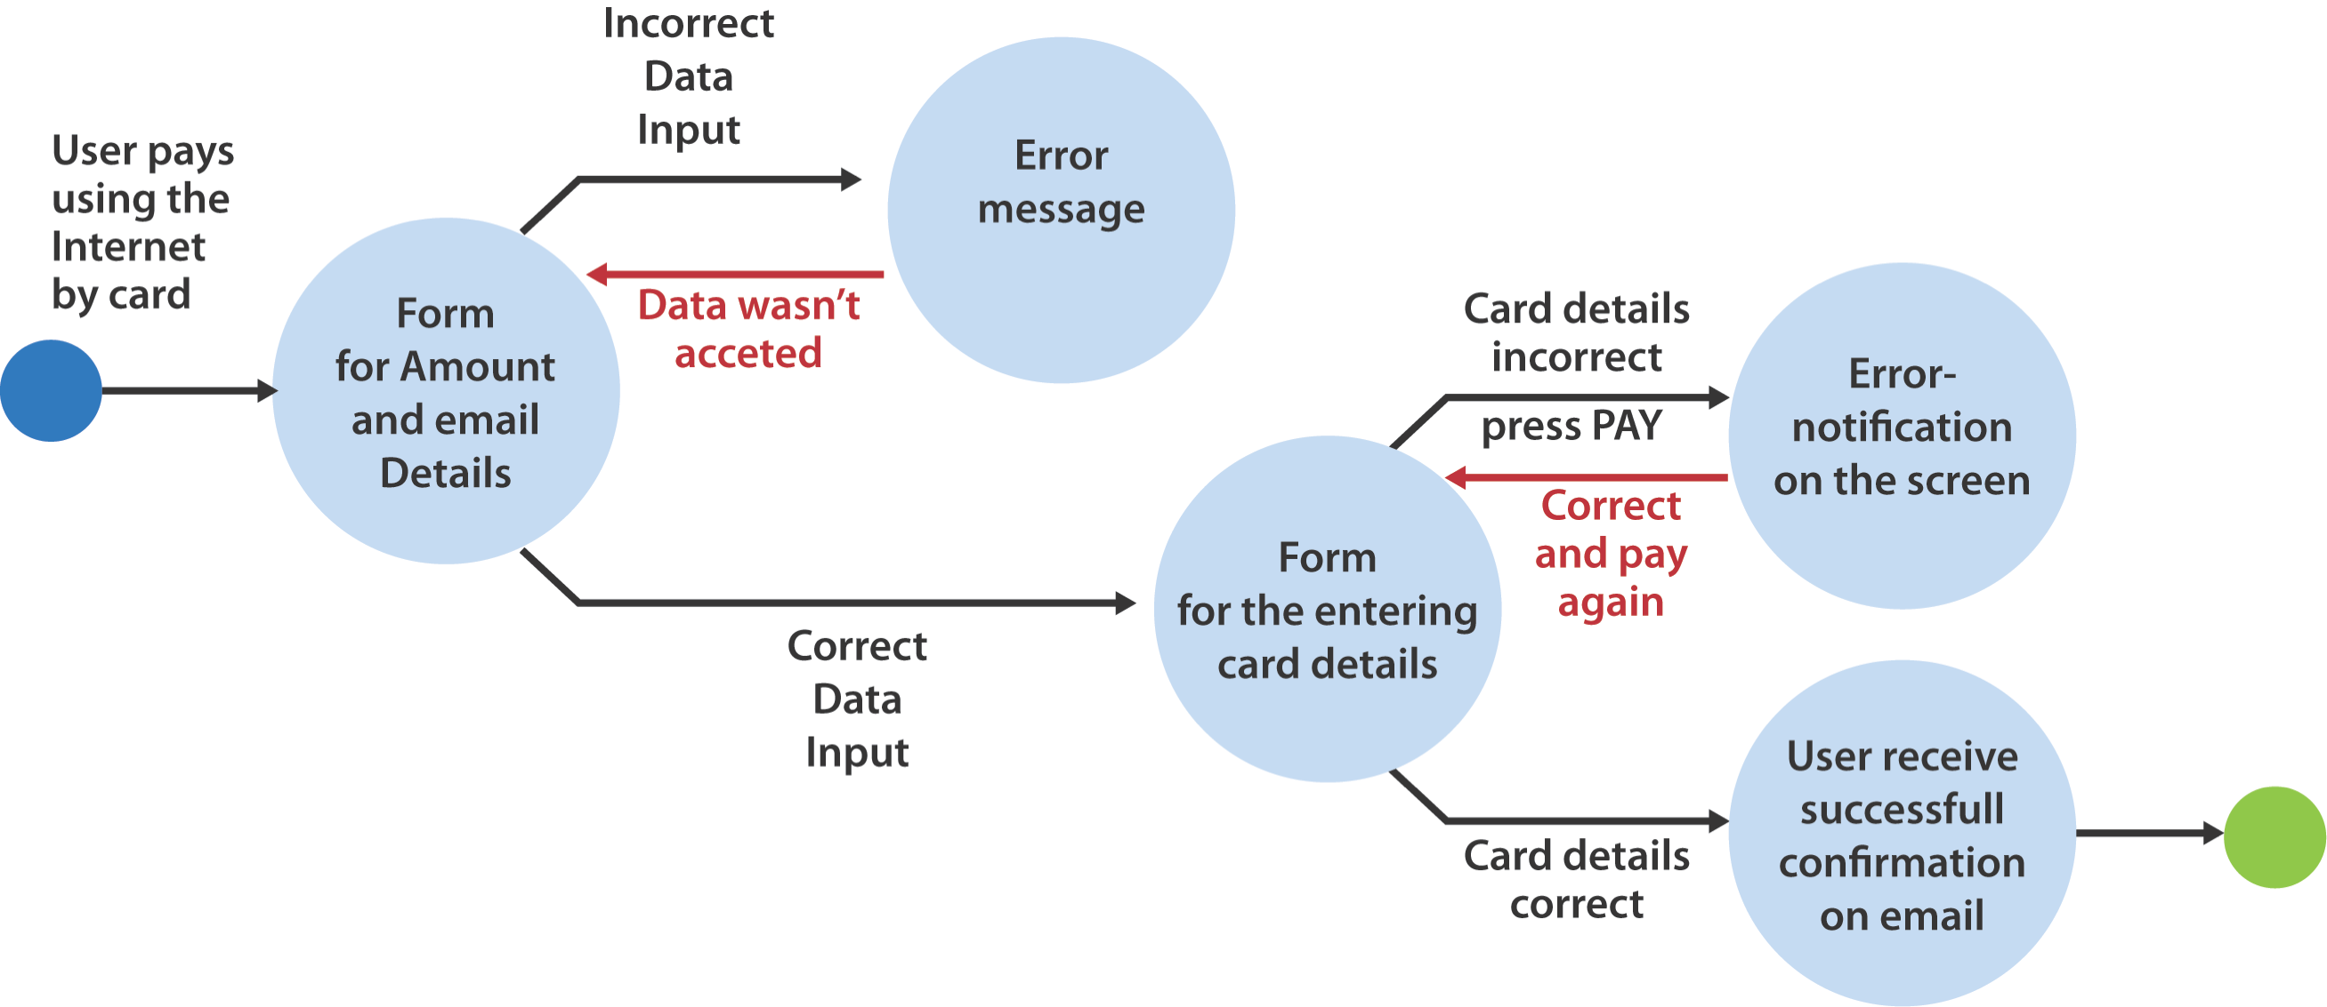
State Transition Diagram
State transition User wants to pay for using the Internet with Payment card. He enters amount of money he needs to pay, e-mail and press the “Next” button. If entered amount of money is not allowed the user will be asked to correct the sum. In other case will be redirected on payment page. On this page user should enter the 16-digit number of card, period of validity and code of CVV2/CVC2 and then press “Pay”. If entered info is correct user will get email-notification on his email that operation completed success. If some data were entered incorrectly, user will get error-notification on the screen and he should correct it and again press “Pay”.

