Slide 1

Predicting NFL Outcomes Using Machine Learning
Nick Romano

Slide 2
Project Overview
Project Idea
Final Idea: Predicting the Outcomes of NFL Games
Approach
The approach to predicting the outcome of NFL games is to use previous game data in predicting upcoming NFL games
Data Retrieval
The data used was downloaded from Kaggle.
Difficulty: Predicting Player injury occurrence, longevity, and impact.
Initial Idea: Fantasy Football Player Prediction Models
The dataset used ESPN to retrieve the data dating back to the 2002-2003 NFL Season
Includes various game statistics.

Slide 3
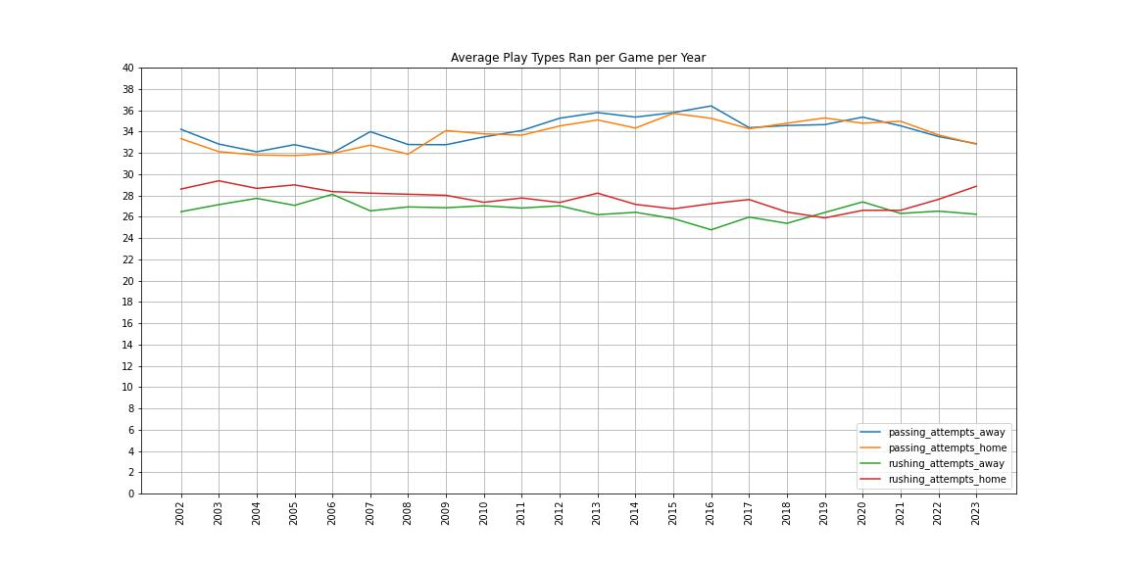
Exploratory Data Analysis
Interesting Insights Found
Starting in 2011-2012, there has been an uptick in the number of passing plays ran per game and a downturn of the number rushing plays per game.
Inclusion of playoff games create an imbalance of games played per season for each team.
Home field advantage – home teams 53% winning percentage dating back to 2002.

Slide 4
Methods & Modeling
Methods
Modeling
In trying to use previous game statistics to predict future NFL Games, a moving average was used to calculate the average statistics over the past 4 games.
Data was split into 32 dataframes, the manipulation was applied to each 32 dataframes, then the 32 dataframes were written back into a single dataframe.
With the trend toward a more passing oriented style of offense, the data was trimmed down to only include games since 2012
Preliminary modeling: KNN Classifier Model
Final Modeling: KNN Classifier, Gaussian Naive Bayes Classifier, and Random Forest Models

Slide 5
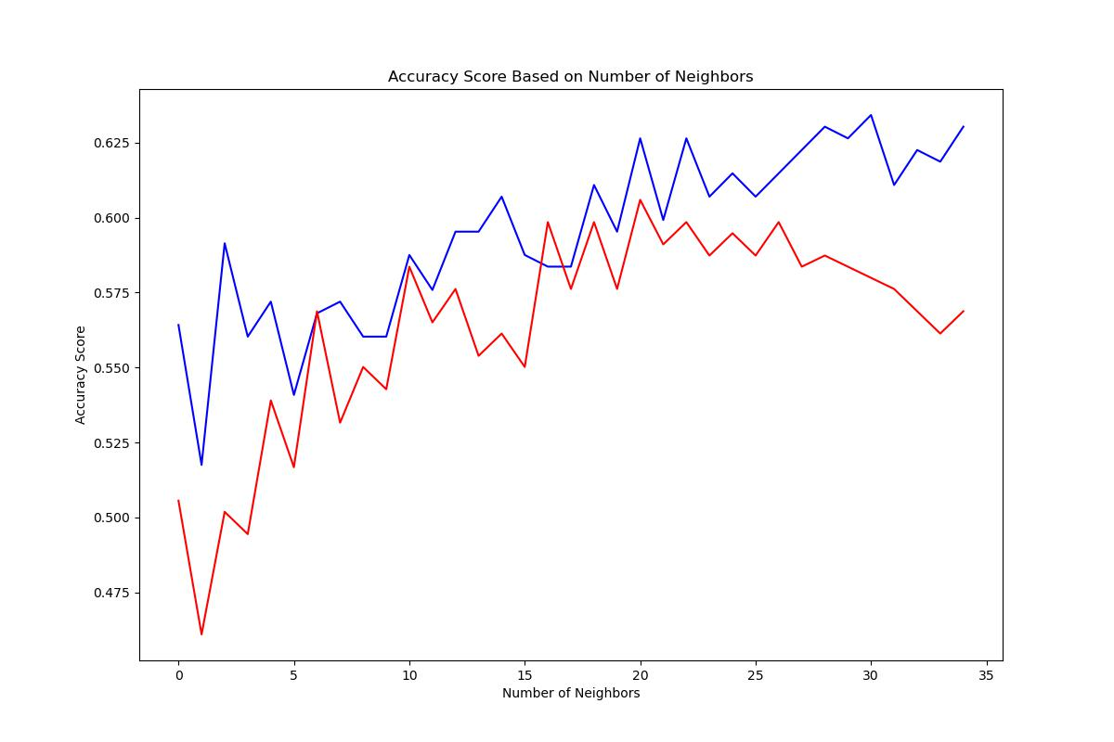
Preliminary Results
Optimal Number of Neighbors: 21
Results
Preliminary Model Used: KNN Classifier Model
Validation Data Used: 2022-2023 Season Games
Accuracy Scores
Testing Data: 63%
Validation Data: 61%

Slide 6
Final Results
Accuracy Scores
Aspects built on from preliminary model/results
Incorporated different moving average periods, to find the optimal period of games to look back on (14 games).
Incorporated Gaussian Naive-Bayes and Random Forest Models on top of the K-Nearest Neighbor Model.
With the KNN Model, the weights = “distance” parameter was used.
Created models after condensing the data to the top ¼ of the more important features (22), and also balancing the data so there are an equal amount of home and away win games results
Data |  | KNN | Gaussian NB | Random Forest
14 Game AVG | Test Data | 64.444% | 63.704% | 62.963%
 | Validation Data | 63.197% | 65.506% | 60.595%
14 Game AVG Condensed to top ¼ important features | Test Data | 60.370% | 63.604% | 61.852%
 | Validation Data | 58.736% | 65.428% | 62.082%
14 Game AVG Balanced for Home and Away team Wins | Test Data | 61.088% | 60% | 58.159%
 | Validation Data | 61.066% | 64% | 61.066%

Slide 7
Future Considerations
Conclusions
Future Work
Considering a winder period window appeared to improve the accuracy of the models in relation of the preliminary model.
Gaussian Naive Bayes performed the best across the 3 models.
Updating the original dataset as future NFL Games are being played.
Considering a weighted moving average – a moving average that givers more weight to the more recent gams within the moving average

Slide 8
Reflection
Looking back at the project, getting the data in the desired from of the moving averages took longer than expected. This was mainly due to trying to find a way to combine the 32 different dataframes for each moving average periods back into one dataframe.
For the purposes of sports betting, accuracy scores in the mid-60’s is a good starting point with some room for improvement.

Slide 9
Questions?

