Slide 1

Natasha Rooney
Web Technologist
GSM Association
@thisNatasha
Playing fair with the Network
Developing Smarter Apps for optimising network resources

Slide 2

2/21
Made after complaints to Network Operators
Complaints about bad performance and connectivity

Slide 3

3/21
What about Web Apps?
The web is awesome!
Always up-to-date
Build once, deploy everywhere
Cloud based data
But web app performance is always lagging behind native. New HTML5 features can help!

Slide 4

4/21
What we will look at:
Resource APIs
Network Information APIs
Detecting browser compatibility
Managing Images

Slide 5






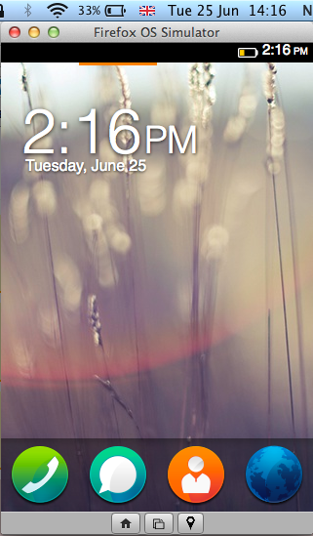
Resource APIs
Battery Status API
navigator.battery.charging
Example Firefox Simulator:
https://developer.mozilla.org/en-US/docs/Tools/Firefox_OS_Simulator
States whether the system's battery is charging.
navigator.battery.chargingTime
Get time remaining in seconds until the battery is fully charged.
navigator.battery.dischargingTime
Get amount of time in seconds left until the battery is drained and the system (device) is suspended.

Slide 6
Resource APIs
Ambient Light API
DeviceLightEvent
Get info about ambient light near device
Task Scheduler API
navigator.taskScheduler
Schedule tasks such as alarm and calendar
Proximity Sensors API
DeviceProximityEvent
Gets info on about the distance between the device and a nearby object

Slide 7
Network Info APIs
Network Information API
navigator.connection.type
The first try! But this told us very little…
navigator.connection.bandwidth
Better! Gets estimation of the current bandwidth in megabytes per second
Attributes
navigator.connection.metered
Created to indicate whether a user is on a pre-pay or capped data plan.
navigator.connection.onchange
[Event] Fired if connection object changes, separate “online” and “offline” events exist.
Events

Slide 8
Network Info APIs
Network Interface API
Proposed spec! What would we like to see?
Strength of network
Listening available networks
Configuring network use
Statistics
Manipulation

Slide 9
9/21
Feature Detection
How do we know if the browser supports new features?

Slide 10
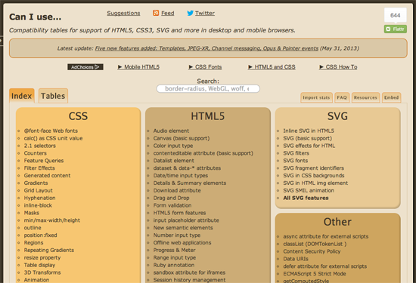
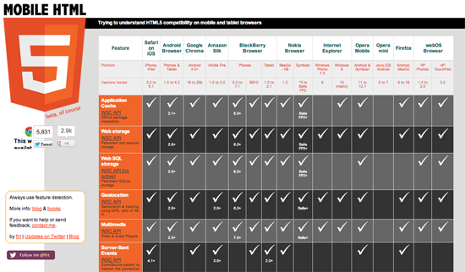
10/21
Feature Detection
Resources
CanIUse.com
MobileHTML5.org

Slide 11
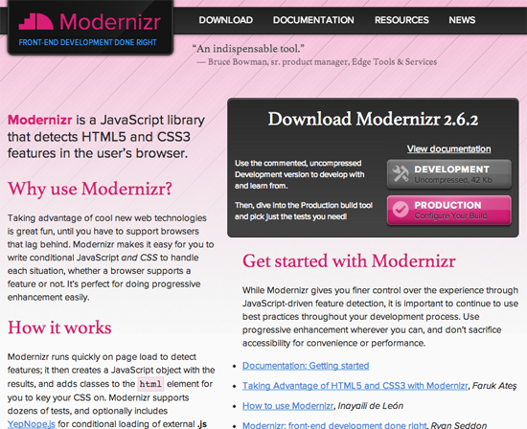
11/21
Feature Detection
Modernizr
Creates JavaScript object
Adds classes to <html>

Slide 12
12/21
^_^
Feature Detection
Ask the Browser!
Is an HTML attribute created?
Was a CSS style applied?
Does this JavaScript API exist?
// test for audio
return !!document.createElement('audio').canPlayType;
// test for geolocation
function supports_geolocation() {
return 'geolocation' in navigator;
}

Slide 13
13/21
Feature Detection
User Agent Sniffing
(function(a,b){if(/(android|bb\d+|meego).+mobile|avantgo|bada\/|blackberry|blazer|compal|elaine|fennec|hiptop|iemobile|ip(hone|od)|iris|kindle|lge |maemo|midp|mmp|netfront|opera m(ob|in)i|palm( os)?|phone|p(ixi|re)\/|plucker|pocket|psp|series(4|6)0|symbian|treo|up\.(browser|link)|vodafone|wap|windows (ce|phone)|xda|xiino/i.test(a)||/1207|6310|6590|3gso|4thp|50[1-6]i|770s|802s|a wa|abac|ac(er|oo|s\-)|ai(ko|rn)|al(av|ca|co)|amoi|an(ex|ny|yw)|aptu|ar(ch|go)|as(te|us)|attw|au(di|\-m|r |s )|avan|be(ck|ll|nq)|bi(lb|rd)|bl(ac|az)|br(e|v)w|bumb|bw\-(n|u)|c55\/|capi|ccwa|cdm\-|cell|chtm|cldc|cmd\-|co(mp|nd)|craw|da(it|ll|ng)|dbte|dc\-s|devi|dica|dmob|do(c|p)o|ds(12|\-d)|el(49|ai)|em(l2|ul)|er(ic|k0)|esl8|ez([4-7]0|os|wa|ze)|fetc|fly(\-|_)|g1 u|g560|gene|gf\-5|g\-mo|go(\.w|od)|gr(ad|un)|haie|hcit|hd\-(m|p|t)|hei\-|hi(pt|ta)|hp( i|ip)|hs\-c|ht(c(\-| |_|a|g|p|s|t)|tp)|hu(aw|tc)|i\-(20|go|ma)|i230|iac( |\-|\/)|ibro|idea|ig01|ikom|im1k|inno|ipaq|iris|ja(t|v)a|jbro|jemu|jigs|kddi|keji|kgt( |\/)|klon|kpt |kwc\-|kyo(c|k)|le(no|xi)|lg( g|\/(k|l|u)|50|54|\-[a-w])|libw|lynx|m1\-w|m3ga|m50\/|ma(te|ui|xo)|mc(01|21|ca)|m\-cr|me(rc|ri)|mi(o8|oa|ts)|mmef|mo(01|02|bi|de|do|t(\-| |o|v)|zz)|mt(50|p1|v )|mwbp|mywa|n10[0-2]|n20[2-3]|n30(0|2)|n50(0|2|5)|n7(0(0|1)|10)|ne((c|m)\-|on|tf|wf|wg|wt)|nok(6|i)|nzph|o2im|op(ti|wv)|oran|owg1|p800|pan(a|d|t)|pdxg|pg(13|\-([1-8]|c))|phil|pire|pl(ay|uc)|pn\-2|po(ck|rt|se)|prox|psio|pt\-g|qa\-a|qc(07|12|21|32|60|\-[2-7]|i\-)|qtek|r380|r600|raks|rim9|ro(ve|zo)|s55\/|sa(ge|ma|mm|ms|ny|va)|sc(01|h\-|oo|p\-)|sdk\/|se(c(\-|0|1)|47|mc|nd|ri)|sgh\-|shar|sie(\-|m)|sk\-0|sl(45|id)|sm(al|ar|b3|it|t5)|so(ft|ny)|sp(01|h\-|v\-|v )|sy(01|mb)|t2(18|50)|t6(00|10|18)|ta(gt|lk)|tcl\-|tdg\-|tel(i|m)|tim\-|t\-mo|to(pl|sh)|ts(70|m\-|m3|m5)|tx\-9|up(\.b|g1|si)|utst|v400|v750|veri|vi(rg|te)|vk(40|5[0-3]|\-v)|vm40|voda|vulc|vx(52|53|60|61|70|80|81|83|85|98)|w3c(\-| )|webc|whit|wi(g |nc|nw)|wmlb|wonu|x700|yas\-|your|zeto|zte\-/i.test(a.substr(0,4)))window.location=b})(navigator.userAgent||navigator.vendor||window.opera,'http://detectmobilebrowser.com/mobile');

Slide 14
14/21
Feature Detection
@supports
New CSS element
If CSS element is supported by browser then implement CSS in block
@supports (
(perspective: 10px) or
(-moz-perspective: 10px) or
(-webkit-perspective: 10px) or
(-ms-perspective: 10px) or
(-o-perspective: 10px) ) {
/* specific CSS applied when 3D transforms,
eventually prefixed, are supported */
}
Source: MDN

Slide 15

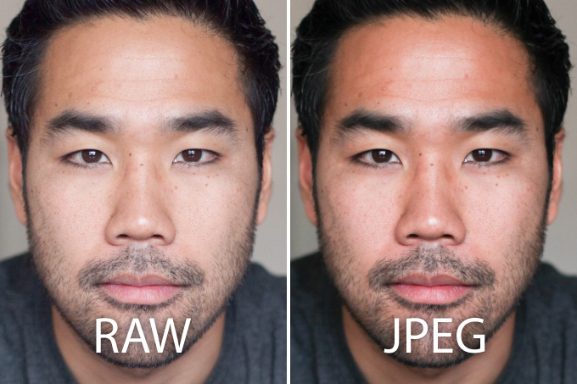
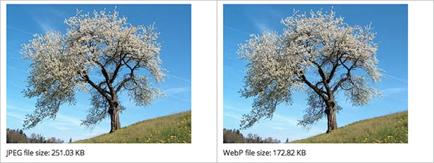
15/21
What about Images?
Images account for 69% of the page bytes being delivered to mobile over the web!
PNG
GIF
Lossy / Lossless
Know your formats!
Lazy Loading / LIQP
Responsive Images
JPEG
WebP

Slide 16
16/21
What did we learn?
The web is great!
Performance issues
New HTML5 APIs can help!
While waiting, let’s be clever about feature detection
And understand images!

Slide 17
17/21
Smarter Apps Guidelines
http://www.gsma.com/technicalprojects/smarter-applications
iOS
For more guidelines including:
Compression
Image Formats
Offline
Error Handling
Security
User Experience
Scheduling
Caching
Android
Windows
Web
Please help us grow the Smarter Apps Guidelines by registering and adding new content!

Slide 18
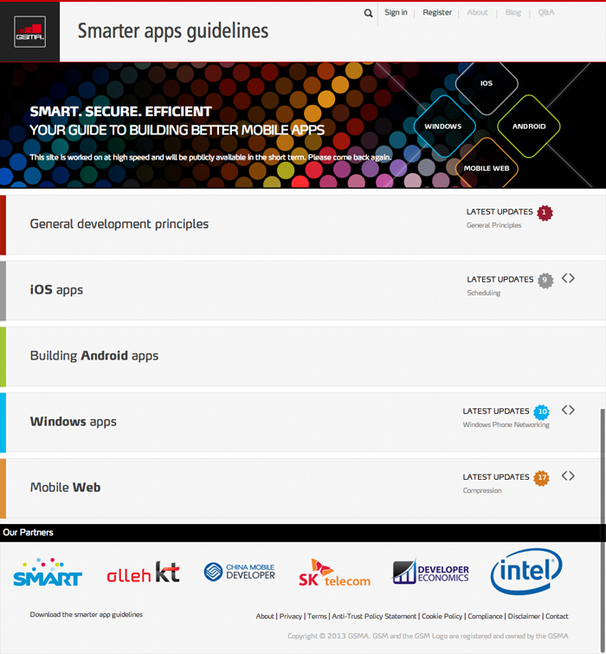
18/21
gsma.com/technicalprojects/smarter-applications

Slide 19
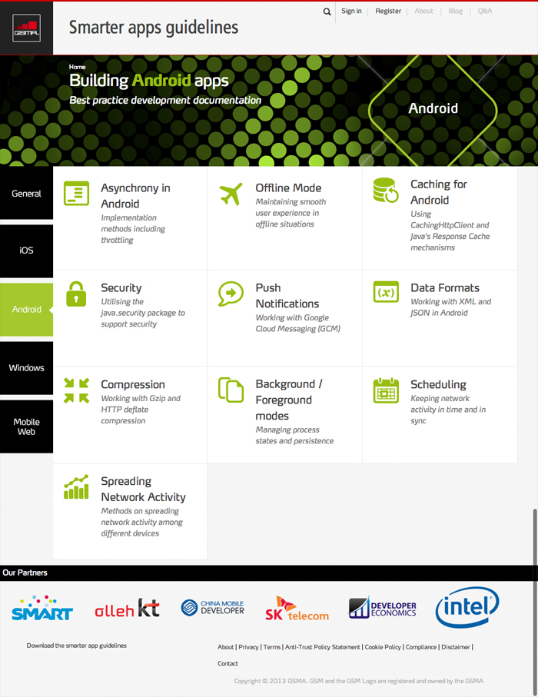
19/21
gsma.com/technicalprojects/smarter-applications

Slide 20
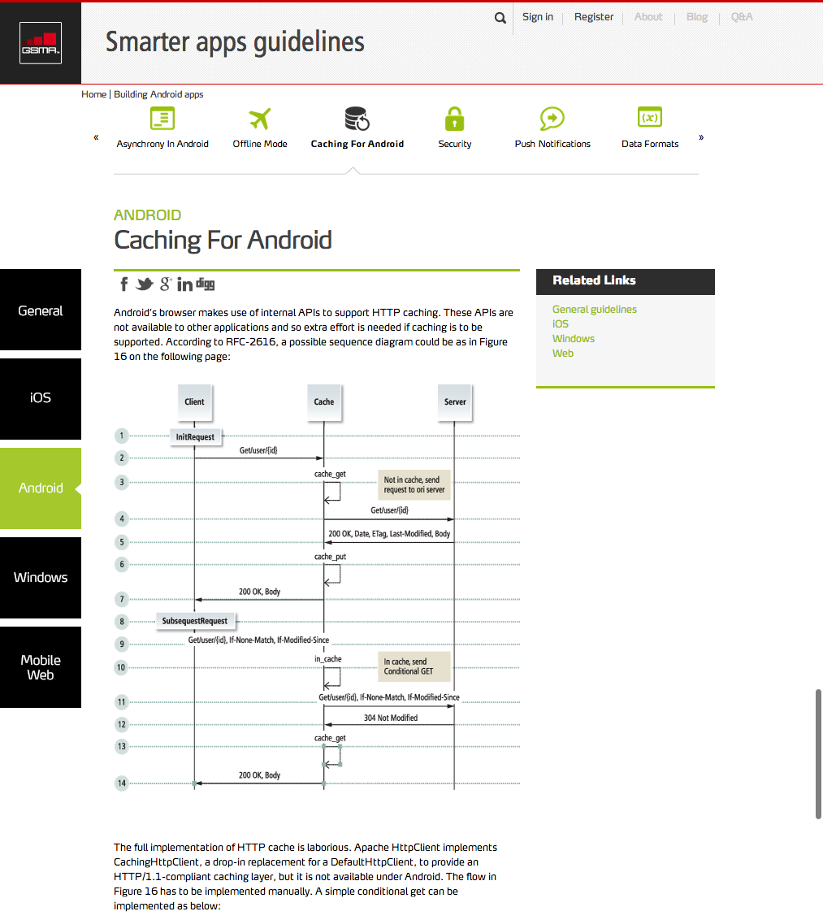
20/21
gsma.com/technicalprojects/smarter-applications

Slide 21
Natasha Rooney
Web Technologist
GSM Association
@thisNatasha
Thank-you!
Playing fair with the Network
Developing Smarter Apps for optimising network resources

